Slide 1
Validation of the cleaning processes
of Robotic Instruments
T. Miorini, Austria
ÖGSV

Slide 2

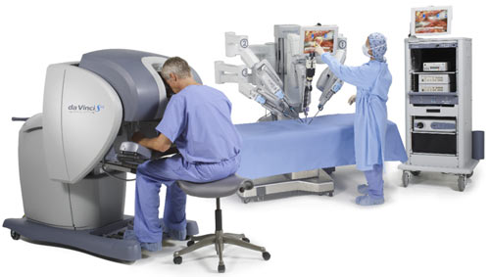
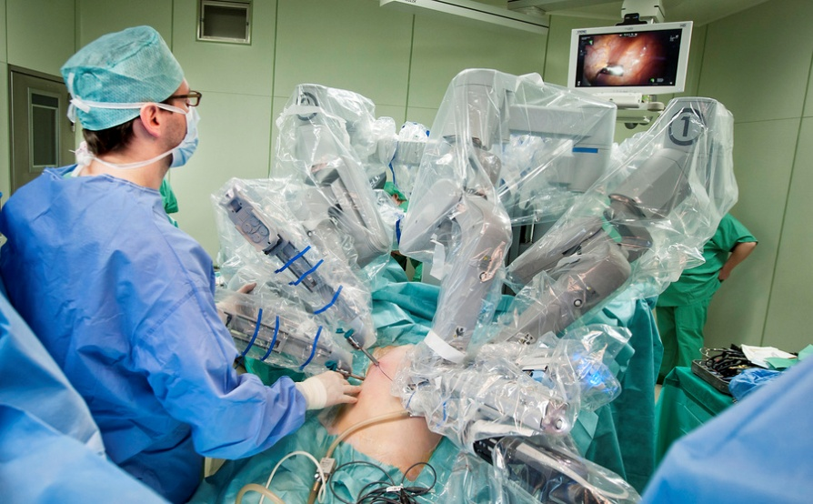
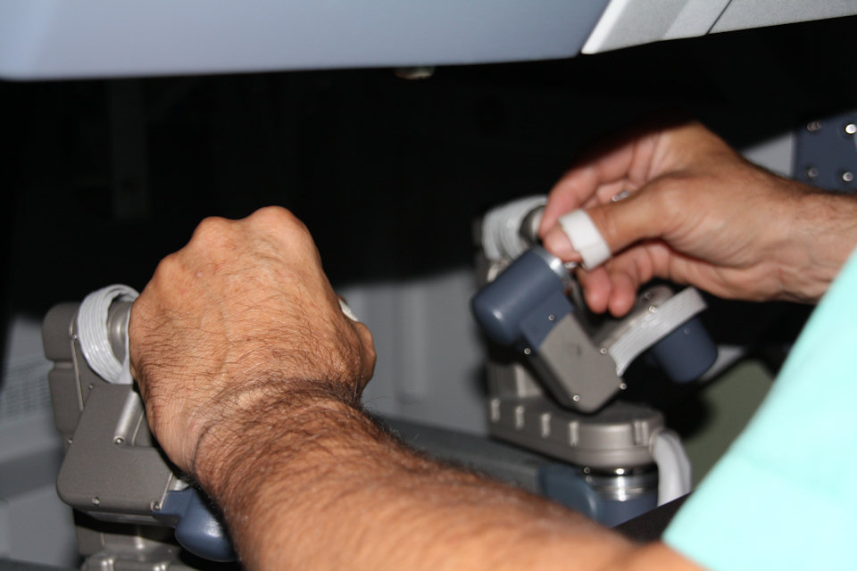
The Da Vinci System:

Slide 3
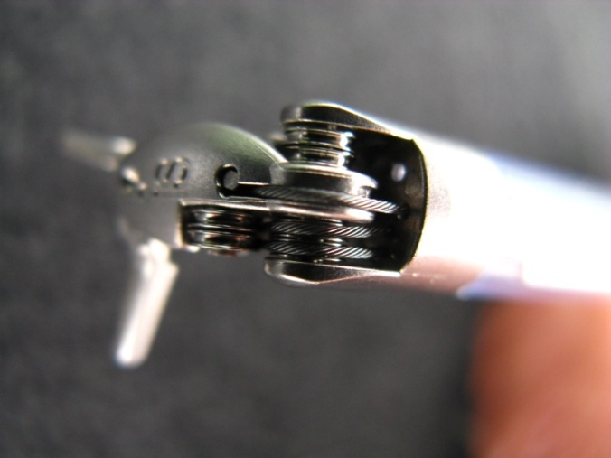
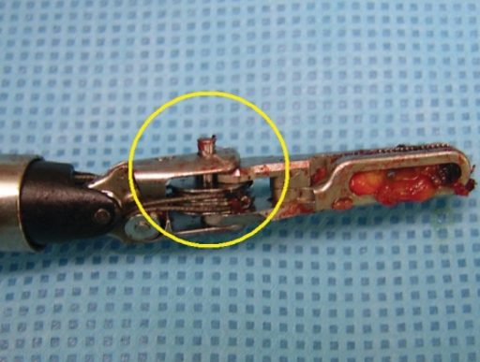
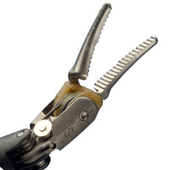
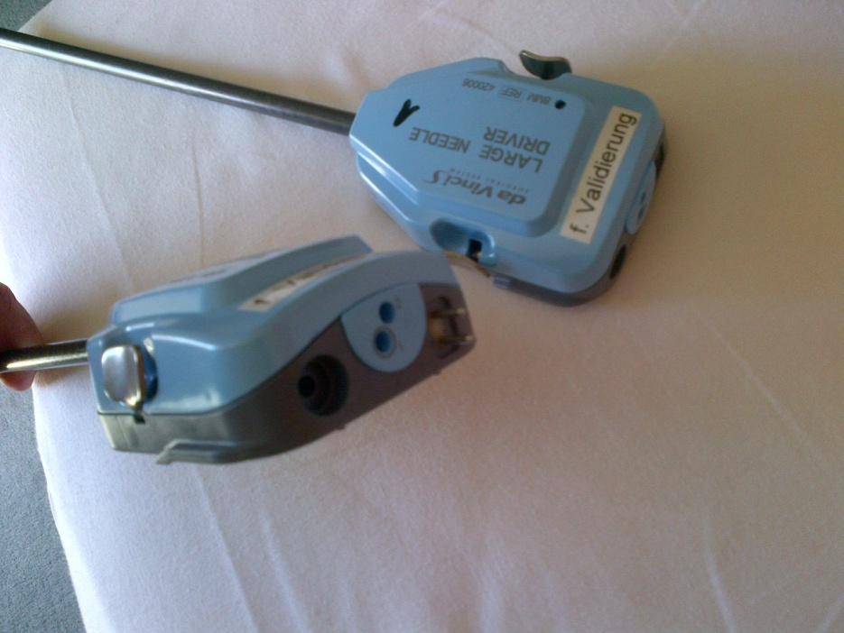
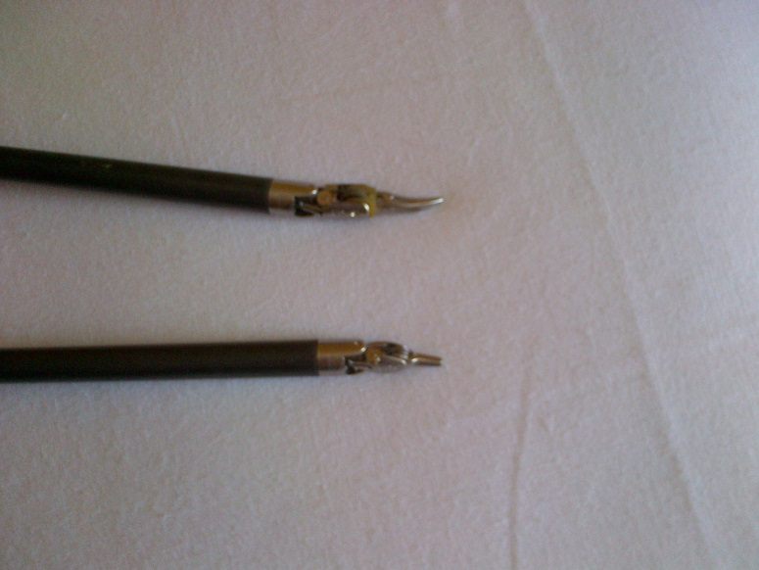
The Problem:
We are talking about
Endowrist® Instruments (Intuitive Surgical)

Slide 4
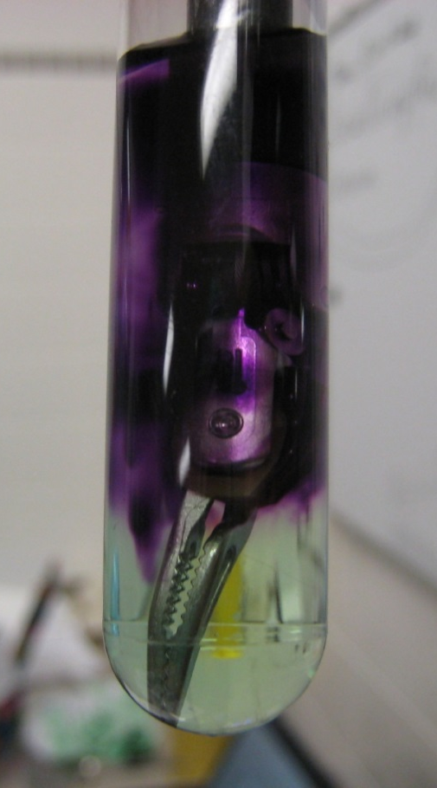
The Problem:
Extremely complex instruments
Thin wires running over small reels
Narrow lumens
Limited possibility of visual inspection
Extensive manual cleaning steps
BCA protein test not applicable
(cross reaction with Wolfram wires)
Positive BCA-reaction due to Wolfram

Slide 5
ÖGSV-Guideline
In Austria manual processes are not able to be validated due to lacking reproducibility and documentation
The Expert Committee of the ÖGSV (Austrian Society for Hospital Sterile Supply) compiled a “Guideline for the Reprocessing of Robotic Instruments” including recommendations for the validation of the cleaning process

Slide 6
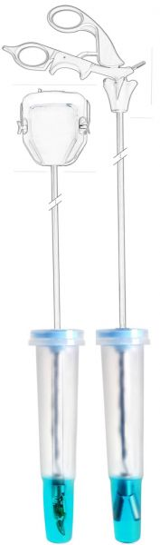
ÖGSV-Guideline
The key points of the guideline are:
Due to the complexity of the instruments the drying phase should be kept as short as possible
Especially the distal tips of the instruments are of importance
It is crucial that the instruments are kept moist until the beginning of reprocessing. This can be managed by tools available from different companies

Slide 7
ÖGSV-Guideline
After the manual cleaning according to the manufacturer´s instructions the protein residual of every single instrument (distal tip) has to be evaluated before the automated cleaning in the WD
Acceptance criteria after manual cleaning:
50 µg/ distal tip
In case of exceedance of the threshold value: Rinsing of the distal tip and repetition of the manual cleaning

Slide 8
ÖGSV-Guideline
In case of compliance with the Acceptance criteria: Immediate cleaning in a WD with specific load carrier for robotic instruments
Acceptance criteria after automated cleaning (before sterilization):
20 µg/ distal tip (to be checked at random on a weekly basis)

Slide 9
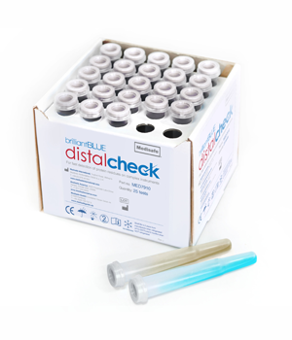
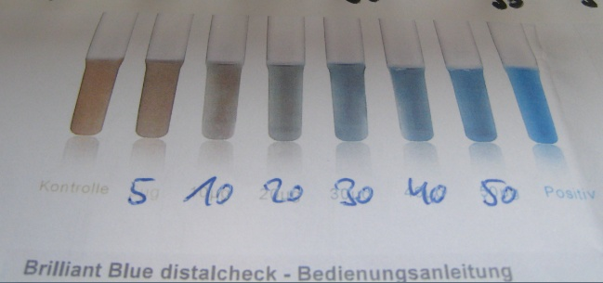
ÖGSV-Guideline
There is positive experience with the Brillant Blue Distal Check (Medisafe) which is approved by Intuitive Surgical

Slide 10
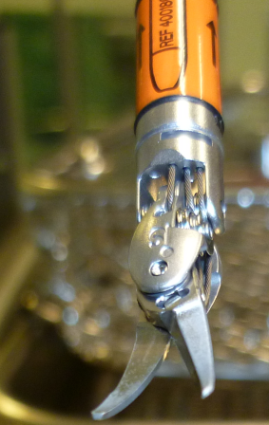
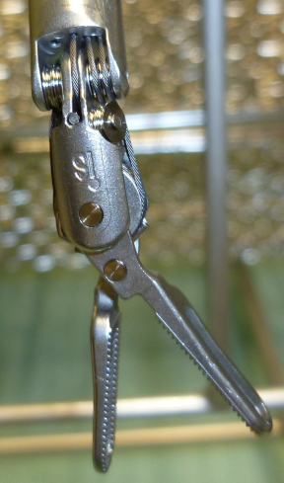
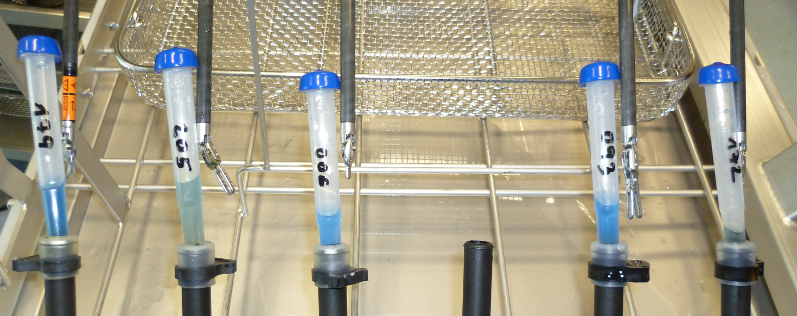

Slide 11
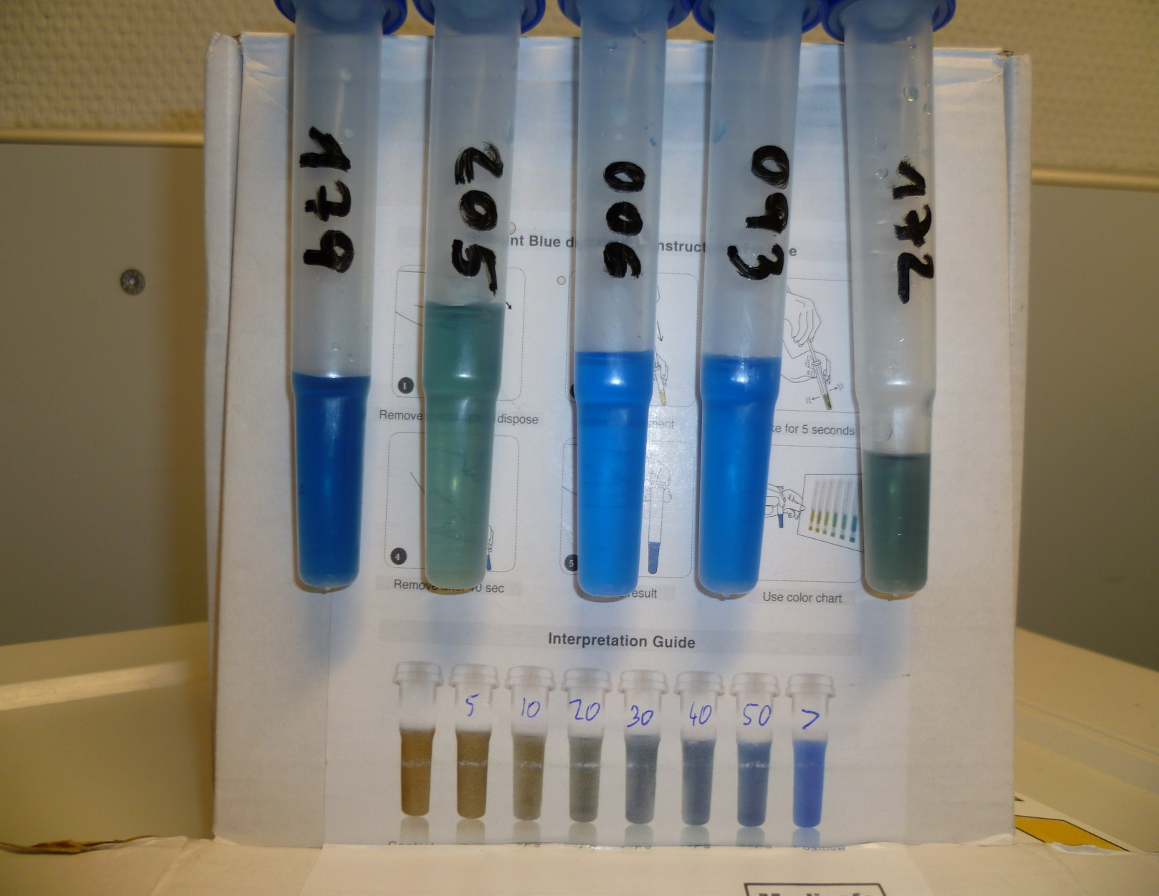
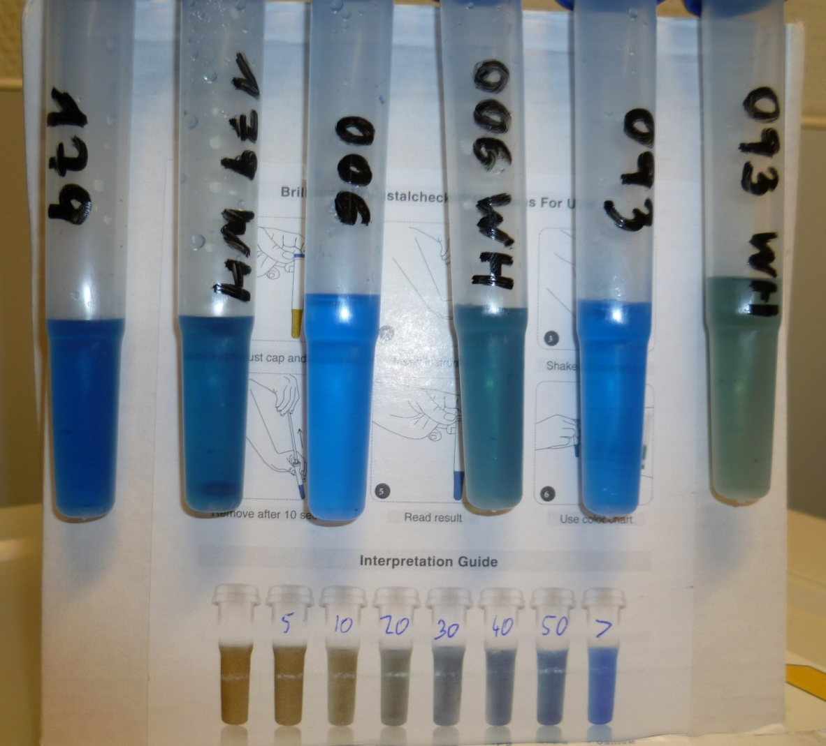
Protein Tests after manual cleaning
First manual cleaning
Second manual cleaning
>50
>50
>50
>50
<50
<50

Slide 12
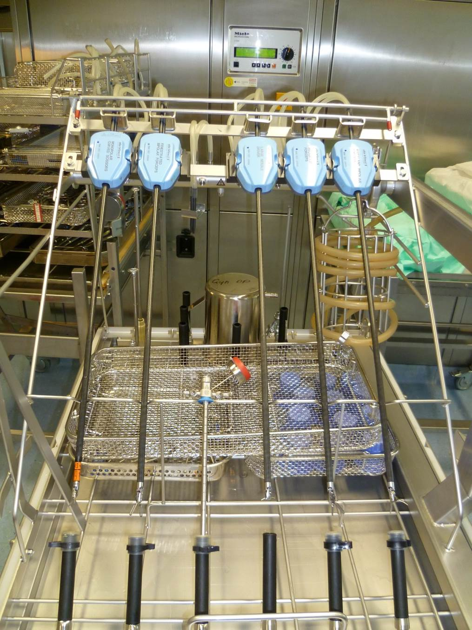
Programme specifications
 | Programme 3 Da Vinci TD
Phase | H₂O | + H₂O (L) | Dosing |  | °C | min
 |  |  | ml/L | DT (°C)
Prerinse 1 | AD | 0 | 0,8 | 40 | 45 | 20
Prerinse 2 | - | - | - | - | - | -
Cleaning 1 | AD | 0 | 0,8 | 40 | 55 | 10
Cleaning 2 | - | - | - | - | - | -
Rinsing 1 | AD | 0 | - | - | 11 | 2
Rinsing 2 | AD | 0 | - | - | 11 | 10
Disinfection | AD | -3 | - | - | 93 | 5
Drying |  |  |  |  | 100 | 15

Slide 13
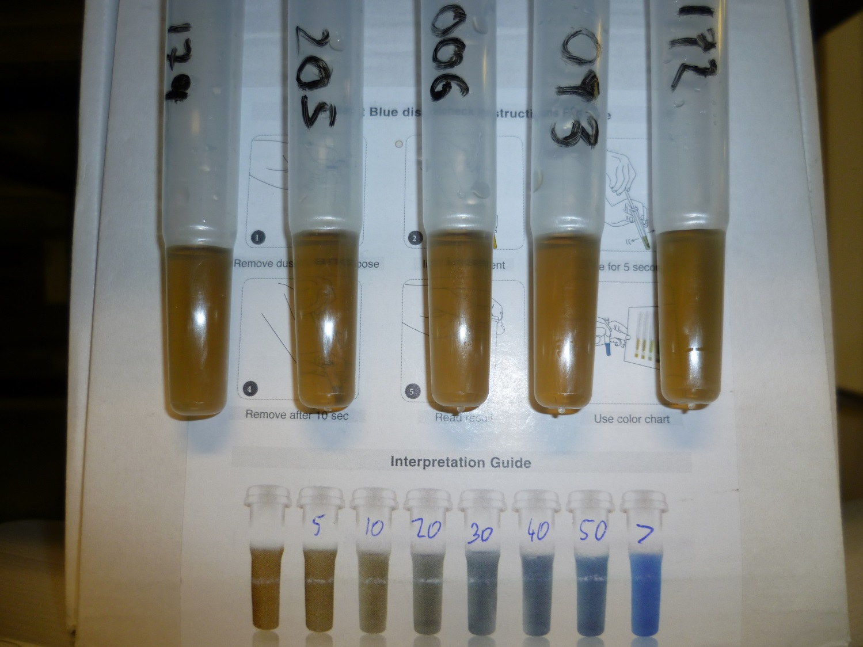
Protein Test after automated cleaning
<50
<50
<50
<50
<50

Slide 14
Conclusion
Validation of cleaning processes of robotic instruments is demanding but possible
Protein tests after manual cleaning are reasonable and compulsory in Austria
Automated cleaning after manual cleaning is essential

Slide 15

THANK YOU
7-10 oct. 2015
FOR YOUR ATTENTION!

