Slide 1
HYDROGEN PEROXIDE STERILISATION IN A ISO EN 13485 ENVIRONMENT
Wouter Meert, manager CSSD, UZ Leuven

Slide 2


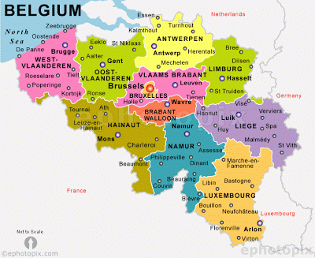
UZ Leuven

Slide 3

UZ Leuven Healthcare campus

Slide 4
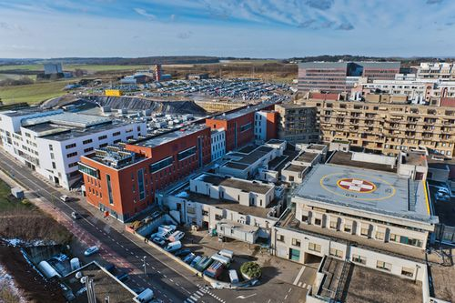

Slide 5
UZ Leuven
1900 beds
9 038 employees
56 658 hospitalizations
684 199 consults (2 748/day)
100 005 one day hospitalizations
53 544 surgical procedures (215/day – 45 operating rooms)

Slide 6
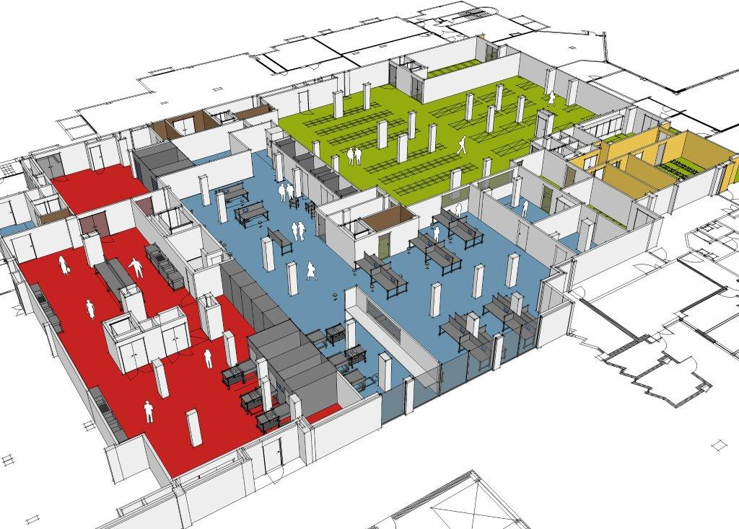
CSSD UZ Leuven

Slide 7
CSSD UZ Leuven
ISO EN 13485 (since 2012, successfull recertification 2015)
54,90 FTE
1900 m2
3 batch and 3 tunnel WD
5 floor load autoclaves
2 Sterrad 100 NX

Slide 8
ISO EN 13485
Organisational structure
Infrastructure
Structure QMS
Process controle
Customer feedback
Staf training

Slide 9
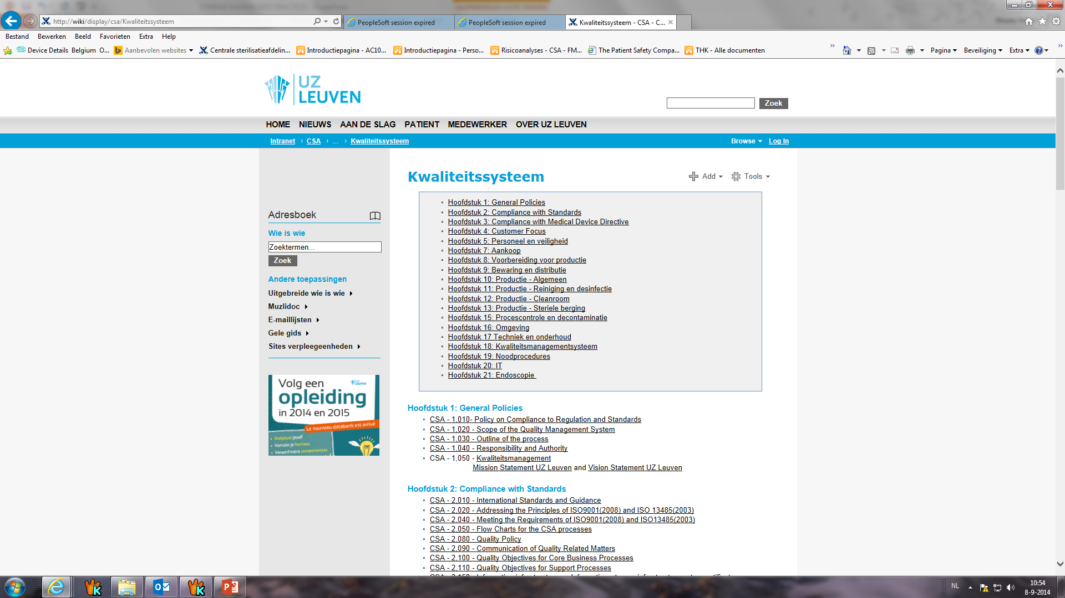
ISO EN 13485

Slide 10
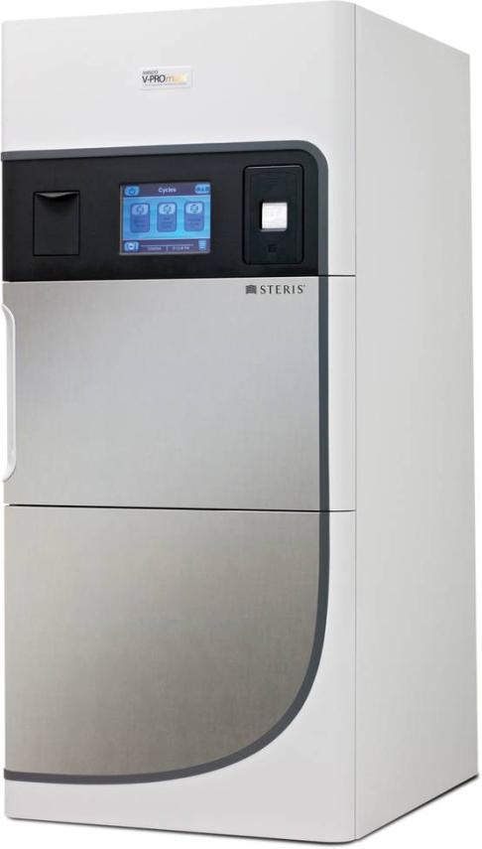
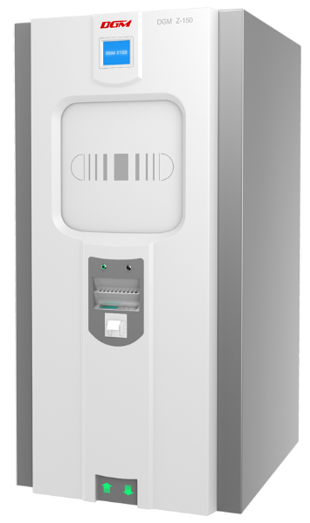
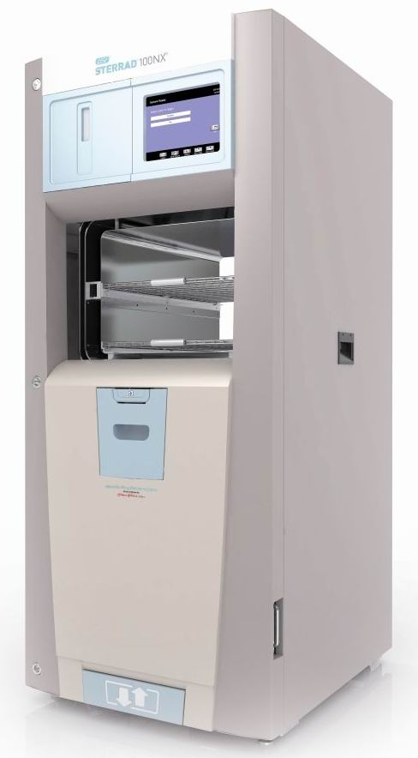
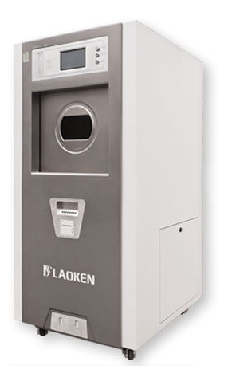
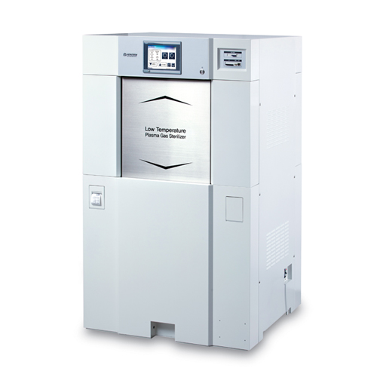
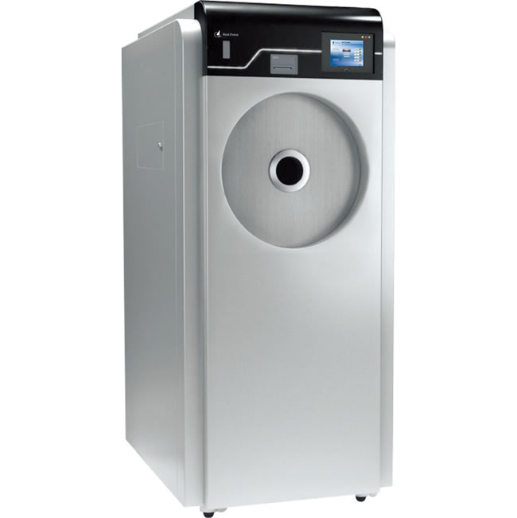
Hydrogen peroxide sterilizers

Slide 11
Hydrogen peroxide UZ Leuven
First Sterrad 100 S bought in 1998
Second in 2000
Half december 2013, 2 new Sterrad 100 NX
Spring 2015, installation double door
Current use 10 – 15 cycle/day/machine
221 different items

Slide 12
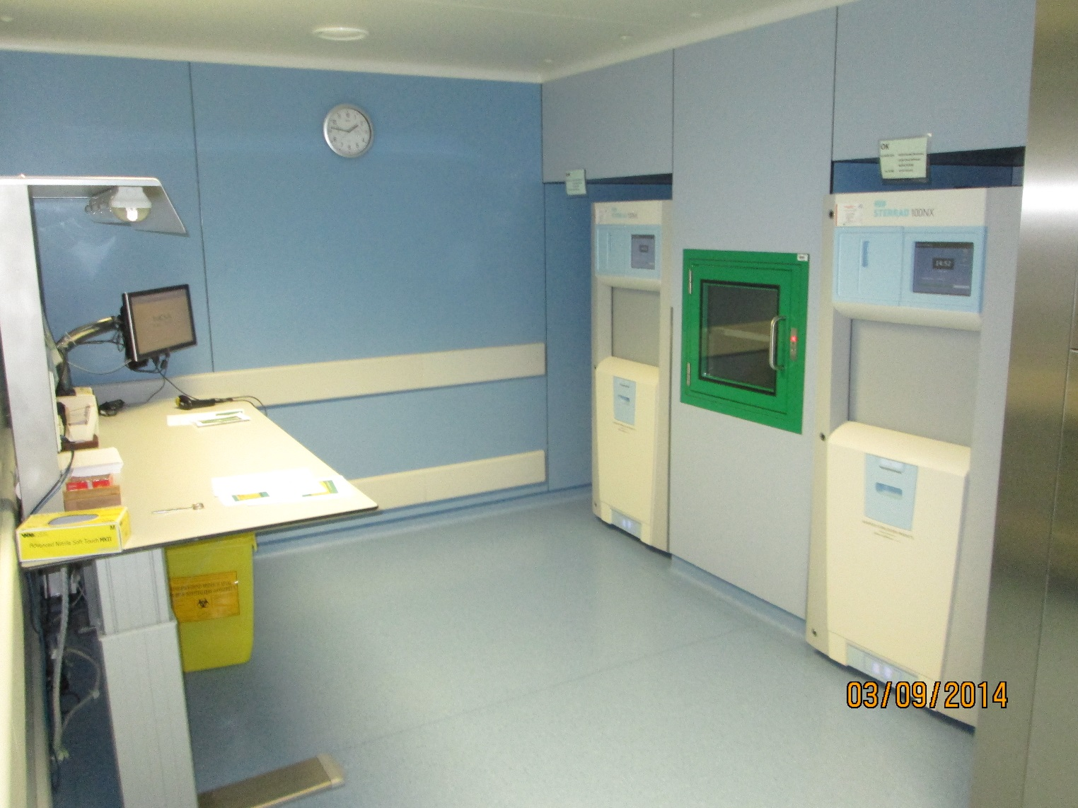
Infrastructure
Before double door installation

Slide 13
Building plans

Slide 14
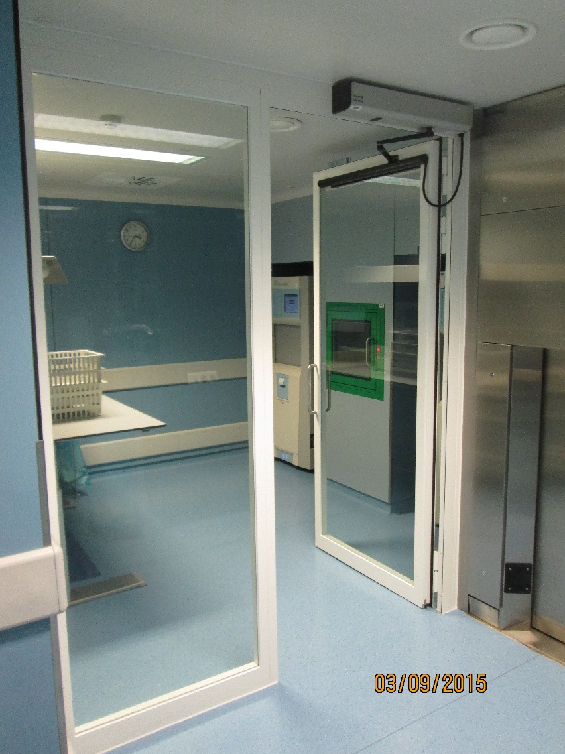
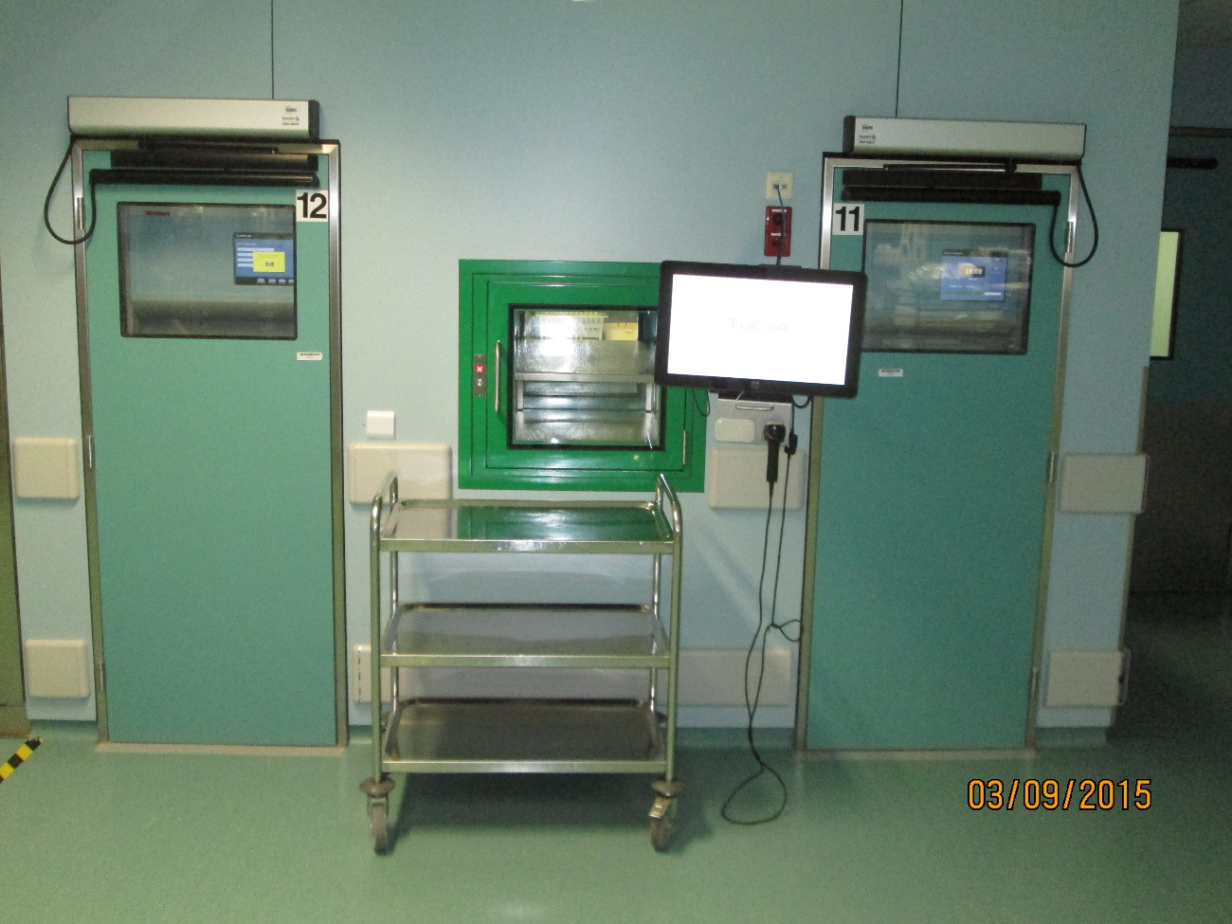
Current setting

Slide 15
Medical instruments
Optics
HD camera’s
Light cables
endoscopes
Da Vinci instruments
Foetal surgery
Brachytherapie
Echoprobes
80 %
Hipec
Sentinel probe
Diamant drills
Electrodes/kirschner

Slide 16
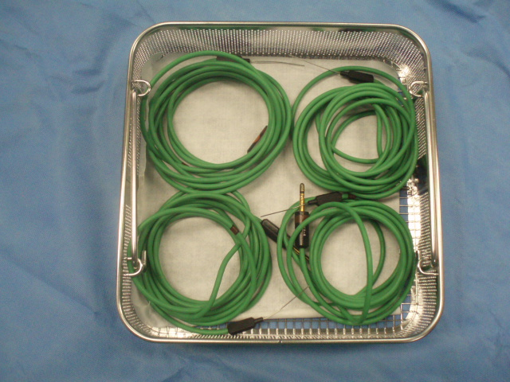
Temperature probe Hipec

Slide 17
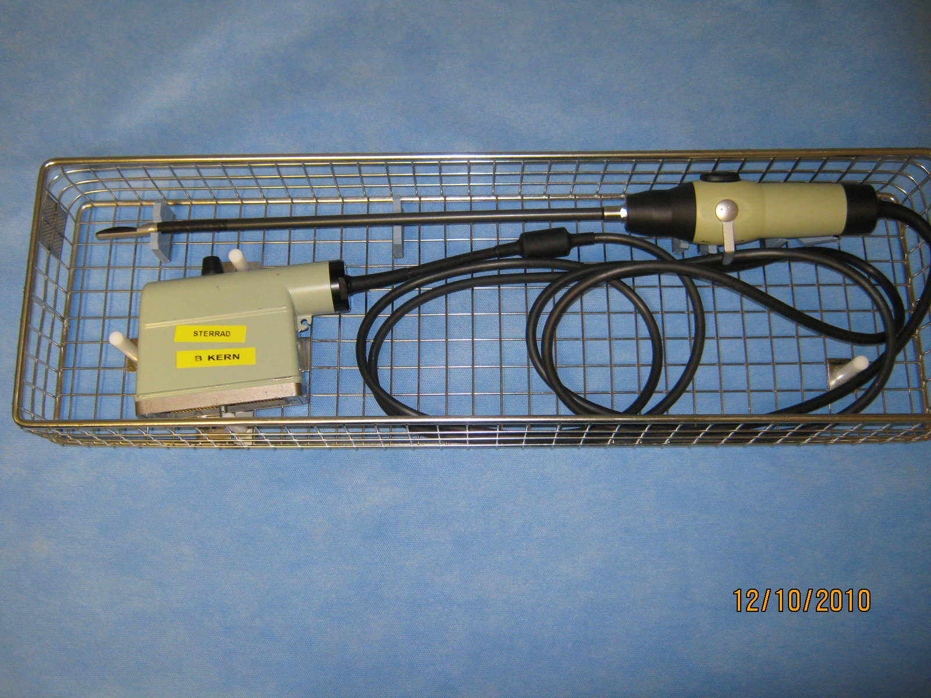
Echo probe

Slide 18
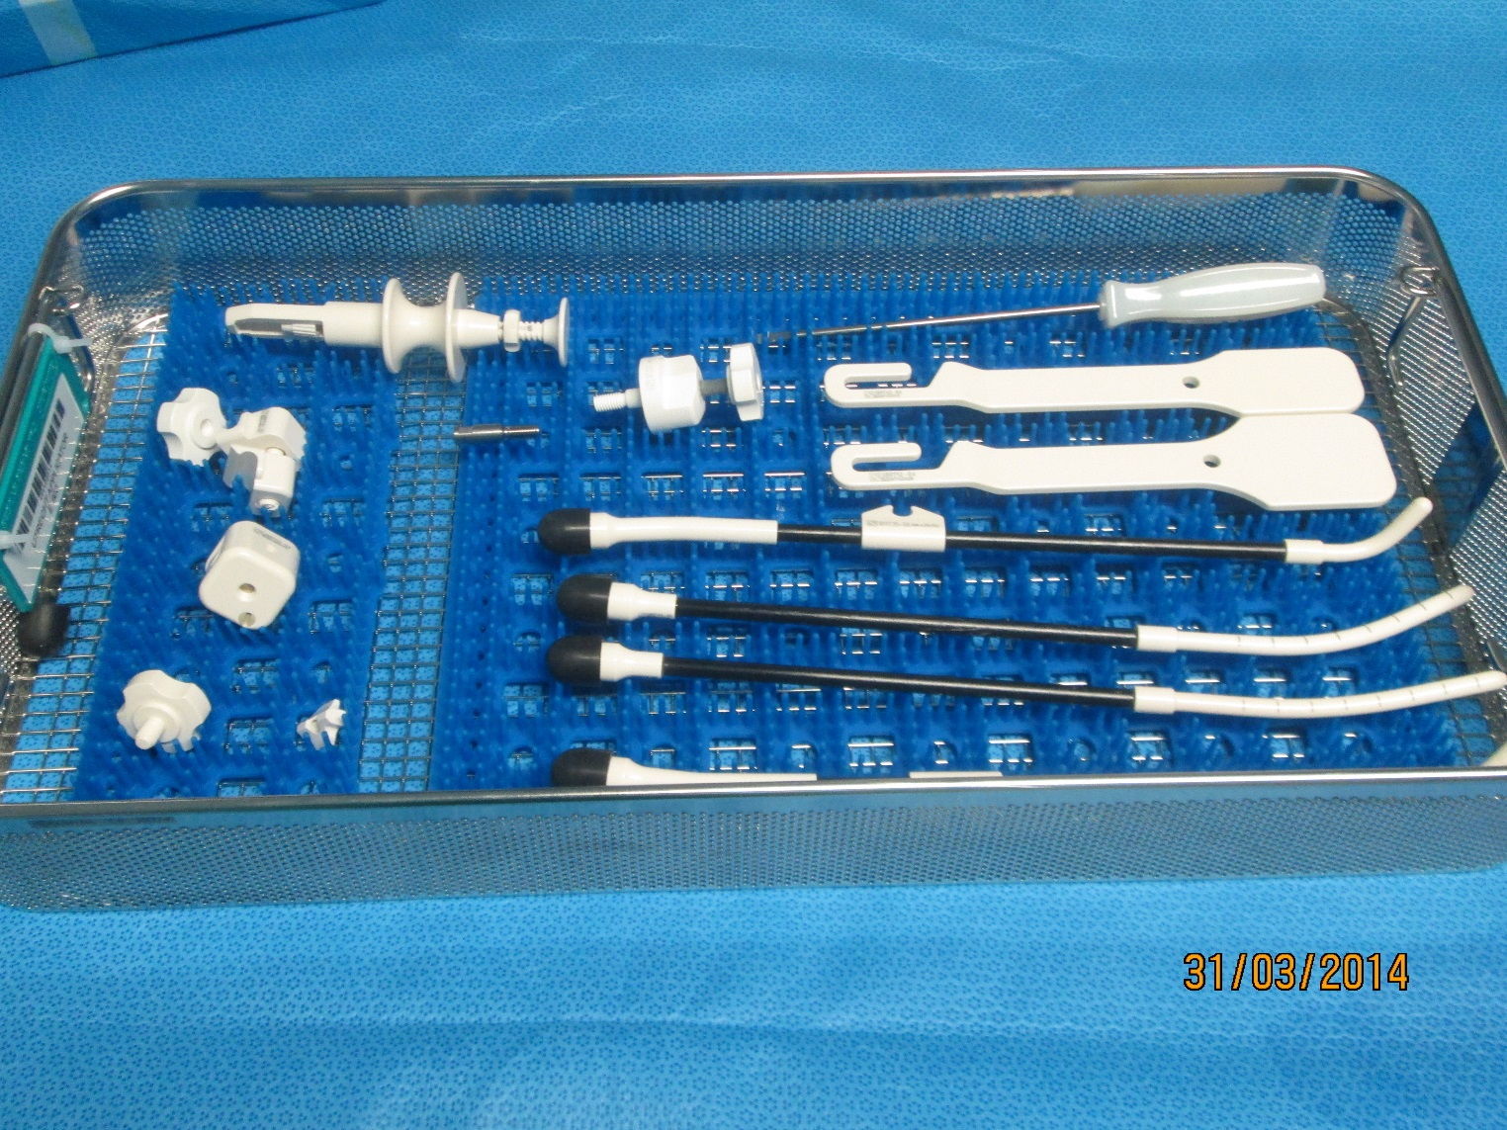
Utrecht applicator brachy

Slide 19
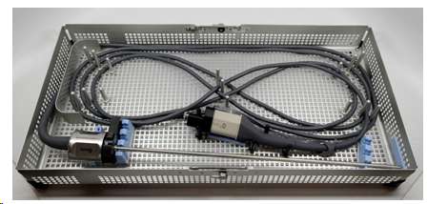
Da Vinci XI

Slide 20
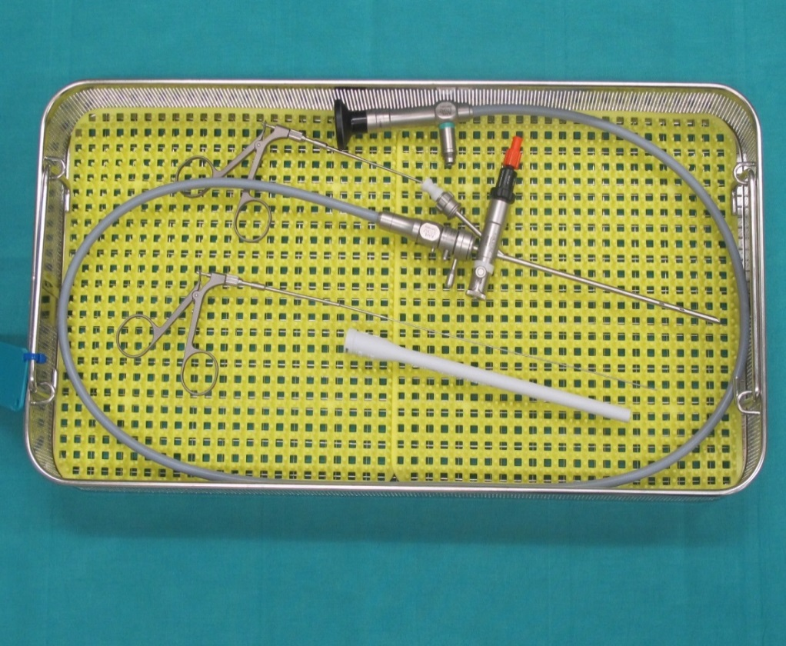
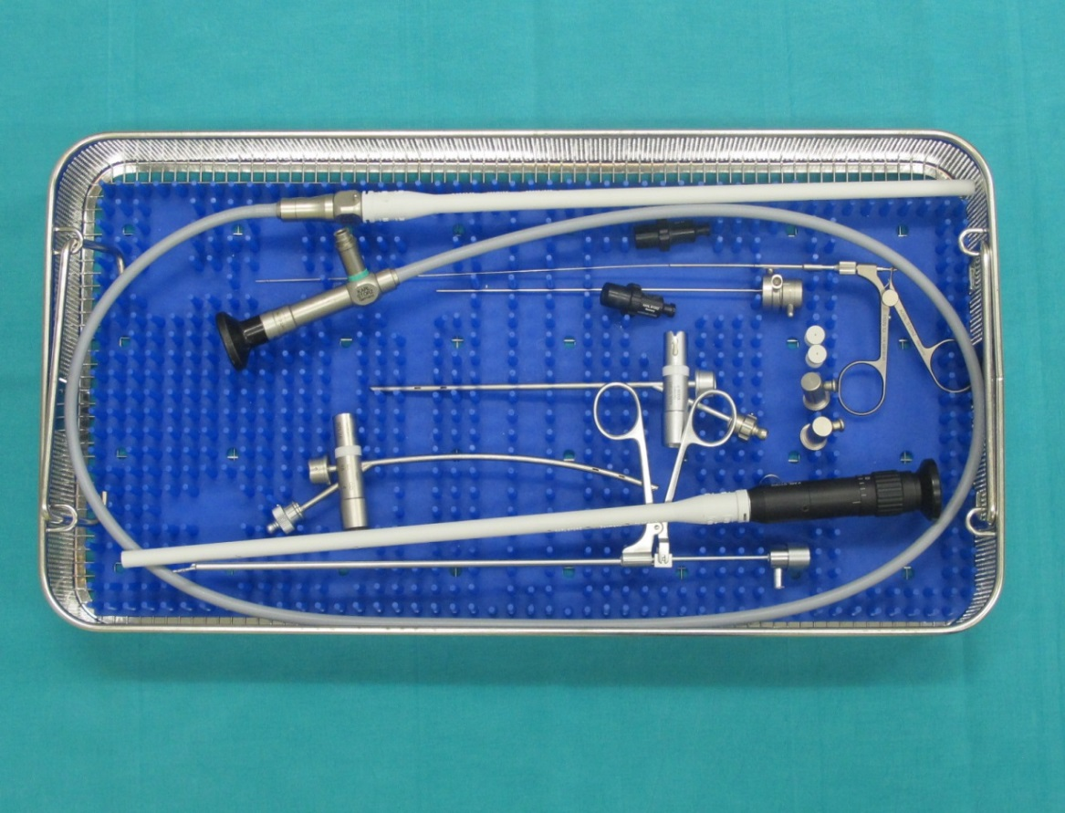
Foetal surgery

Slide 21
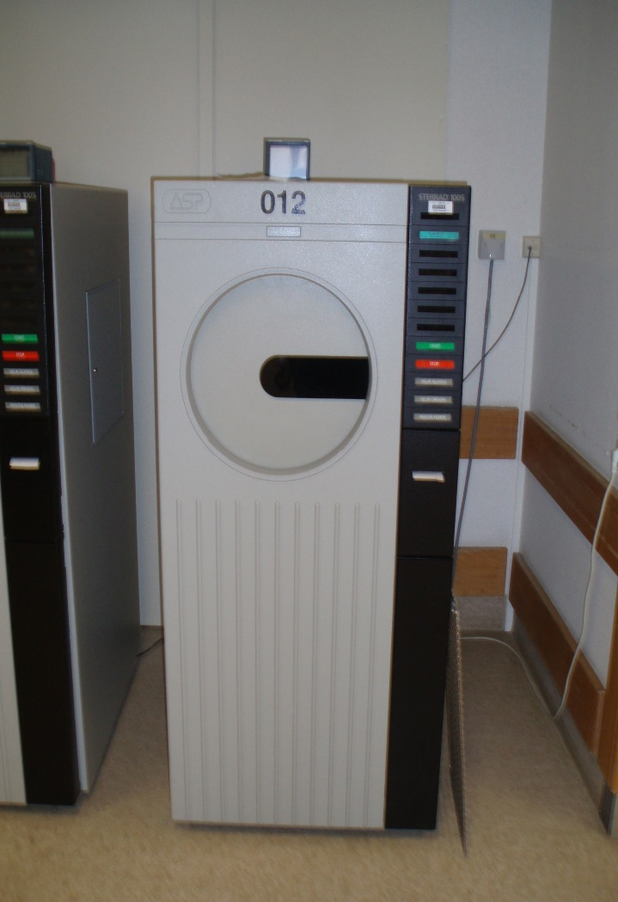
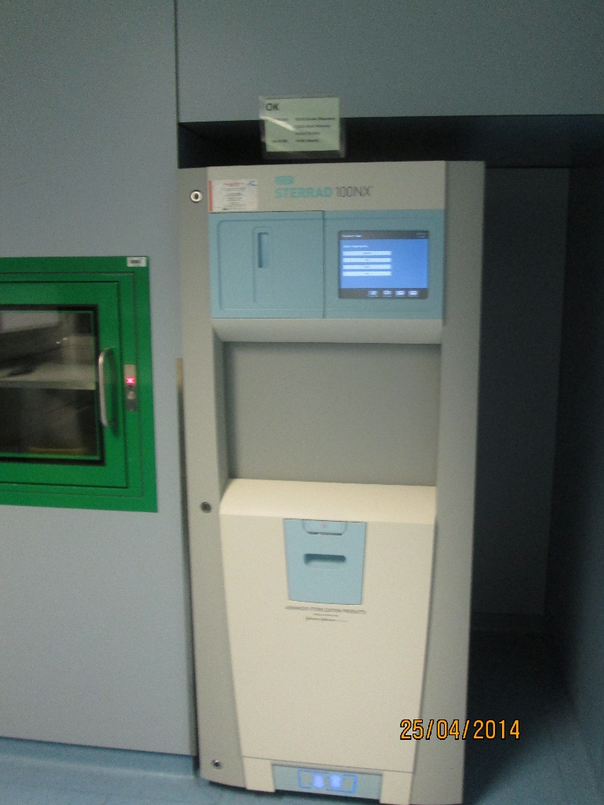
Process switch
Standaard
Duo
Flex
Express
1 proces

Slide 22
Defining process compatibility
Registration conform ISO EN 13485
Listing instruments
Sterilisation Program selection:
  ASP Sterrad Sterility guide
  User manual instrument manufacturer
  Sterility experts ASP
Registration within traceability system and inventory
Training employees

Slide 23
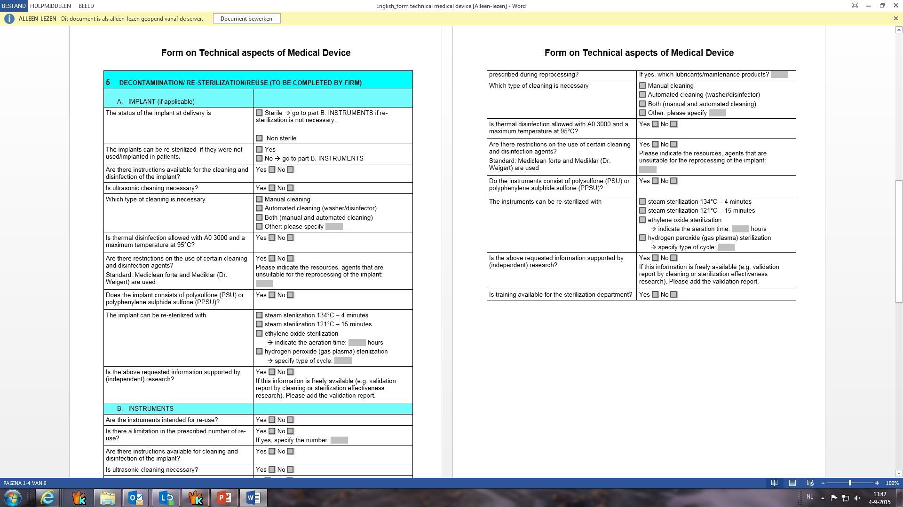

Slide 24
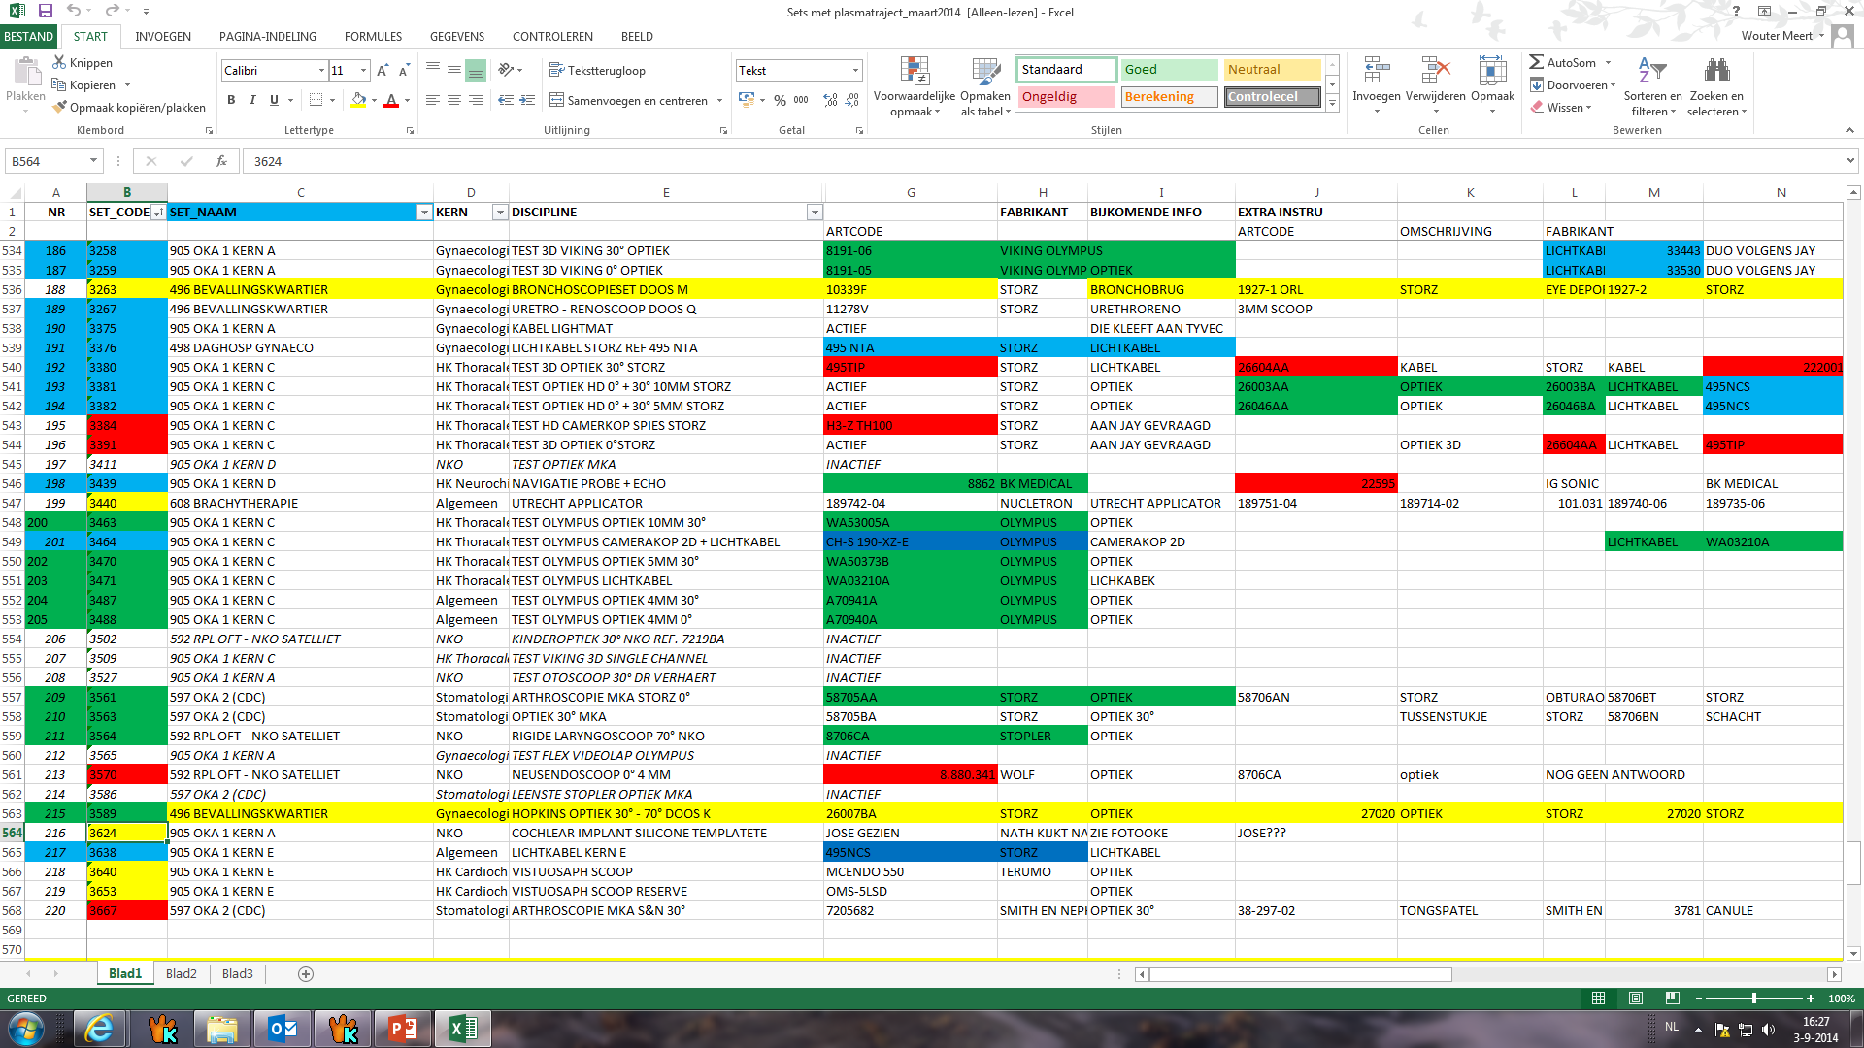

Slide 25
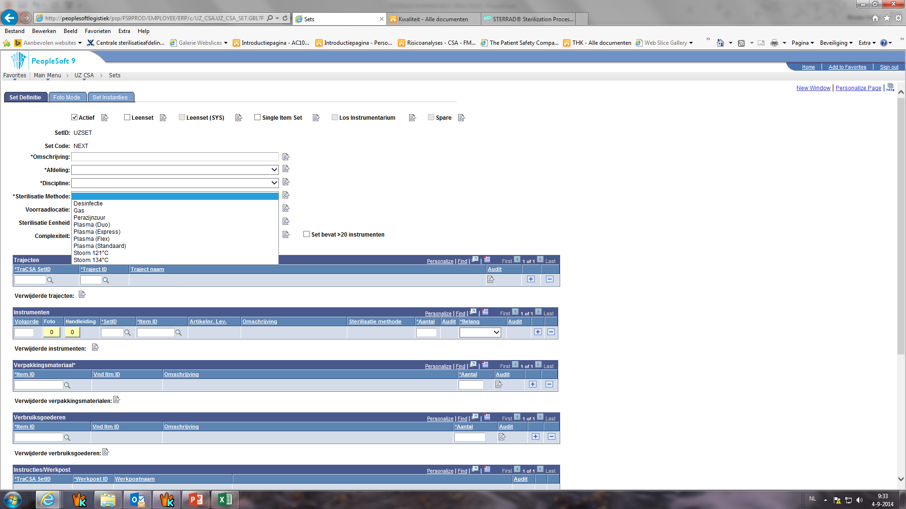

Slide 26
NBN EN ISO 14937
IQ, OQ, PQ
Routine controle:
  Chemical indicators/ biological indicators
Periodically maintenance
Parametric release

Slide 27
Parametric release

Slide 28
Conclusion
Need for hydrogen peroxide LTS within our setting because of specific surgical instruments
Important for ISO EN 13485 :
  Sterrad Sterility Guide
  Support by sterility advisors
  Process control en parametric release
More research is needed on effects of hydrogen peroxide on instruments

Slide 29
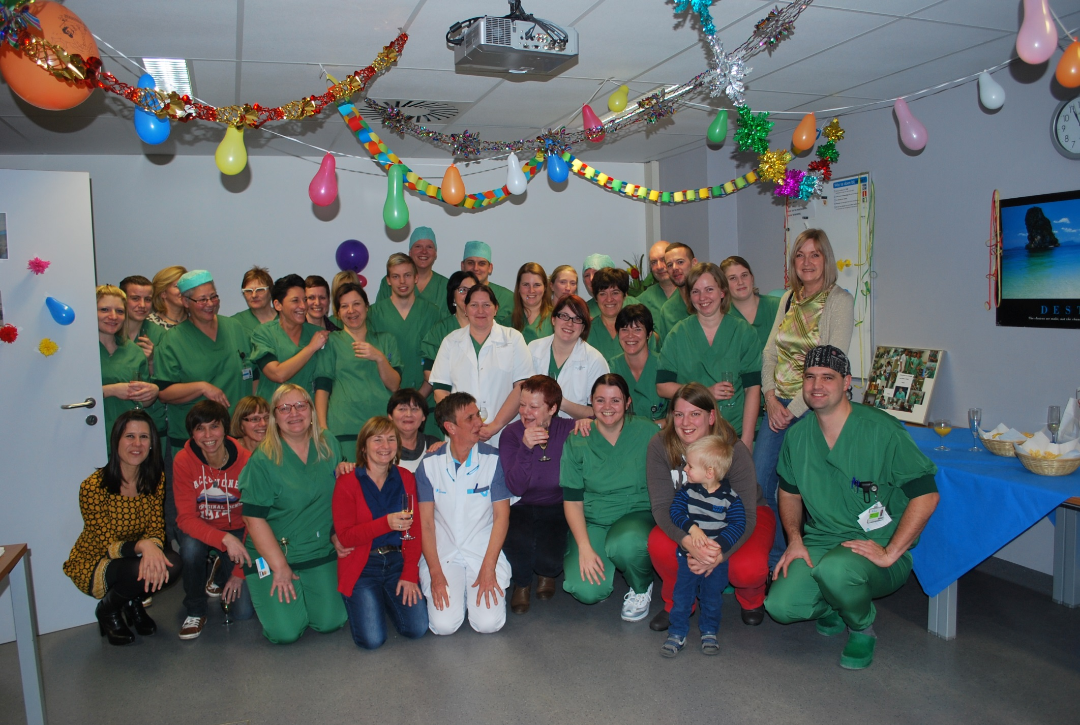
Thank you
Wouter Meert
Manager CSSD
UZ Leuven
wouter.meert@uzleuven.be
Tel 0032 16 34 40 07

