Slide 1
Requirements of validation of packaging systems and sterility assurance
Hartmut Dunkelberg
University Medical Center, Goettingen, Germany
16th World Sterilization Congress & Annual conference of AFS
7-10 October 2015, Lille, France

Slide 2
Topics
Emptying catheter bags: an example of validation of basic operations
Risk of infection when using sterilized products contaminated with a low count of environmental microbes
Validation of visual inspection of sterile barrier systems as one of the methods to detect compromised sterility; relevance of punctures, wet bursting strength, bursting strength and tearing resistance
Validation of maintenance of sterility: compatibility of airborne microbial filtration efficiency of sterile barrier systems with airborne microbial challenge
Responsibility for the handling of terminally sterilized products

Slide 3
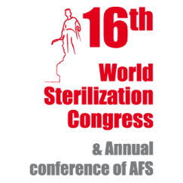
Emptying catheter bags – an example for validation of basic operations

Slide 4
Risks of cross contamination when emptying catheter bags
Contamination of the doorhandles
Contamination of the washer-disinfector handle
Contamination of the clean container found in the washer-disinfector
Contamination of the on/off button

Slide 5
Validation of the procedure for emptying catheter bags
Predetermined acceptance criterion:
strict hygienic isolation of work steps with pathogen contact from those without

Slide 6
Proposal for a written documentation of work steps emptying catheter bags
Step 1: assemble the required equipment;
Step 2: hand hygiene, put on disposable gloves, …;
Step 3: steps including the risk of contaminating the gloves: clean drainage bag outlet with alcohol-based wipe, place urinary container under drainage bag outlet, … etc.

Slide 7
Documentation of work steps emptying catheter bags II
Step 4: hygienic isolation of following operations,
o Alcohol-based hand rub of both hands with gloves
o Hand 1 (with risk of contamination) is used for transporting and emptying the container
o Hand 2 is used for the following “clean” operations: opening the doors, opening and closing the door of the washer-disinfector, pressing the button
Step 5: remove and discard gloves, hand hygiene with alcohol- based hand rub

Slide 8
Risk of infection when using sterilized products contaminated with a low count of environmental microbes

Slide 9
Infection/outbreak | Cause | Remarks
Aspergillus meningitis outbreak in 2 hospitals in Sri Lanka after spinal anaesthesia for caesarean section ¹ | “sub-optimal storage of sterile devices for over 6 months after tsunami was most plausible reason” | No infections when syringes are used for other injections. Unopened syringes showed growth.
Outbreak with 80 cases of BSI in 6 US states after use of heparinized saline flush syringes ² | Syringes were prepared as compounded medical products. | P. fluorescens was identified in unopened syringes; The specific source of contamination could not be identified.
Exposure to propofol in 7 hospitals was associated with postoperative infections³ | Risks: “use syringes of propofol that had been prepared up to 24 h beforehand”, “prepare multiple syringes …at one time for use throughout the day.”
1) Guaratne et al.: Ceylon Medical Journal 2006;51:137-42; 2) Gershman et al.: Clinical Infectious Diseases 2008;47:1372-9
3) Bennet et al.: N Engl J Med 1995;333:147-54

Slide 10
Recommendations to reduce the risk of microbial growth by shortening the in-use application time
From a microbiological point of view, the product should be used immediately¹
Replace tubing used to administer blood, blood products, or fat emulsions (…) within 24 hours of initiating the infusion²
Propofol: use strict aseptic technique … discard within 12 hours of opening³
¹) CPMP (Commitee for proprietary medicinal products), 1998
²) CDC, 2011: Guidelines for the prevention of intravascular catheter-related infections, 2011
³) Labeling text of the manufacturer

Slide 11
Validation of visual inspection as one of methods to detect compromised sterility; relevance of puntcures, wet bursting strength, bursting strength and tearing resistance

Slide 12
Defect detection rates of visual inspection of compromised packagings*
Defect size (mm) | Defect detection rate of visual inspection
1.1 | 6.7 %
3.7 | 64.4 %
*Data from Waked et al.: Sterilization wrap inspections do not adequately evaluate instrument sterility. Clin Orthop Relat Res 2007;462:207-11

Slide 13
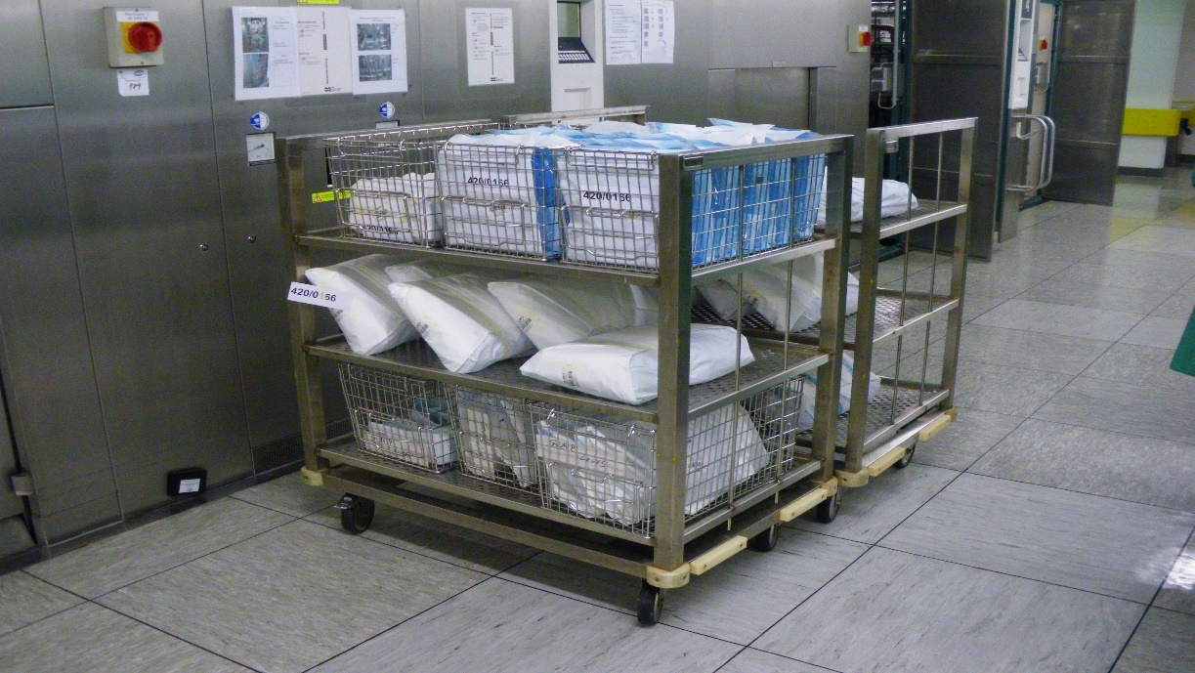
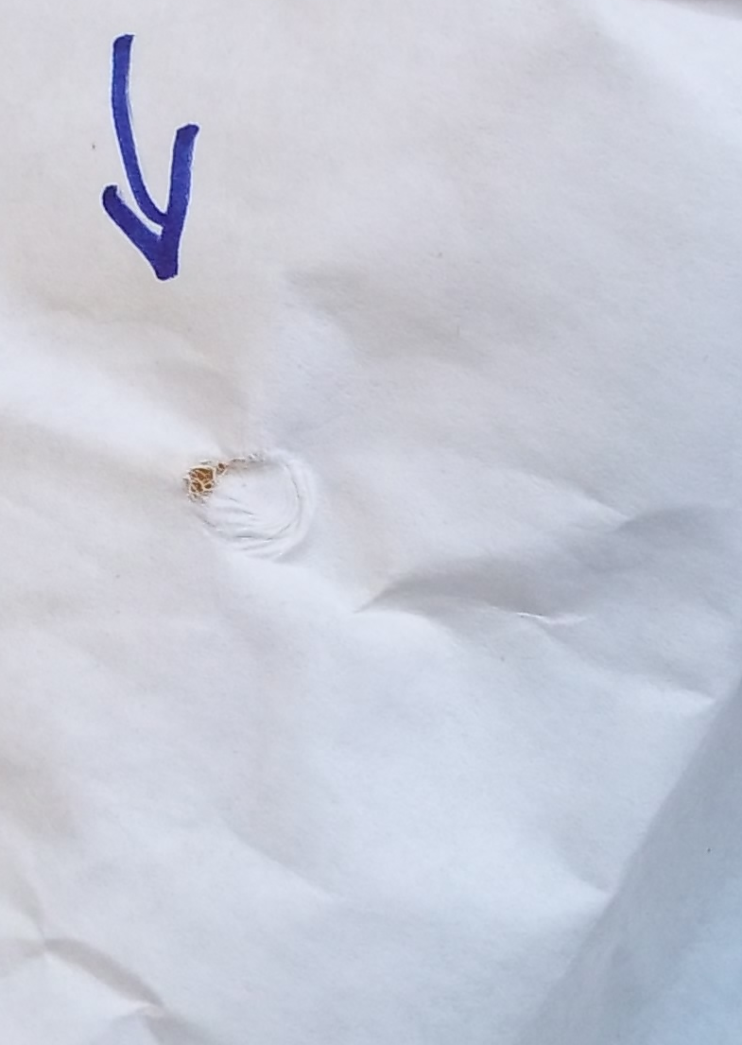
Mechanical pressure caused bursting during steam sterilization:

Slide 14
Limit values of bursting strength, wet bursting strength, and internal tearing resistance according to EN 868 part 2-10
Performance parameter | Material |  |  | Unit
 | Paper (for pouches, reels) | Coated nonwoven m. of polyolefins (for pouches, lids) | Uncoated nonwoven m. of polyolefines (for pouches, lids)
Bursting strength | ≥ 230 | ≥ 700 | ≥ 575 | kPa
Wet bursting strength | ≥ 35 | - | - | kPa
Internal tearing resistance | ≥ 550 | ≥ 700 | ≥ 1000 | mN

Slide 15
Sporadic device-associated infections caused by compromised packaging integrity are difficult to identify
because the microbiological status of the unopened device can no longer be examined,
because exposures and patients are scattered or isolated in time and location.

Slide 16
Validation of maintenance of sterility: compatibility of airborne microbial filtration efficiency of sterile barrier systems with airborne microbial challenge

Slide 17
ISO 11607-1
“Porous materials shall provide an adequate microbial barrier to microorganisms in order to provide integrity of the sterile barrier system and product safety.” *)
*ISO 11607-1, 2006, clause 5.2.2

Slide 18
ISO 11607-1
“the conditions under which the … preformed sterile barrier system are handled shall be established, controlled and recorded…to ensure that the conditions are compatible with the use for which the material and/or sterile barrier system is designed … .”: *)
Temperature range
Pressure range, …
Maximum rate of change of the above. …
Bioburden.
The property of the microbial barrier of the packaging material shall be evaluated.
*) ISO 11607-1, 2006, subclauses 5.1.3 - 5.1.6

Slide 19
Knowing data of barrier efficiency against airborne microbes is absolutely necessary for:
comparing and selecting the suitable and best packaging material,
for assessing the compatibility of the packaging material with provided storage conditions.

Slide 20
Validation of compatibility of the sterile barrier system with events caused by airborne microbial challenge
Predetermined quality attributes
Maintenance of sterility based on quantitative risk analysis
Performance parameter
Airborne microbial retention capacity
Relevant factors to be considered
Level and relevant sizes of airborne particles bearing microorganisms
Flow rate of air through the layers of packaging material

Slide 21
Validation of compatibility of the sterile barrier system with events characterized by airborne microbial challenge
Volume flow based on air pressure change:
p x V = const.
Volume flow based on temperature change:
Calculation of compatibility:
Airborne bioburden (< 5 µm): 10 CFU/m³
n = number of events compatible with SAL
Room temperature: 20 °C
number of events per week
 | scenario A | scenario B
∆t = 1 °C; | 1 | 7
∆p = 10 hPa | 1 | 7
bioburden sized < 5 µm | 10 CFU/m³ | 10 CFU/m³
Filtration efficiency: 99.6%
volume: V₁ = 0.5 L
Microbial challenge per event:
N₀ = ∆V _{t + p} x 10 CFU/m³

Slide 22
Calculation of the number of events (n) and shelf life compatible with the SAL
exposure scenario |  | 1 event per week scenario A | 7 events per week scenario B
 | number of events (n) | shelf life | shelf life
single wrap | 3.7 | 3 weeks | 3 days
double wrap | 934 | (18 years) | 2.6 years

Slide 23
Consequences of the proposed validation procedure
Low variations of temperature and low rates of their changes reduce the microbial challenge;
Transports (containership, transport plane) with relevant temperature changes and atmospheric pressure changes raise the microbial challenge;
Outsourcing of sterilization can increase the risk of recontamination through transport routes with convulsions, temperature variations, changes in air pressure (different altitudes).

Slide 24
Mayworm, D:
“When products are packaged so that they remain sterile, the archaic practice of outdating is no longer necessary”. *)
*) Mayworm D: Sterile shelf life and expiration dating. J Hosp Supply Process Distrib. 1984;2(6):32-5.

Slide 25
Responsibilities for the handling with terminally sterilized products

Slide 26
Responsibility for the handling of terminally sterilized products
“In general the responsibility for the quality of the packaging material is divided accordingly, where:
the manufacturer of the packaging material and/or system is responsible for the quality of the packaging material as it is being supplied, and the identification of the intended use;
the user of the packaging material and /or system for its proper application, and by implication for the final quality of the packaging design or system.” *)
*) EN 868-1, 1997, Annex A.1.2

Slide 27
Summary
The use of the best possible validation methods can help prevent hospital acquired infections.
Event-Related Sterility Maintenance Policy is well-accepted and should be practised consistently according to International Standards.

Slide 28
Thank you for your attention

