Slide 1
Validation of hydrogene peroxide Sterilizers following ISO 14937
Klaus Roth
SMP GmbH
Prüfen Validieren Forschen
Hechingerstrasse 262
72072 Tuebingen
Germany

Slide 2
Validation of the cleaning processes
Validation of disinfection processes
Validation of sterilization processes
Validation of instrument behaviour with respect to
Steam sterilization
Ethylenoxide sterilization
Formaldehyde sterilization
Hydrogene peroxide sterilization
Research in the field of prions
Testing of new instruments designs
Testing of cleaning agents
Testing of disinfection agents
Fields of activities:

Slide 3
ISO 14937:2009
Sterilization of health care products -- General requirements for characterization of a sterilizing agent and the development, validation and routine control of a sterilization process for medical devices

Slide 4
ISO 14937:2009
Requirements:
Selection of the test organism
Definition of the D-Value of the organism
Biological Indicators following ISO 11138
Chemical Indicators following ISO 11140
Pass-Fail criterias

Slide 5
Selection of the test organism
Geobacillus stearothermophillus is well accepted to test hydrogene peroxide sterilization processes.
A minimum of 10⁶ cfu per indicator should be used, when the sterilizer is running in half cycle mode.
All microorganisms have to be killed in half cycle mode

Slide 6
Definition of the D-Value of the test organism
In microbiology, D-value refers to decimal reduction time and is the time required at a given temperature to kill 90% of the exposed microorganisms. The term is used in assessing microbial thermal resistance and thermal death time analysis.
Thus after a colony is reduced by 1 D, only 10% of the original organisms remain, i.e., the population number has been reduced by one decimal place in the counting scheme. Generally, each lot of a sterilization-resistant organism is given a unique D-value. When referring to D-values it is proper to give the temperature as a subscript of the "D". For example, given a hypothetical organism which is reduced by 90% after exposure to temperatures of 300° F for 20 minutes, the D-value would be written as D_{300F} = 20 minutes. D-value determination is often carried out to measure a disinfectant's efficiency to reduce the number of microbes present in a given environment.^{[1]}
(Wikipedia)

Slide 7
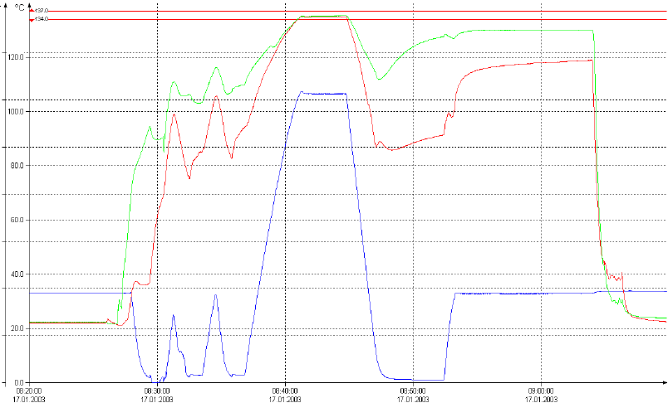
Definition of the D-Value
Cycle in a resistometer for steam
ISO 18472
Cycle in a steam sterilizer

Slide 8
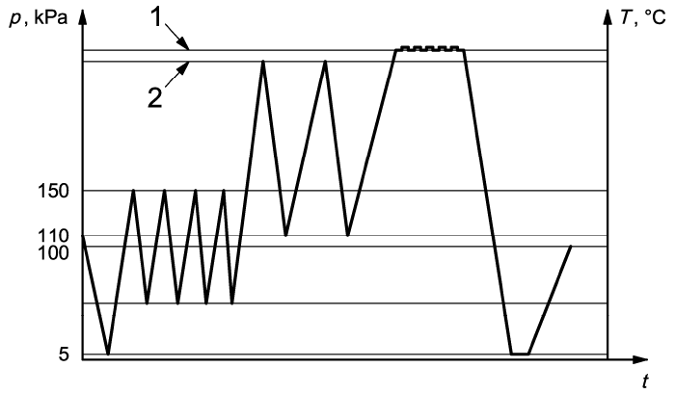
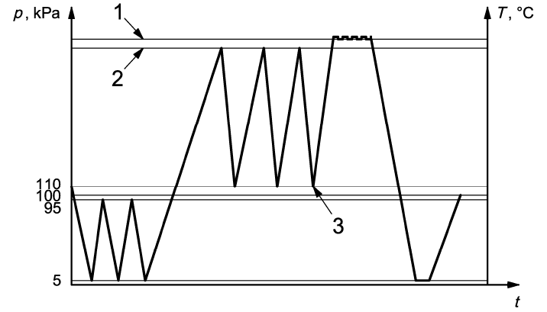
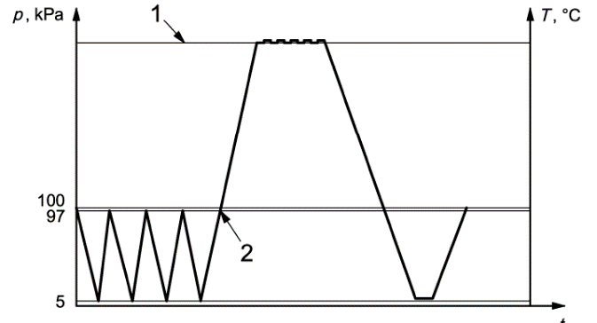
Definition of the D-Value
The cycles in a steam sterilizer are well established.
Different types of cycles are known:
Subatmospheric Transatmospheric Super atmospheric
The preparation time is not defined.
Only the plateau phase is defined by time, temperature and pressure

Slide 9
Definition of the D-Value
Sterilization cycles in a H²O² sterilizer:
Each manufacturer has designed his own cycle.
Some manufacturer have the same cycle for all models and adapt the amount of H²O² to the size of the chamber.
Some manufacturer has an individual cycle for each model
We found cycles with
One injection phase
Two injection phases
Four injection phases
The individual design of the sterilization phase has to be regarded when setting up a resistometer for H²O² sterilization.
We found in reports D-values between 0.56 min and 6 min.

Slide 10
Biological Indicators following ISO 11138
Depending of the carrier material biological indicators failed
Also the same indicators but from differnet lots showed different behavior

Slide 11
Chemical Indicators following ISO 11140
Most of the chemical indicators had already a complete color change after the half cycle

Slide 12
Pass-Fail criterias
Temperature
Humidity
Insufficient vacuum
Low amount of hydrogene peroxide
Load
Combination of failures

Slide 13
Pass-Fail criterias
Temperature
Temperature was set on a lower level (2°C beneath the warning level given by the manufacturer)
Acceptance criteria:
BI has to pass in half cycle mode
If the BI fails in halfcycle mode the CI has to fail in full cycle mode
CI has to fail in half cycle mode

Slide 14
Pass-Fail criterias
Humidity
Depending on the possible load for the sterilizer a wet fabrics was placed inside the chamber. The amount of water was increased until the sterilizer was going into failure mode.
The BI‘s and CI‘s of the cycle were evaluated using the same criterias as mentioned before.

Slide 15
Pass-Fail criterias
Insufficient vacuum
Vacuum was set on a higher level (above the warning level given by the manufacturer)
The BI‘s and CI‘s of the cycle were evaluated using the same criterias as mentioned before.

Slide 16
Pass-Fail criterias
Low amount of hydrogene peroxide
Cycles were run with a lower portion of hydrogen peroxide
Also Hydrogen peroxide at the end of the shelf live was used
The BI‘s and CI‘s of the cycle were evaluated using the same criterias as mentioned before.

Slide 17
Pass-Fail criterias
Combination of failures
Simulated Failures all together have been run with empty and full chamber
The BI‘s and CI‘s of the cycle were evaluated using the same criterias as mentioned before.

Slide 18
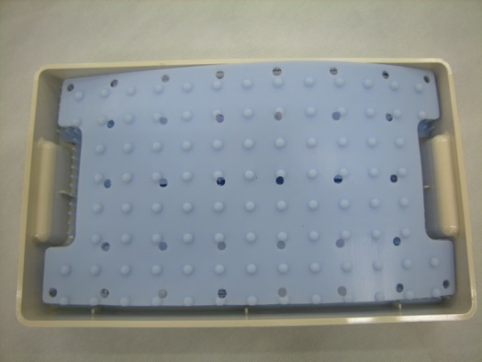
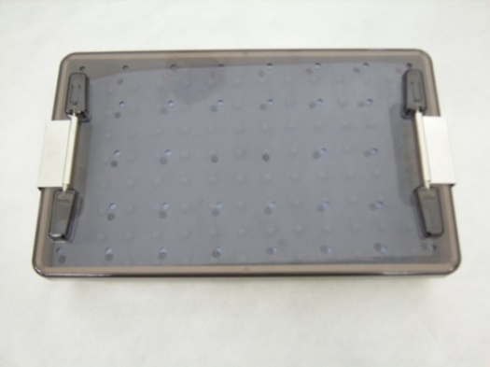

Pass-Fail criterias
Load
The sterilizers have been loaded with silicone mats and/or other materials.
The size of the load was depending on the results of the BI‘s. Sterilization has been performed in half cycle mode.
Example for challenge pack

Slide 19
Sterilizer tested since 2000
Manufacturer | 1 |  |  |  | 2 |  |  | 3 | 4
Sterilizer | 1 | 2 | 3 | 4 | 5 | 6 | 7 | 8 | 9
Comparable Cycle of the different sterilizer models |  |  |  |  | x | x | x
Plasma phase | x | x | x | x | x | x | x | x
Pre-heating | x | x |  |  | x | x | x | x | x
Concentration of H²O² |  |  | x | x |  |  |  | x
Parametric control with calculated concentration of H²O² | x | x |  |  | x | x | x | x | x
Parametric control including measurement of H²O² |  |  | x | x

Slide 20
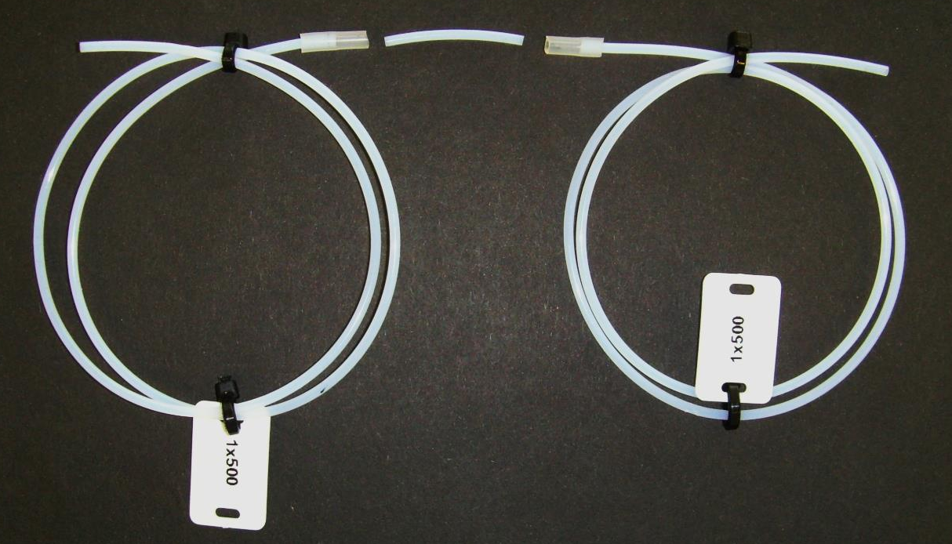
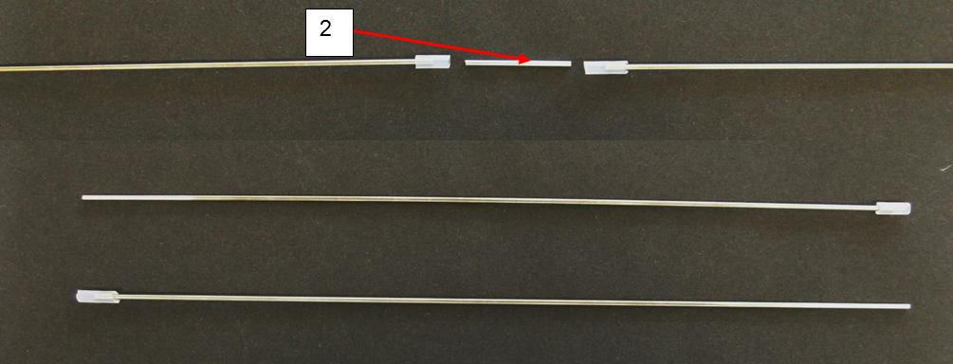
Bioindicators used for the tests

Slide 21
Testing of the spore suspension
Sample No. | Inoculated location | CFU / plate¹⁾ | Incubation ofthe TSB eluate²⁾ | Identification³⁾ | CFU /Inoculated location⁴⁾
54%-1 | 1 | 0 | + | G. stearotherm. | 0
54%-2 | 1 | 7 | + | G. stearotherm. | <10
54%-3 | 1 | 20 | + | G. stearotherm. | >20
27%-1 | 1 | >300 | + | G. stearotherm. | >300
27%-2 | 1 | >300 | + | G. stearotherm. | >300
27%-3 | 1 | >300 | + | G. stearotherm. | >300
13.5%-1 | 1 | Lawn growth | + | G. stearotherm. | >1000
13.5%-2 | 1 | Lawn growth | + | G. stearotherm. | >1000
13.5%-3 | 1 | Lawn growth | + | G. stearotherm. | >1000

Slide 22
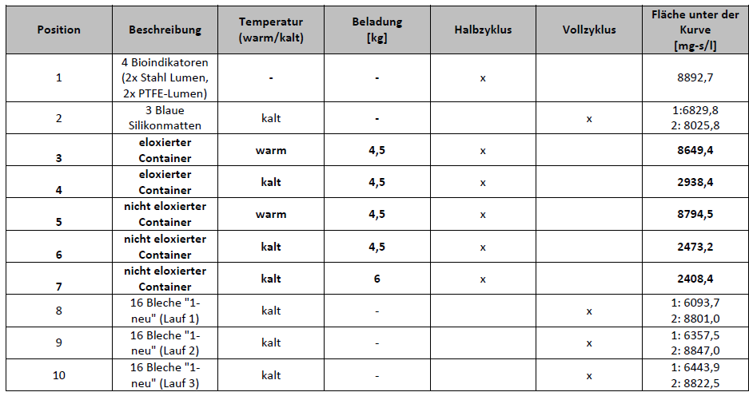
Influence of the temperature

Slide 23
Conclusion
Some H²O² processes have shown good sterilization behavior even against prions
The use of ISO 14937 as a guidance for the IQ, OQ, PQ process for H²O² sterilizer has limitations as not all requirements can be fulfilled (resistometer etc. is missing)
Indicator has to be designed for each specific cycle
The load of the sterilizer has to be defined in details. Deviations in material weight and surface area of the load may lead to a reduction of the safety of the process
PCD‘s should simulate not only the geometry but also the material of the instruments
Specific standards for H²O² sterilizers and the accessories is needed

Slide 24
Nice to have and a must for a
Hydrogene Peroxide Sterilizer
Comparable Cycle of the different sterilizer models | Nice to have
Plasma phase | Not only at the end of the cycle also at the beginning as preconditioning of the load
Pre-heating | Preheated load seems to have an important role to avoid condensation of the sterilizing agent
Concentration of H²O² | Nice to have to improve the performance with respect of the material
Parametric control with calculated concentration of H²O² | Surveillance of the sterilizing agent is a requirement by the standard
Parametric control including measurement of H²O² | Delivers additional information about the sterilizing agent inside the chamber and take into account the interaction with the load

Slide 25
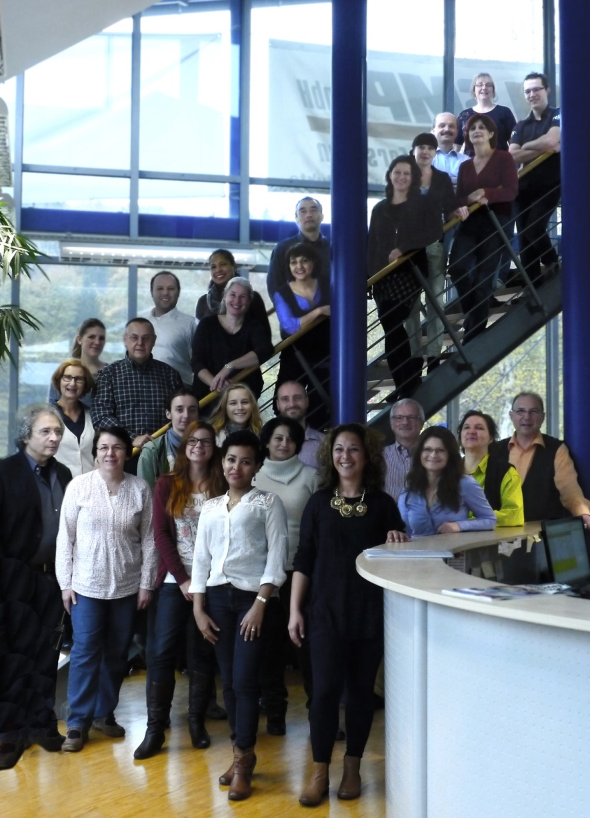
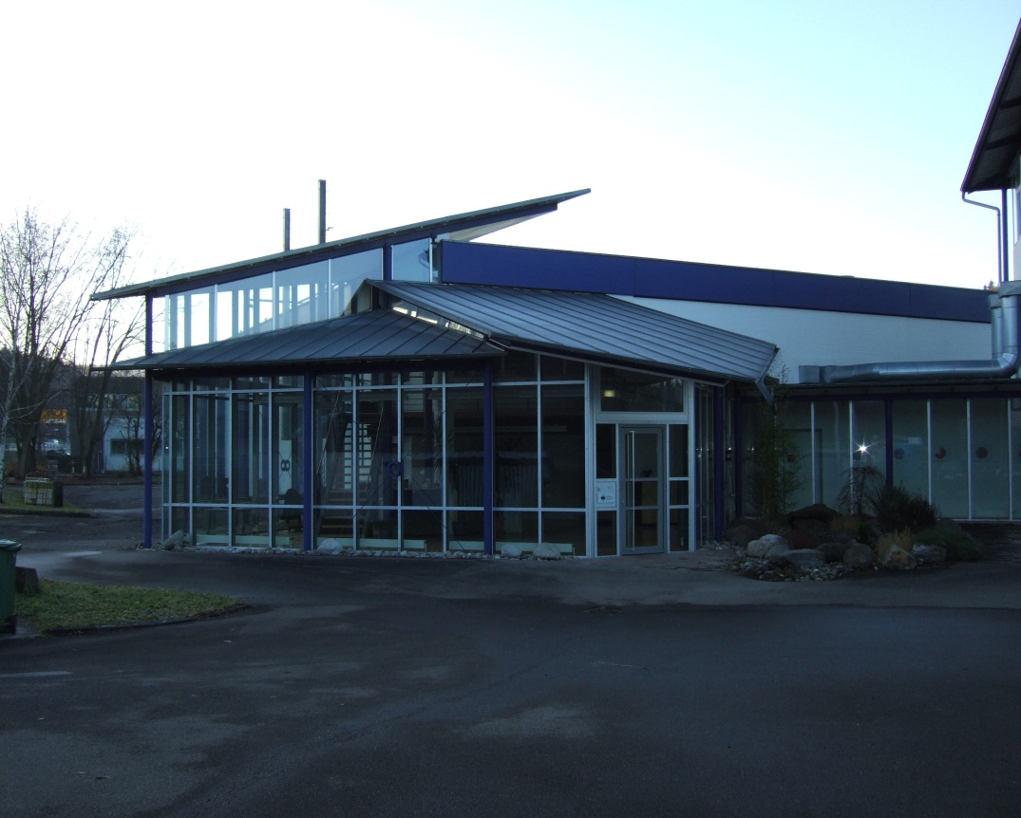
Thank you very much
SMP GmbH
Hechingerstrasse 262
72072 Tübingen

