Slide 1
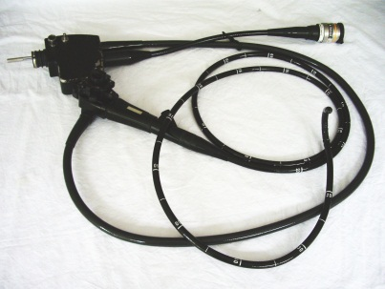
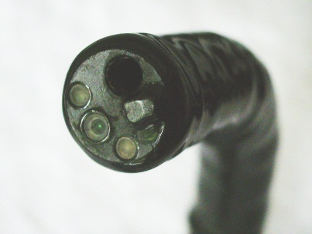
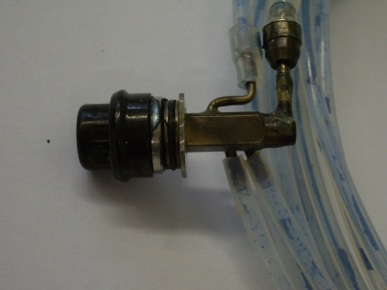
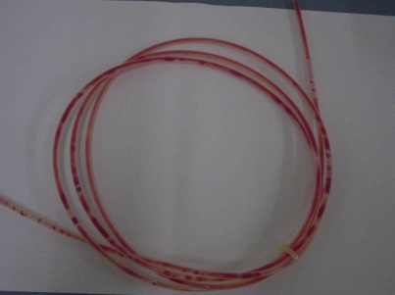
Process Challenge Devices (PCD)
for flexible endoscopes
What are we doing and
where are we going?
Dr. Markus Wehrl
wfk – Cleaning Technology Institute e.V.
WFHSS / 09.10.2015 / Lille

Slide 2

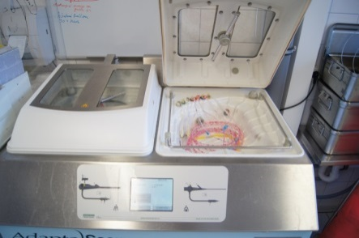
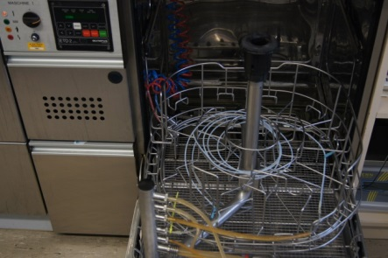
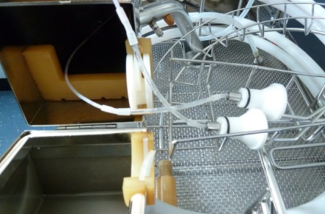
Reprocessing of thermo-labile medical devices
7-10 oct. 2015
Flexible endoscopes and many others: max. Temp. <60 °C
Chemo-thermal disinfection required
  30 - 60 °C
  addition of disinfectants (GA, PAA)
Parametric release similar to thermal disinfection procedures not possible.
Process performance must be verified
→ Process Challenge Devices (PCD)

Slide 3
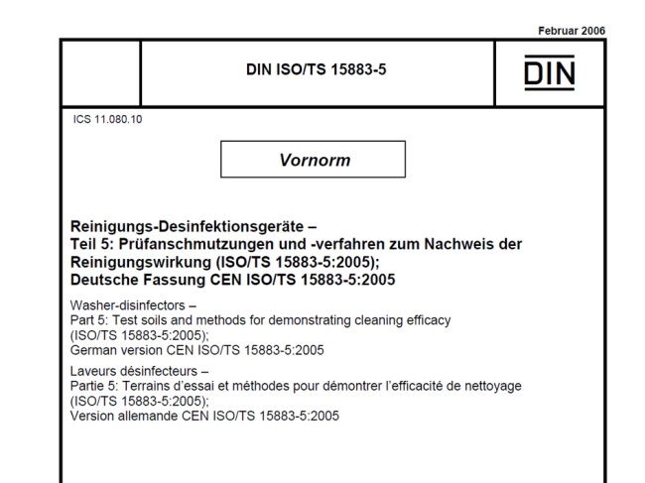
PCD systems acc. to ISO/TS 15883-5
7-10 oct. 2015
Country | Annex | Soiling | Test microorganism
AT | E | wheat flour / eggs / nigrosin | E. faecium
DE | I | reactivated sheep blood | E. faecium
FR | F | - | biofilm of P. aeruginosa
GB | R | glycerol / pork mucin / bovine serum / flour / safranine | n.a.
NL | L | bovine serum albumin / pork mucin / bovine thrombin/ bovine fibrinogen / amidoblack | n.a.

Slide 4
Comparison
Comparative testing of all PCD-systems using a professional WD. Relevant parameters were kept constant:
7-10 oct. 2015
- program - concentrations
- cleaner - disinfectant
- water quality
Cleaning
Disinfection
Müller Alicja: Protein- und Keimentfernung in verschiedenen Prüfkörpern für medizinische Instrumente unter Berücksichtigung des Reinigungs- und Desinfektionsmittels. Diploma-Thesis, Hochschule Niederrhein, Krefeld, January 2008

Slide 5






The German Guideline
“Guideline for the validation of automatic cleaning and disinfection procedures for the reprocessing of flexible endoscopes“
7-10 oct. 2015
Issued in autumn 2011
  15 annexes
  6 test matrices
  9 check lists
Basis of the guideline
EN ISO 15883-1, -4, -5
European Guideline of ESGE / ESGENA

Slide 6
Contributing Societies
DGKH Deutsche Gesellschaft für Krankenhaushygiene e.V.
www.dgkh.de
DGSV Deutsche Gesellschaft für Sterilgutversorgung e.V.
www.dgsv-ev.de
DGVS Deutschen Gesellschaft für Verdauungs- und
www.dgvs.de Stoffwechselkrankheiten e.V.
DEGEA Deutsche Gesellschaft für Endoskopie-Fachberufe e.V.
ww.degea.de
AKI Arbeitskreis Instrumentenaufbereitung
www.a-k-i.org
7-10 oct. 2015
For the establishment of reliable PCD systems the Guideline group initiated the formation of the so-called „Method Group“

Slide 7










„Method group“
Biotec GmbH, Gütersloh, DE
HÜCKER & HÜCKER GmbH, Kelkheim, DE
HYBETA GmbH, Münster, DE
HygCen GmbH, Schwerin, DE
Simicon GmbH, München, DE
SMP GmbH, Tübingen, DE
Representatives of endoscope manufacturer
Arbeitskreis Instrumentenaufbereitung, AKI
Charité, Berlin
Deutsche Gesellschaft für Krankenhaushygiene, DGKH
Hygiene Institut Universität Bonn, Bonn
wfk – Cleaning Technology Institute e.V., Krefeld
7-10 oct. 2015
Representatives
Endoscope
Manufacturer

Slide 8
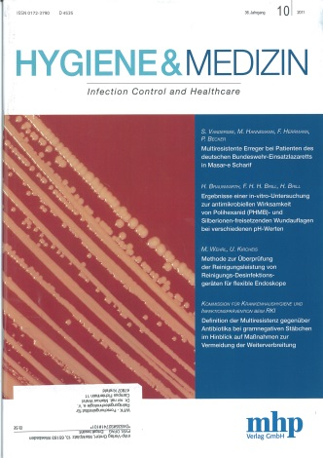
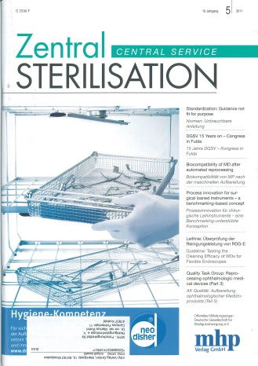
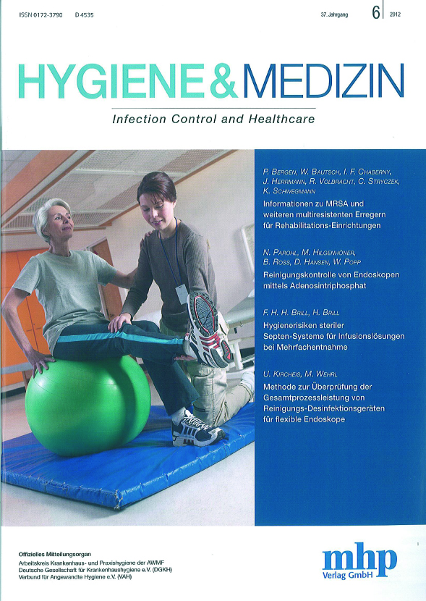
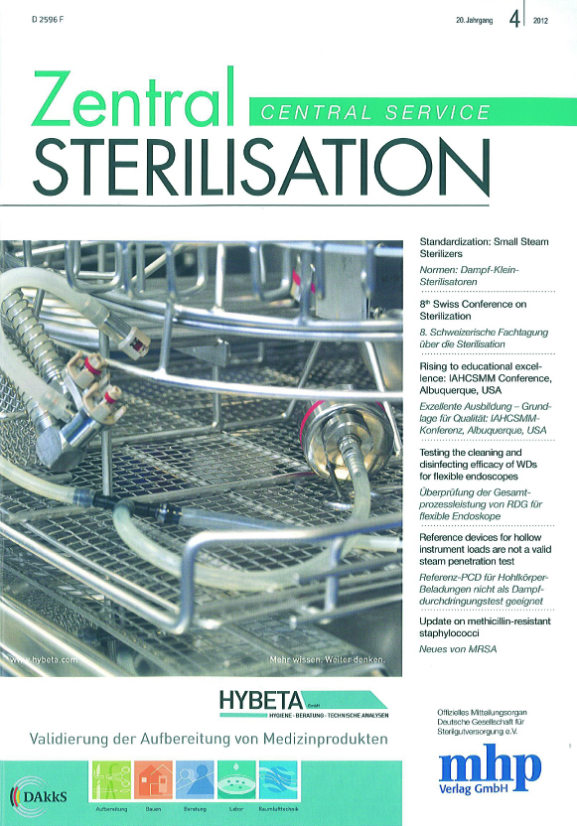
Results of the „Method group“
Establishment of 2 PCD models adopted from ISO/TS 15883-5, Annex I.
Annex 8: PCD for cleaning efficacy
CentralService 2011(5): 352-361
HygMed 2011 36(10): 402-406
Annex 9: PCD for overall process efficacy (cleaning + disinfection)
CentralService 2012(4): 240-249
HygMed 2012(6): 245-249
7-10 oct. 2015

Slide 9
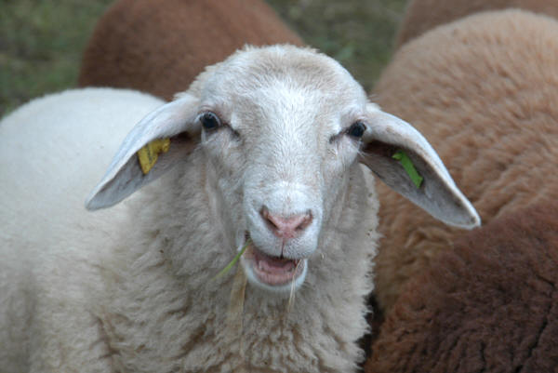
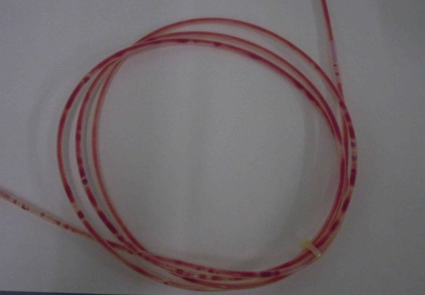
Ann. 8-PCD (Cleaning): Application
PTFE-tube, length: 200 cm
Inner diameter: 2 mm
7-10 oct. 2015
Quantified amount of reactivated sheep blood
Quantification of protein residues (protein is main parameter)
Acceptance criteria *:
  Visual cleanliness
  Guide value: ≤ 800 µg PCD⁻¹**
  Alarm range: 800 < x ≤ 1600 µg PCD⁻¹
  Limit value: > 1600 µg PK⁻¹
* DGKH, DGSV, DGVS, DEGEA und AKI: Leitlinie zur Validierung maschineller Reinigungs-Desinfektionsprozesse zur Aufbereitung thermolabiler Endoskope. ZentralSteril 2011, Supplement 3
** The Guide value was chosen with reference to the value of 6.3 µg cm⁻² published by: Alfa M.J., Degagne P., Olson N.,1999: Worst-case soiling levels for patient-used thermolabile endoscopes before and after cleaning. Am J Infect Control 1999; 27: 168-177

Slide 10
Ann. 8-PCD: Characterization
The „Method group“ carried out several Round-Robin-Tests to characterize and specify the PCD
PTFE-tube material: 4 different tubes tested
→ No influence
Pre-cleaning of tubes with alkaline cleaner (DIN 10511: 1999)
→ No influence
Influence of ultrasound (US) on the recovery rate (RR) of proteins
→ RR increased by ~10 %, facultative application
Quality of used blood is critical
  → Specification: heparinized reactivated sheep blood, preferably “pooled” blood from several animals
  → RR must exceed 70 % but must be significantly below 100 % → Check for quality
7-10 oct. 2015
Wehrl M., 2011: Quantifizierung der Reinigungsleistung bei maschinellen Aufbereitungsprozessen für flexible Endoskope auf der Grundlage des Prüfkörpers nach DIN ISO/TS 15883-5, Anhang I. 5. Kolloquium Medizinische Instrumente, Düsseldorf, 05.05.2011

Slide 11
Ann. 8-PCD: Characterization
7-10 oct. 2015
Soiling of PTFE-tubes, elution, quantification of recovery rates (RR)
“Pooled” sheep blood
n=18
Participant
Average
Recovery Rate (RR): 74,0 % ± 3,1 %
Blood soil: 0.6 – 0.8 g PCD⁻¹
Measuring range: ≥ 10³ (LOD of OPA-method assumed at 10 µg ml⁻¹)

Slide 12
Verification applying WD processes
4 different WD-processes (i.e. machines) were employed for testing
7-10 oct. 2015
Program and cleaner dosing according to manufacturer’s recommendation
Test 1:
full cleaning time
full cleaner dosing
Test 2:
half cleaning time
half cleaner dosing
Test 3:
half cleaning time
no cleaner dosing

Slide 13
Ann. 8-PCD: Specification
7-10 oct. 2015
Test soil: typ. 0.6 - 0.8 g PCD⁻¹
Protein content (referred to BSA): typ. > 85 mg PCD⁻¹
Recovery Rate, RR: 70 % < RR << 100 %
Mod. OPA-method: Limit of quantification (LOD): typ. 5,7 µg ml⁻¹
(rel. uncertainty: 25 %, α=0.05)
Minimal Protein/Surface-concentration: typ. 230 ng cm⁻²
„Analytical dynamic range“: typ. > 3,4 log
PCD systems indicates process errors with high fidelity*
* Biering H., Beilenhoff U., Heintz M.: Investigation of the cleaning efficacy of washer-disinfectors for thermolabile endoscopes. CentralService 2013(3): 190-194

Slide 14

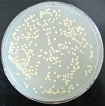
Ann. 9-PCD (Overall Performance): Application
PTFE-tube, length: 200 cm
Inner diameter: 2 mm
7-10 oct. 2015
Quantified amount of reactiv. sheep blood
Quantified number of Enterococcus faecium
Quantification of test organisms after elution
Acceptance criteria *:
  Visual cleanliness
  Guide value: RF ≥ 9
  Alarm range: 8 ≤ RF < 9
  Limit value: RF < 8
* DGKH, DGSV, DGVS, DEGEA und AKI: Leitlinie zur Validierung maschineller Reinigungs-Desinfektionsprozesse zur Aufbereitung thermolabiler Endoskope. ZentralSteril 2011, Supplement 3

Slide 15
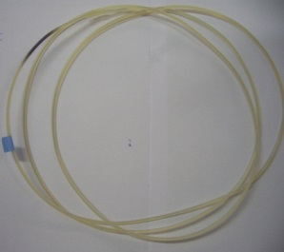
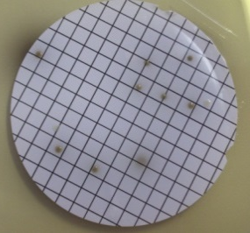
Ann. 9-PCD: Analysis
Check of visual cleanliness
7-10 oct. 2015
or
Determination of endpoint
filling with liquid agar
Elution
of PCD
and
optional
Filling
with liquid agar
Membrane filtration
of the eluate
Serial dilution of eluate

Slide 16
Ann. 9-PCD: Chacterization
The „Method Group“ conducted several Round-Robin-Tests to characterize the PCD model
7-10 oct. 2015
6 Participants
number of PCD in each lab n=3
RR-mean: 2,53 % ± 1,31 %
X
Usually the RR varies between 0,1-2 %
Zühlsdorf B., Martiny H.:. J Hosp Infect 2005(59): 286-291
Zühlsdorf B., Kampf G., Floss H., Martiny H: J Hosp Infect 2005 (61): 46-52
X out-layer
(insufficient coagulation of blood)

Slide 17
where we are going…..
The guideline was issued in autumn 2011
The given Guide value (≤ 800 µg PCD⁻¹) refers to a maximum protein content of 6.4 µg/cm² instrument surface (Alfa et al. 1999 *)
This is “1999-State of the Art”
Thermostabile MDs: actual maximum value of 3 µg cm⁻²
There is an urgent need for actual “State of the Art”-data about residual protein content
after endoscope reprocessing
7-10 oct. 2015
* Alfa M.J., Degagne P., Olson N.,1999: Worst-case soiling levels for patient-used thermolabile endoscopes before and after cleaning. Am J Infect Control 1999; 27: 168-177

Slide 18
….where we will be in December 2015 and beyond
7-10 oct. 2015
The Guideline Group initiated a Field-Study together with 5 companies in Germany, which manufacture PCDs and which validate WD-processes for flexible endoscopes.
The 5 companies collect their data on residual protein contents in PCD and report this to the guideline coordinator of DGKH
Data are collected from April to September 2015 (6 month period)
Data encompasses results of Ann. 8-PCD and alternative PCD models
Within the first 3 months data of 1226 Ann. 8-PCD and of 382 alternative Systems were collected
Data analysis will be ready in December 2015
Acceptance criteria will be adjusted
Revision of the German guideline is planned for 2016

Slide 19

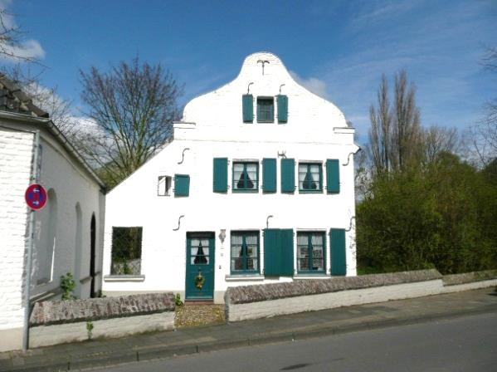
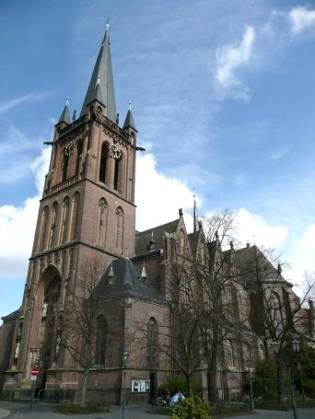
Thank you for your interest and attention…..
7-10 oct. 2015
Dr. Markus Wehrl
wfk – Cleaning Technology Institute e.V.
Campus Fichtenhain 11
47807 Krefeld
Germany
++49-2151-8210-170
m.wehrl@wfk.de

