Slide 1
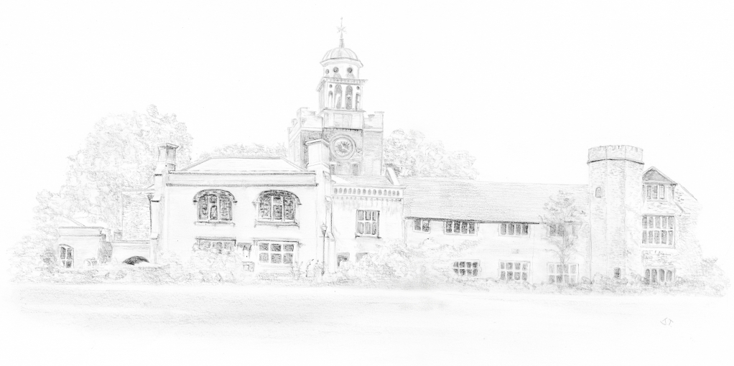
Putting Science
into the new U.K. guidelines
David Perrett
Professor of Bioanalytical Science
Barts & the London School of Medicine & Dentistry
Queen Mary University of London

Slide 2
vCJD appeared in 1996 in U.K.
Most probably came via consuming abnormal prions in BSE infected beef
230 confirmed cases worldwide (Sept 2015)
177 cases in the UK (all dead)
>2050 cases of all forms of CJD since 1990)
Prions adhere very strongly to stainless steel and are not removed by standard decontamination and sterilising procedures
CJD and vCJD has been transmitted via surgical instruments
and blood transfusions
Alzheimer’s disease has also apparently been transmitted
(Collinge et al. Nature Sept 2015)
© Professor David Perrett

Slide 3
vCJD
One vCJD carrier in every 2000 appendices analysed to August 2012 DH data BMJ Sept 2013
Infective dose is about 1000 prion molecules
These suggest that vCJD could self perpetuate in the UK
© Professor David Perrett

Slide 4
1999 – Dept of Health (England) assembled a Research Group on vCJD transmission
Identified need for research into
Present status of decontamination in SSDs
Evaluate protein detection
Investigate practices in hospitals AND general dentistry
Improve instrument design for better cleaning
The research spend to date approx. €25M
© Professor David Perrett

Slide 5
Sterilisation = Decontamination
X
We must reduce the prion risk
However PrP^{sc} is very hydrophobic with a remarkable affinity for stainless steel
There is no routine sensitive assay for vCJD in blood or on surgical devices
So DH working group concluded that we need to study total protein
© Professor David Perrett

Slide 6
Defining the Challenge

Slide 7
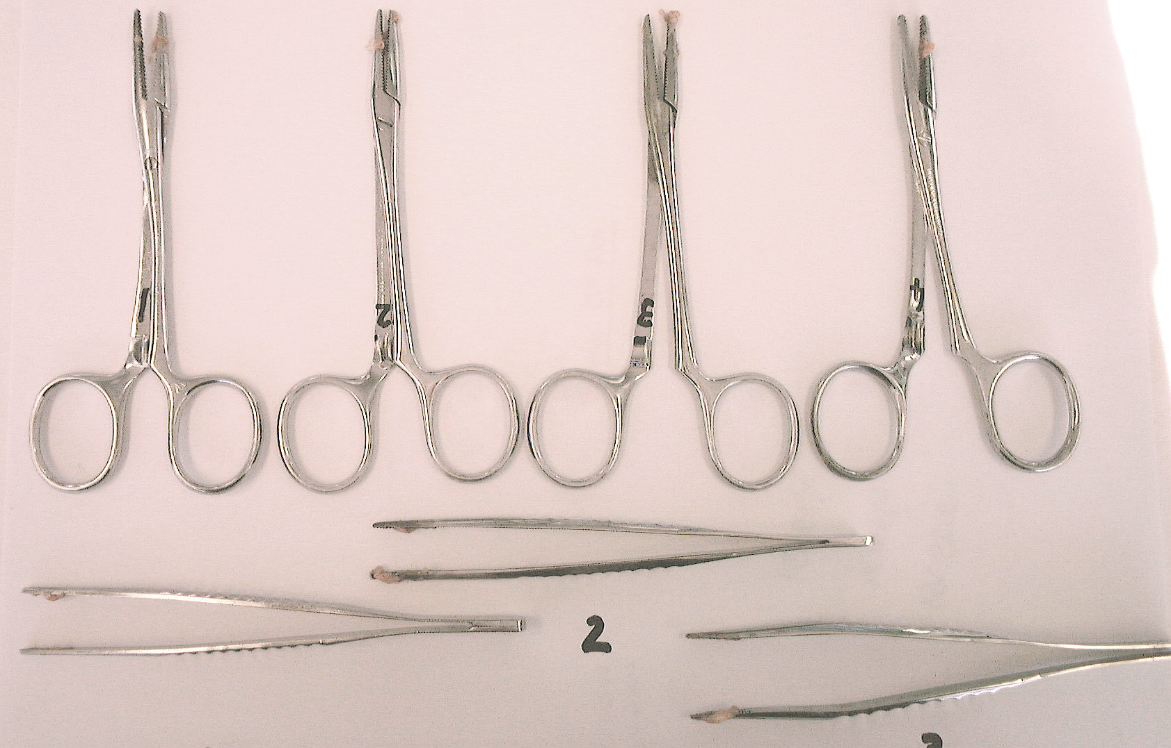
Instruments after chopping Brain Tissue (Wet)

Slide 8
The PROBLEM
Instrument (n=4) Mass (mg) of Tissue added
Kidney Brain
(wet) (dry) (wet) (dry)
Surgical Blade 5.7±2.4 2.0±0.8 48±8 12±1
Forceps 60±45 8.6±13.4 33±32 15.8±15
Tweezers 12±6 1.9±0.9 43±16 14.3±5
Mass (µg) of Protein equivalent
Blades 1140±120 2000±800
Forceps 3000±2250 3300±320
Tweezers 600±300 4300±16 00

Slide 9
The Problem in Hospitals
2003 DH (England) randomly collected instrument trays ready for operations from 25 English hospitals
Residual protein analysis was performed in 5 different laboratory using 5 different methods
I used extensive solubilisation in laboratory detergent followed by OPA/thiol fluorescent assay of the desorbed proteins
© Professor David Perrett

Slide 10
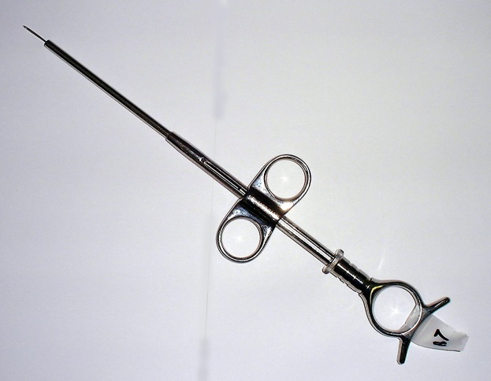
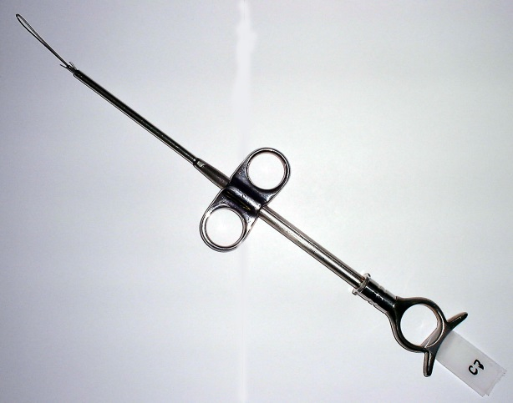
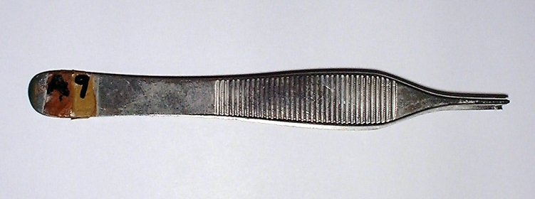
Total Residual Protein
Some Barts data
µg/instrument
© Professor David Perrett

Slide 11
National Decontamination Survey
Quality classification of CSSDs in NHS in England
Initial
Follow-up
NHS Estates Decontamination Report 2001

Slide 12
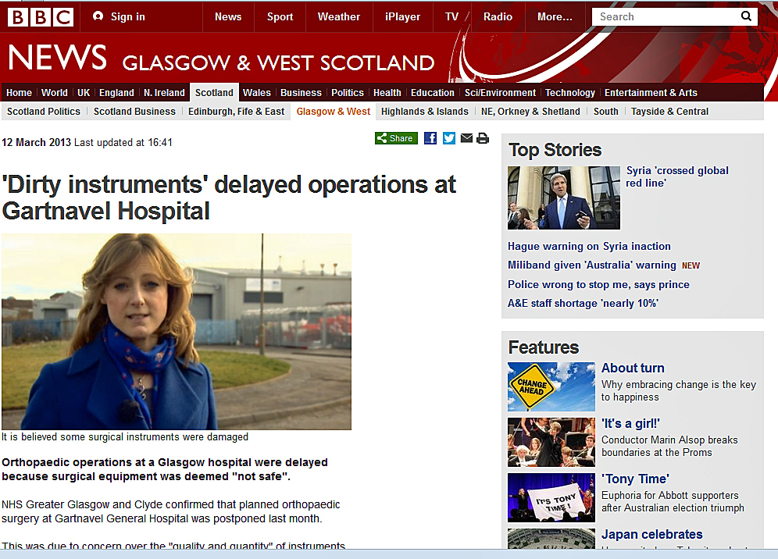
© Professor David Perrett

Slide 13
So why the failings:
If guidelines were
being followed?

Slide 14
Protein released from SSD visually clean and QC failed instruments
Passed Mean mass on Instrument = 40.1µg
Failed Mean mass on Instrument = 49.2µg
N =20 in each group
Visually clean does not mean protein-free

Slide 15
ISO / EU protein test chemistries
ISO 15883-1:2009 annex C
Test methods for the detection and assessment of residual proteinaceous contamination
Methods are
By swabbing followed by
Ninhydrin
Biuret as BCA
By solubilisation in SDS
Followed by OPA/thiol (DMMEA) with spectrophotometric measurement
© Professor David Perrett

Slide 16
Off-instrument testing
ISO 15883-1:2009 part C.3.3.1.2 requires that about 10 cm² of an instrument is swabbed with water wetted swabs for a few minutes prior to testing with recommended chemical tests
Swabbing 10 cm² in itself is a challenge!
Swab with what?
For how long?
Tend to swab visually dirty area not necessarily protein
© Professor David Perrett

Slide 17
Efficiency of removing proteins with Rayon swabs wetted with two different solutions
 | Water | 0.5% Triton X-100 | Swabbing
Bovine Serum Albumin (BSA) A water soluble protein | 32 ± 4% remaining | 20 ± 3% remaining | 10-15 strokes
Fibrinogen A hydrophobic protein | 61 ± 5% remaining | 24 ± 3% remaining | 10-15 strokes
n = 6
We swabbed where we knew we had placed the protein!
Nayuni N, et al. (2013) A critical evaluation of ninhydrin as a protein detection method J Hospital Infection 84 97-102
© Professor David Perrett

Slide 18
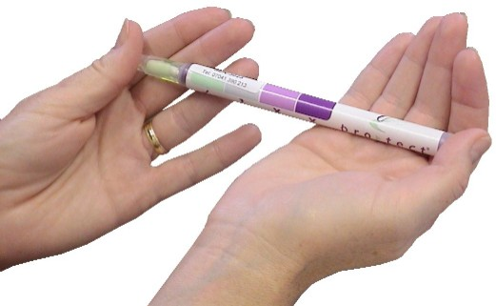
Ninhydrin based testing is one “standard”
to monitor protein removal in SSD
Cost £180 per 100 tests
© Professor David Perrett

Slide 19
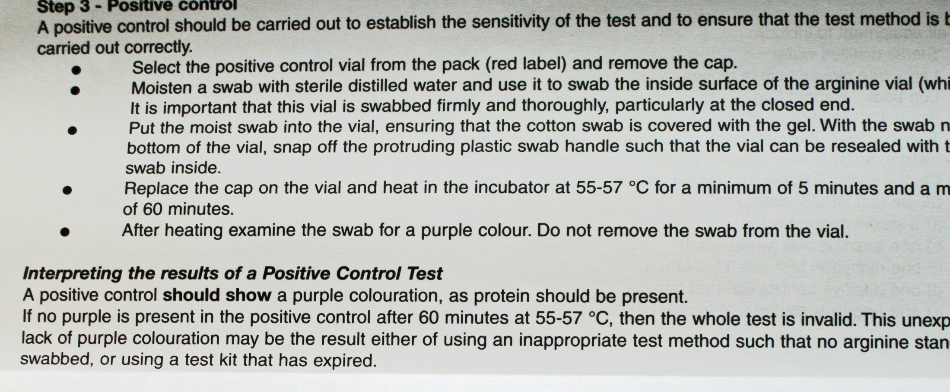
Positive control is not a Protein!
© Professor David Perrett

Slide 20
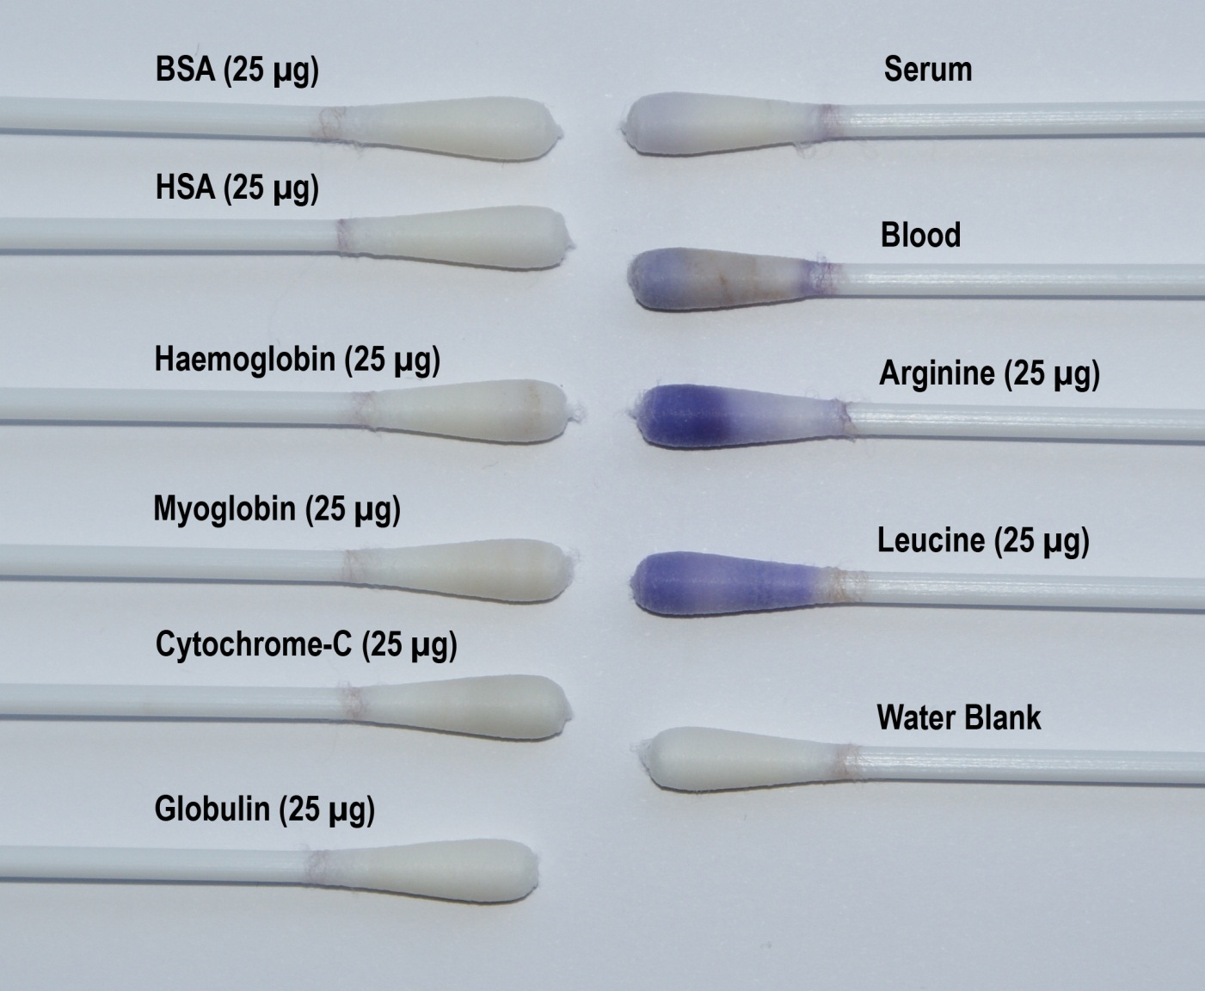
Ninhydrin Test - Different Proteins and Bio-fluids
Nayuni N, et al. (2013) A critical evaluation of ninhydrin as a protein detection method J Hospital Infection 84 97-102
© Professor David Perrett
Notes:
20

Slide 21
So we studied
other available test chemistries

Slide 22
Commercial test kits for residual proteins available in U.K.
Chemistry | Mode | Trade Name | Supplier | Sensitivity (µg BSA)
Copper binding + complexation | BCA | Pro-Test-Q | Medisafe | 1
 | BCA | Clean-Trace protein | 3-M | 3 – 50 Depending on temperature and time
 | BCA | Medi-check residual protein test | Hygiena | 1 – 10 Depending on temperature and time
Dye binding | Pyrogallol Red + Molybdate | Pyromol Test | Pereg GmbH | 1
 | Coomassie Brilliant Blue (Bradford Assay) | Scope Check | Valisafe/Medisafe | 1
 |  | Denta Check | Valisafe/Medisafe | 1
Ninhydrin | Ninhydrin | Ninhydrin Protein Detection Test | Browne (Steris) | na
Haemoglobin |  | Haemostik |  | na
Bioluminescence | ATP |  |  | na
Sensitivity taken from manufacturer’ s publications

Slide 23
Bradford (Coomassie) test kit
look for protein turning the solution blue
- 8 4 2 0.8 µg
© Professor David Perrett

Slide 24
Validation of AWDs in UK
A qualified test engineer applies a test soil to some instruments,
then runs a washer cycle and then checks for residual protein
Browne’s soil
Add water to powder, shake vigorously
and apply to the test load with a brush
Dry for 30 min at RT, wash with normal procedures then inspected for residual soil. The soil’s bright red colour allows easy identification of areas not properly cleaned
Non-toxic; contains no blood products
Edinburgh soil
100ml Fresh egg yolk
10ml Defibrinated horse blood
2g Dehydrated hog mucin
Dry on, wash and then test with…
ninhydrin
© Professor David Perrett

Slide 25
U.K. Government’s working group on Decontamination of Reusable Surgical Instruments concluded that the present methods for protein detection on reusable instruments are not fit for purpose.
Methods need to be some 100x more sensitive and detect proteins on the total instrument
Realistically this is only possible using fluorescence

Slide 26
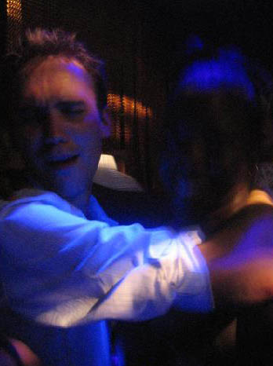
Fluorescence
Compared to colorimetric measurements
is more 1000x more sensitive
is many fold more specific
but it needs intense light
sources often lasers
© Professor David Perrett

Slide 27
In situ protein detection technologies funded by DH (England) in 2010
University. | Clinical Centre | Chemistry (Technology) | Sensitivity | Notes.
Barts QMUL. | GOSH and UCHL (London). | OPA/NAC (CCD imaging) | Detection at levels <50 ng/ml.
University of Southampton. | Southampton General Hospital. | SYPRO- Ruby Thioflavin, (EDIC/EF) | 10 pg/mm² for total protein. 400 pg/mm² for amyloid. | Dual scan with amyloid specific stain.
University of Edinburgh. | Royal Infirmary Edinburgh | FITC (EFSCAN). | 100 attomoles/ mm^{2.}
OPA/NAC = o-phthalaldehyde / N-acetyl – L-cysteine;
EDIC/EF = episcopic differential interference contrast / Epifluorescence;
EFSCAN = fluorescence scanning of FITC fluorescein Isothiocyanate

Slide 28
My system combines
OPA/N-Acetyl-cysteine a fluorescent reagent
with
CCD visualisation
with
2-D & 3-D quantitation
to
detect residual proteins in situ
2011 Concept and design patented by my university (QMUL)
A licence was granted to Synoptics Cambridge UK
© Professor David Perrett

Slide 29
OPA/NAC Reagent for Proteins
Fluorescence ex 350nm Em 450nm
© Professor David Perrett
Notes:
29

Slide 30
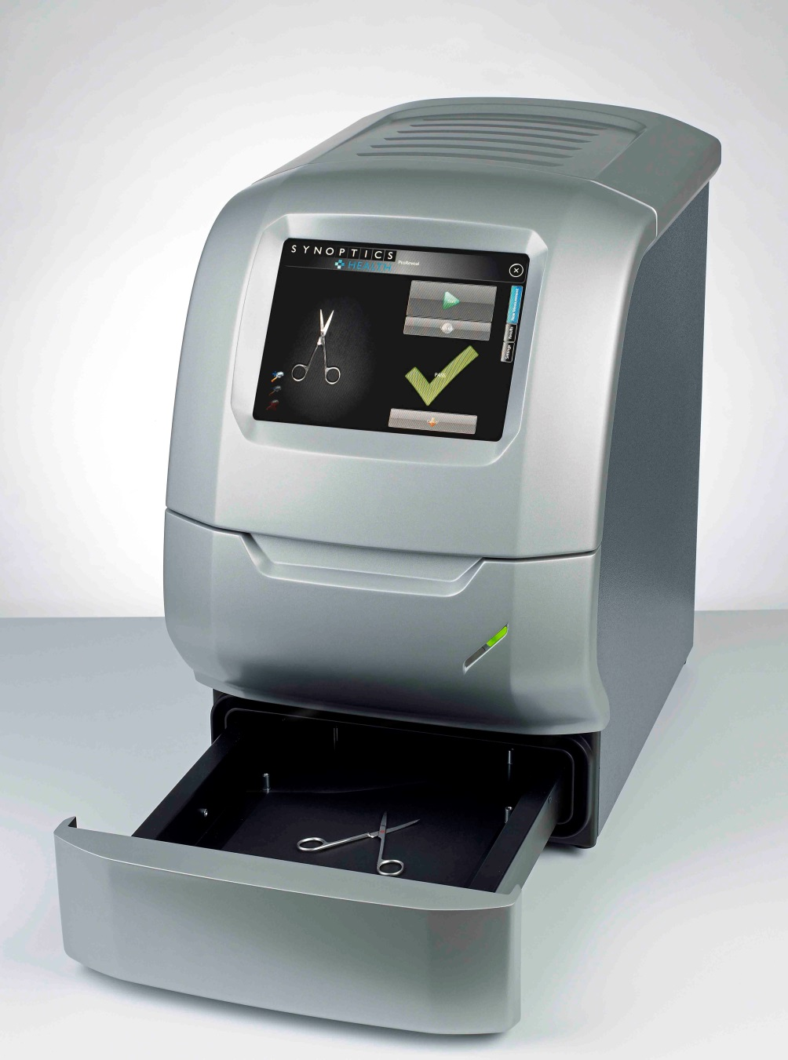
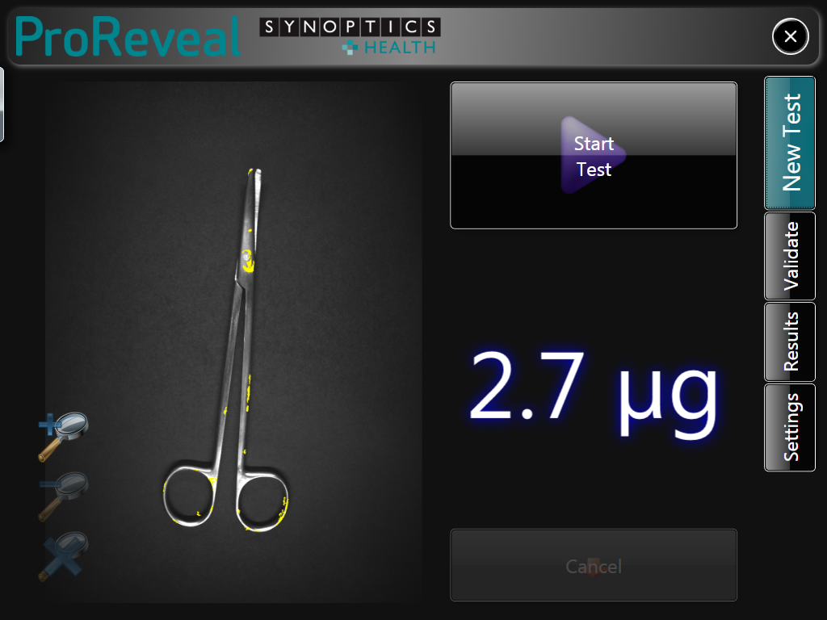
ProReveal - 2015

Slide 31
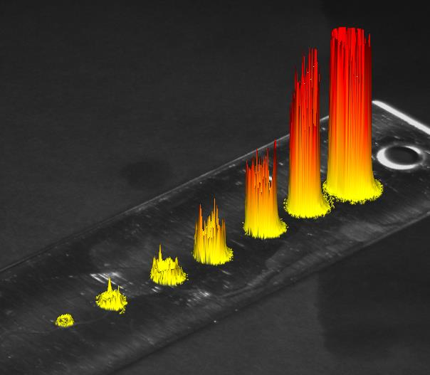
Typical BSA protein standard calibrant
8 µg
4 µg
2 µg
1 µg
0.5 µg
0.25 µg
0.125 µg
LoD (Sensitivity) 50ng/spot
© Professor David Perrett

Slide 32
Typical ProReveal Image
Total protein /side = 5.3µg
pg/mm² = 30.3pg

Slide 33
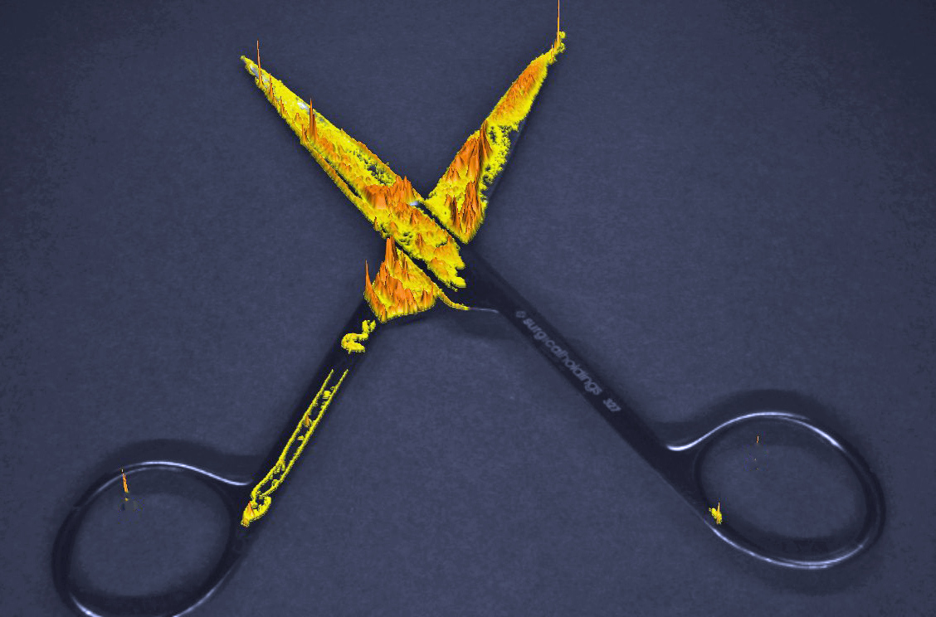
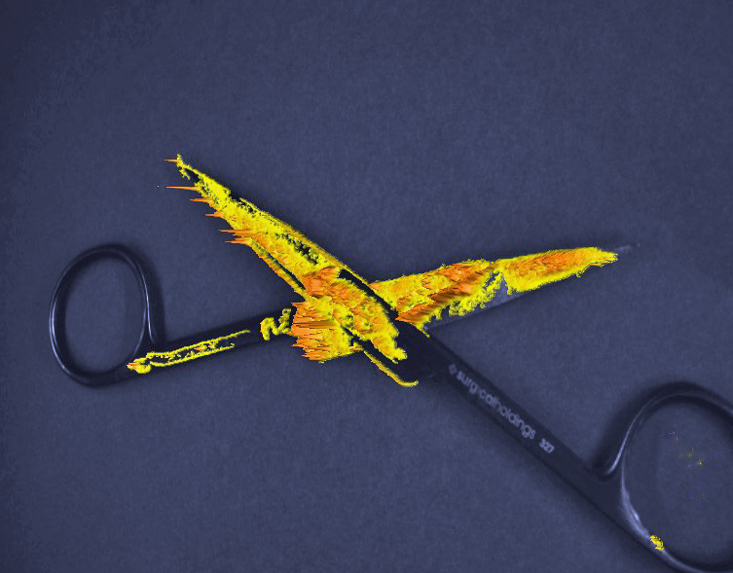
Reproducibility of ProReveal
Same pair of washed then sprayed scissors repeatedly placed
in system and imaged
Partially open (n=8)
Fully open (n=6)
Mean 26.11 21.85
SD 0.90 0.55
CV 3.45% 2.54%

Slide 34
Typical results using brain spotted SS tags
with alkaline wash in an AWD
BAKED - post wash
Brain spotted SS tags - pre-wash
48 H AIR DRIED - post wash

Slide 35
Quantitative Data

Slide 36
Studies on allowing post- operation drying
ALKALINE (Dry)
ALKALINE (Moist)
ENZYMATIC (Dry)
ENZYMATIC (Moist)
© Professor David Perrett

Slide 37
Titanium Eye Set
Washed in outsourced SSD using detergent X
Washed in SSD C using enzymatic detergent
Total Protein shown = 158 µg
Total Protein shown = 0.8 µg
© Professor David Perrett

Slide 38
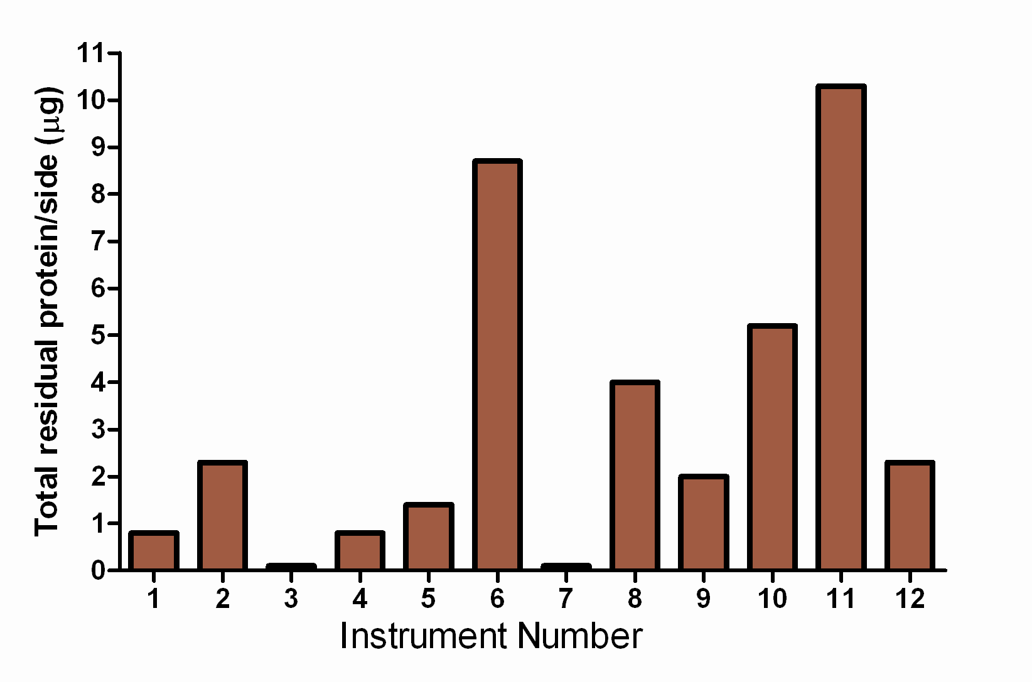
Setting limits Eye set (dry µg/side)
© Professor David Perrett

Slide 39
Optimisation of Automatic Washer Study
© Professor David Perrett
Notes:
39
Three years ago the Department of Health funded myself and colleagues to investigate the performance of detergents and AWDs from first principles.

Slide 40
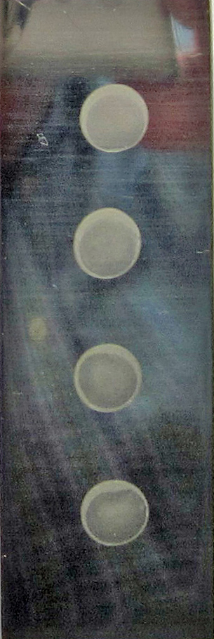
ValiPro Tag
Cleaned, polished 316L stainless steel tag
Size of standard microscope slide
i.e. 26 x 76mm
Accurately pipetted 80 µL spots of 10%
brain homogenate in PBS
(equivalent 40 µg protein or 1 µg/mm²)
Proteins annealed to the SS at 75ºC
for 1 hour
Q.C. tested
The system is designed so that a wash in RO water in a laboratory sonic bath removes about 50% of the annealed protein
© Professor David Perrett
Notes:
First I had to invent a simple system that could be used to quantitatively measure the performance of the test conditions. So the Pro-Tag system was developed. It is a simple device the size of a microscope slide to which we anneal spots of brain homogenate. I have some with me.

Slide 41
Methods
3000 tags were washed using alkaline, enzymatic, neutral detergents and water in a specially modified Getinge AWD
Many combinations of conditions e.g. temperature, time, detergent concentration, dictated by a Design of Experiments programme
Following washing residual protein on each tag was quantified using ProReveal
Results were re-analysed in the DoE package to generate optimal washing conditions
Optimal conditions were then applied to 240 contaminated instruments

Slide 42
Summary of washing efficiency
Data is mean ± SD for a whole group (n = 60 instruments) in each study
% residual protein
Water alone 1.14 ± 2.8
Alkali 0.63 ± 0.6
Non-ionic detergent 0.44 ± 0.88
Enzyme 0.44 ± 0.48

Slide 43
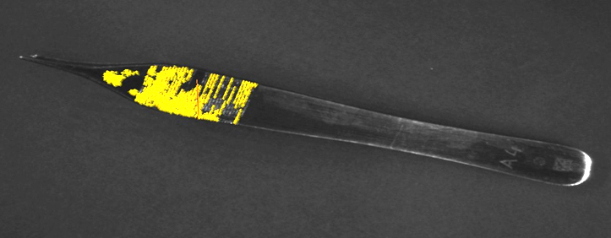
Randomly chosen images of optimally washed instruments
Water washed forceps 4A
Alkali washed forceps 4A
Non-ionic washed forceps 8A
Enzyme washed forceps 17A

Slide 44
Tri-Lab study
The three centres (St Barts / Edinburgh & Southampton University.
Test specimens
Reusable Instruments decontaminated under controlled conditions.
Instruments decontaminated by SSDs thought to be compliant with current CFPP guidance.
Single-use instruments not subject to decontamination procedures.

Slide 45
Total Residual Protein on 150 instruments from 6 hospitals

Slide 46
Main Findings
All three groups/technologies gave similar results
Data for similar instrument types submitted by each group, then a normal (Gaussian) distribution of residual protein was apparent
London and Edinburgh found residual protein that 10-20% instruments had unacceptable high levels
Such statistical sound results mean that further calculations are possible

Slide 47
Implications for SSD use?
Sampling procedures? – essentially instrument of a common type drawn from sets
Trend analysis? – we can exert downward pressure on protein levels?
Use of RAG tests etc. – relatively easy to establish at local level but national standards may be difficult
Care needed on operational risk control (e.g. keeping instruments in sets)
At present instruments subject to re-washing after testing
Use of soil testing can be avoided

Slide 48
Some basic facts
Some 1000µg of protein are on a dirty instrument
1ng of residual contamination may carry 10³ infectious units (Weissman assays)
Infection requires about 10³ prion proteins
Validated steam sterilization gives a reduction factor of ca. 10³ (Fernie Edinburgh)
1 in 2000 people are vCJD carriers
New technologies can detect <50ng of residual protein
So what residual protein contamination levels will give meaningful risk reduction?
Working Party set this challenge to epideminologists
Dr Nigel Tomlinson (DH) and Dr Andre Challet (PHE)

Slide 49
The science outlined here today along with the Tomlinson/Challet calculations has informed a significant updating of UK guidelines
The Advisory Committee on Dangerous Pathogens (ACDP), an official DH of Health body, issued new guidance in May 2015

Slide 50
ANNEX C of ACDP guidance 2015
GENERAL PRINCIPLES OF DECONTAMINATION AND WASTE DISPOSAL
provides information on the general principles of decontamination and waste disposal for transmissible spongiform encephalopathies (TSEs)
www.gov.uk/government/uploads/system/uploads/attachment_data/file/427855/Annex_C_v3.0.pdf

Slide 51
So how clean is clean?
Maximum residual protein - 5µg total per instrument side
Units are BSA equivalent
Lower limits needed for neurosurgical instruments
SSDs can develop their own QC for each AWD based on a cohort of some 20 instruments tested at least weekly
Time post-operation should not exceed 1 hour
Using new technologies for residual protein quantitation is encouraged
Now they have to be adopted in SSDs.
Instructional guidance updating CFPP0101 & HTM 2030
will be published in spring 2016

Slide 52
Summary
New protein detection tests make progress possible
SSDs can routinely produce very clean instruments
Uncertainties over removal characteristics of the PrP^{sc} molecule remain
General upper limit of 5µg per instrument side is likely to give meaningful risk reduction

Slide 53
Thanks to
The late Prof Don Jeffries (Chair of DH Decon Group)
All members of the DH Decon Working Group
The teams at the various SSDs we’ve worked with
Alasdir at Synoptic Health for his programming
DH for funding all this
Thanks to you for listening

