Slide 1

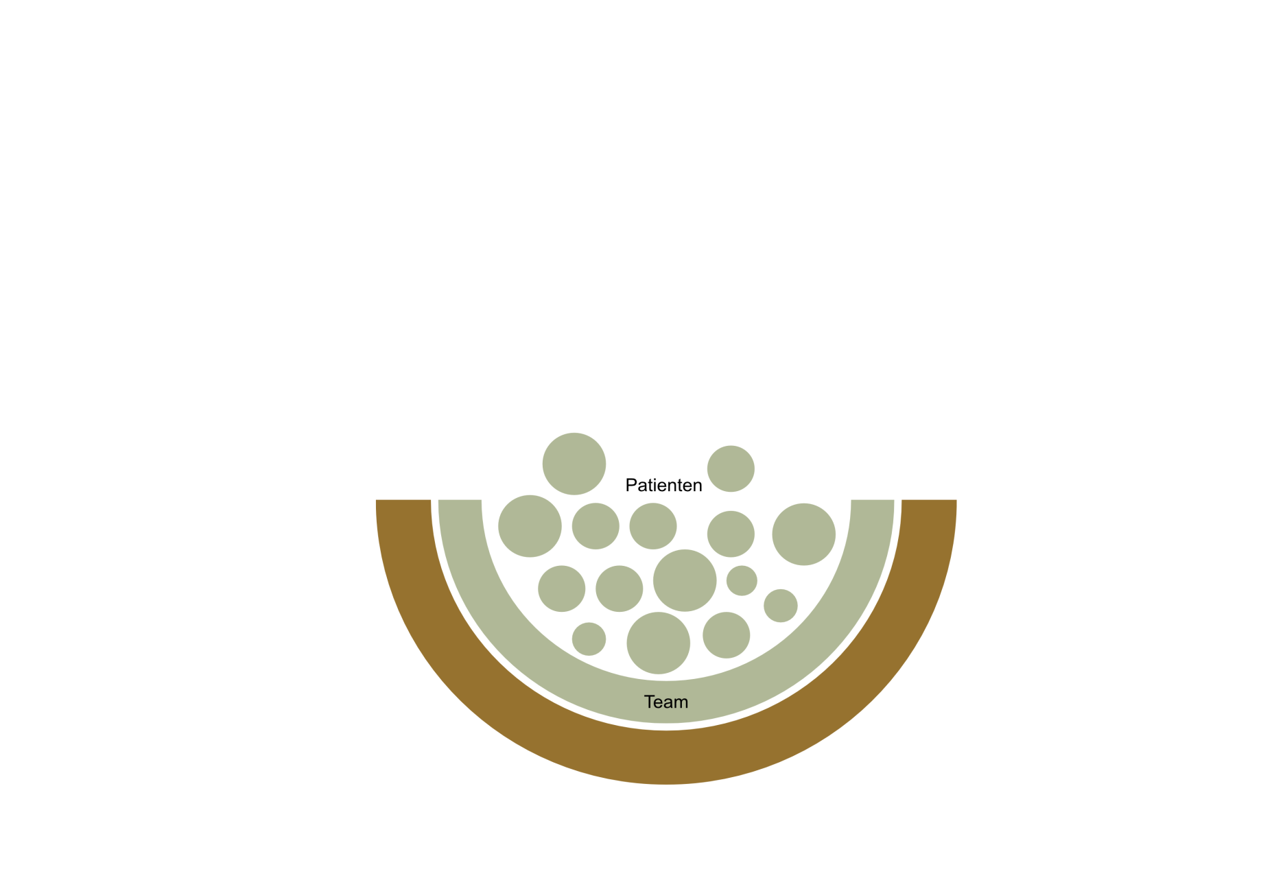
The role of the patient in a multidisciplinary team - the patient is “in"
Nothing is more powerful than an idea
which time has come.
Victor Hugo

Slide 2
My personal experience
Prevention of infection begins in
one own‘s mind
and
Knowing the problem is the beginning of
quality assurance

Slide 3
Main sources of HAI in Health-care facilities
Viable sources of infections Inanimate sources of contamination
Patient
Hands
Oral cavity
Vest. nasi
Blood
Skin
Faeces
Visitors, staff
Hands
Vest. nasi
Resp. track
Clothing
Water
Points of use
Sink
water tap
Med. Device
Surface
touched
dust
aerosol
exposed
surfaces
Notes:
3
3

Slide 4
Traditionally, HCWs Dominate the Management of Infection Control
So far, most infection prevention strategies have been addressed to HCWs, and in particular to infection control doctors and nurses.
Aside of guidelines targeting behavioral aspects, the implementation of “universal precautions” is in the emphasis of the daily work, including barrier nursing, hand hygiene, disinfection of surfaces close to the patient, safe reprocessing of medical devices, use of laundry, and antibiotic stewardship.
Universal precautions are supported by structural aspects of hospital building, safety of water and food, efficient facility management, and immunization of HCWs.
However, globally, we have no guidelines to involve the patient into the prevention of infection.

Slide 5
The Unexploited Resource “Patient”
Even if all universal and special precautions are regulated based on evidence-base, and are correctly implemented, the risks of transmission caused by patients themselves remain unconsidered.
The patient himself may become both, target and transmitter of HAIs, if basic knowledge on infection prevention is lacking.
Because of the major potential of this aspect, patients should be included into measure to prevent infection.
If the patient acquires a basic knowledge on how he can contribute to his self-protection against contracting HAI, he will not only implement this, but he will feel safe. By doing so, his confidence in the healing process will be fostered.

Slide 6
Motivating Patients
No patient wants to set himself at risk of acquiring a HAI. However, often the basic knowledge required for self-protection from HAI is neither thought at school, at home, or in the media.
Therefore, the hospital must take the patient on board to support him to prevent HAI himself.

Slide 7
Information and Education
First, the patient must be included into measures able to contribute towards his own protection against HAI.
This, however, requires educating the patient. He will always show compliance if he is included as important partner during his treatment, including prevention of HAI.
Only the "responsible" patient can actively participate in preventing "his" infection.

Slide 8
Our First Experiences
Our first results demonstrate how the patient may be successfully introduced into his own protection against HAI.

Slide 9
Prerequisites
Understandable, compassionate language of the medical team is the chief requirement that allows the patient to actively participate in measure to prevent HAI in himself.

Slide 10
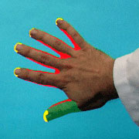
Importance of Hand Hygiene
Hand hygiene is generally considered to be the
most
important measure to prevent the spread of HAI

Slide 12
the Five Moments for
Patient Hand Hygiene
When entering the room
When leaving the room
Before intake of food
After using the washroom (WC)
Before and after contact with his own wounds and mucous membranes

Slide 13
Hand hygiene was even
Effective in Public Institution
Hand rub was only used at work - the intervention group were instructed how to use the hand rub and advised to use it at least five times daily, especially after toilet use, cleaning nose, before eating and after contact with ill colleges, customers, and archive material without supervision
Hübner, Hübner, Wodny, Kampf, Kramer. Effectiveness of alcohol-based hand disinfectants in a public administration: impact on health and work performance related to acute respiratory symptoms and diarrhoea. BMC Infect Dis 2010, 10: 250

Slide 14
Number of Single Episodes of Illness
Symptom | Control |  | Intervention |  | OR
 | healthy | ill | healthy | ill
Common cold | 599 | 89 | 526 | 59 | 0.70*
Sinusitis | 640 | 5 | 575 | 10 | 2.23
Sore throat | 576 | 68 | 529 | 56 | 0.88
Fever | 625 | 20 | 571 | 14 | 0.77
Coughing | 579 | 66 | 538 | 47 | 0.77*
Bronchitis | 640 | 5 | 576 | 9 | 2.00
Pneumonia | 644 | 1 | 585 | 0 | 1.00
Influenza | 642 | 3 | 582 | 3 | 1.10
Diarrhoea | 607 | 38 | 576 | 9 | 0.25*
*statistically significant (χ2- Test, p < 0.05)

Slide 15
Number of Single Episodes of Absence
Symptom | Control |  | Intervention |  | OR
 | healthy | ill | healthy | ill
Common cold | 625 | 20 | 571 | 14 | 0.77
Sinusitis | 643 | 2 | 577 | 8 | 4.46*
Sore throat | 632 | 13 | 570 | 15 | 1.28
Fever | 634 | 11 | 576 | 9 | 0.90
Coughing | 627 | 18 | 571 | 14 | 0.85
Bronchitis | 643 | 2 | 576 | 9 | 5.02*
Pneumonia | 644 | 1 | 585 | 0 | 1.00
Influenza | 642 | 3 | 582 | 3 | 1.10
Diarrhoea | 637 | 8 | 582 | 1 | 0.14*
*statistically significant (χ2- Test, p < 0.05)

Slide 16
Percentage of Days on Medical Leave
Symptom | Control | Intervention | p-values
Common cold | 2.78 | 2.07 | 0.008*
Sinusitis | 0.12 | 0.34 | 0.312
Sore throat | 1.53 | 1.34 | 0.424
Fever | 0.31 | 0.25 | 0.037*
Coughing | 2.00 | 1.85 | 0.024*
Bronchitis | 0.2 | 0.39 | 0.235
Pneumonia | 0,08 | 0.00 | 0.283
Influenza | 0.12 | 0.13 | 1.000
Diarrhoea | 0.92 | 0.11 | 0.074
*statistically significant (χ2- Test, p < 0.05)

Slide 17
Education and Raising Awareness of Patients for Hand Hygiene
Poster in the hospital’s lobby calls attention to the importance of hand hygiene with emphasis to use the automatic dispensers in the lobby and at entrance to the wards with increased risk for infection

Slide 18
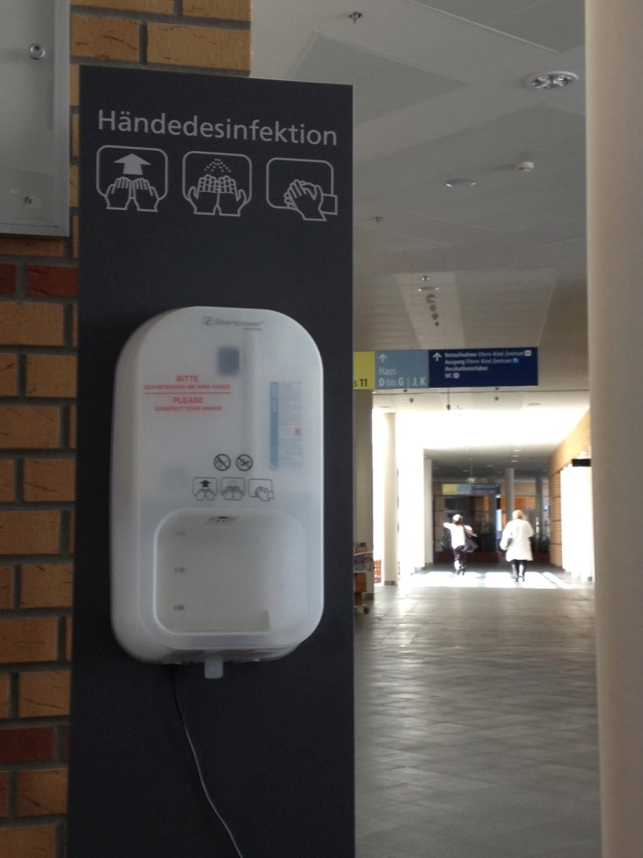
Automatic Dispenser within the Lobby of our University Hospital inGreifswald
„No chance for nosocomial infections by hand disinfection “
The hands are the main transmitters of infection. Through thorough wetting of the hands with hand rubs pathogens are killed on your hands and cannot be transmitted. Take the chance and use the readily available dispensers. The use of alcohol-based hand rubs is not affiliated with any dangers to your skin.
In addition, you should avoid recontamination of your hands with pathogens through hand contact with railings and furniture when entering different hospital areas.

Slide 19
Patient Flyer
Ad admission, each patient obtains a flyer as part of patient records. The flyer highlights the following:
Importance of hand hygiene and moments for this measure
Role of hygiene before and after WC use
Avoidance of unnecessary contacts with objects and surfaces
Information on protection measures when colonized or infected with multidrug-resistant pathogens (MRSA, VRE, Gram-negative bacteria, Noro viruses, C. difficile)
Information on how to prepare before surgery
Information for wound care and changing of wound dressings
Behavioral guidance for patients having stoma, urinary, or vascular catheters
Encouraging patients to report any anomalies during course of treatment, i.e. pain at insertion of peripheral venous catheters, postoperative pain at the surgical site, diarrhea, fever, chills

Slide 20
Visitor Flyer
If you are suffering from an infection (especially diarrhea, flu), please call prior to your visit. We will then explain the necessary protection measures
Please use the dispensers for hand disinfection before entering the patient room
Please do not sit at the bedside
If the patient is colonized or infected with MDRO, the patient and the visitors get a special instruction sheet.

Slide 21
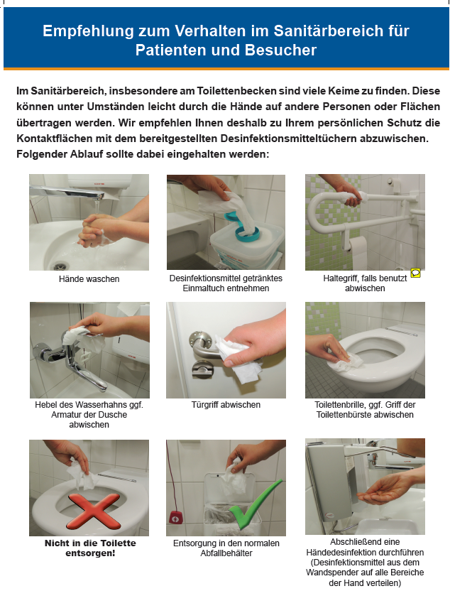

Recommendations for Patients’ and Visitors’ Behaviour in Sanitary Areas
In sanitary areas, particularly on WCs, a number of potential pathogens may be present. If your hands get contaminated, these may easily be transferred to other individuals or surfaces. Therefore, we recommend for your own safety to disinfect the surfaces with the available disinfection wipes. Please follow the depicted images below:
Wash hands
Take disinfection wipe
If used, disinfect rail
Disinfect faucets
Disinfect door knob
Disinfect Toilet seat
Do not throw wipe in WC
Discharge in waste bin
Perform a final hand disinfection after procedure

Slide 22

Check-list for Risk Assessment of Colonization/ Infection by MDRO
At admission, each patient receives the
MDRO recording sheet
If increased risk: preemptive isolation until result of microbiological samples is returned.
The target MDRO

Slide 23
The MDRO Recording Sheet
Dear Patient,
Worldwide, an increase of MDRO is noted. For your successful treatment, it is important to find out whether you could be colonized with such bacteria.
Therefore, we would ask you to answer the following questions:

Slide 24
14 Questions
Do you know if you were colonized or infected with MRSA in the past?
Do you know if you were colonized or infected with other critical pathogens in the past?
If yes, which pathogen.
Have you been hospitalized during the past 12 months in any healthcare facility?
Have you been taken care of in an Intensive Care Unit during the past moth?
Have you had contact to carriers of multidrug-resistant pathogens (accommodation in the same room) during your current stay at our healthcare facility?
Do you live in a nursing home?
Do you have a chronic wound?
Have you received an antibiotic in the past months?

Slide 25
14 Questions
9. Do you have an indwelling catheter (urinary
bladder, percutaneous endoscopic gastrostomy etc.)
10. Are you on dialysis?
11. Did you recieve dialysis or have you been
hospitalized in a foreign country during the past
year?
12. Have you spent longer than one month in Africa,
Arabian Peninsula, Asia, USA, South Europe or
Mediterranean during the past year?
13. Do you work on an animal farm?
If yes, which animals do you work with?
14. Do you undergo treatment for a chronic or serious
illness (e.g. chemotherapy, radiation therapy)

Slide 26
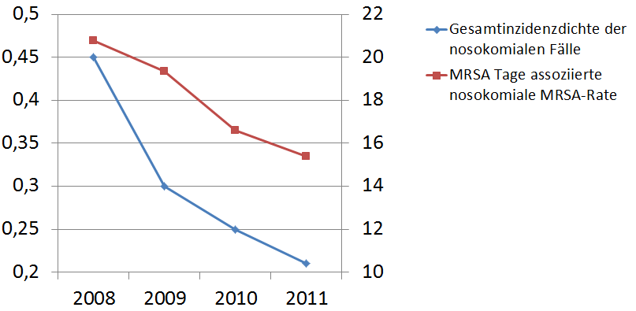
Decrease of Nosocomial MRSA Transmission within our University Hospital after Risk Adapted MRSA Screening
Number of nosocomial
MRSA cases per 1,000
MRSA days
Number of nosocomial
MRSA cases per 1000
patient-days
Kramer A et al. Die Greifswalder MRSA-Präventionsstrategie und die Rolle von POCT. In: Eiff W v. (Hrsg) POCT-Management. Medhochzwei, Heidelberg, 239-62, 2013

Slide 27
Gram-negative MDRO
Early identification of carriers with preemtive isolation has the potential to prevent outbreaks

Slide 28
Infection Prevention Check-out
Voluntary evaluation of the patient’s impression on the quality of hygiene by use of a questionnaire

Slide 29
14 Questions
Do you feel adequately informed regard hygiene?
Did you have had adequately opportunity for hand disinfection during your stay?
Do you like the provision of disinfecting wipes in your sanitary cell?
Have the working clothes of the staff been clean? (separate for doctors and nurses)
Did the staff wore rings or watches? (separate for doctors and nurses)
Was there staff with artificial fingernails? (separate for doctors and nurses)
Did staff disinfect hands before any activity was carried out on you? (separate for doctors and nurses)
Did staff disinfect hands after any activity was carried out on you? (separate for doctors and nurses)

Slide 30
14 Questions
9. Have stethoscopes been disinfected prior to
be used on you?
10. Have you been sufficiently informed why you need
to be isolated and what to consider?
11. Did staff wore protective clothing when entering
you room?
12. Have you been satisfied with the cleanliness of
your room?
13. Were door handles disinfected daily?
14. Have you been satisfied with the cleanliness of
your sanitary cell?

Slide 31
Example: Answer to Question 7
Did staff disinfect hands before any activity was carried out on you?
Difference between various disciplines in our university hospital:
Yes: 76-92 % (mean 84 %)
Not always: 8 – 24 % (mean 16 %)
No: 0-2 % (mean 0.4%)
Increase of consumption of hand rub between 15 and 40% after introduction of the Infection prevention check-out!

Slide 32
Next Planned Step – Breakfast Television
We will use the patients channel to educate him with the short film
"How can I protect myself during my hospital stay from infection - a short film for a long life”

Slide 33
Screenplay of the Patients’ Movie in our Hospital’s TV Chanel
The movie starts with the question of a patient to a surgeon before the planned operation: “Do I have any risk of contracting an infection?“
The surgeon explains that there is no zero risk for infection, only a zero tolerance towards infection control deficiencies, which is adopted by the hospital.
Short statement, that our university hospital has successful established all important measures of a multibarrier strategy to prevent nosocomial infections. These include: …

Slide 34
Implemented actions to prevent SSI
These include:
Qualified reprocessing of medical devices including beds
Comprehensive hand hygiene concept
Surface disinfection
Screening of MDRO
Antisepsis
Barrier nursing and isolation precautions
Adequate air conditioning system in the operation theatre
Professional clothing to prevent infections
Infection control and surveillance of MDRO and HAI.

Slide 35
The second aspect covers:
2. How you can the patient protect himself from contracting infection from the environment
Explanation of the efficacy of hand hygiene to prevent transmission of pathogens
Discouraging social handshakes among patients
Avoidance of unnecessary contacts with objects and surfaces in the hospital
Disinfection of hands before and after visit to the toilet, and disinfection of relevant contact surfaces in the sanitary room
Not use of personal belongings of other patients
Asking visitors and staff not to sit on patients beds

Slide 36
Special Recommendations
3. Priorities for personal behavior
No showering of open wounds with tap water without sterile filter
No opening of wound dressings to peek a look at the progress of the wound healing
Keeping the urine bag below the bladder level. The urine collection bag is not a handbag!
Avoidance of assistance from other patients. Instead, call the staff.
Rapid information if abnormalities appear during the course of treatment, i.e. pain, diarrhea, fever, chills, …

Slide 37
Behavior in Specific Areas
4. Isolation units
Follow the pictograms and instructions on the door
Ensure compliance with the protection measures recommended for you

Slide 38
Conclusion
All patients showed high levels of interest, were open-minded and welcomed their involvement in self-protection against HAI.

Slide 39

Thank for your attention!
Caspar David Friedrich

