Slide 1
Do We Have The Magical Tool To Prevent Bacterial Survival In Hospitals CHEAP COPPER ?
Notes:
Good morning everybody. It is a great pleasure to be here with all of you in the marvelous Lil. I must say that I am grateful to the WFHSS, for accepting my abstract. Today I will speak about the benefits of having the copper in the hospital environments. Shall we begin….

Slide 2
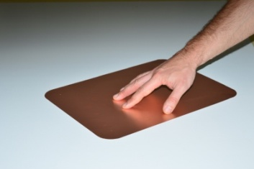
Copper
Commercially available copper protective surface labels
“IonProtect” were tested in our study.
Active material is 20μm passivated copper based alloy, laminated with self adhesive liner.
Different dimension and sizes are available, however we trimmed it by scissors according to our need.
by Arrowpack
www.arrowpack.eu
Notes:
We have made a research ….

Slide 3
Hospital Aquired Infections
Healthcare-associated infections are important wide-ranging concern in the medical field.
Infectious agents causing healthcare-associated infections may come from endogenous or exogenous sources.
Both developed and resource-poor countries are faced with the burden of healthcare-associated infections. In a World Health Organization (WHO) cooperative study (55 hospitals in 14 countries from four WHO regions), about 8.7% of hospitalized patients had nosocomial infections
Notes:
Unfortunately infections can appear everywhere, to everybody.

Slide 4
Bacterial Surviving
Acinetobacter baumannii, Hafnia alvei, Stenotrophomonas maltophilia and Pseudomonas aeruginosa are emerging as problematic opportunistic pathogens due to the rapid increase in multidrug resistance.
One critical factor for transmission of a microorganism from a patient or healthcare worker to the environment and then to an other person is the ability of that microbe to survive on that environmental surface. If the microorganism dies on the surface, then the transfer cannot occur.
Biofilm formation is an important feature of most clinical isolates allowing their persistence on colonized surfaces.
Notes:
The crucial factor is the surface. If we change the environmental surface, than there is a great chance to stop the microbes survival.

Slide 5
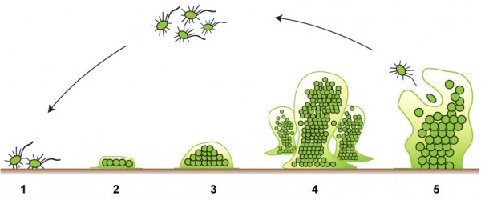
Bacterial Biofilms
Structured community of bacterial cells enclosed in a self-produced polymeric matrix and adherent to an inert or living surface. (definition by JW Costerton at the Center for Biofilm Engineering in Montana )
Bacteria first adhere to surfaces and begin to excrete a slimy, glue-like substance that can anchor them to all kinds of material
Then they build the matrix that holds the biofilm together
Notes:
The procedures of forming bacteria biofilms are as follows…….

Slide 6
Quorum Sensing In Bacterial Biofilms
During colonization bacteria begin to communicate through phenomenon called quorum sensing by emitting chemical messages
Disease-causing bacteria begin to behave as a group with a communication network
It can occur in a single species, but also in between diverse species

Slide 7
Aim Of This Study
Copper ions, either alone or in copper complexes, have been used for centuries to disinfect liquids, solids and human tissue. Today copper is used as a water purifier, algaecide, fungicide, nematocide, molluscicide, and as an anti-bacterial agent. Copper also displays potent anti-viral activity. (1,2,3)
To determine biocide effect of copper sheets against hospital acquired multiresistant strains of A. baumannii, H. alvei, S. maltophilia and P. aeruginosa.
1. Block, S. S. Disinfection, Sterilisation and Preservation 2001, 9, 1857.
2. Dollwet, H. H. A., Sorenson, J. R. J. Trace Elements in Medicine 2001, 2, 80.
3. Kuhn, P. J. http://www.copper.org/environment/doorknob.html, 1983.
Notes:
The most important thing of this study actually is the determination of the biocide effect of copper.

Slide 8
Material And Methods (Bacterial Strains)
20 strains of A. baumannii
20 strains of H. alvei
20 strains of S. maltophilia
20 strains of P. aeruginosa
Were isolated from patients admitted in different hospitals in Macedonia and Kosovo in one year period.
Strains were kept at -40oC in Laboratory for Microbiology, Diagnostic laboratories, Clinical Hospital Acibadem Sistina in Skopje, Macedonia.
Notes:
These are the materials and methods used in the research.All these

Slide 9
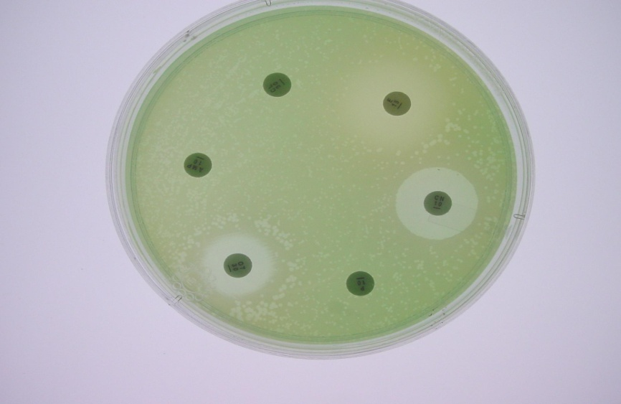
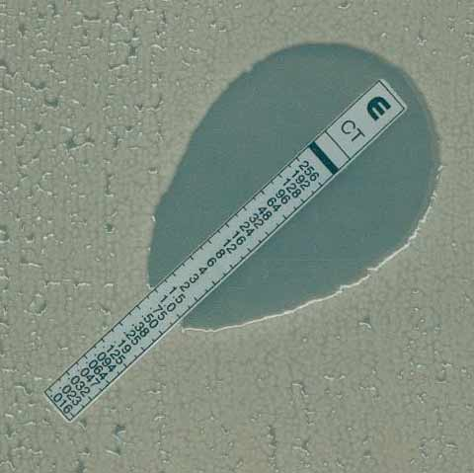
Material And Methods (Susceptibility Testing)
Antibiotic susceptibility was tested using conventional disc diffusion method (Oxoid).
An E-test for Imipenem, Amikacin, Tobramycin and Piperacillin-Tazobactam was also performed in order to determine MICs (Oxoid).
Notes:
We have also made a susceptibility testing.

Slide 10
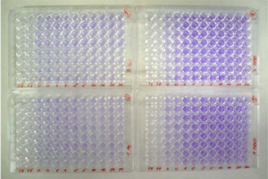
Material And Methods (Biofilm Forming Ability)
The biofilm-forming ability of each strain was classified under one of four categories: none, weak, moderate or strong, based upon OD-s of bacterial films. We defined the cut-off OD (ODc) for the micro-titer plate test as three standard deviations above the mean OD of the negative control.
Optimal density (OD) of the solution was measured at 570nm, for each well in microtiter-plate, within 24h and 48h of incubation, for each strain.
Biofilm forming ability of the strains was performed using modified microtiter-plate technique.
Notes:
We have tested the biofilm forming ability too.

Slide 11
Material And Methods (Biofilm Forming Ability)
Strains were classified as follows:
OD ≤ ODc | non-adherent
ODc < OD ≤ 2 x ODc | weakly adherent
ODc < OD ≤ 4 x ODc | moderately adherent
4 x ODc < OD | strongly adherent

Slide 12
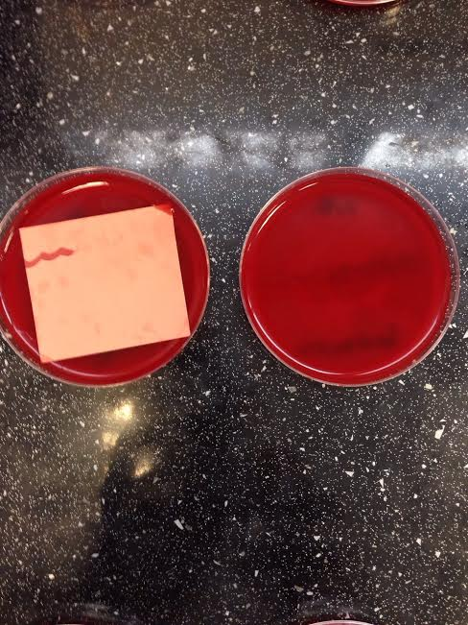
Material And Methods (Copper Biocide Activity)
All strains were then suspended in saline (0.5McFarland) and inoculated on Columbia agar plates (Oxoid).
Each strain was inoculated on two plates. One was control, second was covered with copper sheets.
Plates were incubated on 37oC over the night.
The copper leaf was removed and plates were incubated additional night.
Notes:
We have made a test that proved the cooper biocide activity.

Slide 13
Results (Susceptibility Testing)
Bacterial resistance to multiple antibiotics:
 | Ceftriaxon | Ceftazidime | Cefepime | Amikacin | Tobramycin | Imipenem | Pip-Tazobactam | Colistin
A. baumannii | 20 | 20 | 20 | 20 | 20 | 19 | 19 | 3
H. alvei | 20 | 20 | 20 | 5 | / | 2 | 2 | /
S. maltophilia | 20 | 20 | 18 | 12 | 10 | 6 | 8 | /
P. aeruginosa | 20 | 20 | 19 | 13 | 14 | 8 | 14 | /
Notes:
Here are the results and numbers.

Slide 14
Results (Biofilm Forming Ability)
 | non-adherent | weakly adherent | moderately adherent | strongly adherent
A. baumannii | / | / | / | 20
H. alvei | / | / | 3 | 17
S. maltophilia | / | / | 2 | 18
P. aeruginosa | / | / | / | 20
Notes:
These are the results of biofilm forming ability

Slide 15
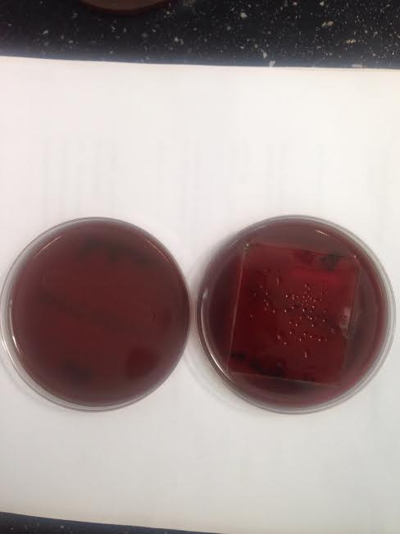
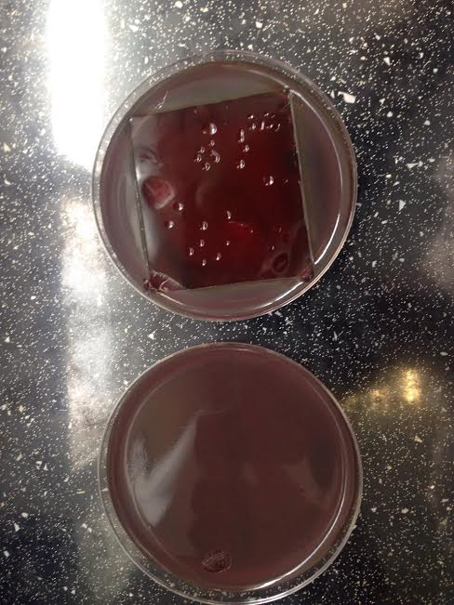
Results (Copper Biocide Activity)
Notes:
And the results of copper biocide activity.

Slide 16
Results (Copper Biocide Activity)
Placed copper sheets showed total biocidal activity against all 80 hospital acquired multidrug resistant bacterial strains.
There was total absence of bacterial growth within first overnight incubation under the copper sheets, but also total absence after additional overnight incubation even after the copper sheets was removed.
Our copper leafs showed total inhibition of biofilm formation in 65 bacterial strains that were proved to have strong biofilm forming ability, and in 5 strains with moderate ability to form a biofilm.
Notes:
These are the results…..

Slide 17
Conclusions
More research is needed on possible links between biofilm formation and patient's infection, the role of biofilm-forming ability in antimicrobial drug resistance and efforts in controlling the biofilm-related infections (identification of molecular mechanisms in regulation of biofilms)
Our goal should be to eliminate infections that arise following admission to the hospital. Infections can cause patients to remain in the hospital for a longer than expected period of time due to treatment and management of the infection. In certain severe situations an infection can cause death.
Many microbes can survive on surfaces for long times. These environmental surfaces can be involved in the transfer of microorganisms to patients and subsequently in the development of hospital-associated infections.
Notes:
At the end here are the facts that we have concluded.

Slide 18
Conclusions
Use of efficiant copper with proved biocide effect and ability to prevent forming of bacterial biofilm could prevent bacterial adherence and survival in hospital environment, especially in high-risc areas such are: operating theaters, ICUs, sterilization department, hematological patient wards, transplanted patients wards and many others.
In the era of bacterial multiresistance and panresistance we should not surrender the battle, instead we must seek for new tools to fight and prevent life-threatening infections in our hospitals.

Slide 19
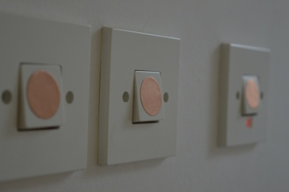
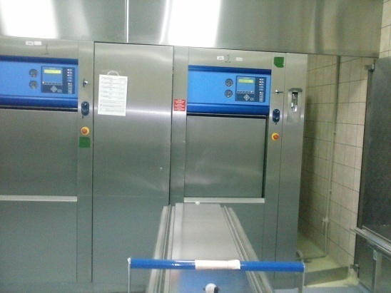
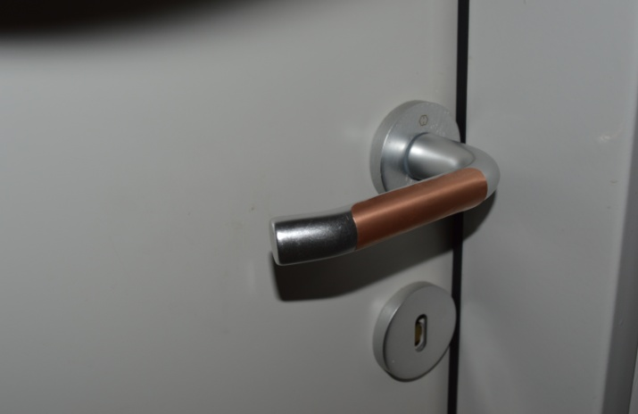
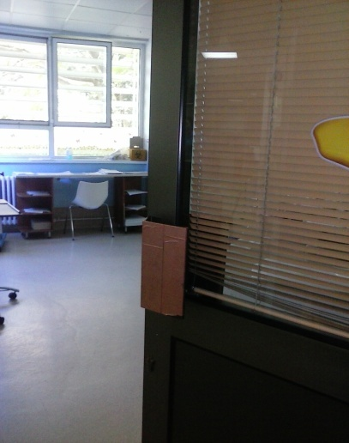
Notes:
The copper can be placed on all critical surfaces and places, as you can see.

Slide 20
The project team
Aneta Simonoska
aneta.simonoska@gmail.com
Biljana Curcic-Trajkovska
b.curcictrajkovska@gmail.com
microbiologist
Julija Jovanovska
Snezana Ujevic
Notes:
Also, these are the people responsible for the success of this project, me….Thank you all for your attention.

Slide 21
Thank you for your attention

