Slide 1
Biological indicators role in CSSD equipment qualification and monitoring
Paulo Roberto Laranjeira

Slide 2
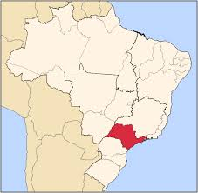
Brazil
 | Population (2010)
Brazil | 200.000.000
São Paulo State | 41.000.000
Greater São Paulo City | 22.000.000
 | Quantity
Hospitals | 9.000
Pharmeutical Industries | 823
Notes:
Introduction about Brazil

Slide 3
Orion C.E. - Brazil
Founded 1998
32 employees
12 equipment qualification teams
Certified Kaye System maintenance and calibration services
Notes:
Short presentation of my company, showing what we qualified last year.

Slide 4
Regulations and Standards
Regulations
Standards
By country;
Establishes minimum qualification requirements:
Frequency;
Load;
Responsibilities.
Requirements for load monitoring
International and local;
Qualification and re-qualification steps;
Critical normative criteria;
Informative criteria;
Load monitoring.
Notes:
Regulations must be met. They don´t tell you how to do it. Standards will help you with that.

Slide 5
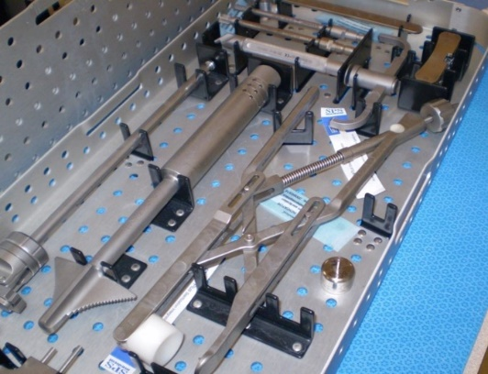
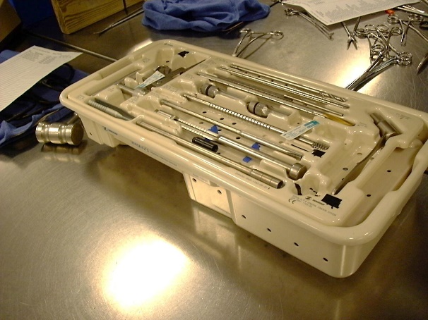
Manufacturer IFU´s
Standards
ISO 17664
ISO 11737
Standard 134ºC 4 minutes Cycle
Notes:
Manufacturer is responsible for supply a validated IFU, that will inform, among other info, if the sterilization cycle is a standard one or not

Slide 6
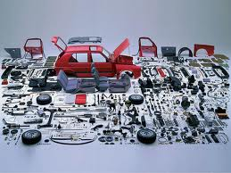
First Step
Protocols must be written and approved prior to equipment challenge
Qualification protocols
Indicators (biological, chemical and physical) protocols
CHANGE CONTROL
Notes:
Base on regulations, determine which standards will be used. Protocol must define qualification and monitoring criteria. Change control is important to determine when an equipment needs to requalified.

Slide 7
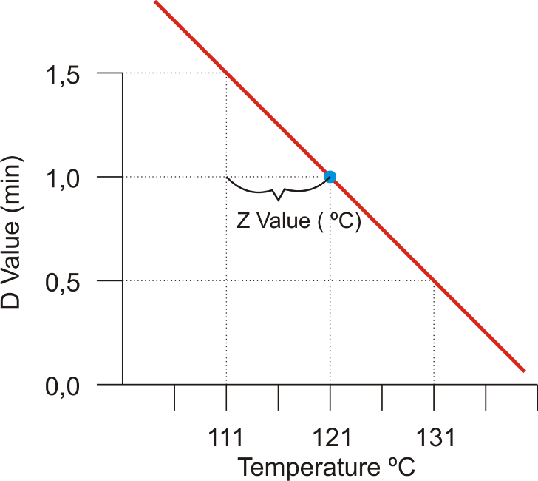
Thermal Destruction of Microorganisms
Theory:
Fo
Tref = 121ºC
D = 1 minute
Z = 10ºC
OverKill = 12 logs
1.000.000 | Log 10⁶
100.000 | Log 10⁵
10.000 | Log 10⁴
1.000 | Log 10³
100 | Log 10²
10 | Log 10¹
0 | Log 10⁰
0,1 | Log 10⁻¹
0,01 | Log 10⁻²
0,001 | Log 10⁻³
0,0001 | Log 10⁻⁴
0,00001 | Log 10⁻⁵
0,000001 | Log 10⁻⁶
1 min
1 min
1 min
1 min
1 min
1 min
1 min
1 min
1 min
1 min
1 min
1 min
12 minutes
Notes:
The sterilization will cause a logarithmical reduction of microorganisms. In theory, for every 1 minute @ 121ºC, for a Z value of 10ºC, we will have a reduction of 1 log. Total 12 minutes

Slide 8
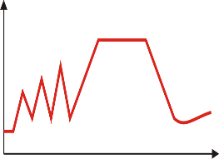
Thermal Destruction of Microorganisms
1.000.000 | Log 10⁶
100.000 | Log 10⁵
10.000 | Log 10⁴
1.000 | Log 10³
100 | Log 10²
10 | Log 10¹
0 | Log 10⁰
0,1 | Log 10⁻¹
0,01 | Log 10⁻²
0,001 | Log 10⁻³
0,0001 | Log 10⁻⁴
0,00001 | Log 10⁻⁵
0,000001 | Log 10⁻⁶
3 min
1 min
3 min
3 min
1 min
T = 121ºC
D₁₂₁ = 1,5 minutos
Z = 20ºC
T = 134ºC
D₁₃₄ = 0,33 minutos
Z = 20ºC
3 min
1 min
3 min
3 min
1 min
Notes:
For real evidence using a BI: D=1,5 and Z =20ºC, we will need 18 minutes @ 121ºC for a 12 log reduction or 4 minutes @ 134ºC for a 12 log reduction

Slide 9
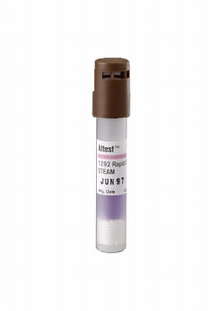
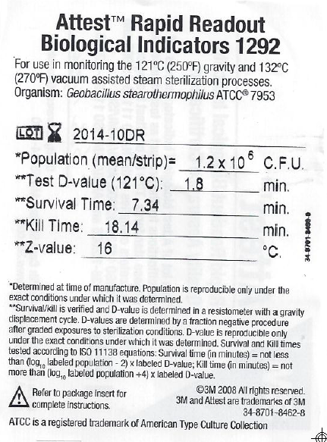
Biological Indicator – Real evidence
Fo = 1,8 * (Log 1,2 x 10⁶ - Log 1,0 x 10⁻⁶)
Fo ≈ 21 minutes @ 121ºC
Notes:
How to determine the minimal exposure time

Slide 10
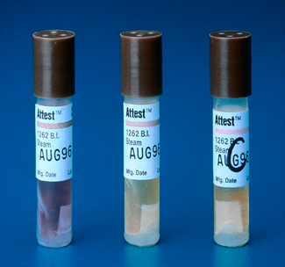
Cycle 121ºC/15 min (exposure only)
Calculated Lethality during Exposure
Tempo | Tmín. | Let. Inst. | Let. Acum. | No
16:03:30 | 100,0 | 0,00 | 0,00 | 1,20E+06
16:04:30 | 105,0 | 0,00 | 0,00 | 1,20E+06
16:05:30 | 110,0 | 0,00 | 0,00 | 1,20E+06
16:06:30 | 115,0 | 0,00 | 0,00 | 1,20E+06
16:07:30 | 121,0 | 1,00 | 1,00 | 3,34E+05
16:08:30 | 121,0 | 1,00 | 2,00 | 9,29E+04
16:09:30 | 121,0 | 1,00 | 3,00 | 2,59E+04
16:10:30 | 121,0 | 1,00 | 4,00 | 7,19E+03
16:11:30 | 121,0 | 1,00 | 5,00 | 2,00E+03
16:11:30 | 121,0 | 1,00 | 6,00 | 5,57E+02
16:12:30 | 121,0 | 1,00 | 7,00 | 1,55E+02
16:13:30 | 121,0 | 1,00 | 8,00 | 4,31E+01
16:14:30 | 121,0 | 1,00 | 9,00 | 1,20E+01
16:15:30 | 121,0 | 1,00 | 10,00 | 3,34E+00
16:16:30 | 121,0 | 1,00 | 11,00 | 9,29E-01
16:17:30 | 121,0 | 1,00 | 12,00 | 2,59E-01
16:18:30 | 121,0 | 1,00 | 13,00 | 7,19E-02
16:19:30 | 121,0 | 1,00 | 14,00 | 2,00E-02
16:20:30 | 121,0 | 1,00 | 15,00 | 5,57E-03
16:29:30 | 115,0 | 0,00 | 15,00 | 5,57E-03
16:30:30 | 110,0 | 0,00 | 15,00 | 5,57E-03
16:31:30 | 105,0 | 0,00 | 15,00 | 5,57E-03
16:32:30 | 100,0 | 0,00 | 15,00 | 5,57E-03
Fo (required) = 21 minutes
Why?
Notes:
Show that BIs don´t monitor overkill cycles

Slide 11
Kill x Overkill
Notes:
Biological indicators do not monitor overkill cycles. They are used to determine the lethality curve based on its D and Z values. Cycles should be validated using half cycle approach.

Slide 12
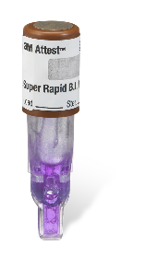
Cycle: 121ºC/15 minutes
Lethality Calculated for Tmin. > 100ºC
Time | Tmin. | Let. Inst. | Let. Acum. | No
121ºC
100ºC
50ºC
Start
END
Notes:
Expected results from indicators

Slide 13
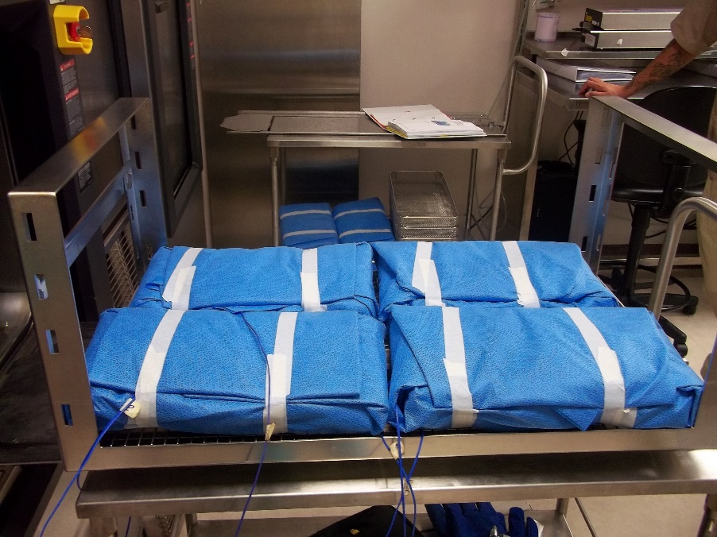
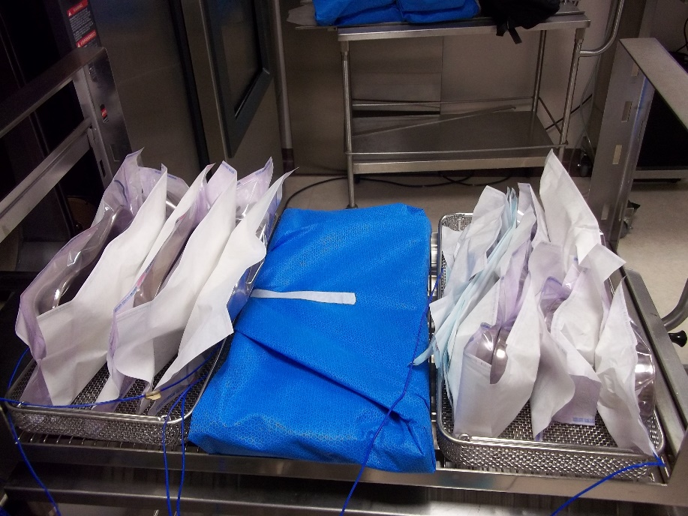
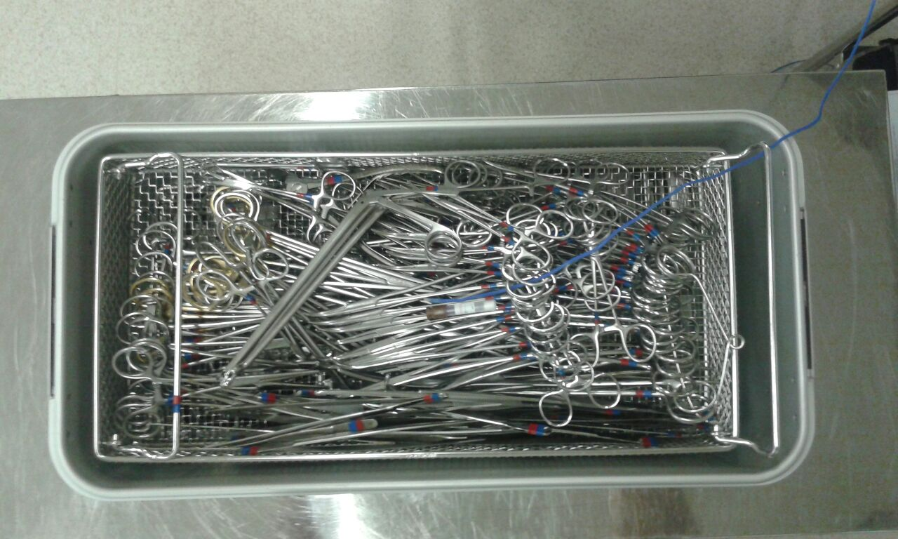
BI´s in the Qualification
Notes:
Sensors and BIs must be placed inside every single item that will sterilized

Slide 14
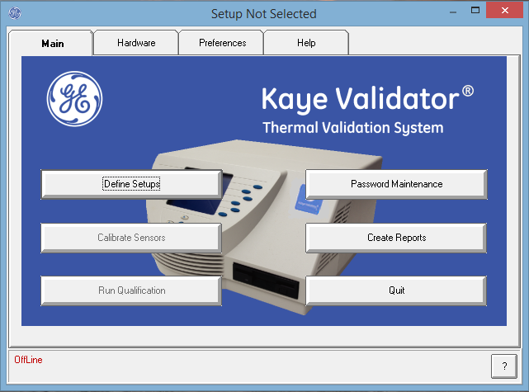
BI´s @ 134ºC/4 min Qualification
Theory Based
D₁₂₁ = 1 minute
Z = 10ºC
Tref = 121ºC
Notes:
Sample of calculations done based on theory

Slide 15
BI´s @ 134ºC/4 min Qualification
Based on BI information @ 121ºC
D₁₂₁ = 1,9 minutes
Z = 20ºC
Tref = 121ºC
Notes:
Sample of calculations done based on BI info

Slide 16
BI´s @ 134ºC/4 min Qualification
Based on calculated D₁₃₄ value
D₁₃₄ = 0,43 minutes
Z = 20ºC
Tref = 134ºC
$$D_{134}=D_{121}∗{10}^{−\frac{134−121}{Z}}$$
$$D_{134}=1,9∗{10}^{−\frac{134−121}{20}}$$
$$D_{134}=0,43 min$$
Notes:
Sample of calculations done based BI info and calculated D value

Slide 17
Integrating F0 @ 134ºC/4 min cycles
Theory Based
D₁₂₁ = 1 minute
Z = 10ºC
Tref = 121ºC
Based on BI @ 121ºC
D₁₂₁ = 1,9 minutes
Z = 20ºC
Tref = 121ºC
Based on calculated D₁₃₄ value
D₁₃₄ = 0,43 minutes
Z = 20ºC
Tref = 134ºC
Lethality = 159 minutes
Lethality = 25 minutes
Lethality = 4,96 minutes
Notes:
Results showing that teorical approach leads to a false safety margin. BI´s info used correctly will give a fairly close result to the real thing.

Slide 18
Monitoring 134ºC/4 min cycles
Sal = 1 x 10⁻⁷
134ºC
125ºC
121ºC
50ºC
Notes:
Why do we have indicators showing a valid cycle, but it has been aborted before even started

Slide 19
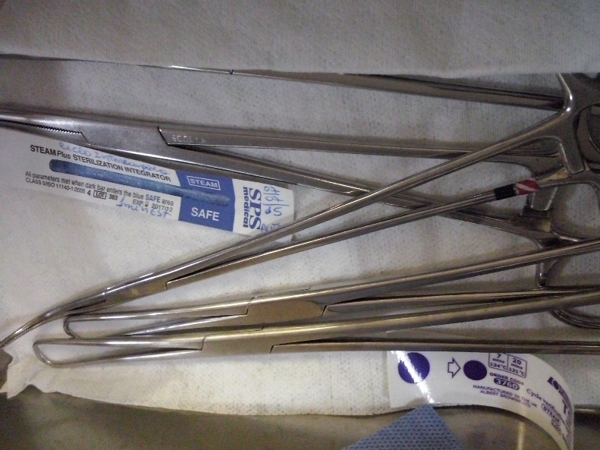
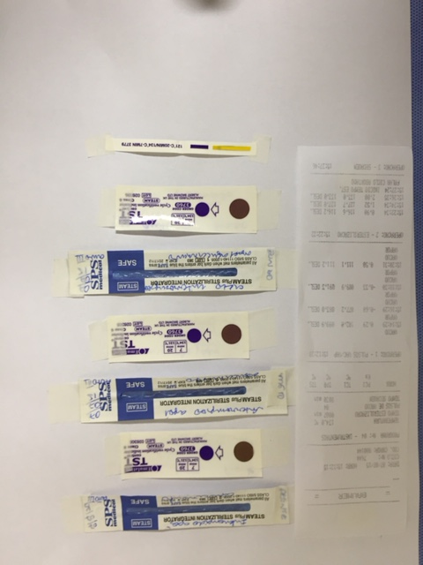
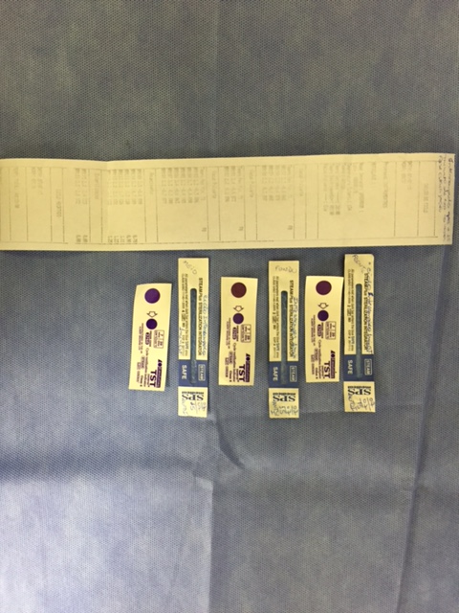
Recent occurrence
Notes:
Recent occurrence, where the cycle was aborted and all indicators showed OK! Customer tested aborting after coditioning phase and after the heating curve, and still approved!!!!

Slide 20
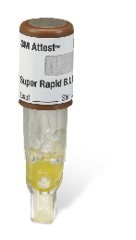
134ºC/4 min
Lethality Calculated for Tmin. > 100ºC
Time | Tmin. | Let. Inst. | Let. Acum. | No
134ºC
125ºC
121ºC
50ºC
Start
End
Notes:
1st reason ambient or very light loads will reach lethality before even the cycle begins. It its important to have a PCD that represents the worst case and will give the correct result.

Slide 21
Sterilization Cycle 1
Notes:
2nd reason, the conditioning and drying phases are not standardized, only the exposure phase. It is common to find sterilizers with a very long heating up time, like this example, where the heating time is longer than the exposure phase. This situation influences the readout of indicators (biological and chemical) given unreliable results. This example also shows the difference response in load temperature at conditioning phase;

Slide 22
Sterilization Cycle 2
Notes:
This a well adjusted equipment, were load temperatures do not go above 121 at the conditioning phase, the heat up ramp is adequate and the cycle is well controlled.

Slide 23
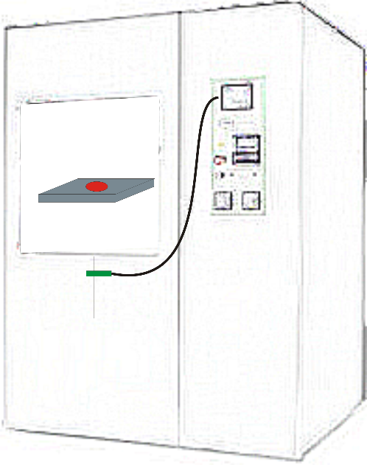
Equipment Control
134ºC
125ºC
3 minutes
Notes:
Sterilizers controls the cycle based ona temperature measured at the drain, a pressure measured from a port at the chamber. Presence of NCG inside the chamber will centralized in the center of a package, and the equipment will not register this event. At the end of the cycle the printout will approve the cycle, but temperature inside de load was never sufficient to guarantee sterilization.

Slide 24
Equipment Control
Water
Saturated Steam
Super Heated Steam
155
135
120
115
100
85
70
55
40
Water + Steam
2159
568 joules
2727 joules

Slide 25
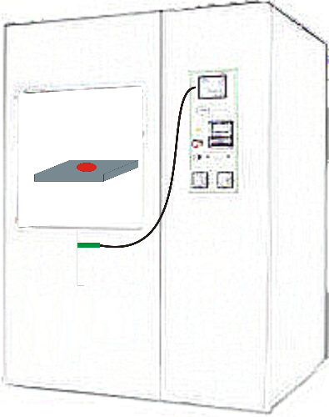
Sensor error
Deviation
Temp ºC | Lethality
1,0 | 26%
0,5 | 12%
0,3 | 7%
Notes:
Calibration error have a great impact in the lethality calculation. Sensor position at the drain influence de correct temperature readout, where when the equipment is ajusted with it at the center of the drain and after a maintenance or calibration it is placed close to the wall, temperature will have different readings.

Slide 26
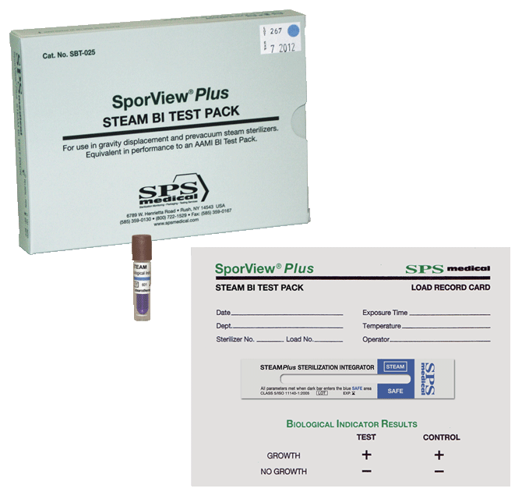
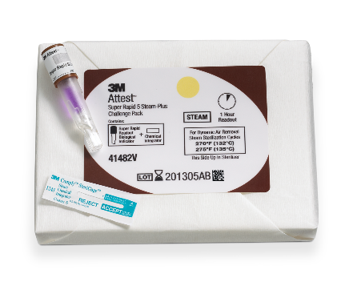
Monitoring best practices
Biological Indicators
Monitor half cycles
Results depends on incubation period
Real evidence of sterilization
When placed inside a PCD will adequately monitor:
NCG
Superheated steam
Chemical Indicators
Full cycle monitor
Immediate results
Requires:
EN 285
ISO 17665
ISO 11607
When placed inside a PCD will adequately monitor:
NCG
Notes:
Must use all indicators to monitor correctly a sterilization cycle

Slide 27
Thank You!
Eng. Paulo Roberto Laranjeira
e-mail: prlaranjeira@usp.br
Celular e Whatsapp: 11-98473-3020
Facebook: prlaranjeira@gmail.com
Pictures and data: Google© e OrionCE

