Slide 1

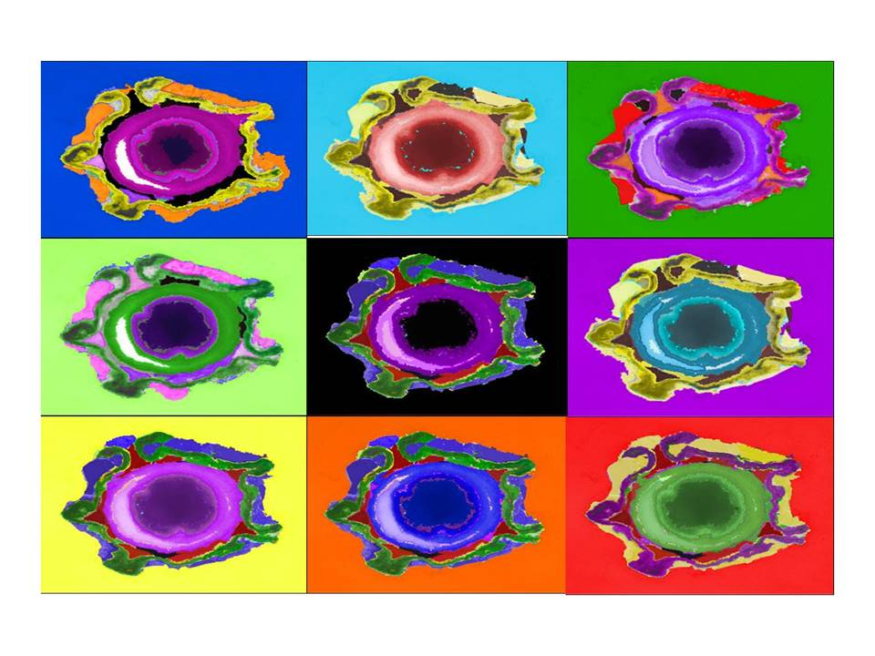
Bacterial endospores: structure, resistance and sporicidal testing
Jean-Yves Maillard
Cardiff School of Pharmacy and Pharmaceutical Sciences
Cardiff University

Slide 2
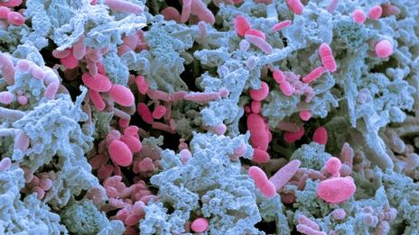
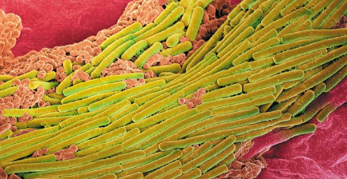
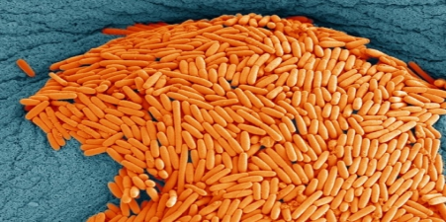
OVERVIEW
Endospores & susceptibility to biocides
Tests for sporicidal activity
Impact of targeting endospores on formulation design
Sporicides and surface applications
1
J-Y Maillard – WFHSS Lille 2015

Slide 3
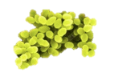
ENDOSPORES AND SUSCEPTIBILITY TO BIOCIDES
2
J-Y Maillard – WFHSS Lille 2015

Slide 4
ENDOSPORES & SUSCEPTIBILITY TO BIOCIDES
STERILISATION
Low
Level of susceptibility
High
prions
bacterial spores
protozoal cysts
mycobacteria
naked viruses
vegetative Gram-negative
fungi
protozoa
vegetative Gram-positive
enveloped viruses
SPORICIDES
HLD
3
J-Y Maillard – WFHSS Lille 2015

Slide 5
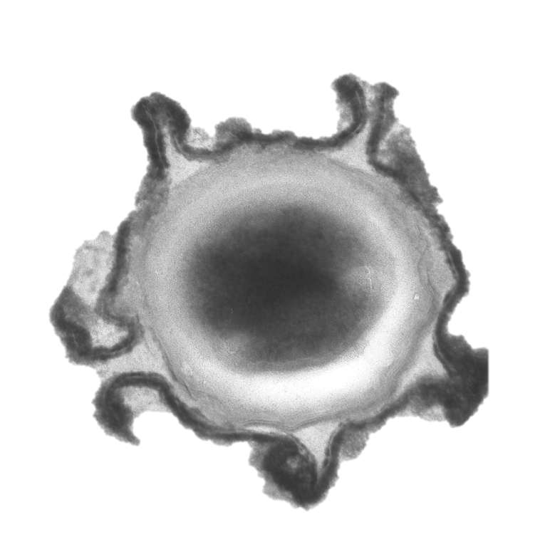
ENDOSPORES & SUSCEPTIBILITY TO BIOCIDES
Leggett et al. J Appl Microbiol 2012; 113: 485-98.
EXOSPORIUM
Degradation ?
Persistence on surfaces
SPORE CORE
Small Acid Soluble Proteins (SASPs)
Protection of nucleic acid
Low water content
Protection of proteins
SPORE COATS
Barrier to biocides
INNER MEMBRANE
CORTEX
Highly compressed
Barrier to biocide
Barrier to rehydration
Barrier to biocides
Physical pressure to inner membrane
4
J-Y Maillard – WFHSS Lille 2015

Slide 6
ENDOSPORES & SUSCEPTIBILITY TO BIOCIDES
EXOSPORIUM
Oxidising agents
SPORE CORE
Hydrogen peroxide
SPORE COATS
Hypochlorites, chlorine dioxide, hydrogen peroxide, ozone, glutaraldehyde, ethylene oxide, iodine, chlorhexidine
CORTEX
Alkali, hypochlorites, chlorine dioxide,ozone, glutaraldehyde, iodine chlorhexidine
INNER MEMBRANE
5
J-Y Maillard – WFHSS Lille 2015

Slide 7
ENDOSPORES & SUSCEPTIBILITY TO BIOCIDES
SPORICIDAL ACTIVITY
Ethylene oxide
Glutaraldehyde
Formaldehyde
ortho-phthalaldehyde
Hydrogen peroxide
Peracetic acid
Chlorine dioxide
Ozone
Sodium hypochlorite
Sodium dichlororisocyanurate (?)
Chloramine-T
Calcium hypochlorite
Iodine and iodophors
“SPORISTATIC” ACTIVITY
Highly reactive compounds
High-level disinfection
Not formulations
Phenols and cresols
Quaternary ammonium compounds
Biguanides
Organic acids and esters
Alcohols
Russell AD. Clin Microbiol Rev 1990; 3:99-119.
6
J-Y Maillard – WFHSS Lille 2015

Slide 8
ENDOSPORES & SUSCEPTIBILITY TO BIOCIDES
Maillard J-Y. J Hosp Infect 2011; 77:204-9.
Examples of sporicidal activity of NaOCl and NADCC
Results difficult to compare - different methods
Results from suspension tests are not necessarily the same as those from a carrier test
7
J-Y Maillard – WFHSS Lille 2015

Slide 9
ENDOSPORES & SUSCEPTIBILITY TO BIOCIDES
Biocides efficacy against the transmission of C. difficile
Lawley et al. Appl Environ Microbiol 2010; 76: 6895-900
Murine model – disinfection of cages (15 mL for 10 min)
BIOCIDES | COMPOSITION | TRANSMISSION
70% ethanol | Alcohol | High
HiBi Scrub | Chlorhexidine digluconate | High
Flash | Benzisothiazolinone | High
Steri-7 | Isothiazolin-benzalkonium chloride | High
Virusolve | Alkyl triamine/bromine | Low
Chlor-clean | Sodium dichloroisocyanurate | nill
Hydrogen peroxide vapour | Hydrogen peroxide vapour (400 ppm 1 min) | nill
8
J-Y Maillard – WFHSS Lille 2015

Slide 10
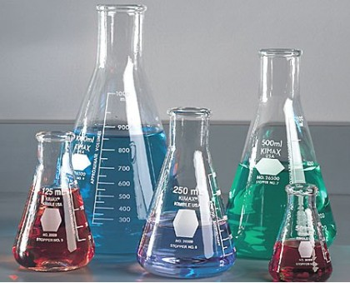
TESTS FOR SPORICIDAL ACTIVITY
9
J-Y Maillard – WFHSS Lille 2015

Slide 11
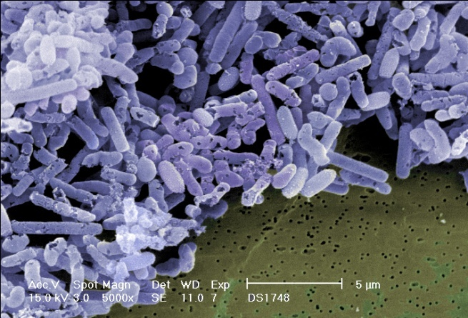
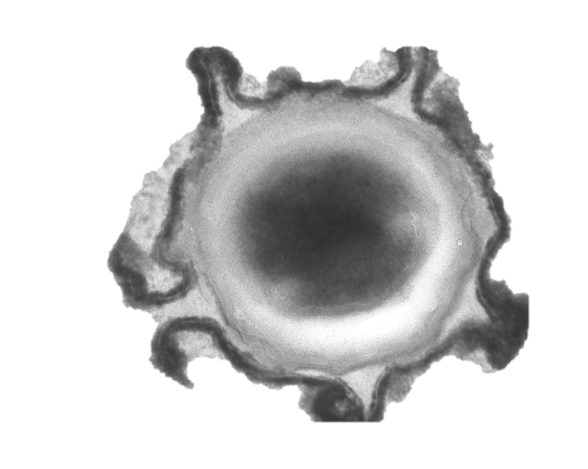
TESTS FOR SPORICIDAL ACTIVITY
Principles
SPORULATION
SPORICIDAL ACTIVITY
OUTGROWTH
BACTERICIDAL
ACTIVITY
GERMINATION
SPORISTATIC ACTIVITY
10
J-Y Maillard – WFHSS Lille 2015

Slide 12
TESTS FOR SPORICIDAL ACTIVITY
Principles
Spore suspension in buffer or dried on a surface
Addition of active
Neutralisation
Recovery and growth of vegetative bacteria
Germination
Outgrowth
Multiplication
(visible colony)
Sporicidal activity: Difference between the number of viable spores added to the test vessel and surviving spores following exposure… as measured following germination and outgrowth, and multiplication of vegetative bacteria (to form a visible colony)
11
J-Y Maillard – WFHSS Lille 2015

Slide 13

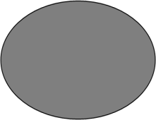
TESTS FOR SPORICIDAL ACTIVITY
Principles
Leggett et al. J Appl Microbiol, under review.
Dormant Spore
1.
Spore Treatment
2.
Neutralisation
3.
4.
6.
Germination
Lysed Spore
Dormant Spore
Germinated Spore
5.
7.
Outgrowth
No Growth
Sporicidal
No Growth
Sporicidal
No Growth
Sporicidal
12
J-Y Maillard – WFHSS Lille 2015

Slide 14
TESTS FOR SPORICIDAL ACTIVITY
Principles
Leggett et al. J Appl Microbiol, under review.
Dormant Spore
8.
Spore Treatment
9.
14.
Incomplete / No Neutralisation
Neutralisation
10.
12.
15.
17.
Germination
Germinated Spore
Dormant Spore
Partially Germinated Spore
Germinated Spore
11.
13.*
16.*
18.
Outgrowth
No Growth
Bactericidal/Bacteristatic
Normal Growth
Sporistatic
Normal Growth
Sporistatic
Normal Growth
No activity
13
* Denotes the requirement for some additional agent (e.g. lysozyme) to resume germination
J-Y Maillard – WFHSS Lille 2015

Slide 15
TESTS FOR SPORICIDAL ACTIVITY
Effect of test methods on sporicidal activity
Comparison of standard test protocols on sporicidal efficacy
Aims: Comparative studies of efficacy test protocols
EN14347: Basic sporicidal activity
Temperature: 20ºC; contact time: 5 and 60 min; no soiling
EN13704: Sporicidal suspension test
Temperature: 20ºC; contact time: 5 and 60 min; no soiling
ASTM2197: Surface test – stainless steel disk
Temperature: 20ºC; contact time: 5 and 60 min; no soiling
AOAC 996.04: Surface test – porcelain carrier
Temperature: 20ºC; contact time: 5 and 60 min; no soiling
Bacillus subtilis: spore preparation according to EN14347 protocol
Clostridium difficile: spore preparation according to the Clospore protocol
14
J-Y Maillard – WFHSS Lille 2015

Slide 16
TESTS FOR SPORICIDAL ACTIVITY
Effect of test methods on sporicidal activity
5 min contact time | Log₁₀ Reduction (± SD)
BIOCIDES/PRODUCTS Clean condition | BS EN 14347 |  | BS EN 13704 |  | AOAC 966.04 |  | ASTM E2197
 | C. diff | B. sub | C. diff | B. sub | C. diff | B. sub | C. diff | B. sub
Glutaraldehyde - 2% | 0.54 (0.26) | 1.92 (0.15) | 0.27 (0.20) | 0.00 (0.40) | -0.41 (0.08) | -0.09 (0.00) | 0.49 (0.04) | O.18 (0.03)
Ortho-phthalaldehyde- 0.55% | 1.73 (0.27) | 1.77 (0.05) | 0.65 (0.25) | -0.09 (0.34) | 1.76 (0.74) | 0.02 (0.00) | 1.66 (0.09) | -0.01 (0.02)
Ortho-phthalaldehyde- 0.65% | 1.19 (0.29) | 1.93 (0.32) | 0.73 (0.28) | -0.22 (0.37) | 2.35 (0.74) | 0.16 (0.00) | 1.77 (0.72) | 0.02 (0.04)
Didecyldimehtyl ammonium chloride -1% | 1.16 (0.35) | 1.87 (0.29) | 0.11 (0.11) | -0.24 (0.29) | 0.11 (0.15) | -0.04 (0.00) | 0.05 (0.13) | 0.13 (0.05)
Bis(aminopropyl)laurylamine – 1% | 0.99 (0.34) | 1.87 (0.23) | 0.22 (0.05) | 0.25 (0.57) | -0.10 (0.12) | -0.20 (0.00) | 1.15 (0.20) | 0.30 (0.02)
Amine -1% + quaternary ammonium- 1% | 1.05 (0.66) | 0.48 (0.09) | 0.15 (0.05) | 0.63 (0.15) | 0.40 (0.60) | -0.20 (0.00) | 0.06 (0.23) | 0.31 (0.05)
Anoxy-Twin-1200 ppm | >6.16 (0.25) | >6.81 (0.64) | >5.96 (0.17) | >4.88 (0.10) | 5.05 (0.08) | 3.65 (0.00) | >5.17 (0.77) | >5.31 (0.02)
Aniosept Activ – 2% | TBC | TBC | > 6.44 (0.03) | > 6.18 (0.07) | 5.05 (0.08) | 2.15 (0.00) | 2.12 (0.11) | 4.01 (0.16)
NaOCl 5000 ppm | >6.16 (0.25) | 1.36 (0.06) | >5.96 (0.17) | 1.36 (0.14) | 5.05 (0.08) | 0.95 (0.00) | >5.83 (0.00) | 0.38 (0.03)
15
J-Y Maillard – WFHSS Lille 2015

Slide 17
TESTS FOR SPORICIDAL ACTIVITY
Effect of test methods on sporicidal activity
60 min contact time | Log₁₀ Reduction (± SD)
BIOCIDES/PRODUCTS Clean condition | BS EN 14347 |  | BS EN 13704 |  | AOAC 966.04 |  | ASTM E2197
 | C. diff | B. sub | C. diff | B. sub | C. diff | B. sub | C. diff | B. sub
Glutaraldehyde - 2% | 1.87 (0.50) | 0.56 (0.03) | 1.57 (0.12) | 0.44 (0.47) | 1.60 (0.22) | 0.12 (0.00) | 1.17 (0.08) | 0.66 (0.06)
Ortho-phthalaldehyde- 0.55% | >6.11 (0.33) | 0.62 (0.11) | >5.96 (0.17) | 0.48 (0.63) | 5.05 (0.08) | 0.19 (0.00) | 5.83 (0.02) | 0.29 (0.06)
Ortho-phthalaldehyde- 0.65% | >6.11 (0.33) | 0.56 (0.07) | >5.96 (0.17) | 0.77 (0.39) | 5.05 (0.08) | 0.12 (0.00) | >5.83 (0.00) | 0.20 (0.09)
Didecyldimehtyl ammonium chloride -1% | 2.31 (0.45) | 0.70 (0.16) | 0.23 (0.09) | 0.07 (0.72) | 0.44 (0.20) | 0.54 (0.00) | 0.39 (0.30) | 0.41 (0.05)
Bis(aminopropyl)laurylamine – 1% | 3.22 (0.55) | 0.69 (0.05) | 0.25 (0.09) | 0.60 (0.54) | -0.08 (0.17) | -0.07 (0.00) | 1.22 (020) | 0.40 (0.10)
Amine -1% + quaternary ammonium- 1% | 0.90 (0.20) | 1.02 (0.16) | 0.03 (0.03) | 0.68 (0.01) | 0.44 (0.04) | 0.11 (0.00) | 0.23 (0.17) | 0.48 (0.10)
Anoxy-Twin-1200 ppm | >6.11 (0.33) | >6.27 (0.00) | >5.96 (0.17) | >4.88 (0.10) | 5.05 (0.08) | >5.81 (0.00) | >5.83 (0.00) | >5.31 (0.02)
Aniosept Activ – 2% | 4.12 (0.60) | 3.54 (0.15) | >6.44 (0.03) | >6.18 (0.07) | 5.05 (0.08) | >5.81 (0.00) | >5.83 (0.00) | 5.06 (0.24)
NaOCl 5000 ppm | >6.11 (0.33) | >6.27 (0.00) | 5.96 (0.17) | >4.88 (0.10) | 5.05 (0.08) | >5.81 (0.00) | >5.83 (0.00) | 4.28 (0.07)
16
J-Y Maillard – WFHSS Lille 2015
Notes:
C. Difficile spores are more susceptible than B. subtilis spores
The test method affects the sporicidal activity results when a short contact time (5 min) is used.
Amine/QAC have no sporicidal activity
Chemical neutralisation of amines/QAC is an issue

Slide 18
TESTS FOR SPORICIDAL ACTIVITY
Chemical neutralisation of amines/QAC
 | Log₁₀ Reduction (SD)
 | Didecyldimehtyl ammonium chloride |  |  | Bis(aminopropyl) laurylamine |  |  | Amine + quaternary ammonium
 | 0.5% | 1% | 2% | 0.5% | 1% | 2% | 0.5% | 1% | 2%
Neutralisation | 0.28 | 0.46 | 0.30 | 0.26 | 0.47 | 0.27 | 0.24 | 0.43 | 0.31
Filtration | 0.25 | 0.44 | 0.27 | 0.73 | 0.48 | 0.86 | 0.27 | 0.46 | 0.50
17
J-Y Maillard – WFHSS Lille 2015

Slide 19
TESTS FOR SPORICIDAL ACTIVITY
Chemical neutralisation of amines/QAC
 | Filtration |  |  |  | Neutralisation
Dilution | Neat | -1 | -2 | -3 | Neat | -1 | -2 | -3
Didecyldimehtyl ammonium chloride
0.5% | >300 | >300 | >300 | >300 | 0 | 0 | >300 | 294
1% | >300 | >300 | >300 | >300 | 0 | 0 | 0 | >300
2% | >300 | >300 | >300 | 300 | 0 | 0 | 0 | 280
Bis(aminopropyl) laurylamine
0.5% | >300 | >300 | >300 | >300 | 0 | 0 | >300 | >300
1% | >300 | >300 | >300 | >300 | 0 | 0 | >300 | >300
2% | >300 | >300 | >300 | 101 | 0 | 0 | >300 | 298
Amine + quaternary ammonium
0.5% | >300 | >300 | >300 | 300 | 0 | 0 | >300 | >300
1% | >300 | >300 | >300 | >300 | 0 | 0 | >300 | >300
2% | >300 | >300 | >300 | 199 | 0 | 0 | 0 | 276
18
J-Y Maillard – WFHSS Lille 2015

Slide 20
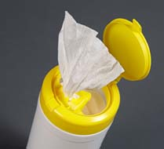
IMPACT OF TARGETING ENDOSPORES ON FORMULATION DESIGN
19
J-Y Maillard – WFHSS Lille 2015

Slide 21
ENDOSPORES AND FORMULATION DESIGN
Considerations about a product
FACTORS INHERENT TO THE BIOCIDE
Concentration | Concentration exponent (η)
Formulation | Including pH, surfactants, ion chelators etc.
 | Ingredients (compatibility)
Improving penetration
Spore coats/cortex – surfactants/wetting agents?
Triggering germination
Germinants – correct combination
Targeting cortex – enzymes?
Enhancing spore mechanical removal from surfaces
Exosporium? –surfactants/ wetting agents
Aggregates
20
J-Y Maillard – WFHSS Lille 2015

Slide 22
ENDOSPORES AND FORMULATION DESIGN
Considerations about a product
FACTORS INHERENT TO THE BIOCIDE
Concentration | Concentration exponent (η)
Formulation | Including pH, surfactants, ion chelators etc.
 | Ingredients (compatibility)
B. subtilis strain name | Strain abbreviation | Strain description
B. subtilis PS533 | WT | Wild-type strain carrying plasmid pUB110, which contains a kanamycin resistance marker.
B. subtilis PS578 | α⁻β⁻ | Two genes (sspA and sspB) that encode the two major α/β-type SASP were deleted
B. subtilis PS3394 | cotE⁻ | Strain PS3394 carries pUB110 and contains a tetracycline resistance cassette inactivating the cotE gene essential for proper spore coat assembly.
21
J-Y Maillard – WFHSS Lille 2015

Slide 23
ENDOSPORES AND FORMULATION DESIGN
Considerations about a product
Excipients altering the activity of XX (-%) against spores of B. subtilis PS3394(cotE-)
Log₁₀ reduction in spores/mL relative to PAA only
aaa bbb ccc ddd eee fff ggg
Amphoteric Alkalinity Source Solvent Chelator
Surfactants
Excipients altering the activity of XX (-%) against spores of B. subtilis PS533 (WT)
Log₁₀ reduction in spores/mL relative to PAA only
aaa bbb ccc ddd eee fff ggg hhh iii
Amphoteric surfactants Non-ionic surfactants Solvents
22
J-Y Maillard – WFHSS Lille 2015

Slide 24
ENDOSPORES AND FORMULATION DESIGN
Considerations about a product
FACTORS INHERENT TO THE APPLICATION
Contact time
Temperature | Q₁₀
Soiling
Relative humidity | Gaseous biocides, antimicrobial surfaces, wipes
Surface type | Permeability, nature etc.
Applicator | Delivery of the sporicide(s); wipe, spray, liquid
Applications:
Does my efficacy test reflect how the sporicide is delivered?
Compatibility of the materials/vessels/containers with the active
Effect of the applicator of target microorganisms (spores)
Require a realistic test protocol to enable the comparison of different formulation/applicator combinations
23
J-Y Maillard – WFHSS Lille 2015

Slide 25
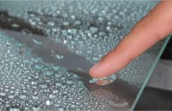
SPORICIDES & SURFACE APPLICATIONS
24
J-Y Maillard – WFHSS Lille 2015

Slide 26
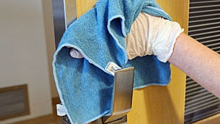
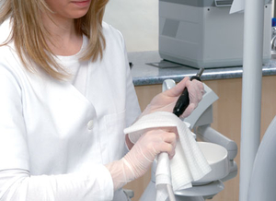
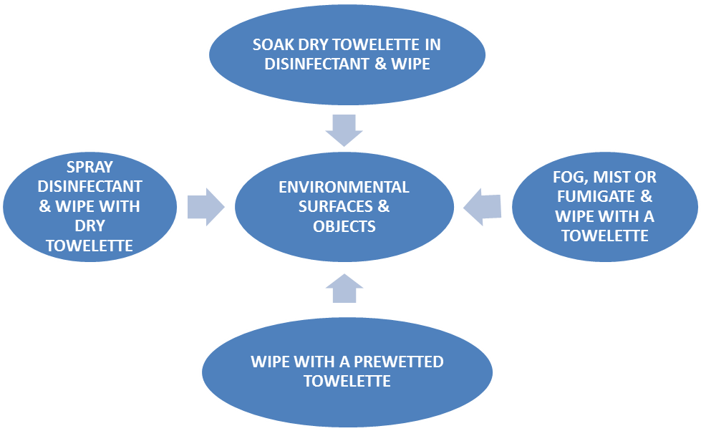
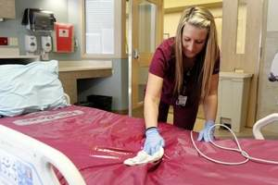

SPORICIDES & SURFACE APPLICATIONS
Possible scenarios for decontaminating high-touch environmental surfaces by wiping
Sattar & Maillard AJIC 2013;41:S97-S104.
25
J-Y Maillard – WFHSS Lille 2015

Slide 27
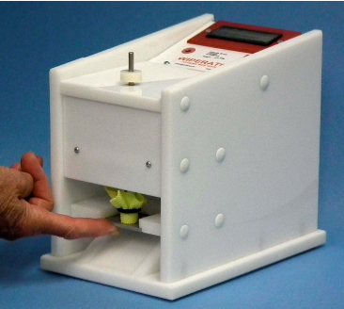
SPORICIDES & SURFACE APPLICATIONS
ROLE OF WIPES – 3 STEP TEST (ASTM E2967-15 –May 2015)
Williams et al. J Hosp Infect 2007;67:329-35
Sattar et al. J Hops Infect 201, in press
Remove bioburden from a surface
Stage 1 – bacterial removal
How good are the wipes in removing microbial contaminants? (not killing effect)
Prevent transfer of bioburden from the wipe to other surfaces
Stage 2 – bacterial transfer “adpression tests”
Can the wipes transfer survivors to other surfaces (i.e. cross-contaminate)?
Where antimicrobial is present – kill the microbial bioburden
Stage 3 – Antimicrobial activity
Can the wipes kill the bacteria they remove?
26
J-Y Maillard – WFHSS Lille 2015

Slide 28
SPORICIDES & SURFACE APPLICATIONS
USE OF WIPE BASED PRODUCTS – efficacy testing against C. difficile NCTC12727
Siani et al. AJIC 2011; 39(3), 212-218
Wipes | Bacterial Removal (log₁₀ cfu/disk ± SD) 500 g surface pressure | Bacterial transfer following 10 s wiping time at 500 g surface pressure
Negative control | 1.13 (± 0.36) | 5 consecutive transfers. TNTC
NaOCl soaked wipe | 2.02 (± 0.21) | 5 consecutive transfers. TNTC
WIPE A | 4.09 (± 0.79) | No spore transferred
WIPE B | 0.22 (± 0.07) | 5 consecutive transfers. From 0 to TNTC
WIPE C | 1.30 (± 0.33) | 5 consecutive transfers. From 0 to TNTC
WIPE D | 0.57 (± 0.07) | 5 consecutive transfers. From 1 to TNTC
WIPE E | +0.08 (± 0.08) | 5 consecutive transfers. TNTC
WIPE F | 1.14 (± 0.65) | 5 consecutive transfers. From 83 to TNTC
WIPE G | 0.67 (± 0.11) | 5 consecutive transfers of ≤43 bacteria
WIPE H | 0.88 (± 0.13) | 5 consecutive transfers. From 2 to TNTC
WIPE J | 0.84 (± 0.66) | 5 consecutive transfers. From 40 to TNTC
27
J-Y Maillard – WFHSS Lille 2015

Slide 29
SPORICIDES & SURFACE APPLICATIONS
APPROPRIATE TEST PROTOCOLS FOR DIFFERENT STAGES
Intelligent design (formulation)
Formulation/applicator combinations (can be used for product documentation)
Standard tests (product claim)
DELIVERY SYSTEM
TARGET
MICROORGANISM
FORMULATION
SURFACES
28
J-Y Maillard – WFHSS Lille 2015

Slide 30
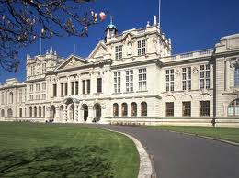
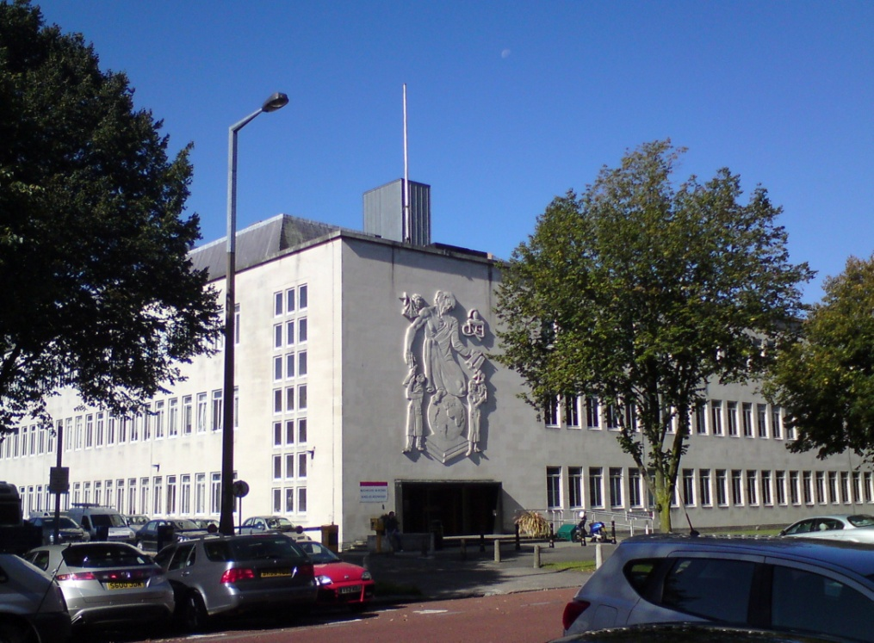
THANK YOU
29
J-Y Maillard – WFHSS Lille 2015

