Slide 1



Development of cleaning agents for biofilm removal
Philipp Stiefel¹, Stefan Mauerhofer², Stefanie Altenried¹, Qun Ren¹, Urs Rosenberg²
1) Laboratory for Biomaterials, Swiss Federal Laboratories for Materials Science and Technology (Empa), Lerchenfeldstrasse 5, CH-9014 St.Gallen, Switzerland.
2) Borer Chemie AG, Gewerbestrasse 13, CH-4528 Zuchwil, Switzerland
Sponsored by:

Slide 2

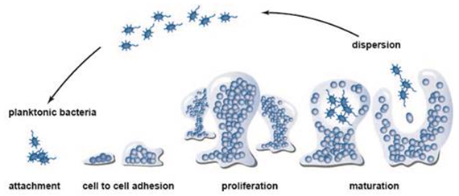
Biofilms
Structured communities of microorganisms on surfaces or at interfaces.
Self-made matrix made from extracellular polymeric substances (EPS) consisting of polysaccharides, proteins, lipids, nucleic acids and oder substances.
Biofilm-associated microorganisms up to 1000 fold less sensitive to antimicrobial substances compared to their planctonic forms.
7-10 oct. 2015
1

Slide 3
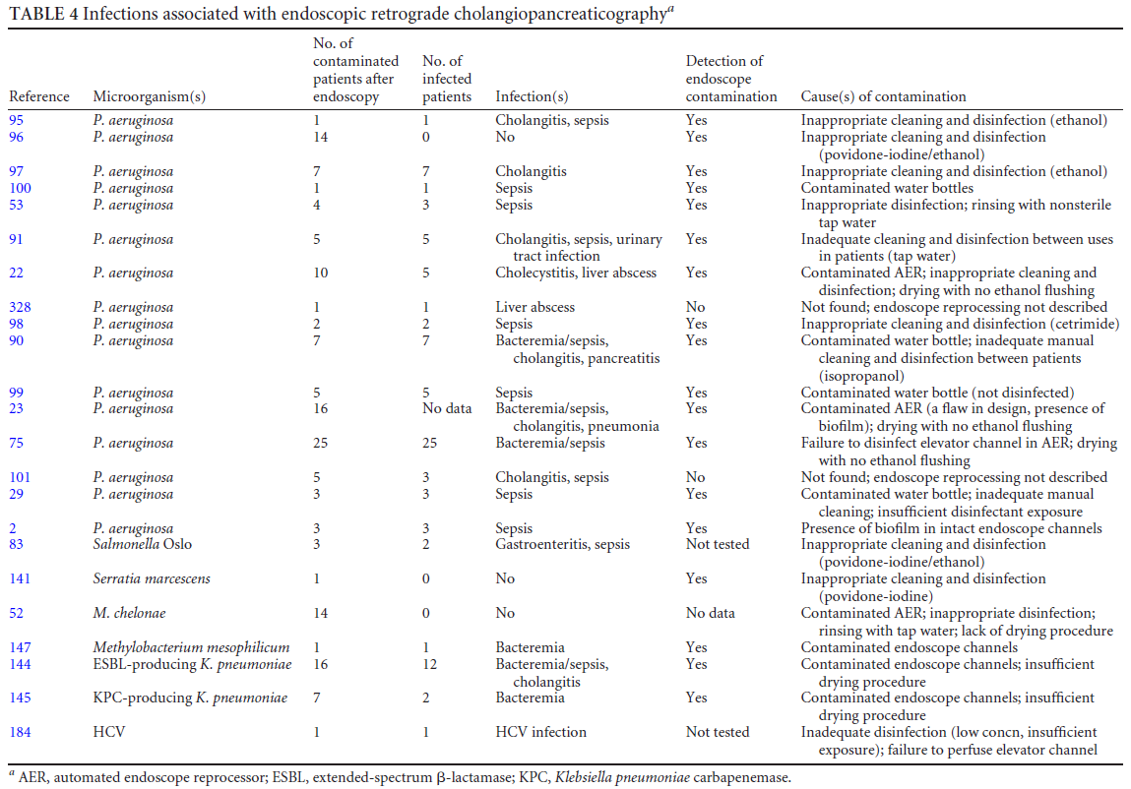
Endoscopes and infections
7-10 oct. 2015
Kovaleva et al. 2013
2

Slide 4
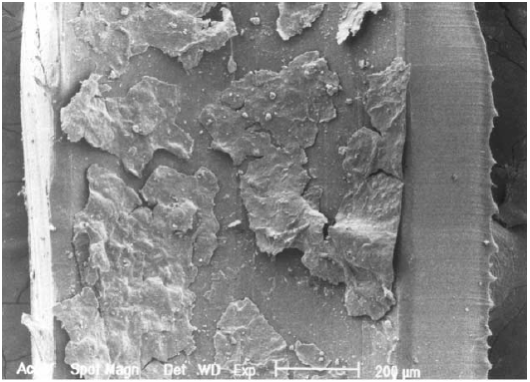
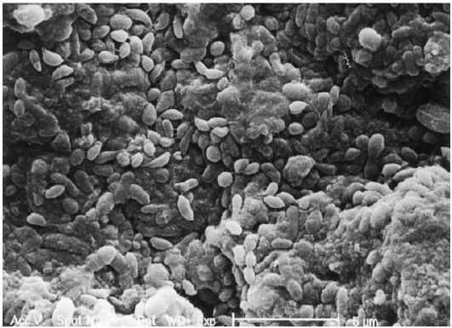
Biofilm in endoscope channels
7-10 oct. 2015
REM-pictures of two different air-/water channels with biofilm:
confluent soil-biofilm-layer (low resolution).
multi-layer biofilm composed of healthy appearing cells surrounded by and overlaid with amorphous appearing EPS (high resolution).
Pajkos et al. 2004
3

Slide 5
Cleaning models
Screening-methods for testing large numbers of formulations and parameters plus different methods for analysis:
→ microtiter plate format
More laborious methods closer to the real application of products:
→ flow cell
→ endoscope channels (EN ISO TS 15883-5)
→ others?
7-10 oct. 2015
4

Slide 6
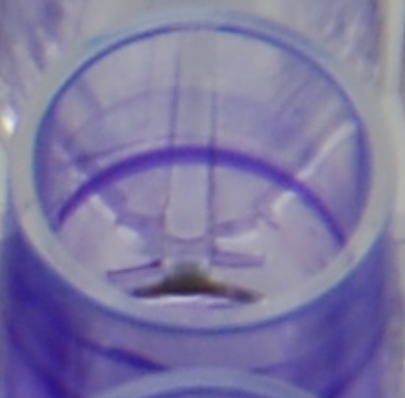
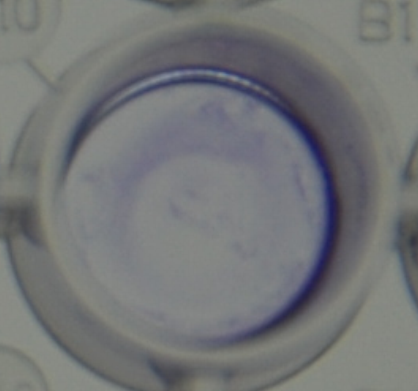
Growing biofilms in microtiter plates
96-well microtiter plates from polystyrene with flat bottom.
Growing biofilms: dilute pre-culture to 0.2 OD in 30% TSB + 0.25% glucose. Incubate 200 μL / well at 33 °C while shaking at 40 rpm during 24 hours.
Appearance of biofilms (crystal violet staining):
7-10 oct. 2015
P. aeruginosa
S. aureus
5

Slide 7
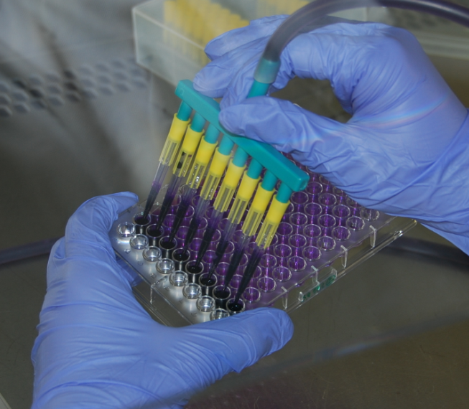
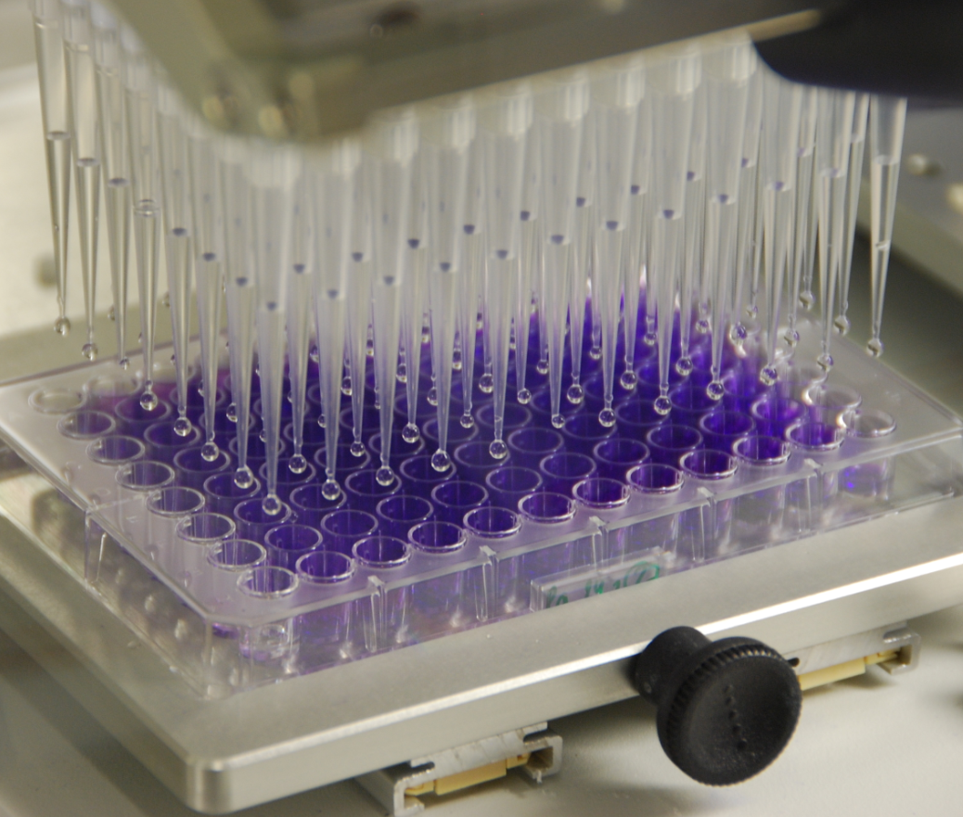
Cleaning experiments in microplates
Sucking off medium
Washing 1x with 300 μl 0.9% NaCl
Adding of 300 μl cleaner sol. (1% in water of standardized hardness (WSH))
Incubating for 40 min at 25°C without shaking
Removing cleaner solution
Wash 3x with 300 μl 0.9% NaCl
Applying analysis method
7-10 oct. 2015
6

Slide 8
Potential analysis methods
Total biomass (bacteria and EPS)
→ Crystal Violet (CV)
→ Safranin Red
→ Congo Red
Total bacteria (live and dead)
→ SYTO 9
→ Acridine Orange
Living bacteria
→ SYTO 9 / Propidium Iodide
→ BacTiter-GloTM assay (ATP)
→ Turbidity Threshold (growth kinetics)
Proteins
→ CBQCA
→ NanoOrange
→ SYPRO Ruby
→ FITC
Polysaccharides
→ Calcofluor White
→ ConA-FITC
→ Dubois
7-10 oct. 2015
7

Slide 9
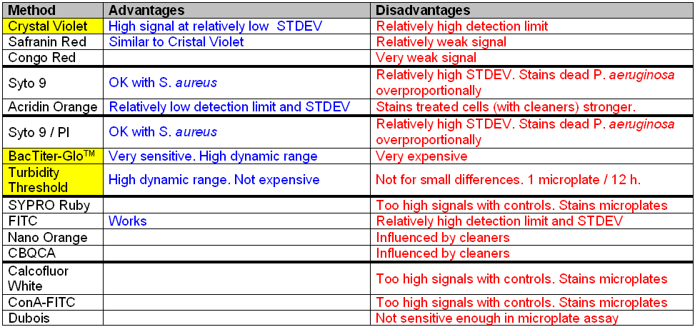
Advantages / disadvantages
Application in microtiter plates
7-10 oct. 2015
8

Slide 10
Assays – what they can tell us
Crystal Violet
stains total biomass (bacteria snd EPS)
→ biofilm removal without differentiation between EPS and bacteria.
BacTiter-GloTM
differential staining of living bacteria
→ bacteria removal and/or –killing without differentiation of the two.
Turbidity Threshold
bacterial growth kinetics (OD₅₉₅)
→ bacteria removal and/or –killing without differentiation of the two.
7-10 oct. 2015
9

Slide 11
P. aeruginosa / S. aureus biofilm removal
Crystal Violet (CV) staining
7-10 oct. 2015
Optical density
S. aureus
Optical density
P. aeruginosa
10

Slide 12
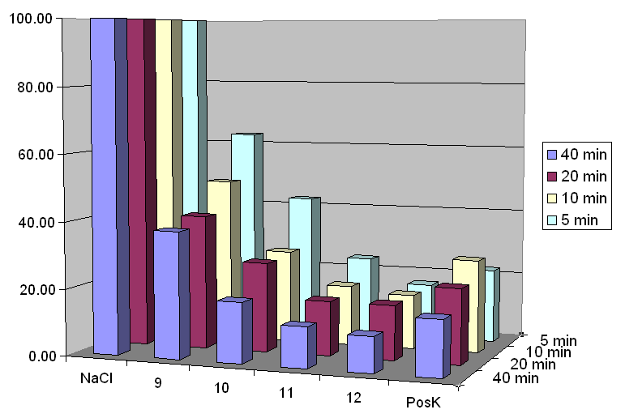
Incubation time and biofilm removal
P. aeruginosa (CV-staining)
7-10 oct. 2015
Residue [% of NaCl]
11

Slide 13
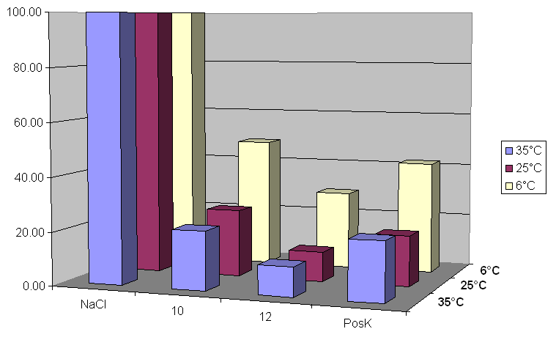
Incubation temperature and biofilm removal
P. aeruginosa (CV-staining)
7-10 oct. 2015
Residue [% of NaCl]
12

Slide 14
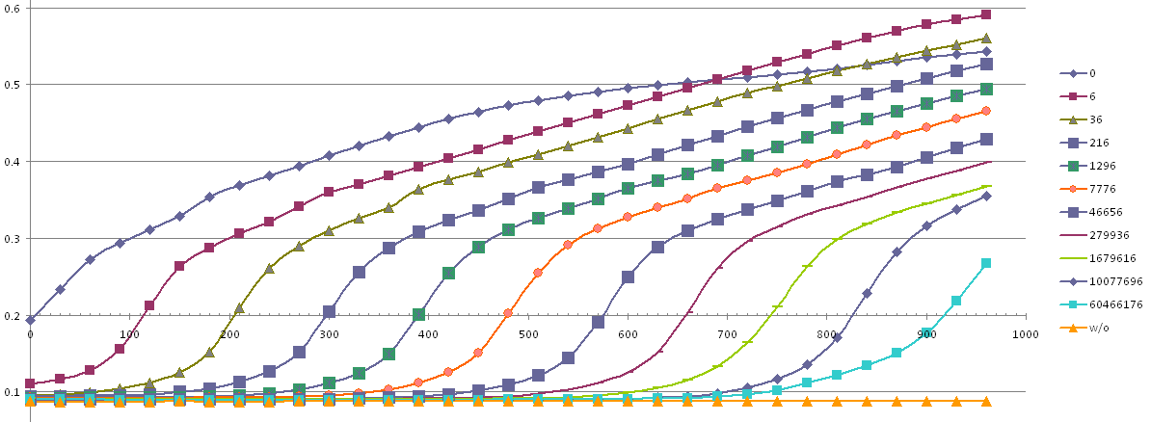
Growth of remaining bacterial Turbidity
Turbidity Threshold
7-10 oct. 2015
RF 1.48 log
RF 1.84 log
RF 5.98 log
Serial dilution for calibration
13

Slide 15
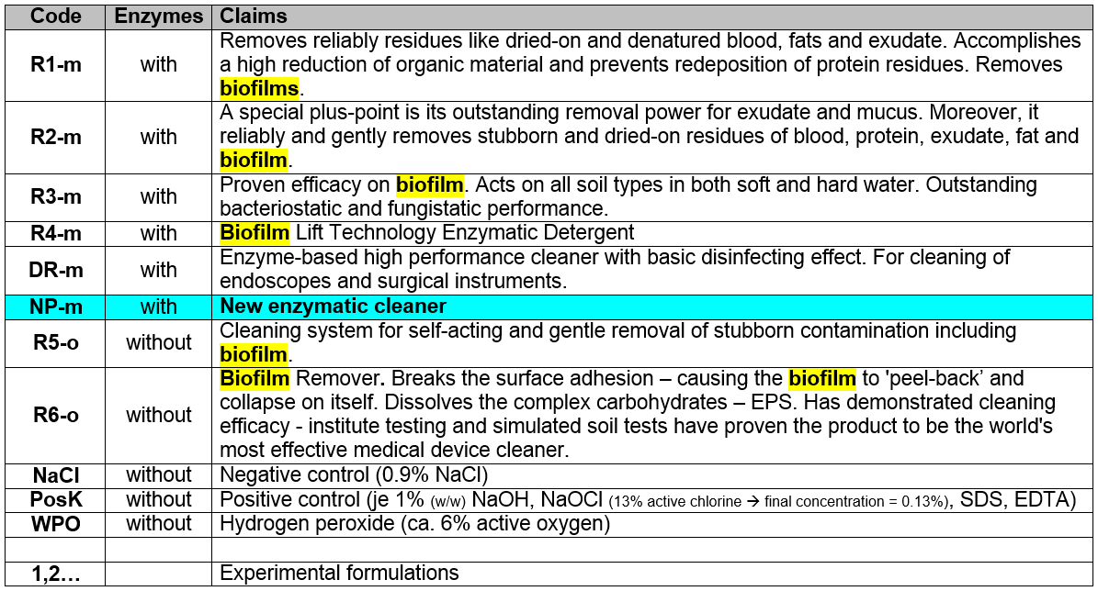
Products under scrutiny
7-10 oct. 2015
14

Slide 16
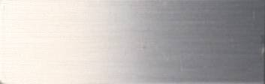
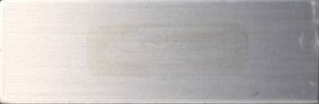
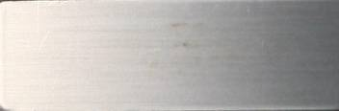
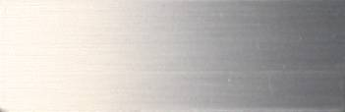
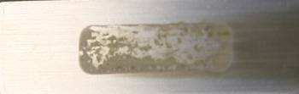
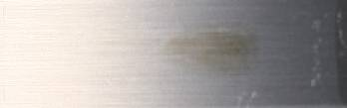
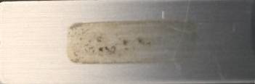
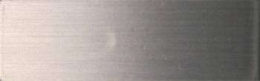
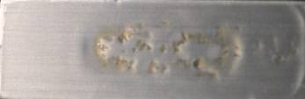
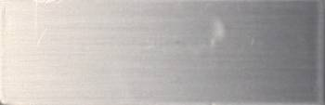
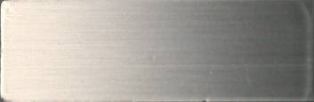
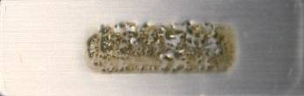
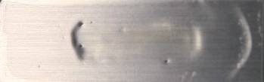
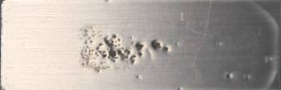
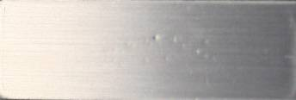
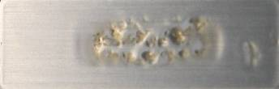
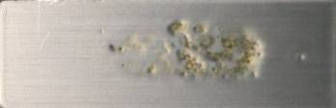
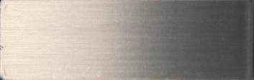
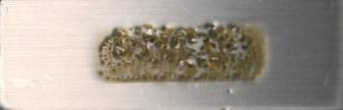
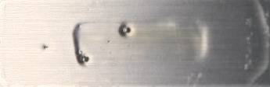
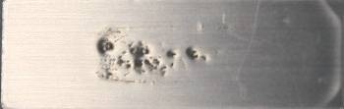
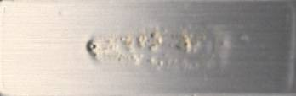
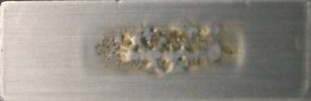
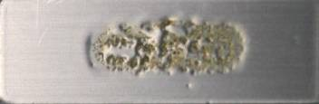
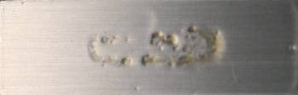
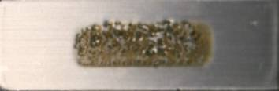
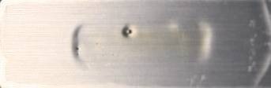
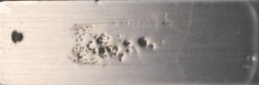
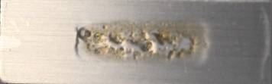
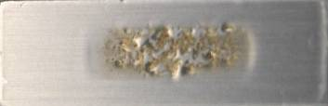

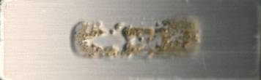
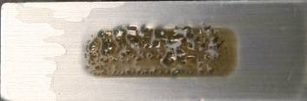
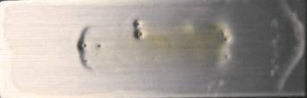
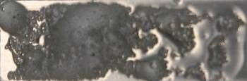
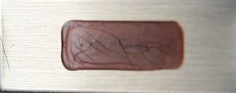
TOSI-cleaning
1% in tap water of ca. 16°d at room temperature (ca. 22°C)
7-10 oct. 2015
R1-m
R3-m
DR-m
NP-m
R6-o
PosK
WPO
rinsed
dried
60 min
45 min
30 min
15 min
0 min
15

Slide 17
P. aeruginosa vs. S. aureus
Microtiter plate, biofilm reduction 40 min static conditions, CV-staining
7-10 oct. 2015
287
134
16

Slide 18
Living cells reduction (P. aeruginosa)
Microtiter plate, 40 min static conditions, BacTiter-GloTM assay
7-10 oct. 2015
17

Slide 19
Biofilm & living cells reduction
Crystal Violet & BacTiter-GloTM assay
7-10 oct. 2015
18

Slide 20
Flow cell with OCT-visualization
Optical coherence tomography (OCT) is an established medical imaging technique that uses light to capture micrometer-resolution, 3d images from within optical scattering media (e.g., biological tissue). OTC is based on low-coherence interferometry, typically employing near-infrared light. The use of relatively long wavelength light allows it to penetrate into the scattering medium (Wikipedia).
7-10 oct. 2015
Miniaturized flow cell 120x2x1 mm (LxWxH)
Heterothrophic waste water biofilm (source: supernatant of activated sludge) cultivated during 24h in fed-batch mode.
Rinsed with 0.9% NaCl
Cleaning experiments in flow through mode (16 ml/min)
Experiments with NP-m and PosK.
Time resolved video of 2d-sections (xz-plane)
along flow path (x-direction)
19

Slide 21
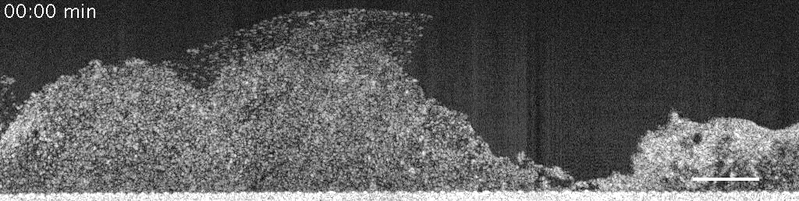

Slide 22
Endoscope dummy test
EN ISO/TS 15883-5:2005 Appendix F
7-10 oct. 2015
Filling a 2 m endoscope channel ∅ 4 mm with 10 ml P. aeruginosa over night culture.
Growing biofilm for 72 h at 30°C by recirculation
(40 mL/min) with defined addition of growth medium.
Rinsing channel with 0.9% NaCl for 1 min at 20 ml/min.
Cutting channel in 30 cm sections for cleaning experiments (static or with flow through at 200 ml/min (cleaning) and 4 ml/min (disinfection)).
Analysing for OD_{595nm} and colony forming units (CFU) and carrying out quantification of sugar (Dubois) and protein (Lowry).
20

Slide 23
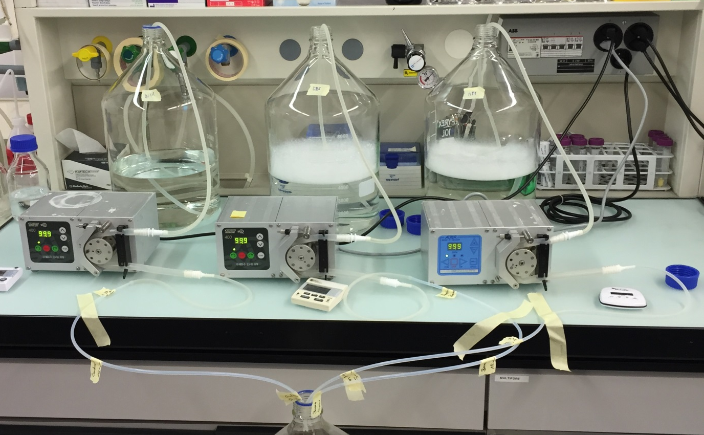

E. channel cleaning - experimental setup
7-10 oct. 2015
treatment
Rinsing
0.9% NaCl
20ml/min
1min
Cleaning
1% cleaner
Contr.: WSH
200ml/min
5 / 15min
Rinsing
0.9% NaCl
20ml/min
1min
Disinfection
deconex®
HLD PA / PA20
4ml/min
15min
Rinsing
0.9% NaCl
20ml/min
1min
Cutting
longitudinal
in 2 halves
5mm sections
Vortex
5min
Without disinfection
21

Slide 24






Analysis methods
7-10 oct. 2015
OD₅₉₅
(bacteria)
Serial dilution
(bacteria)
Dubois method
(sugar)
30µl
30µl
30µl
…
Sample
150µl
120µl
120µl
120µl
Lowry method (protein)
22

Slide 25
Bacteria reduction
Static (without pumping) vs. flow through cleaning (pumping at 200 ml/min)
7-10 oct. 2015
0.8
1.6
RF log₁₀
2.5
2.1
23

Slide 26
Reduction of protein and sugar
Flow through cleaning: 5, 15 min, 200 ml/min
7-10 oct. 2015
NP-m fulfills requirements of EN ISO/TS 15883-5:2005 Appendix F
24

Slide 27
Summary reduction of all parameters
Flow through cleaning:15 min, 200 ml/min
7-10 oct. 2015
25

Slide 28
Comparison dummy / microplate
7-10 oct. 2015
→ Microplate
→ Dummy, flow through
26

Slide 29






Residual biofilm under microscope
CYTO 9-staining (nucleic acids)
WSH
NP-m
R2-m
7-10 oct. 2015
250 μm
250 μm
250 μm
250 μm
250 μm
250 μm
R3-m
R1-m
R6-o
27

Slide 30






Residual biofilm under microscope
Higher resolution
WSH
NP-m
R2-m
7-10 oct. 2015
25 μm
25 μm
25 μm
25 μm
25 μm
25 μm
R3-m
R1-m
R6-o
28

Slide 31


Without / with disinfection
Cleaning 15 min, 200 ml/min → disinfection 15 min, 4 ml/min
7-10 oct. 2015
39

Slide 32






Biofilm before / after disinfection
Disinfectant: deconex® HLD PA (formulated pH-neutral peracetic acid)
7-10 oct. 2015
WSH cleaning
WSH cleaning
NP-m cleaning
250 μm
25 μm
25 μm
After WSH & Disinfection
After WSH & Disinfection
After NP-m & Disinfection
250 μm
25 μm
25 μm
30

Slide 33
Summary
Different analysis methods for different phases of product development required.
Results of microplate screening methods essentially congruent with more laborious dummy tests.
S. aureus biofilm less resistant than P. aeruginosa biofilm, particularly when using enzymatic cleaners.
Disinfectant-cleaners and cleaners with biocidal ingredients generally didn’t clean effectively, neither biofilm nor blood. They showed particularly low performance in case of S. aureus biofilm.
Only excellent cleaning guarantees the success of the following disinfection stage. This is especially true in case of biofilm.
There is often a big gap between manufacturer claims and real performance. → Need for standardized test methods and definition of minimal performance requirements for medical device cleaners.
Within this project, a new enzymatic product with excellent cleaning performance for biofilm and blood was developed, which will be used for manual (pre-)cleaning of flexible endoscopes as well as surgical instruments.
7-10 oct. 2015
31

Slide 34

Thank you for your attention!
The project team
7-10 oct. 2015
Dr. Qun Ren, Empa
Stefan Mauerhofer, Borer
Dr. Philipp Stiefel, Empa
Dr. Urs Rosenberg, Borer
Stefanie Altenried, Empa
Jana Schneider, Empa
32

