Slide 1
The benefits of using the Ancitrak® ancillaries reprocessing tool in the sterilisation process in a major hospital
Anne-Cécile Duployez
8 October 2015
Notes:
Hello,
First of all, I would like to thank the organisers for allowing me to present this work to explain the benefits of using the Ancitrak® ancillaries reprocessing tool in the sterilisation process in a major hospital, namely the University Hospital (CHRU) in Lille.

Slide 2
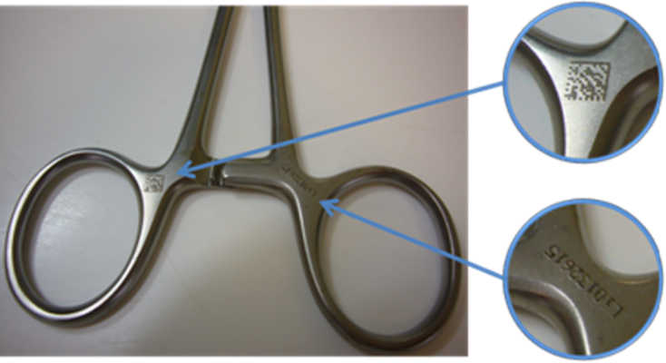
Introduction
Traceability of individual instruments for the majority of the hospital's "proprietary" procedure trays
But for ancillaries: the vast majority of trays consist of medical devices that cannot be engraved
Traceability of individual instruments is not possible
Specific risks
Notes:
Traceability of individual instruments has been put in place for all the procedure trays in Lille CHRU. However, certain medical devices cannot be etched. For these, full traceability of each instrument is not possible and this causes specific risks. This is the case for ancillary instrument trays.

Slide 3
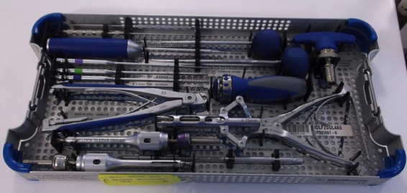
Introduction
Ancillary instruments = set of specific instruments used to insert or remove an implant
Notes:
Ancillary instruments are a set of specific instruments used to insert or remove an implant.

Slide 4
Supply chain for Ancillary instruments
One-off loan: temporary availability of reusable medical devices (RMD) for a scheduled operation
Long term loan = consignment: available for the duration of the contract (36 months on average)
NB: 590 ancillaries on temporary loan, 200 ancillaries on long term consignment
A complex supply chain with multiple players
Notes:
These expensive and specific trays are loaned by the suppliers: Either one-off loans for a scheduled operation or long term loans (consignment).
In Lille, we have about 590 short term loans and 200 long term consignments.
The supply chain is therefore complex with multiple players, such as the supplier, the pharmacy, the operating theatre (OT) and the sterilisation service.

Slide 5
Introduction
Risks:
Patient care
Lack of traceability
Incomplete trays delivered to the OR making the required operation impossible
Financial
Cost of disputes with suppliers in case of lost instruments
Major HR impact
→Development of Ancitrak® by ATH Medical
Notes:
The potential risks caused by these unetched devices relate
on the one hand, to patient care with a lack of traceability and a risk of incomplete procedure trays interfering with the planned activities,
and on the other hand, there is a financial risk related to disputes with suppliers if instruments go astray and the costs in terms of human resources.
It is for these reasons that ATH Medical® created Ancitrak®.

Slide 6
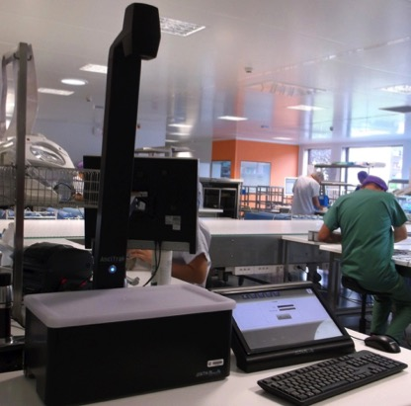
Ancitrak®
Work station
with touch-screen display
computer connected
to a network,
own reprocessing
software
Notes:
Ancitrak® consists of a work station with a touch-screen display. The work station is connected to a computer with its own reprocessing software, in turn connected to a computer network.

Slide 7
Ancitrak®
Learning phase
Reprocessing
Placing the instrument on the platform
Learning visual recognition of the instrument with a confidence rating
Validation by the user
Indication of where to place the instrument on the tray
Placing the instrument on the platform
The instrument is recognised by Ancitrak®, which indicates the right position on the tray
Notes:
First of all, there is a learning phase concerning the procedure tray. Each instrument is recorded by visual recognition and a photo, and by inputting the reference and the indication of the right position on the tray.
The tray can then be reprocessed. The instrument placed on the platform is recognised and its exact position indicated.

Slide 8
Ancitrak®
Notes:
This is the programme's screen at the start of reprocessing.
On the left, the diagram showing the completed tray with a photo, the reference and name of the instrument, the quantity to be validated, and the quantity recorded. During reprocessing, the quantity can also be modified manually.
On the top right of the screen is the photo of the instrument placed on the platform.
Below, the photo of the complete tray with the red dots representing each device not yet validated.

Slide 9
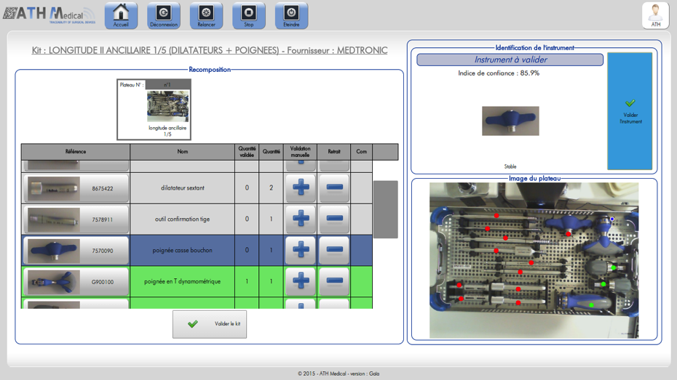
Ancitrak®
Notes:
Once the instruments have been validated during reprocessing, the lines in the diagram and the dots on the photo of the tray turn green.

Slide 10
Ancitrak®
Notes:
If there are a number of identical instruments, the line in the diagram remains orange until the full quantity has been reached. When the quantity validated is equal to the theoretical quantity, the line turns green.

Slide 11
Ancitrak®
Notes:
If the quantity validated is greater than the quantity recorded, the line turns yellow to warn the operator.

Slide 12
Ancitrak®
Notes:
Once the full tray is complete, all the lines and dots are green.

Slide 13
Context of the pilot study
In collaboration with the UNIHA purchasing group
Pilot for 6 months at Lille CHRU
Qualified OR Nurse appointed specifically for the project
Ancillaries on loan and long term consignment for the neurosurgery Operating Room (OR)
Pilot study into sterilisation reprocessing and the neurosurgery OR
Notes:
The pilot study I am going to present ran for 6 months at the Lille CHRU in collaboration with UNIHA.
A qualified OR Nurse dedicated to the project monitored ancillaries on long and short term loan to the neurosurgery OR.
The pilot included both sterilisation and the OR.

Slide 14
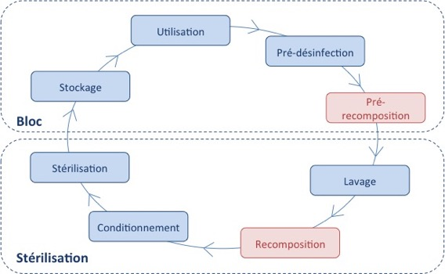
Context at the Lille CHRU
Traceability by individual instrument with data matrix code for 2 steps of the process: in the theatre and during sterilisation
New step: pre-reprocessing of trays before going to sterilisation
In red: step with traceability of each individual instrument
Notes:
At the Lille CHRU, traceability by individual instrument using a data matrix code is carried out in 2 steps:
During reprocessing at the sterilisation stage
and also in the operating theatres where the procedure trays are pre-reprocessed before going to sterilisation

Slide 15
Context at the Lille CHRU
Ancillary on long term consignment | Ancillary on short term loan
Delivery to the pharmacy | Delivery to the pharmacy
OR Nurse: inventory and contents description sheet with the medical device references, photos | OR Nurse: inventory and contents description sheet with the medical device references, photos
Qualified Sterilisation Nurse: verification and input into the AdvanceSté® programme | Qualified Sterilisation Nurse: verification of conformity between the sheet and the actual contents
Sterilisation Technicians: reprocessing using AdvanceSté® | Sterilisation Technicians: Reprocessing using contents description sheets in hard copy
Notes:
The ancillaries are delivered to the pharmacy. They are then sent to the OR where the OR Nurses check the equipment and the detailed contents description sheets for the trays.
After this, the two channels for the one-off loans and the ancillaries on consignment diverge.
The ancillaries on consignment are entered into the AdvanceSté® traceability programme by the Qualified Sterilisation Nurses and then reprocessed using the programme by the Sterilisation Technicians.
The ancillaries on short term loan, however, are reprocessed using the hard copy sheets after verification by the Qualified Sterilisation Nurses.

Slide 16
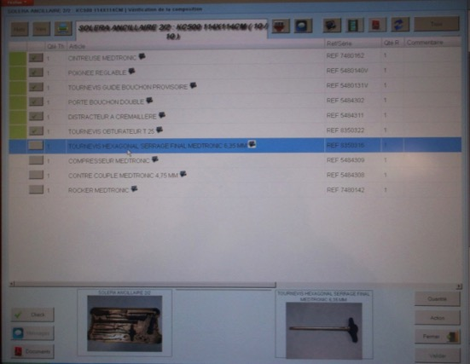
Context at the Lille CHRU
Ancillary on consignment with AdvanceSté®
For each medical device: Name Reference Quantity Photo
Notes:
Here is the screen for the AdvanceSté® programme. Each line corresponds to an instrument with its name, reference and the quantity. The photo of the tray and the instrument appears at the bottom of the screen.
For unetched devices, they are ticked off manually using the boxes on the of the screen.

Slide 17
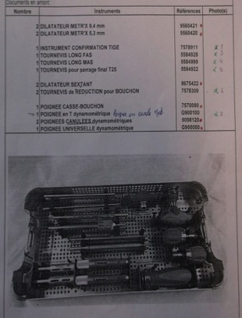
Context at the Lille CHRU
Ancillary on short term loan
Hard copy Full view of the tray (photo) For each medical device: Name Reference Quantity
Notes:
For the hard copy version, the name and reference of the instrument, and quantity, are in the diagram. There is only one full photo of the procedure tray.

Slide 18
Objectives
To assess the benefits of using Ancitrak® in the operating theatre and for sterilisation as a tool to enhance the traceability of unetched ancillaries on short and long term loan and the reprocessing of procedure trays
Expected benefits
Qualitative:
Health safety through the implementation of traceability for unetched and unrecognised instruments
Guaranteed patient care: e.g. the certainty of having a complete procedure tray
Inventory undisputed by the supplier
Quantitative:
Reprocessing time with and without the tool
Recognition rates for the instruments
Notes:
The objective of the pilot is to assess the benefits of using Ancitrak® in the operating theatre and for sterilisation as a tool to enhance the traceability of unetched ancillaries on short and long term loan.
The expected benefits are partly qualitative: health safety with traceability by individual instrument for unetched medical devices, guaranteed patient care thanks to the completeness of procedure trays and the availability of an inventory undisputed by the supplier.
Also, quantitative benefits in terms of reprocessing time and recognition rates for the instruments.

Slide 19
Method
Programming: recording tray contents in the Ancitrak® programme: Project OR Nurse
Assessment of tray reprocessing at the Stérinord centre:
Reprocessing carried out by
Project OR Nurse
Sterilisation Technician
Reprocessing time
Recognition rates for the medical devices
Notes:
The first phase involved the project OR Nurse learning how to use the Ancitrak® programme for neurosurgery ancillaries.
The second phase involved the assessment by the project OR Nurse and the Sterilisation Technicians of procedure tray reprocessing in the sterilisation stage.
The parameters assessed were the reprocessing times and recognition rates for the medical devices

Slide 20
1) Recording the data
Recording the contents of the trays:
Name and reference of the instruments
Photos
Position of the instrument on the tray
Quantity of each instrument
Step carried out only once when a new tray is introduced
102 different procedure trays (long and short term) meaning roughly 2,900 instruments
about 75% ancillary instrument trays without implants
Average recognition rates: 89%
Notes:
Firstly, recording of the procedure trays as outlined above. This step is carried out only once when a new tray is introduced.
102 different short and long term loan ancillaries were entered. It should be noted that about 75% of these trays did not contain implants
The average recognition rate for the instruments was 89%.

Slide 21
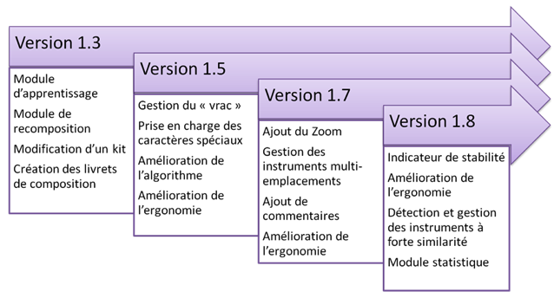
Improving the tool
1st phase enabled improvements to the tool
Programming
Training the Sterilisation Technicians
Reprocessing with and without Ancitrak®
Notes:
This first phase of programming made it possible to improve the programme by reviewing the ergonomics of the device and instrument recognition.
These improvements were continuous throughout the pilot study.

Slide 22
2) Reprocessing in the sterilisation stage
1st part: discovering the tool and training
40 Sterilisation Technicians trained
2nd part: recording times with and without Ancitrak®
18 Technicians monitored (out of 40)
Without: with AdvanceSté® or hard copy (loan)
Notes:
The second step for processing procedure trays at the sterilisation stage involved two parts. 40 Technicians were informed and trained on the tool. 18 of them were then timed during reprocessing with and without Ancitrak®, in other words for normal reprocessing with either the AdvanceSté® programme or the hard copy version.

Slide 23
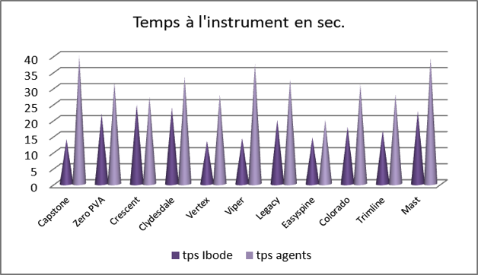
Reprocessing times
1st part: discovering the tool
Average time for the project OR Nurse
Notes:
When discovering how to use the tool, there is quite a difference in the time taken for reprocessing by the project OR Nurse (in dark purple) and by the Sterilisation Technicians.
These differences are related to the type of procedure tray being reprocessed.

Slide 24
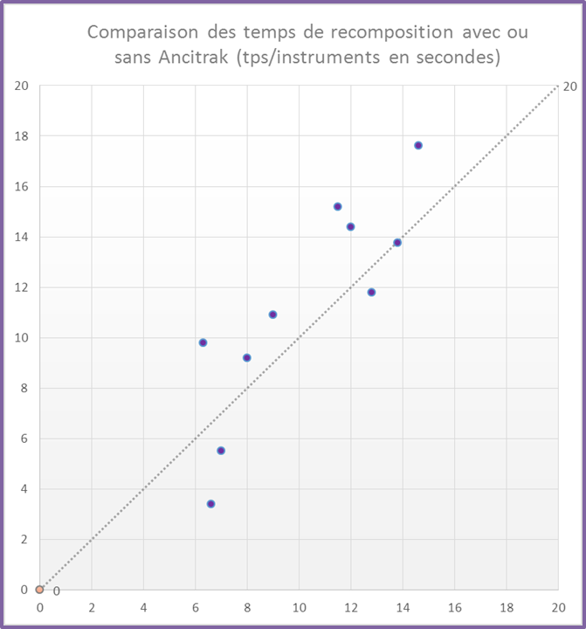
Reprocessing times
1st part: discovering the tool
Ancitrak®
For 70% of the ancillaries, there were productivity gains
The more complex the box, the more time is saved
AdvanceSté®
Notes:
Using Ancitrak® resulted in productivity gains with reduced reprocessing time for about 70% of ancillaries.
The more complex the box, the more significant the time saving was.

Slide 25
Reprocessing times
2nd part: recording times with and without Ancitrak®
Sterilisation Technicians: longer time WITH Ancitrak®
Notes:
When comparing reprocessing times with and without Ancitrak®, the times vary according to the type of tray. The average reprocessing time is longer with Ancitrak® for the Sterilisation Technicians, whereas the opposite is true for the project OR Nurse.
PRÊT = LOAN
BOUGIES DE DISTRACTION = REAMERS
ECARTEUR = RETRACTOR
Temps/instr/avec = time per instrument with
Temps/instr/sans= time per instrument without

Slide 26
Assessment of reprocessing
Considerable differences depending on the tray
Assistance with reprocessing:
loaned ancillaries: little or no knowledge of contents, more attractive than the hard copy version
For complex trays with several layers: easier to fill
Time differences between Technicians and OR Nurse due to regular use of the tool
→ Learning phase for Technicians / Routine for OR Nurse
Notes:
There are considerable differences in reprocessing times depending on the type of ancillary.
Ancitrak® is of assistance for the reprocessing of loaned ancillaries of which there is little knowledge of the contents, and the hard copy version is less attractive.
Reprocessing is also facilitated for complex trays with several layers, with assistance for filling.
The differences in reprocessing times between the OR Nurse and the Sterilisation Technicians is explained by the former making routine use of the tool, whereas the Technicians use it only occasionally.

Slide 27
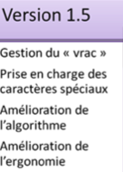
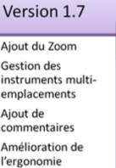
Assessment of reprocessing
Improved reprocessing times (instrument / second) with Ancitrak®:
 | Discovery phase | Reprocessing phase | Time savings
Project OR Nurse | 15’’ | 10.2’’ | 32.0%
Sterilisation Technician | 31.6’’ | 18.5’’ | 41.5%
Improvements mainly to the ergonomics and use of the programme:
Less hesitation over the position of the medical device on the tray
More precise positioning
Notes:
There is nevertheless an improvement in reprocessing times between the discovery phase and the reprocessing phase for both the Sterilisation Technicians and the project OR Nurse.
At the same time, the change to the version of the programme may have contributed to the time saved, particularly due to the more precise positioning of the instruments

Slide 28
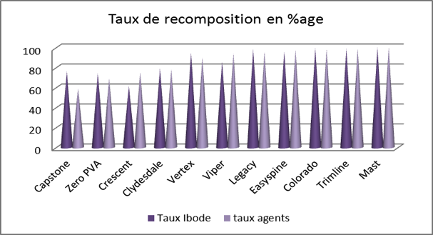
Recognition rates for the medical devices
1st part during the training phase for the Technicians
Version 1.5 of the programme
Recognition rates similar for OR Nurse / Technicians
< 80%
Notes:
The recognition rates for the instruments are similar whether reprocessing is carried out by the OR Nurse or the Sterilisation Technicians.
Note that four trays had a recognition rate of less than 80%.
Taux Ibode = Rates Project Nurse
Taux agents = Rates Technicians

Slide 29
Recognition rates for the medical devices
2nd part during reprocessing
Version 1.7 of the programme
→ In blue: < 80%
 | Sterilisation Technicians | Project OR Nurse
Names of procedure trays | Average recognition rates | Average recognition rates
ALIF ANCILLARY 1 | 87
AVENUE | 92 | 91.3
REAMERS | 33 | 55
CAPSTONE | 86 | 61.5
CLYDESDALE |  | 69
COLORADO | 94
CRESCENT | 71 | 87
EASYSPINE | 98.5
ENDORING | 95.14 | 94
LEGACY | 97.44
LONGITUDE | 76.2 | 72
MAST | 95 | 83
MOBIDISC (LOAN) | 88
NEX-LINK | 95 | 97
ORACLE | 100
PMI | 74 | 86
QUADLEG | 92.58 | 90
ROI-C | 37
SOLERA | 100 | 90
SOVEREIGN | 87 | 90
T-PAL (LOAN) | 47 | 44
TRIMLINE | 94 | 99
VERTEX (LOAN) | 75
VIPER | 85 | 94.7
ZERO PVA (LOAN) | 65.1 | 68.7
ZEPHIR |  | 35.0
Notes:
During the reprocessing phase using the new version of the programme, there are similar recognition rates. The blue lines correspond to average recognition rates of less than 80%.
Once again, we see the 4 trays from the 1st phase.

Slide 30
Assessment of recognition rates for the medical devices
Link between the recognition rate and the complexity of the tray:
Implants
Very similar devices
→ Improvements to the tool with the new versions V 1.8 (choice between 2 similar medical devices with photo and position)
→ Limits of the tool for some similar medical devices or medical devices that are too light
Notes:
The recognition rate is linked to the complexity of the procedure tray. The rate is lower when the tray consists of implants or very similar devices.
Recognition of the devices could be somewhat improved with the new version of the programme, but will remain limited by the tool for medical devices that are too light or too similar.

Slide 31
Qualitative
Assessment of the discovery phase using a questionnaire
Sterilisation Technicians having carried out reprocessing with Ancitrak®
Neurosurgery operating room Qualified OR and Auxiliary Nurses
Notes:
For the qualitative assessment of the tool, we asked the neurosurgery nursing staff and the Sterilisation Technicians to complete a questionnaire after the discovery phase for Ancitrak®.

Slide 32
Sterilisation Technicians' answers
Sample of 16 Technicians
Impression of saving time: 78.6%
Impression that reprocessing was more accurate: 90.9%
Positive comments:
- quick and easy to understand and use
- recognition of each instrument
- time saved during the reprocessing and filling of the trays
Negative comments:
- programme ineffectual for very small or light items
- time lost if very few instruments in the ancillaries
- does not differentiate between items that closely resemble each other
Notes:
16 Sterilisation Technicians answered the questionnaire. 78.6% of them believed that time had been saved and 90.9% that reprocessing was more accurate.
The ergonomics of the device, using the programme, placing the instruments on the tray, the recognition of the instruments and the flagging of any missing instruments were all deemed satisfactory for the majority of the technicians.

Slide 33
Neurosurgery OR staff answers
Sample of 9 people (Qualified and Auxiliary Nurses)
Impression of saving time: 33.3%
→ little reprocessing carried out
Impression that reprocessing was more accurate: 88.9%
Positive comments:
- visibility of information
- reprocessing easier than with AdvanceSté®
Negative comments:
- programme ineffectual for very small or light items
- does not differentiate between items that closely resemble each other
- touch screen malfunctions in presence of water
Notes:
We obtained 9 answers from the neurosurgery OR staff. 88.9% of respondents found that reprocessing was more accurate, but only 33.3% thought that time had been saved. This low percentage could be explained by the low number of procedure trays reprocessed using Ancitrak®.
The other parameters mentioned earlier were also deemed to be satisfactory.
Whether in the OR or during sterilisation, the issue of recognition of very light or similar devices was raised.

Slide 34
Next steps for the study (ongoing)
In the OR:
Impact on loans
Reprocessing in the OR
Study involving the whole circuit: assessing the completeness of the trays
Use in routine phase
Improving the tool:
Improved recognition of similar instruments (V 1.8)
Implants
Benefits for other types of equipment? (e.g. laparoscopy)
Notes:
The study is still ongoing for the assessment of a number of parameters.
- The impact on loans (for the inventory and the contents sheet) and the pre-reprocessing of procedure trays is being assessed in the neurosurgery OR.
- The assessment of completeness rates throughout the circuit with use of Ancitrak® during the routine phase.
- Monitoring of improvements to the programme regarding the recognition of instruments and on implants.
- If possible, assessment when used for other, unetched devices such as equipment for laparoscopic surgery.

Slide 35
Loans
Methodology:
Times for the OR Nurses, including sterilisation
1st results: encouraging
In the OR:
During sterilisation:
→ Time saved because inventory and tray contents sheet with photos done in a single step
 | Number of medical devices | Time without Ancitrak® (min's) | Time with Ancitrak® (min's) | Time saved
2 trays | 44 (including implants) | 54.35 | 30.57 | 43.75%
7 trays | 241 (including implants) | 162.1 | 96.96 | 40.19%
 | Number of medical devices | Time without Ancitrak® (min's) | Time with Ancitrak® (min's) | Time saved
6 trays | 90 | 30 | 15.20 | 49%
Notes:
For ancillaries on loan, the times taken by the OR Nurses for handling procedure trays were monitored both in the neurosurgery OR and during sterilisation,
The first results are encouraging, with time savings of about 40% when using Ancitrak®. These savings can be explained by the inventory and the contents sheet with photos being done in a single step

Slide 36
Expected outcomes
Time savings for OR Nurses during sterilisation
Easier verification for equipment on loan
Input into Advance for equipment on consignment
Time saved in the OR:
Inventory and processing at the same time
Financial savings on disputes with suppliers
HR benefits?
Notes:
All those involved have high expectations of the benefits of using Ancitrak®:
Concerning sterilisation, time saved when verifying equipment on loan and inputting data into AdvanceSté® by the OR Nurses for ancillaries on consignment.
Concerning the OR , easier handling for new ancillaries
- Concerning the pharmacy, a financial gain by reducing the cost of disputes with suppliers
Finally, benefits in terms of human resources may be possible.

Slide 37
Conclusion
Assistance with the reprocessing of ancillaries on loan and complex procedure trays:
Improved traceability
More accurate reprocessing
Time saved
Prototype undergoing continuous improvement
Time needed to adapt to the tool
Limits of the tool in terms of the recognition of certain devices
Full assessment pending the results of the ongoing study in the OR
Notes:
The initial results of the assessment show that Ancitrak® is of assistance in reprocessing on-loan ancillaries and complex operating trays with improved traceability and more accurate reprocessing. There are related time savings that could be further improved with more regular use.
The prototype is undergoing continuous improvement, with certain limits having been observed in terms of the recognition of certain devices
A more complete assessment will be possible once all the results have been received.

