Slide 1
8714252024906

Slide 2
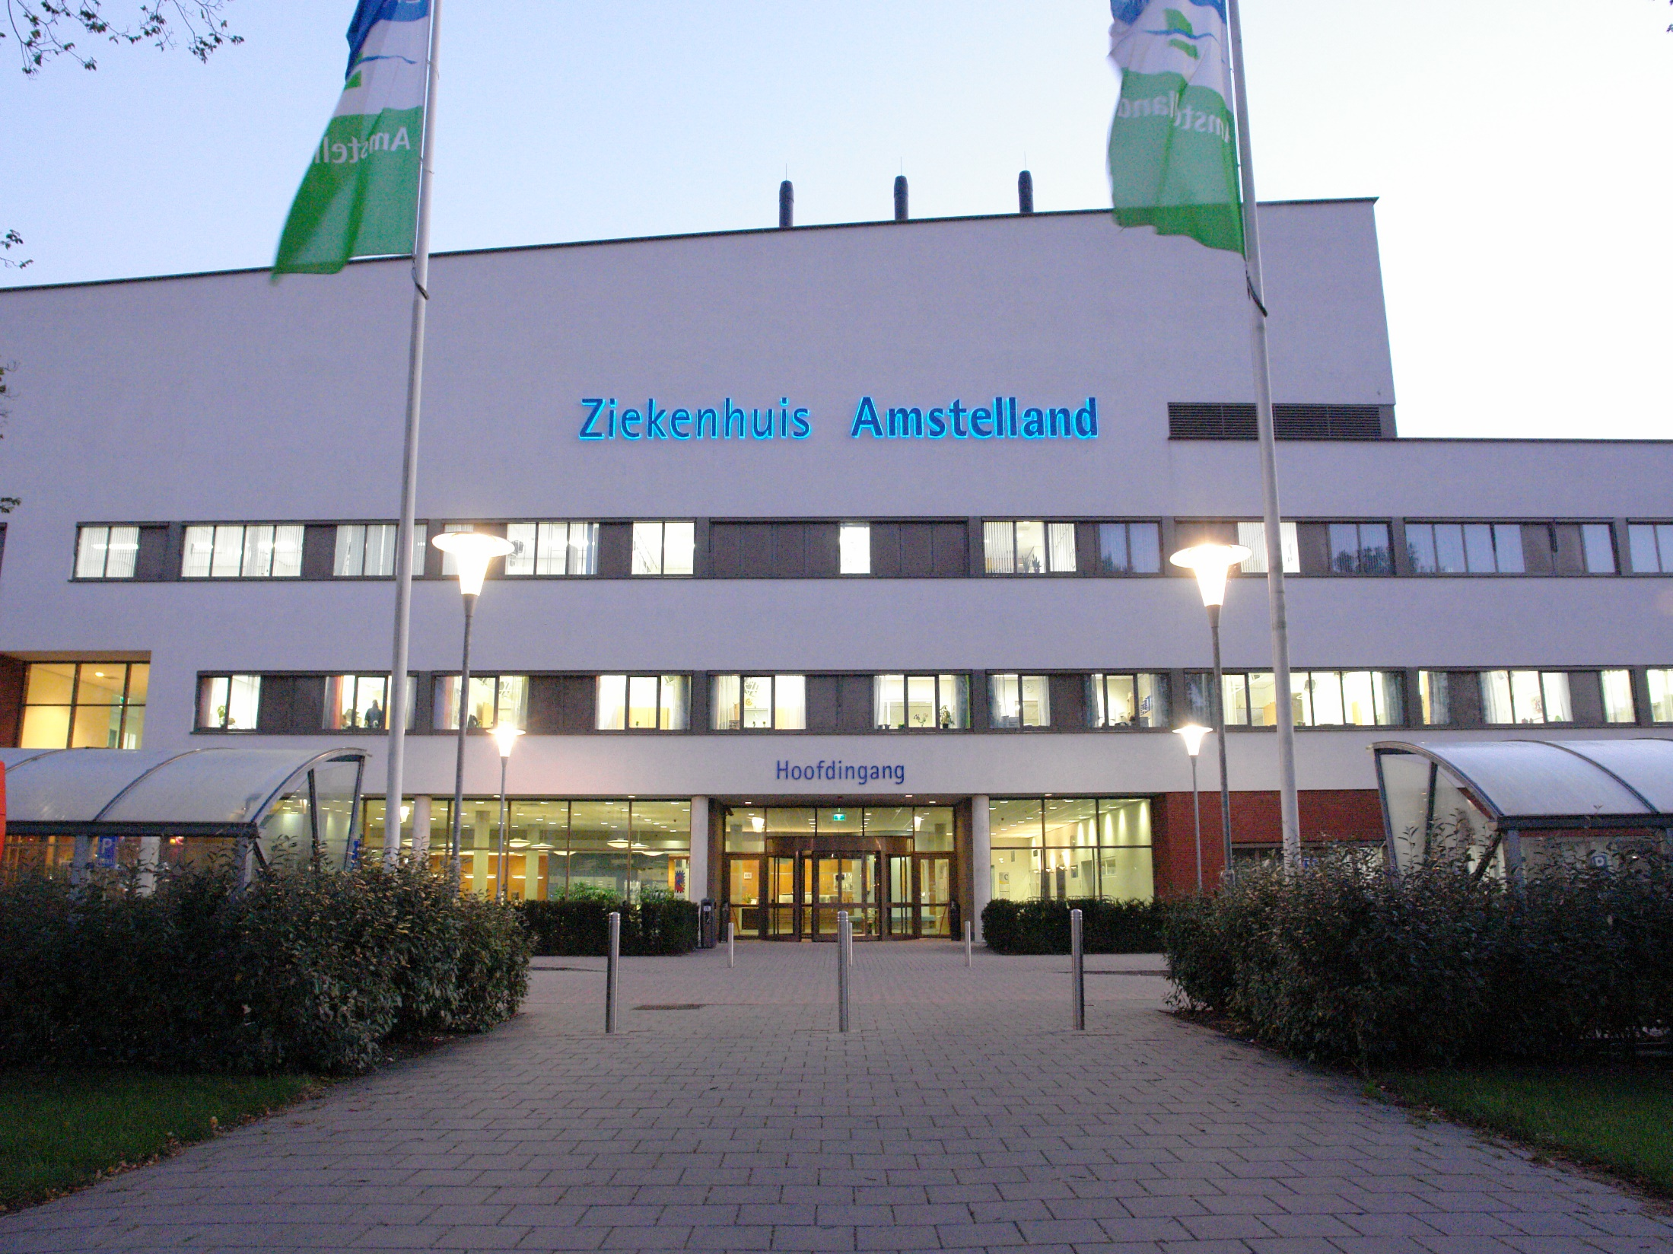
7-10 oct. 2015

Slide 3
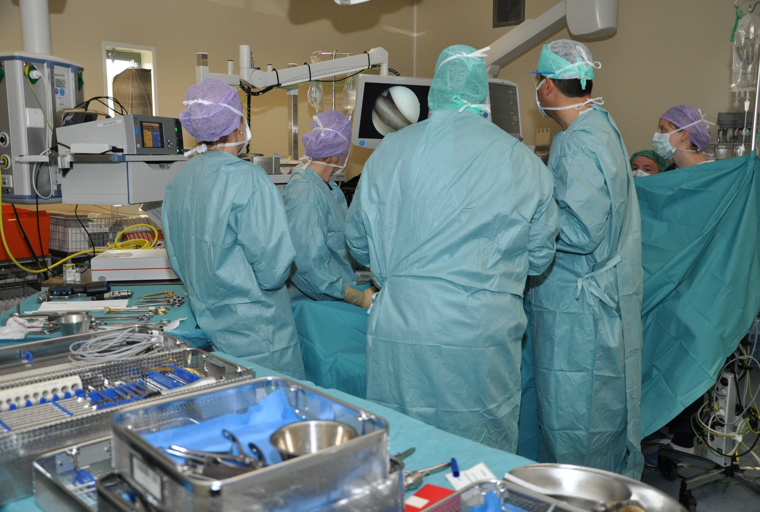
7-10 oct. 2015

Slide 4
The supply chain of sterile medical devices in your hospital:
Improving patient safety and gaining efficiency on stock control
7-10 oct. 2015

Slide 5
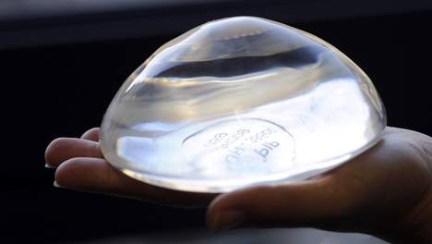
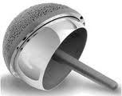
7-10 oct. 2015

Slide 6
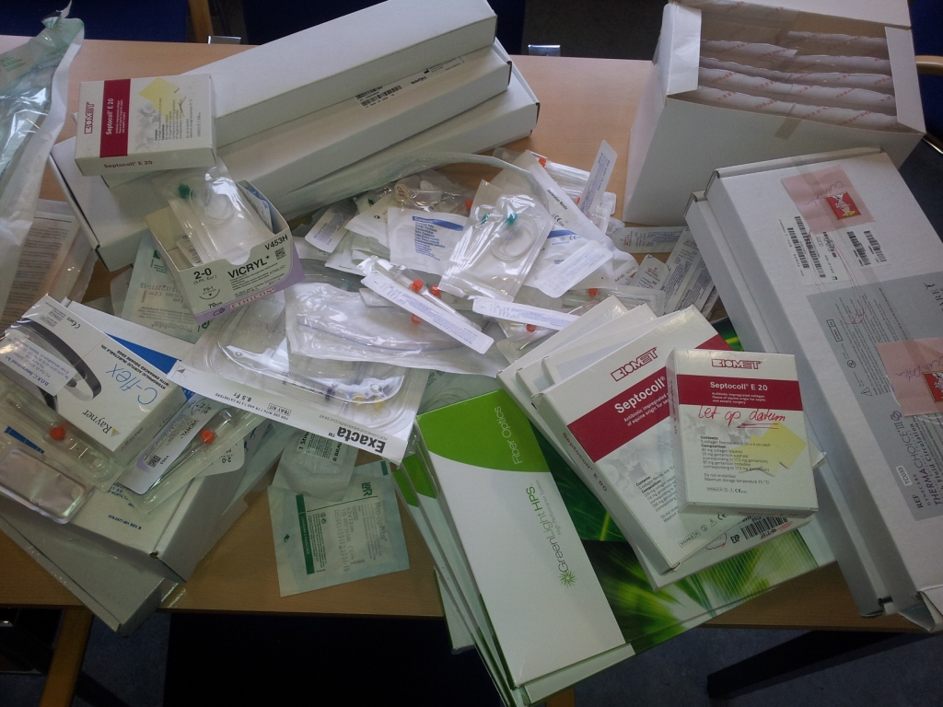
7-10 oct. 2015

Slide 7
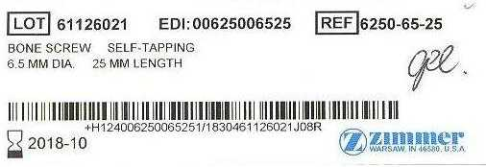
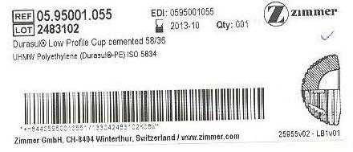
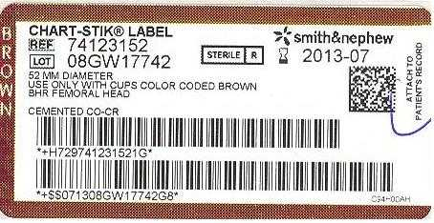
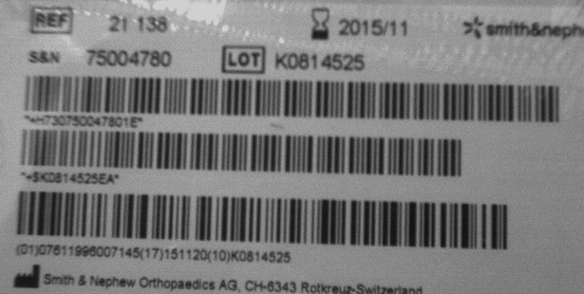
7-10 oct. 2015

Slide 8
7-10 oct. 2015

Slide 9
7-10 oct. 2015

Slide 10
7-10 oct. 2015

Slide 11
Why did we start
Manual recall procedure
High stock level
No insight in costs of operations
Waste reduction
No control on sterile date in warehouse
To many last minute emergency deliveries of sterile medical devices
Manual replacement procedure
7-10 oct. 2015

Slide 12
How did we start
relabelling
Update data on inventory
Together with the supply chain partners in the hospital
Process redesign: how will it work?
Create traceability
Level III en IIb items and >€15, starting with 700 items
7-10 oct. 2015

Slide 13
7-10 oct. 2015

Slide 14
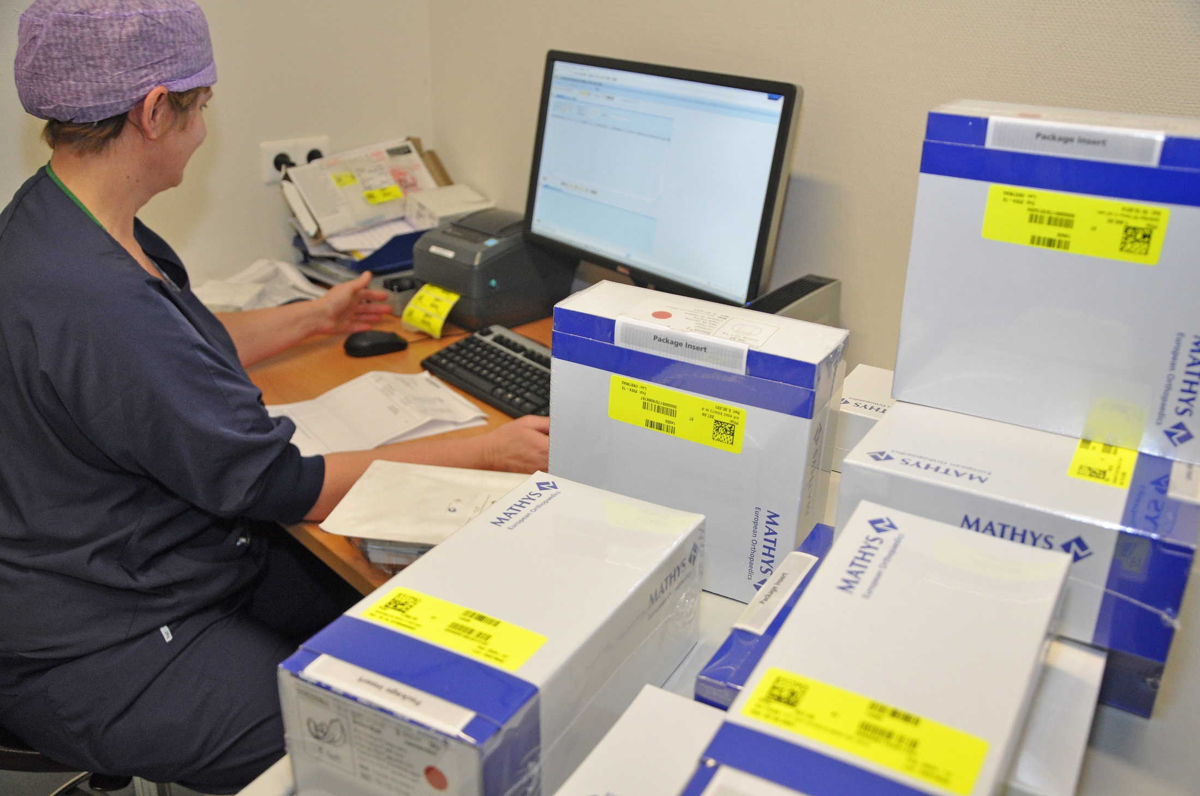
7-10 oct. 2015

Slide 15
Results after 1.5 year
Over 12,000 unique items registered at the patient a year
Over 1.000 items are in the system
Automated recall within 2 minutes
Sterile date check automated and in control
Waste reduction by € 60,000 per year
Lower stock level from € 700,000 to € 525,000
Insight in material cost per operation
Slow learning curve on inventory management Sterile supply
Still manual registration of products
7-10 oct. 2015

Slide 16
7-10 oct. 2015

Slide 17
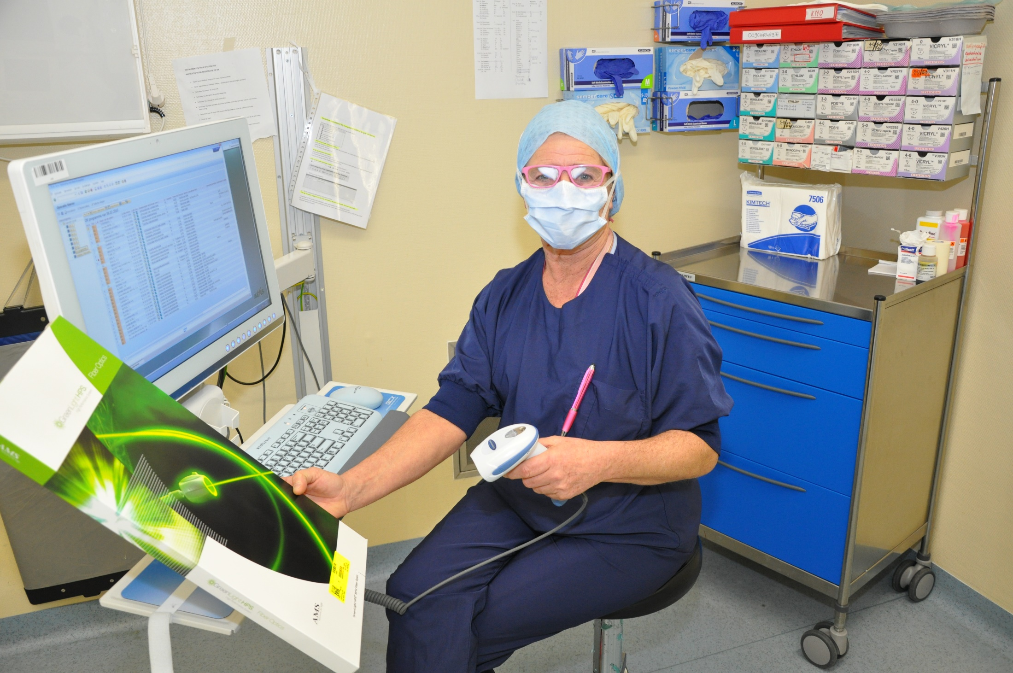
7-10 oct. 2015

Slide 18
Take-away message
Scan, scan, scan
Just do it, but do it together with: OR-nurse, logistics, finance, procurement and IT.
Make a business case
Choose your way of implementation
Realize that inventory management is an other ball game
And then …..
7-10 oct. 2015

Slide 19
Take-away message II
You can improve patient safety by:
Having an automated recall procedure
Being in control on sterile date on level III and IIb items
Having the wright materials on time for the operations
And lowering the costs of the hospital by:
Reducing waste
Lower stock level and related cost of holding stock
Gaining insight over cost and pricing of operations
7-10 oct. 2015

Slide 20
2019: See you in the Netherlands? anniversary
VDSMH 20 year and SVN 50 year in 2019

