Slide 1
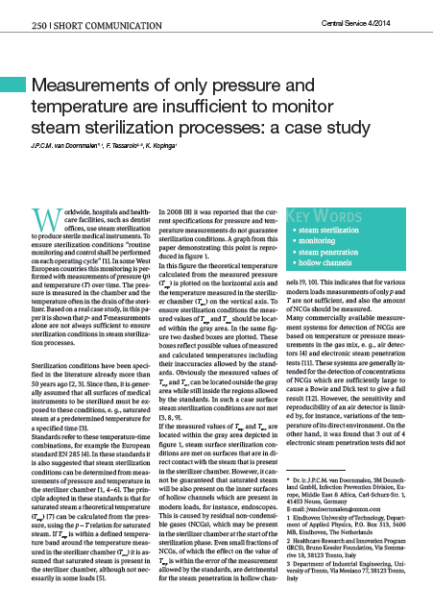
Measurements of only pressure and temperature are insufficient to monitor steam sterilization processes: a case study
Dr.ir. Josephus P.C.M. van Doornmalen Gomez Hoyos
3M Deutschland GmbH (Germany)
Eindhoven University of Technology (the Netherlands)

Slide 2

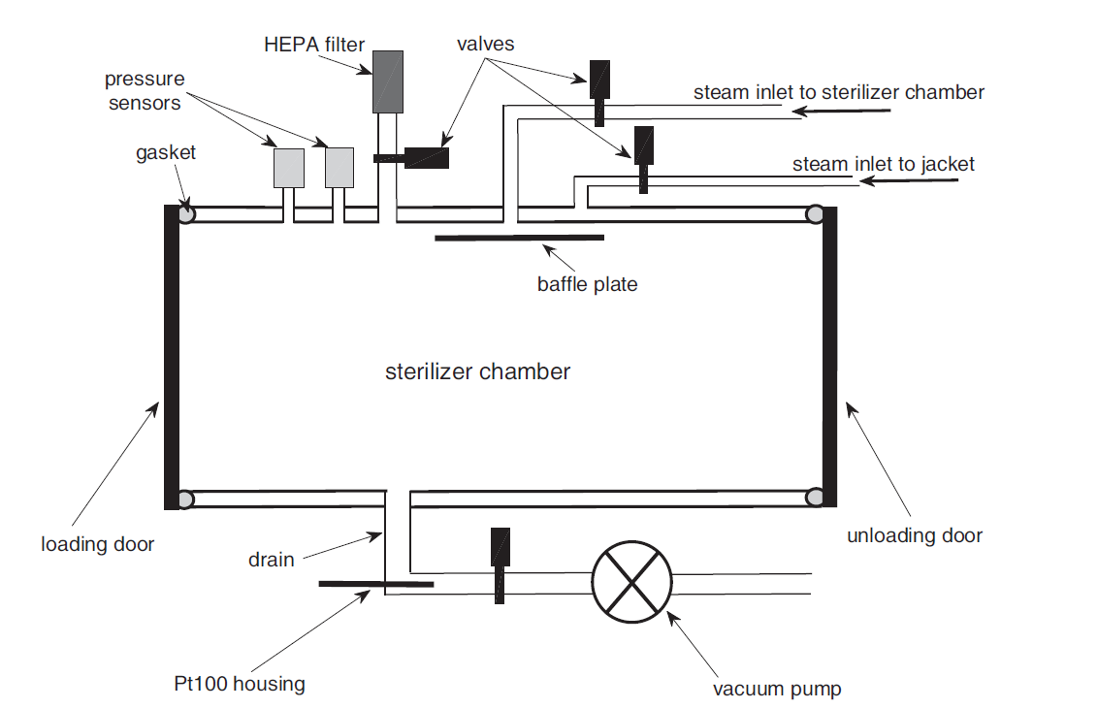
Outline
7-10 oct. 2015
Steam sterilization conditions
Monitoring
Pressure - temperature
Results out of practice
Possibilities
Conclusions

Slide 3

The physical parameters for surface steam sterilization are:
Humidity, temperature, and, time
Temperature, pressure, and, time
Humidity, temperature, pressure, and, time
Notes:
Include this slide to remind yourself and train the audience that a poll/question is coming

Slide 4
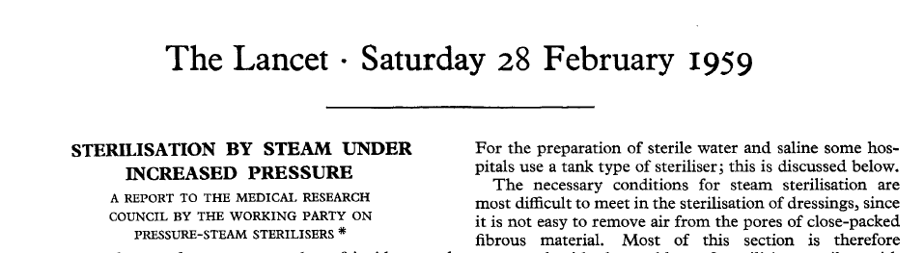
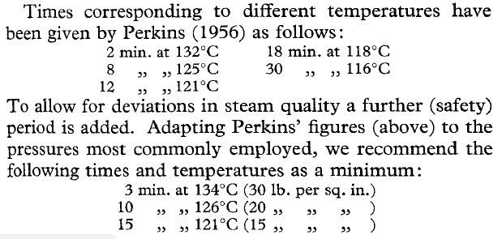
Steam sterilization conditions
Steam sterilization conditions according to the literature [3]
Saturated steam
Specified temperature-time combination
[3] Working Party on Pressure Steam Sterilizers of the Medical Research Council. Sterilisation by steam under increased pressure. The Lancet, 273:425–435, 1959.

Slide 5
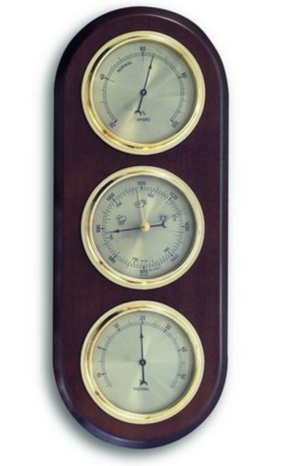
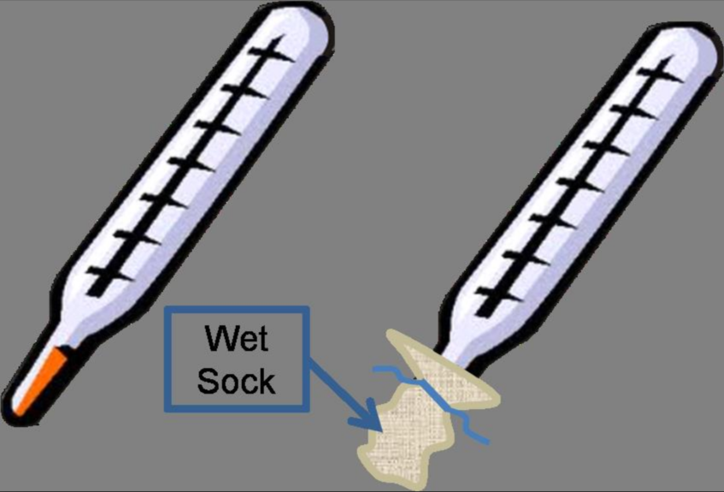
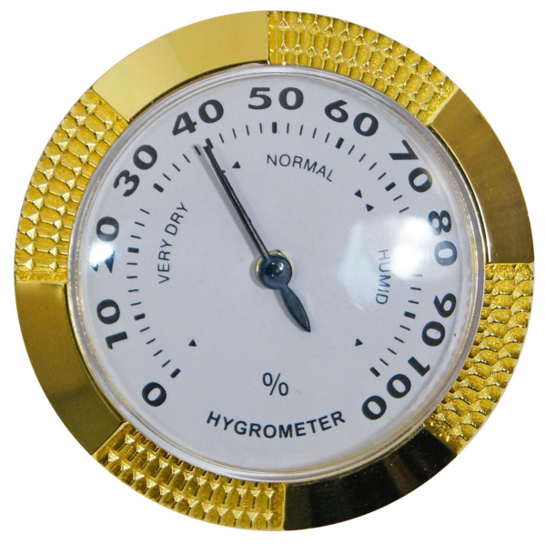
A gas or gas mix can be given any temperature
Conference room has temperature and pressure:
yet we cannot tell:
the gas composition, or,
content of moist.
The (relative) humidity can be measured
Humidity
Pressure
Temperature
Wet Bulb Temperature
Hygrometer

Slide 6
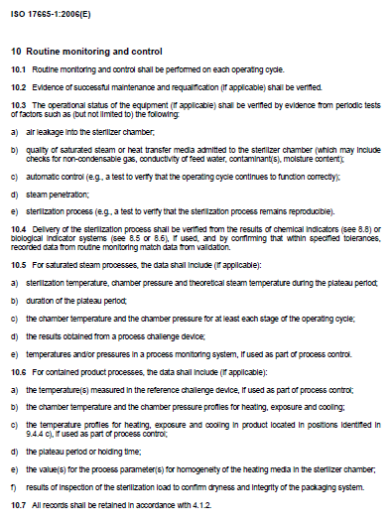
Monitoring
EN 285 [1] clause 3.3: automatic controller
device that, in response to pre-determined cycle variables, operates the sterilizer sequentially through the required stages of the cycle(s)
Control
  process control
Validation
  Qualifying
    combination sterilizer (hardware), process, load, loading pattern and wrapping system
Monitoring
  To permanently observe conditions
  (in a steam sterilization process)
  However ISO 17665-1 clause 10 [2] addresses monitoring
EN 17665 [2] clause 3.60: validation
documented procedure for obtaining, recording and interpreting the results required to establish that a process will consistently yield product complying with predetermined specification
NO defition in ISO or EN standards (ISO 11139, ISO 17665, EN 285).
[1] European Committee for Standardization. standard EN 285: A2:2009 sterilization - steam sterilizers - large sterilizers (includes Amendment A2), 2009.
[2] International Organization for Standardization. ISO 17665-1 2006 Sterilization of health care products – moist heat – part 1: Requirements for the development, validation and routine control of a sterilization process for medical devices. 2006

Slide 7
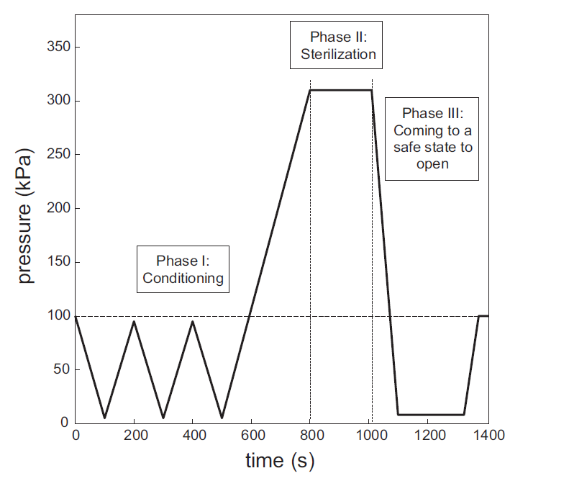
Steam sterilization process
Most common issues to have NCGs:
Bad air removal
  Bad vacuum/low steam inlet
  Too fast pulsing
Leak in hardware
  Not always detectable with the Air leakage test [1]
NCG in steam
Δt_{i}
Δt_{i}
Δt_{i}
Δt_{i}
Δt_{i}
[1] European Committee for Standardization. standard EN 285: A2:2009 sterilization - steam sterilizers - large sterilizers (includes Amendment A2), 2009.

Slide 8
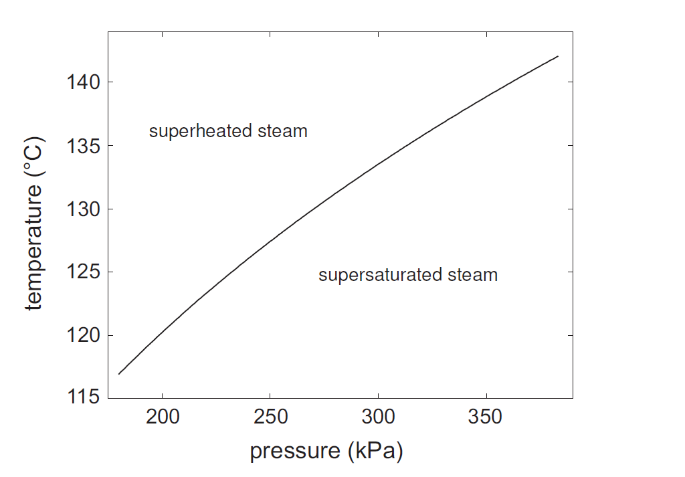
Pressure and temperature relation
Then and only then when saturated steam is present a relation between pressure and temperature exists [4,5].
Consequently (the other way around):
when only the pressure and temperature are known the composition or saturation of the gas mix in a vessel cannot be identified.
[4] Wagner W, Cooper JR, Dittmann A, Kijima J, et al. The IAWPS industrial formulation 1997 for the thermodynamic properties of water and steam. Transactions of the ASME, 122:150–182, 2000.
[5] Irvine TF Jr and Liley PE. Steam and gas tables with computer equations. Academic press, Inc., Boca Raton (FL), 1984.

Slide 9
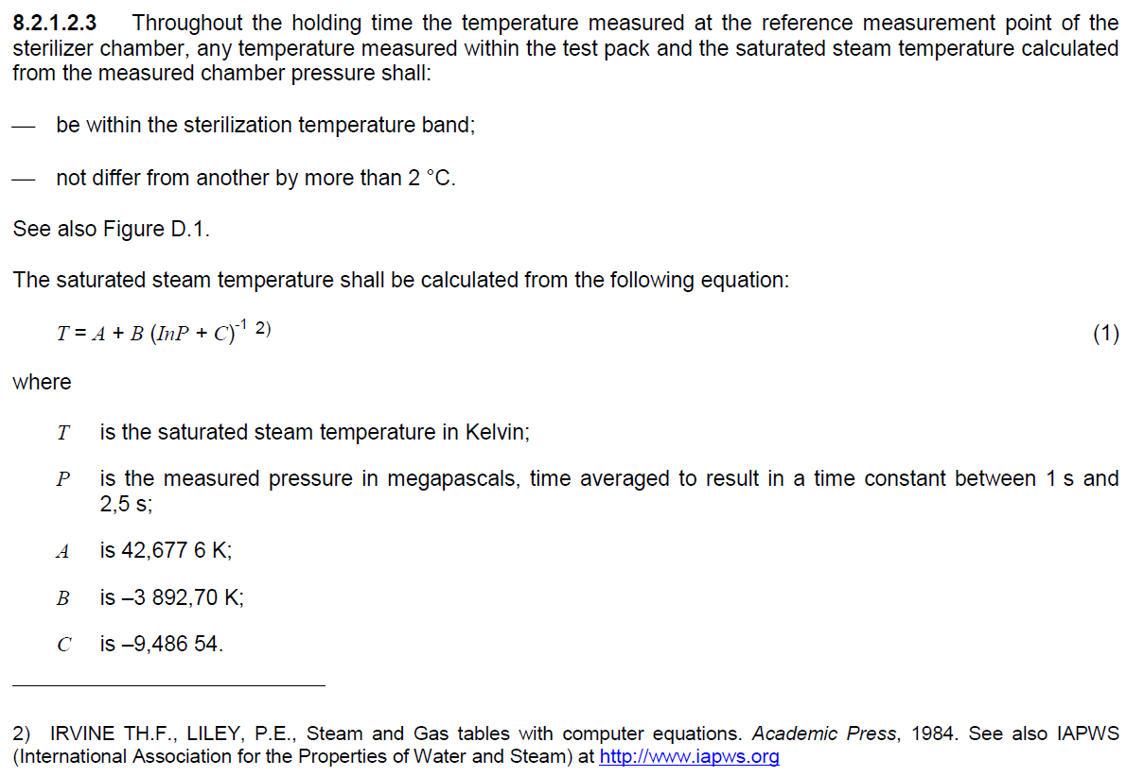
Standard EN 285 Large steam sterilizers [1]
Throughout the holding time the temperature measured at the reference measurement point of the sterilizer chamber, any temperature measured within the test pack and the saturated steam temperature calculated
from the measured chamber pressure shall:
This could be wrongly interpreted
(Could be interpreted as: if p and T have the relation as (1) then saturated steam is present)
[1] European Committee for Standardization EN 285: 2009 Sterilization - Steam sterilizers - large sterilizers (includes Amendment A2)

Slide 10
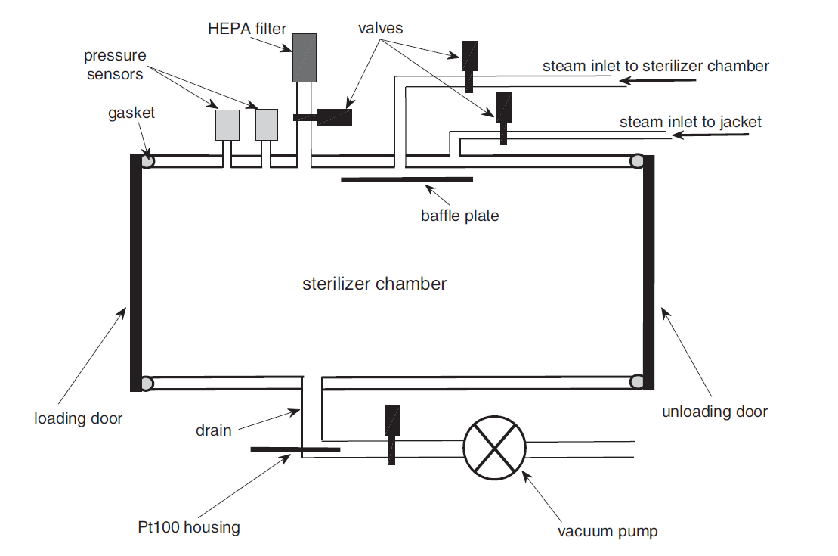
Monitoring pressure and temperature for
Pressure measured in the chamber
Temperature measured in the drain (possibly in condensate)
Temperature sampling rate of 2.5 s or better
Pressure sampling rate of 1 s or better
Possibly not the best positions to monitor the temperature
Possible inaccuracies when sampling rates are not similar [6]
[6] van Doornmalen JPCM and Kopinga K. Review of surface steam sterilization for validation purposes. American Journal of Infection Control 2008; 36: 86–92.

Slide 11
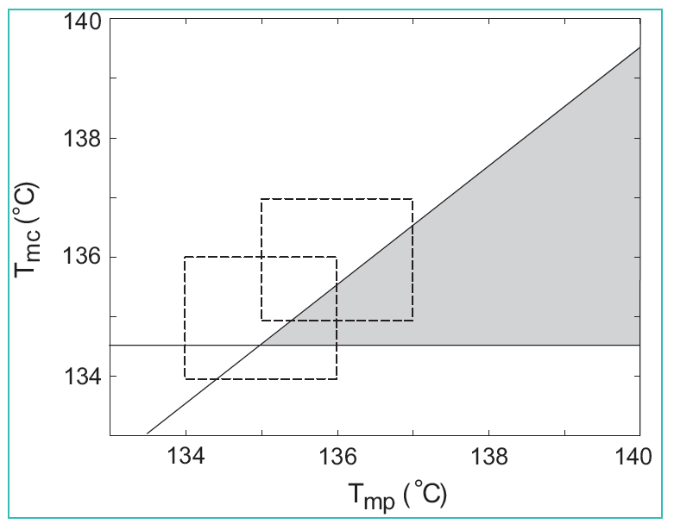
Accuracy of measurements [1]
Temperature
Accuracy from 50 to 150 °C of 1.6 %
Aimed sterilization temperature ≥ 134 °C
At 134 °C equals approximately 1 °C
Results in set point 134 + 1 = 135 °C!
Pressure
Accuracy over 400 kPa of 1.6 %
Equals approximately 4.2 kPa
At 305 kPa equals approximately 1 °C
Results 135 ± 1 °C
`sterilization conditions’
T set point
When the 134 and 137 °C limits are respected the `measurement inaccuracy square’ will always contain not correct areas.
p set point
[1] European Committee for Standardization. standard EN 285: A2:2009 sterilization - steam sterilizers - large sterilizers (includes Amendment A2), 2009.

Slide 12
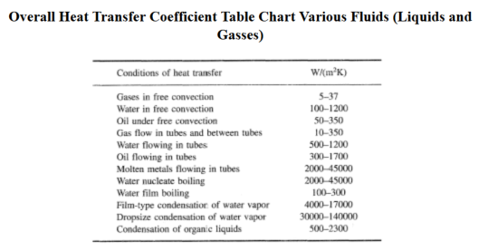
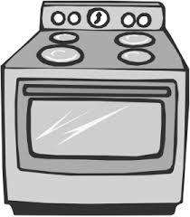
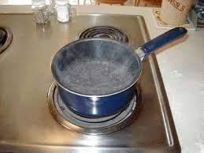
Difference between air and steam
Heat transfer:
  Air:
    Order 100 W/(m²K)
  Condensing water vapor (steam):
    Order 4000 W/(m²K)
  Order 40 difference
[8] table from internet: https://www.engineersedge.com/thermodynamics/overall_heat_transfer-table.htm (last accessed 06/10/2015)

Slide 13
Device principle summary
Wall temperature
Temperature (°C)
Steam curve
Air curve
Time (s)
[9] van Doornmalen JPCM and Kopinga K. Measuring non condensible gases during steam sterilization processes. Review of Scientific Instruments 2013; 84:115106.

Slide 14
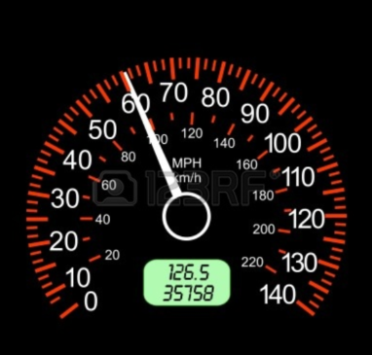
Device principle summary
Velocity
Warm up
velocity = °C/hour
Velocity = km/hour
Distance (km)
Temperature (°C)
Steam curve
km
°C
hour
hour
Time (hour)
Time (s)
Distance

Slide 15
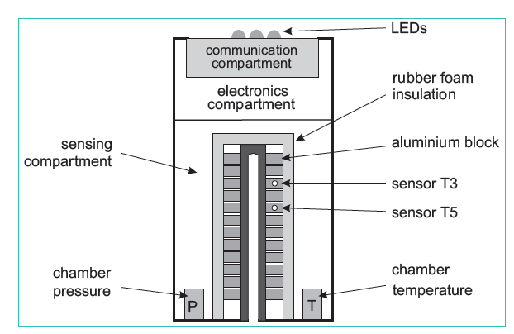
In study used device [9,10]
[9] van Doornmalen JPCM and Kopinga K. Measuring non condensible gases during steam sterilization processes. Review of Scientific Instruments 2013; 84:115106.
[10] Benoit F, Merger D, Hermsen RJ, and van Doornmalen JPCM. A comparison of four commercially available electronic steam penetration tests according to ISO 11140 part 4. Central Service 2011; 3: 180–185.

Slide 16
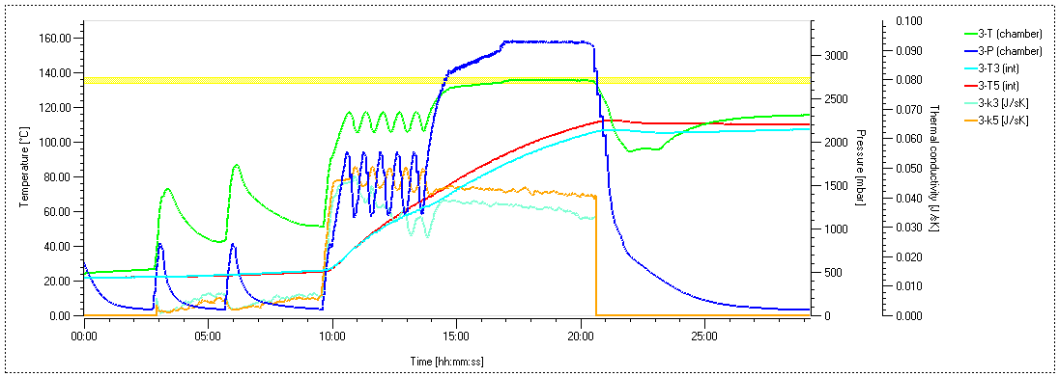
Graph of a process
Distance
Velocity

Slide 17
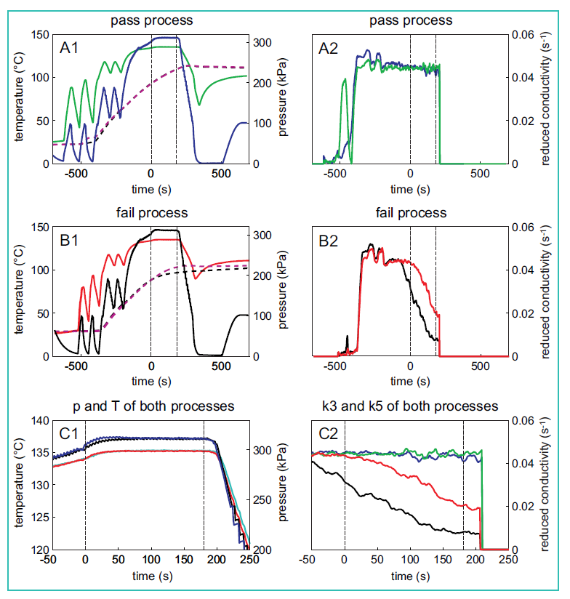
Some results
Measuring temperature and time is insufficient to ensure sterilization conditions

Slide 18
Conclusions
Pressure and time are insufficient for monitoring steam sterilization processes
To ensure/MONITOR steam sterilization additional methods have to be used
Alternatives are available
(in labs and commercially)

Slide 19
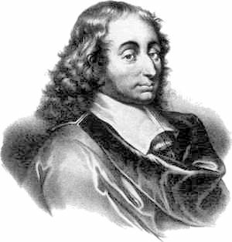
Thank you for your attention!
Blaise Pascal (1623 -1662)
French mathematician, logician, physicist and theologian
“I made this [letter] very long, because I did not
have the leisure to make it shorter.”
Thanks to: prof.dr.ir. Klaas Kopinga
dr. Francesco Terssarolo,
Robbert Jan Hermsen,

