Slide 1
How do you ensure your loan kit is clean and sterile?
Jane Butler
Central Sterilizing Department
The Prince Charles Hospital
Brisbane
Queensland
Australia
Presentation title
Presenter’s name
Department/Unit/Ward
Service line
Facility/hospital
Date

Slide 2

Click here

Slide 3

Map of Australia

Slide 4




City of Brisbane

Slide 5
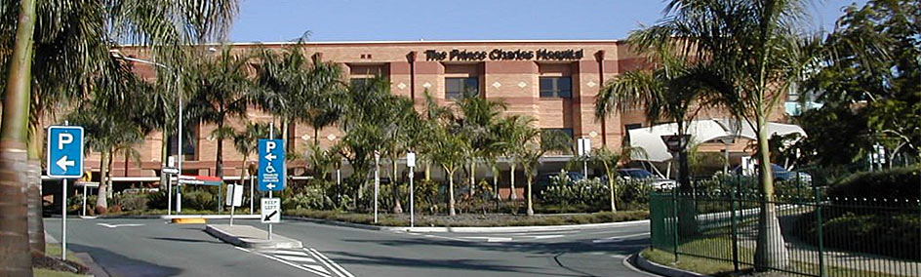


The Prince Charles Hospital

Slide 6
The Objectives
Procedures
Prevention
The risk of contaminated loan instruments
The loan kit
PQ of washers/sterilizers
To ensure cleanness
Product families
Identify complex instrumentation
Ensure instrumentation is sterile

Slide 7
Procedures
January to December 2014
376 Knee Replacements
48 Revision of knee replacements
318 Hip Replacements
57 Revision of hip replacements
25 Shoulder replacements
303 Fractured neck of femurs
Elective orthopaedic only

Slide 8
Loan Kits
2014 processed 5403 loan trays from 16 loan companies
The hospital also has consigned loan sets/kits
3 types of knee replacements
3 Hip sets
Revision hip instrumentation
Instrumentation for fractured neck of femurs

Slide 9
Prevention
Literature reserch produced multiple articles on contaminated instruments
Identify the hazards associated with loan sets
Have risk control processes in place for checking and decanting the loan kit.

Slide 10
Prevention
Follow manufacturer instruction - ISO 17664 2003
Departmental work guidelines
Clinical teacher/Staff development package
Loan set competency for new staff learning
Education- in service
Qualified staff Certificate 111 in Sterilization Services
Adequate staffing
Rotate the loan staff

Slide 11
The Risks
Patient safety and the transmission of infection from contamination with foreign material if reprocessing instruction are not being followed
inadequate instructions for work processes and training
Queensland Health Guideline – Management of Instrument Loan Sets Version 2 – July 2013 Page4

Slide 12
The Risks
sterilized instrument contaminated due to inadequate disassembly and cleaning
inadequate time frame for reprocessing due to the workload of the Central Sterilizing Department (CSD)
damaged/incorrect or missing instruments on a tray rendering the loan set incomplete
Queensland Health Guideline – Management of Instrument Loan Sets Version 2 – July 2013 Page 4

Slide 13
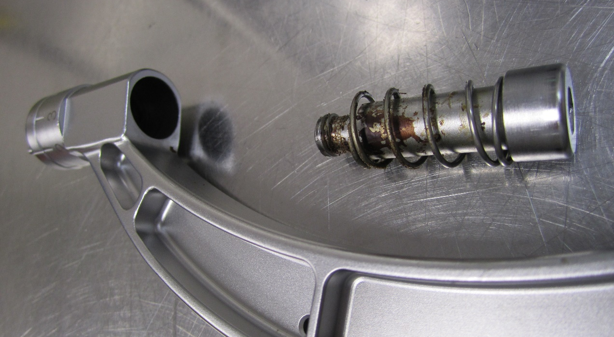
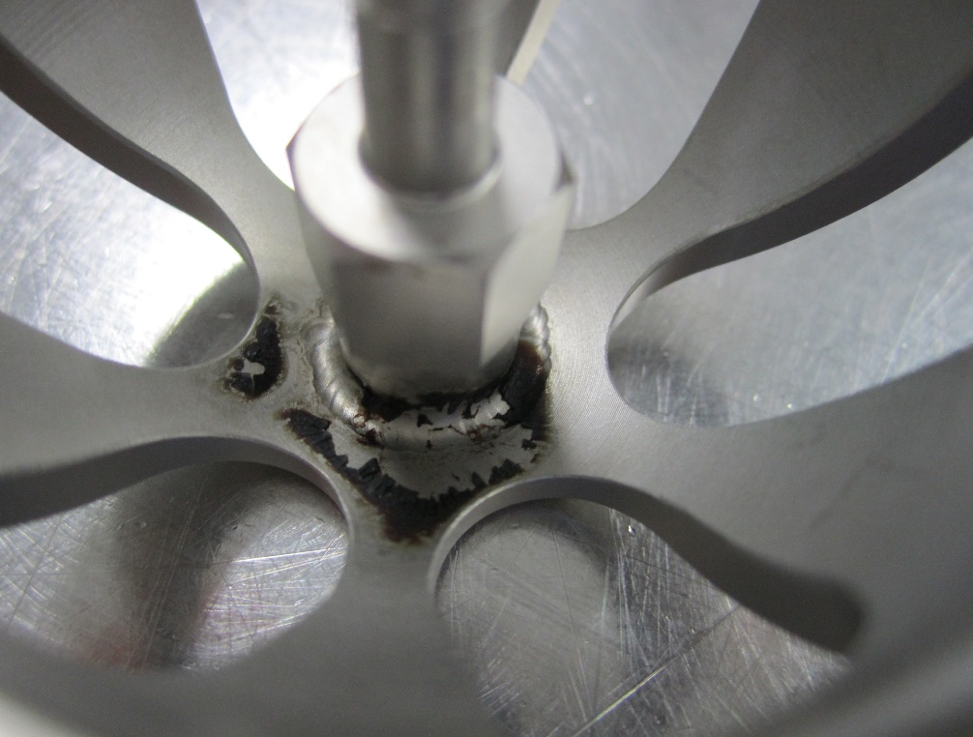
How do we prevent this ?

Slide 14
Risk Control
Comply with Sterilization of medical devices-Information to be provided by manufacturer for the reprocessing of re sterilizable medical device ISO 17664
Medical devices - Quality management systems- Requirements for regulatory purposes ISO 13485:2003(E)

Slide 15
Risk Control
States:
Have documented processes
7.5.1.2.1 Cleanliness of product and contamination control
The organization shall establish documented requirements for cleanliness of product if
a) product is cleaned by the organization prior to sterilization and/or its use, or
b) product is supplied non-sterile to be subjected to a cleaning process prior to sterilization and/or its use,
Medical devices — Quality management systems ISO 13485:2003(E)

Slide 16
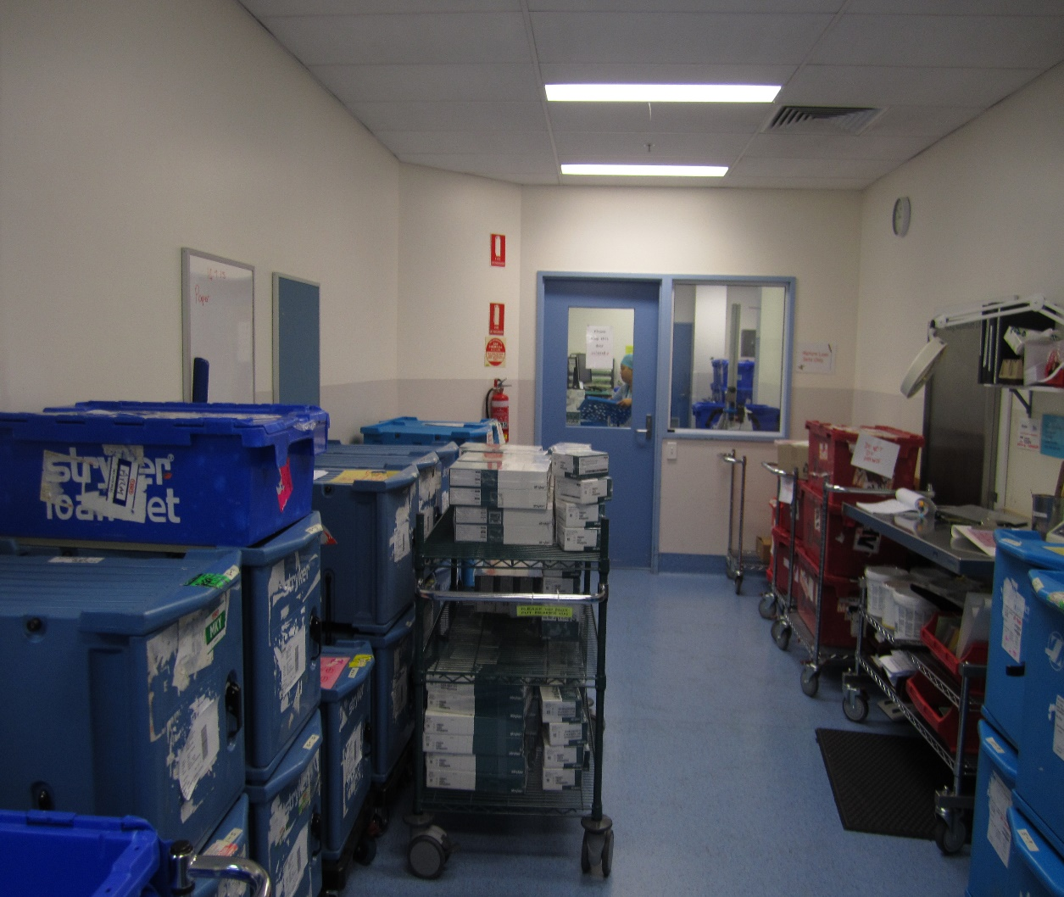
The Process
Always do the kit that is required first if multiple kits arrive at the same time

Slide 17
Loan Room
Record the set into the log
Assess the kit on arrival
Have we previously received the kit
Identify risk instruments with multiple parts
Assess the material of loan instruments is made up of

Slide 18
Loan Room
All loan sets are decanted and dismantled
except screw banks
Keep the tray weight under 5KG (11 pounds)
Check each item off the check list according to serial number
Update check lists to indicate multiple parts
Always phone the loan company if any instructions are not clear

Slide 19
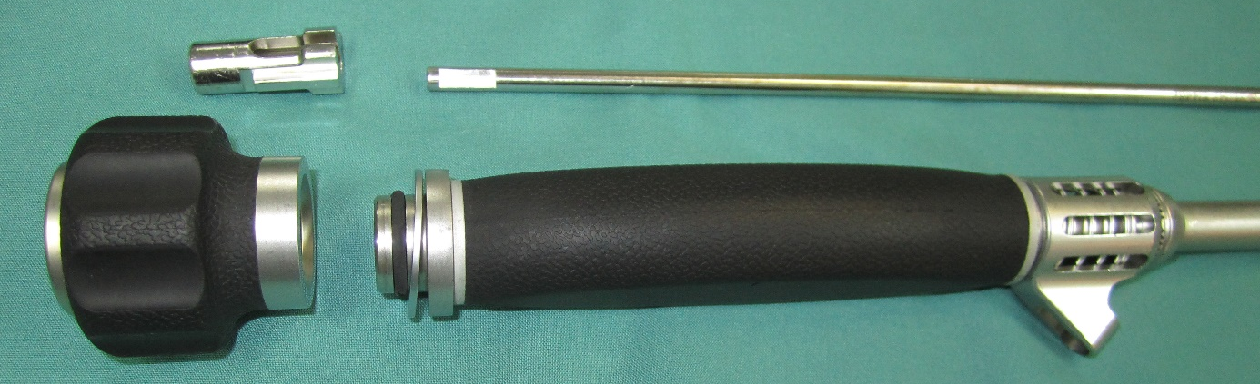
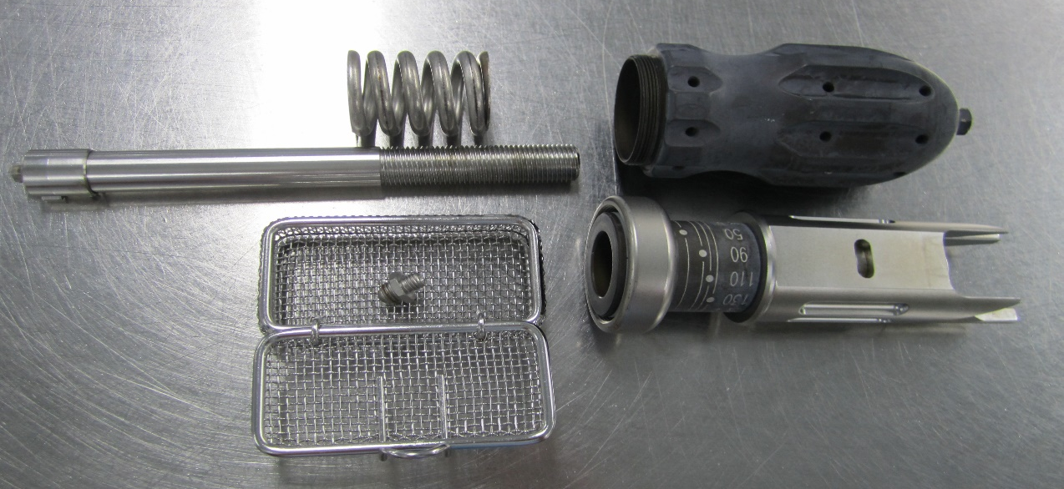
Disassemble Everything

Slide 20
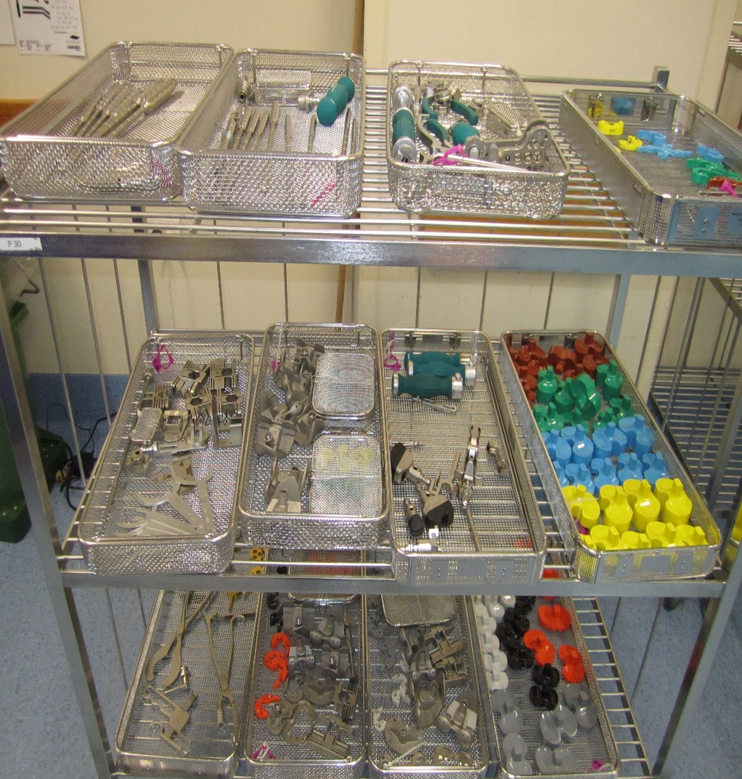
All loan sets are decanted into wire trays/baskets
Sets colour coded and trays numbered

Slide 21
How do we ensure the loan kit is clean?
Washing equipment compliant
Records of compliance of all routine testing
Annual PQ Batch and Index Washer 15883-1:2006[E] Table A.1
PQ the washers with the most complex/difficult loan instruments

Slide 22
How do we ensure the loan kit is clean?
Follow manufacture's instructions for cleaning of loan sets
Ask for the validated documentation of the loan set
Cannulated instruments must go
on a cannulated wash rack
Use washer with ultra sonic program

Slide 23
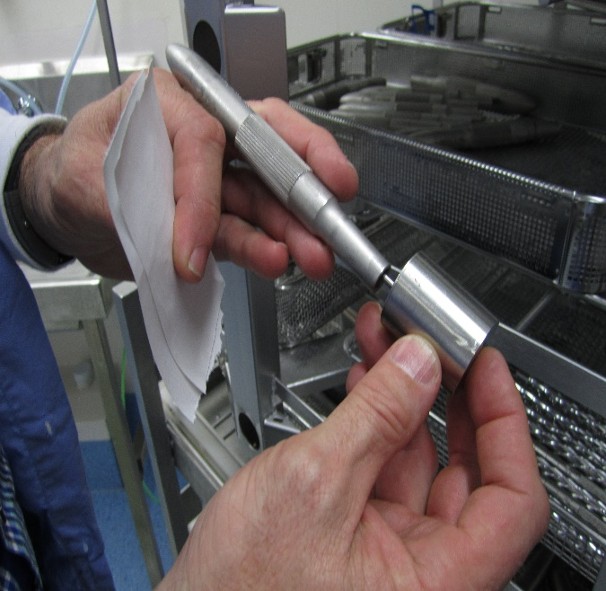
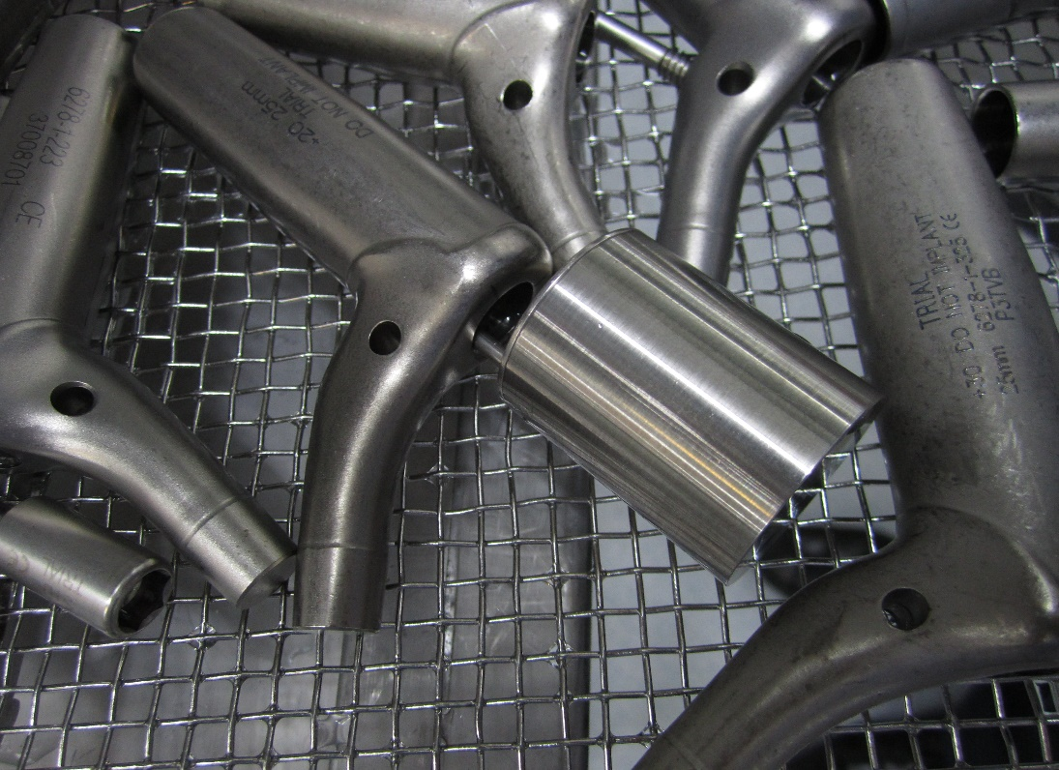

Testing the Washers
Data logo to test the temperature during thermal disinfection of the loan revision trial stem during PQ of washer

Slide 24
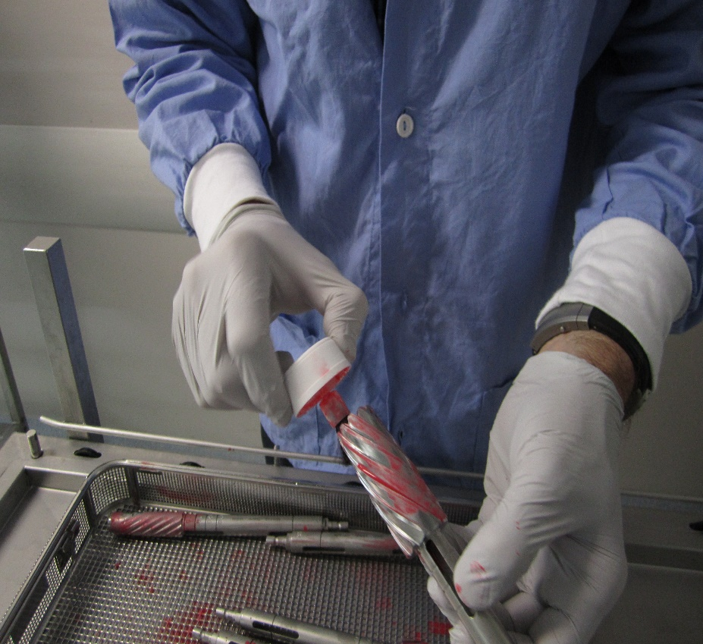
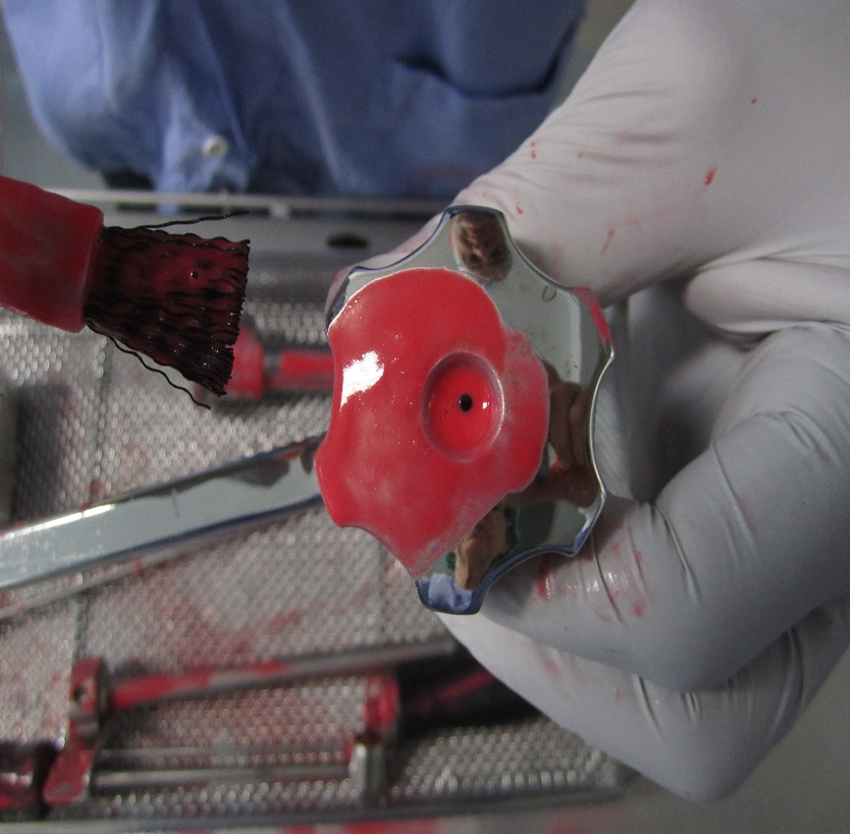
Soil testing during PQ

Slide 25
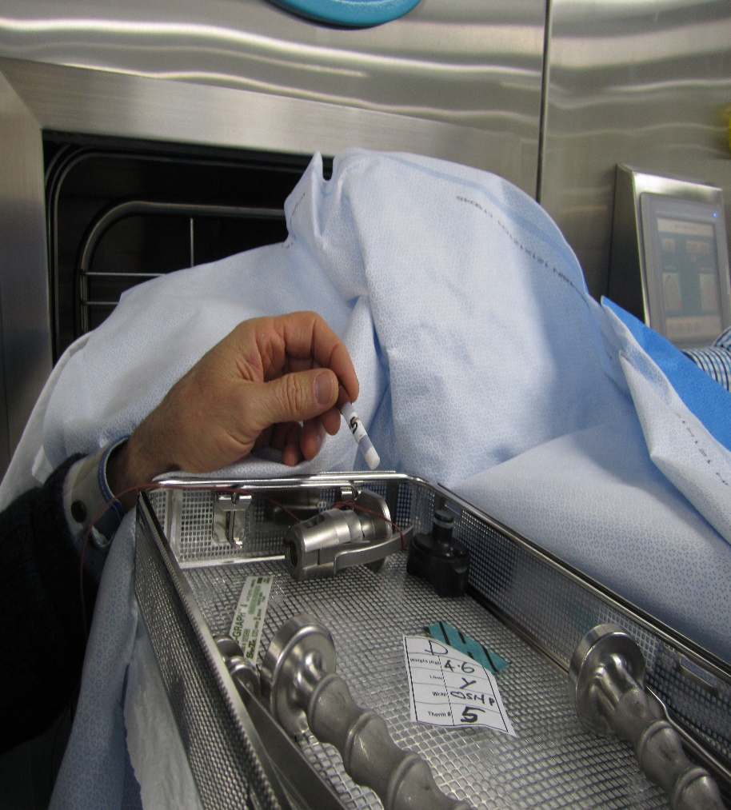
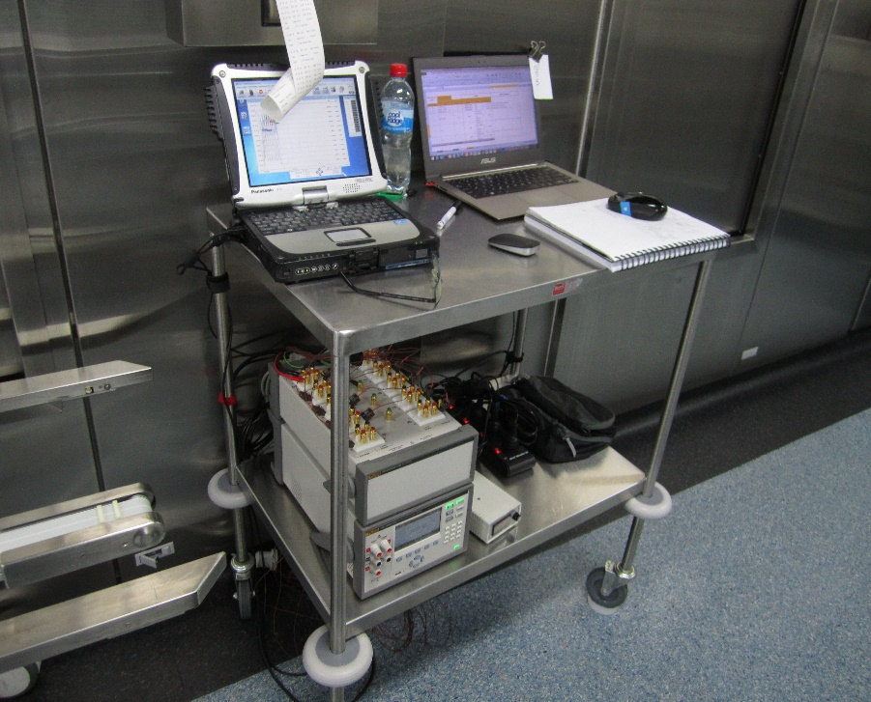
PQ the sterilizers'

Slide 26
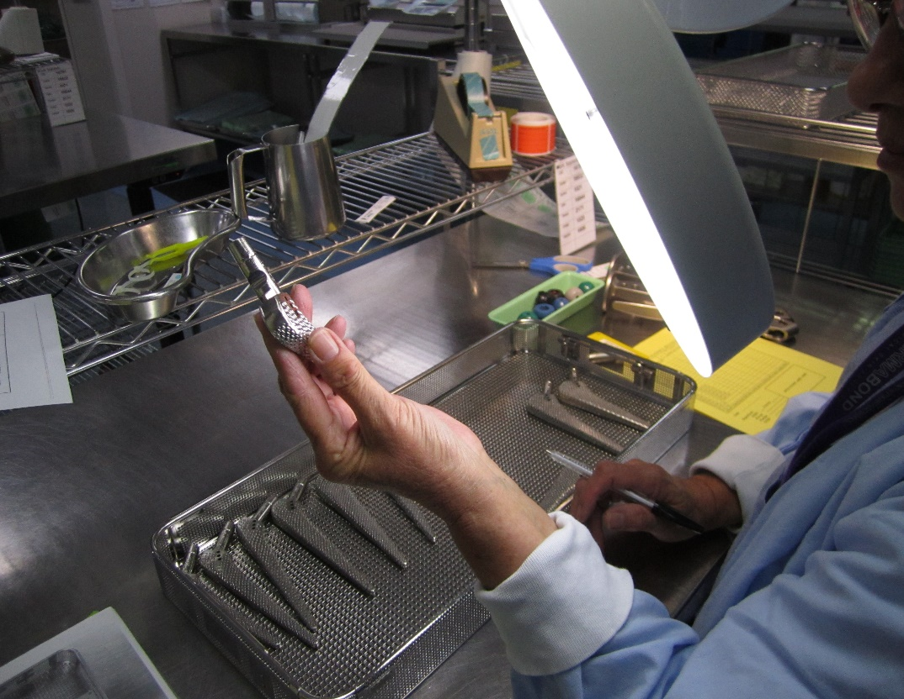
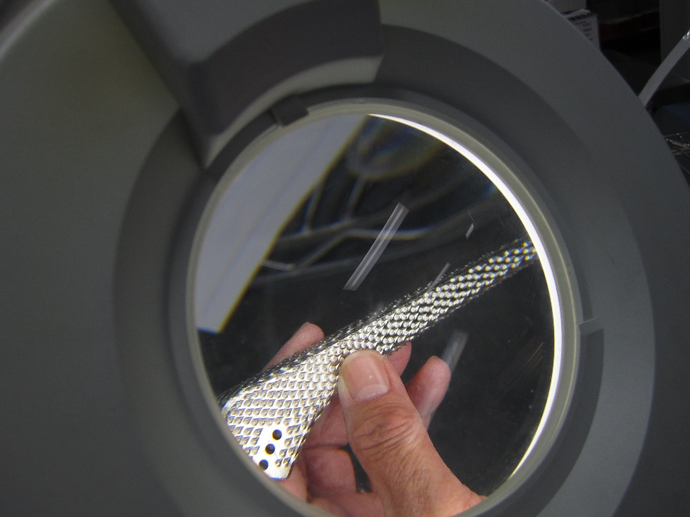
Inspected for cleanness before packing

Slide 27
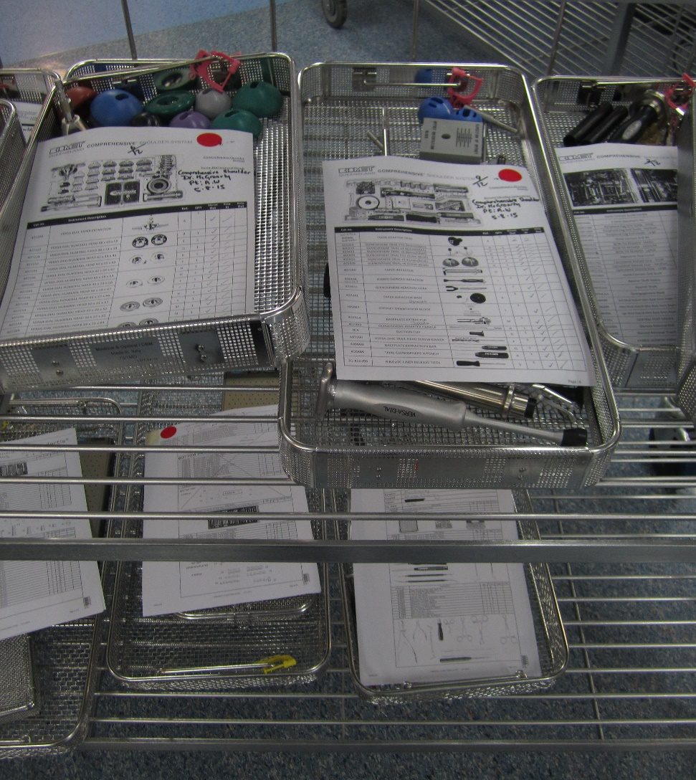
Checked before packing
The loan trays are checked post washing to ensure they are clean and correct according to the check list
Instruments that are dismantled for cleaning are left dismantled for sterilizing

Slide 28
Product Family
Always use the product family attributes with your loan sets or any new instrument accessing them on arrival
Design
Weight
Material
Sterile barrier system

Slide 29
Penetration time to ensure sterilization
Testing at PQ, the lumens and dead end handles take longer to reach holding temperature
This due to the weight of the set which will generate condensate, slowing the removal of air within the lumens ratchet and dead end handles
Reference ISO/TS17665/3 B.7.2 page 28

Slide 30
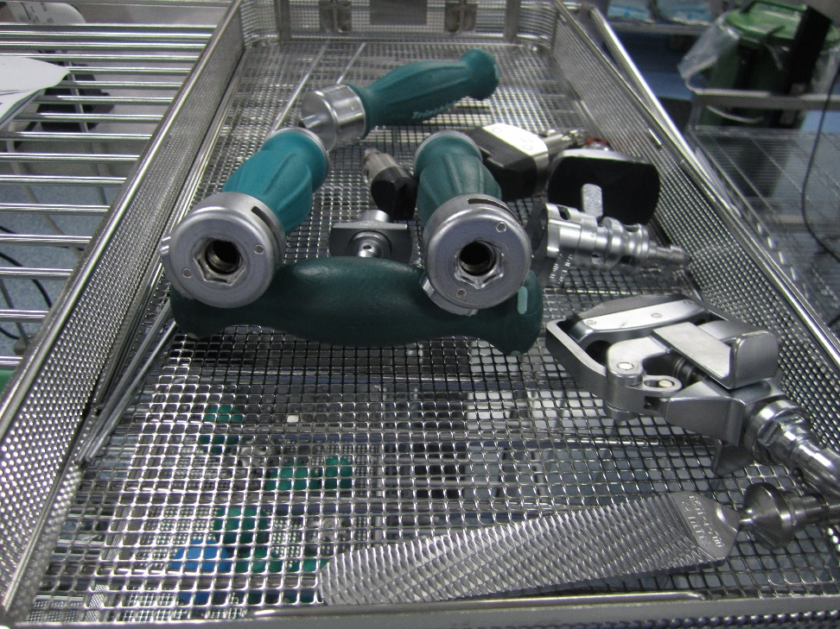

Extended holding time
Not able to PQ all our loan sets
Introduced routine 10 minute holding time for sterilising
Lumen not reaching temperature during 4 minutes holding time

Slide 31
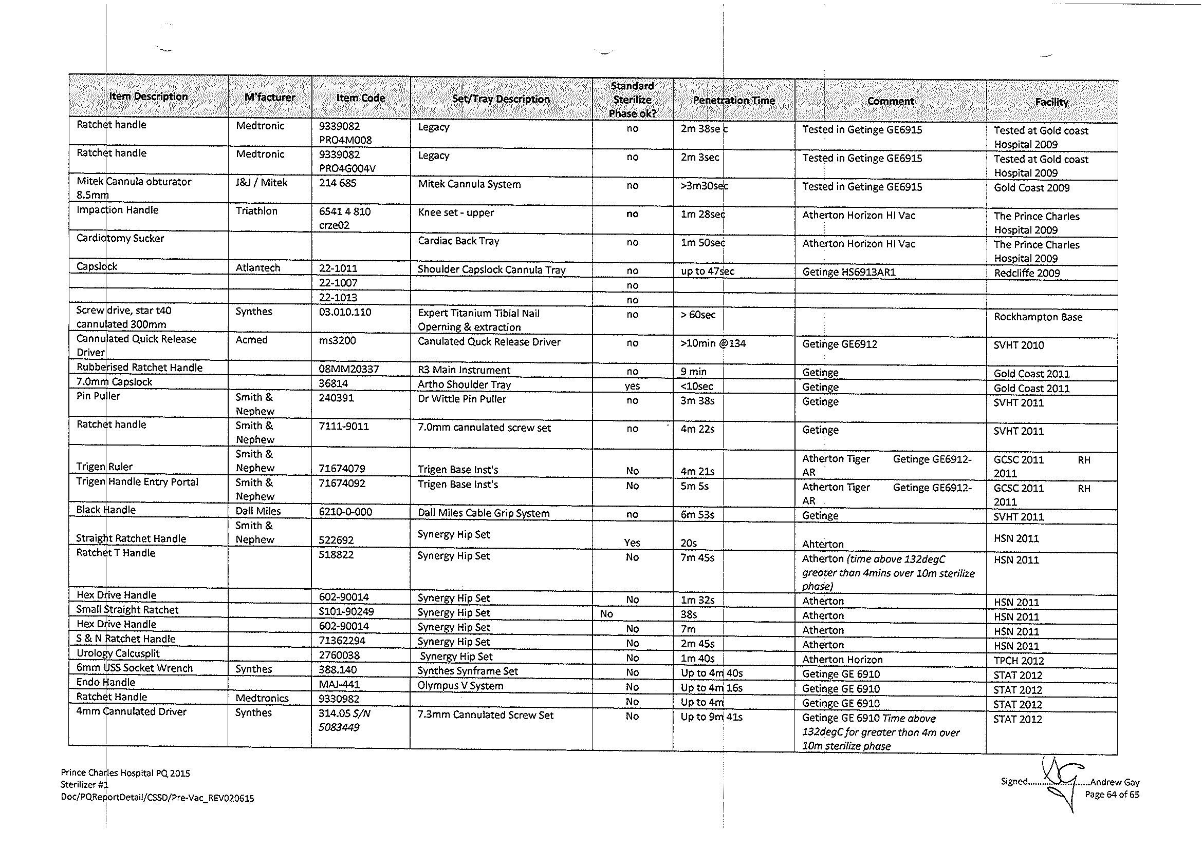

Slide 34
Record of contamination

Slide 35
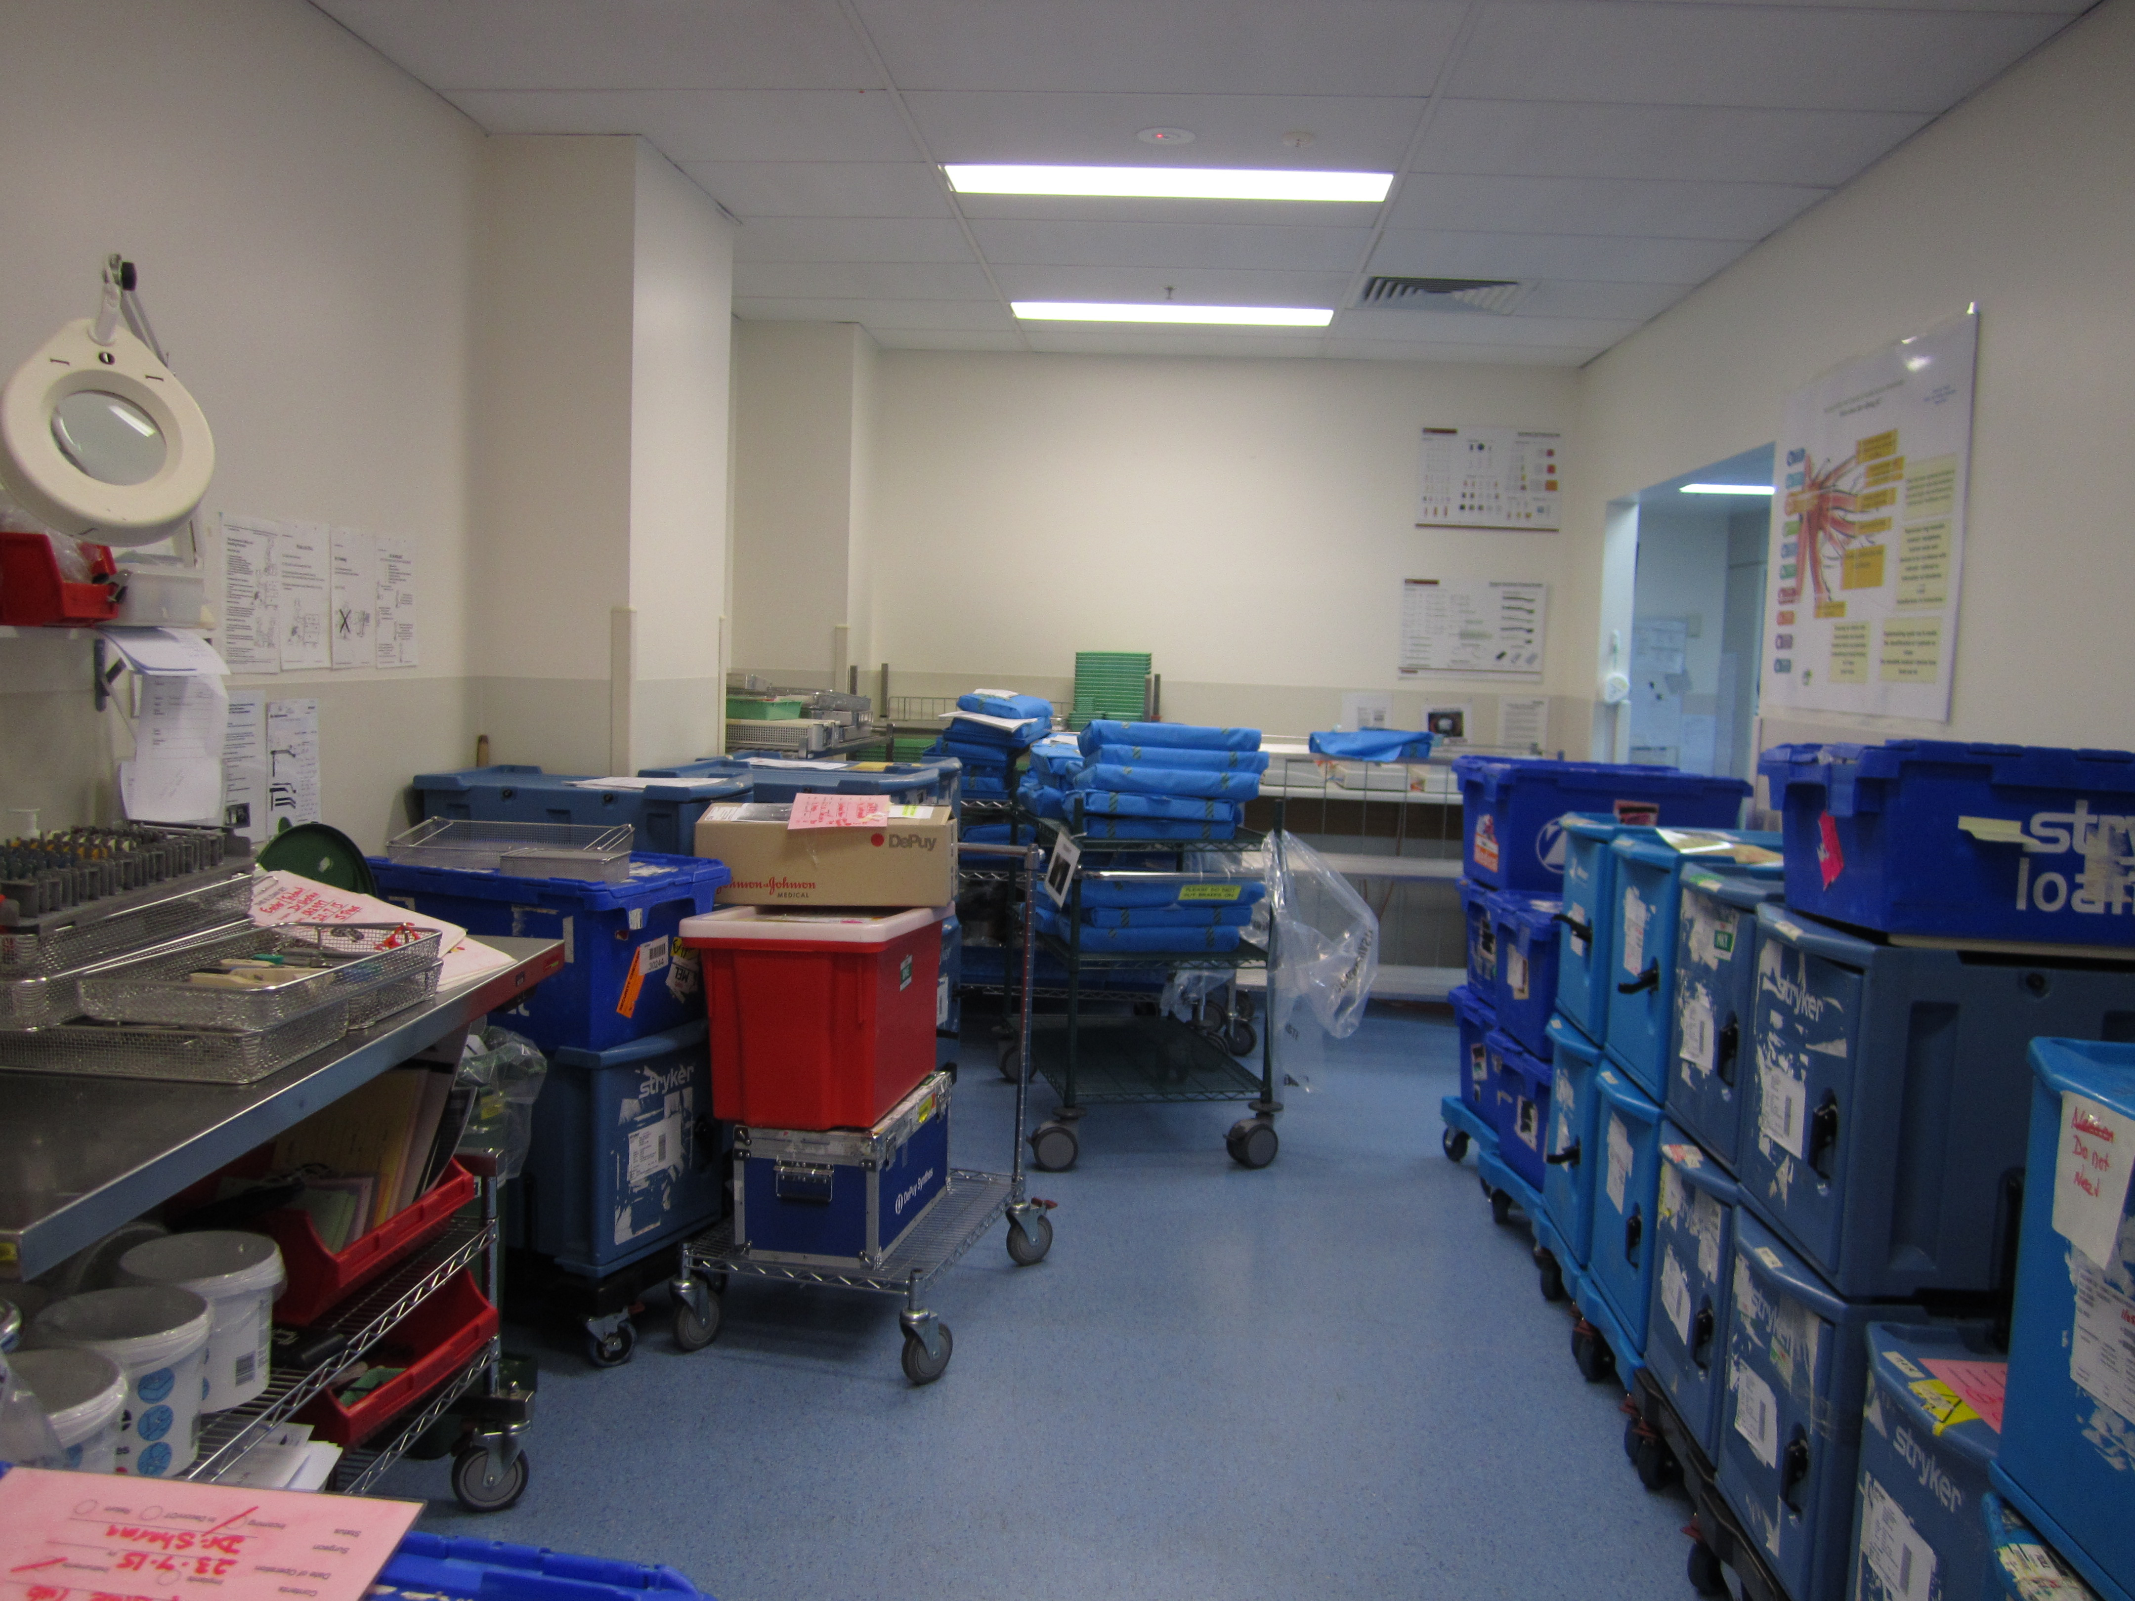
Wastage:
Loan kits ordered
and not used

Slide 36
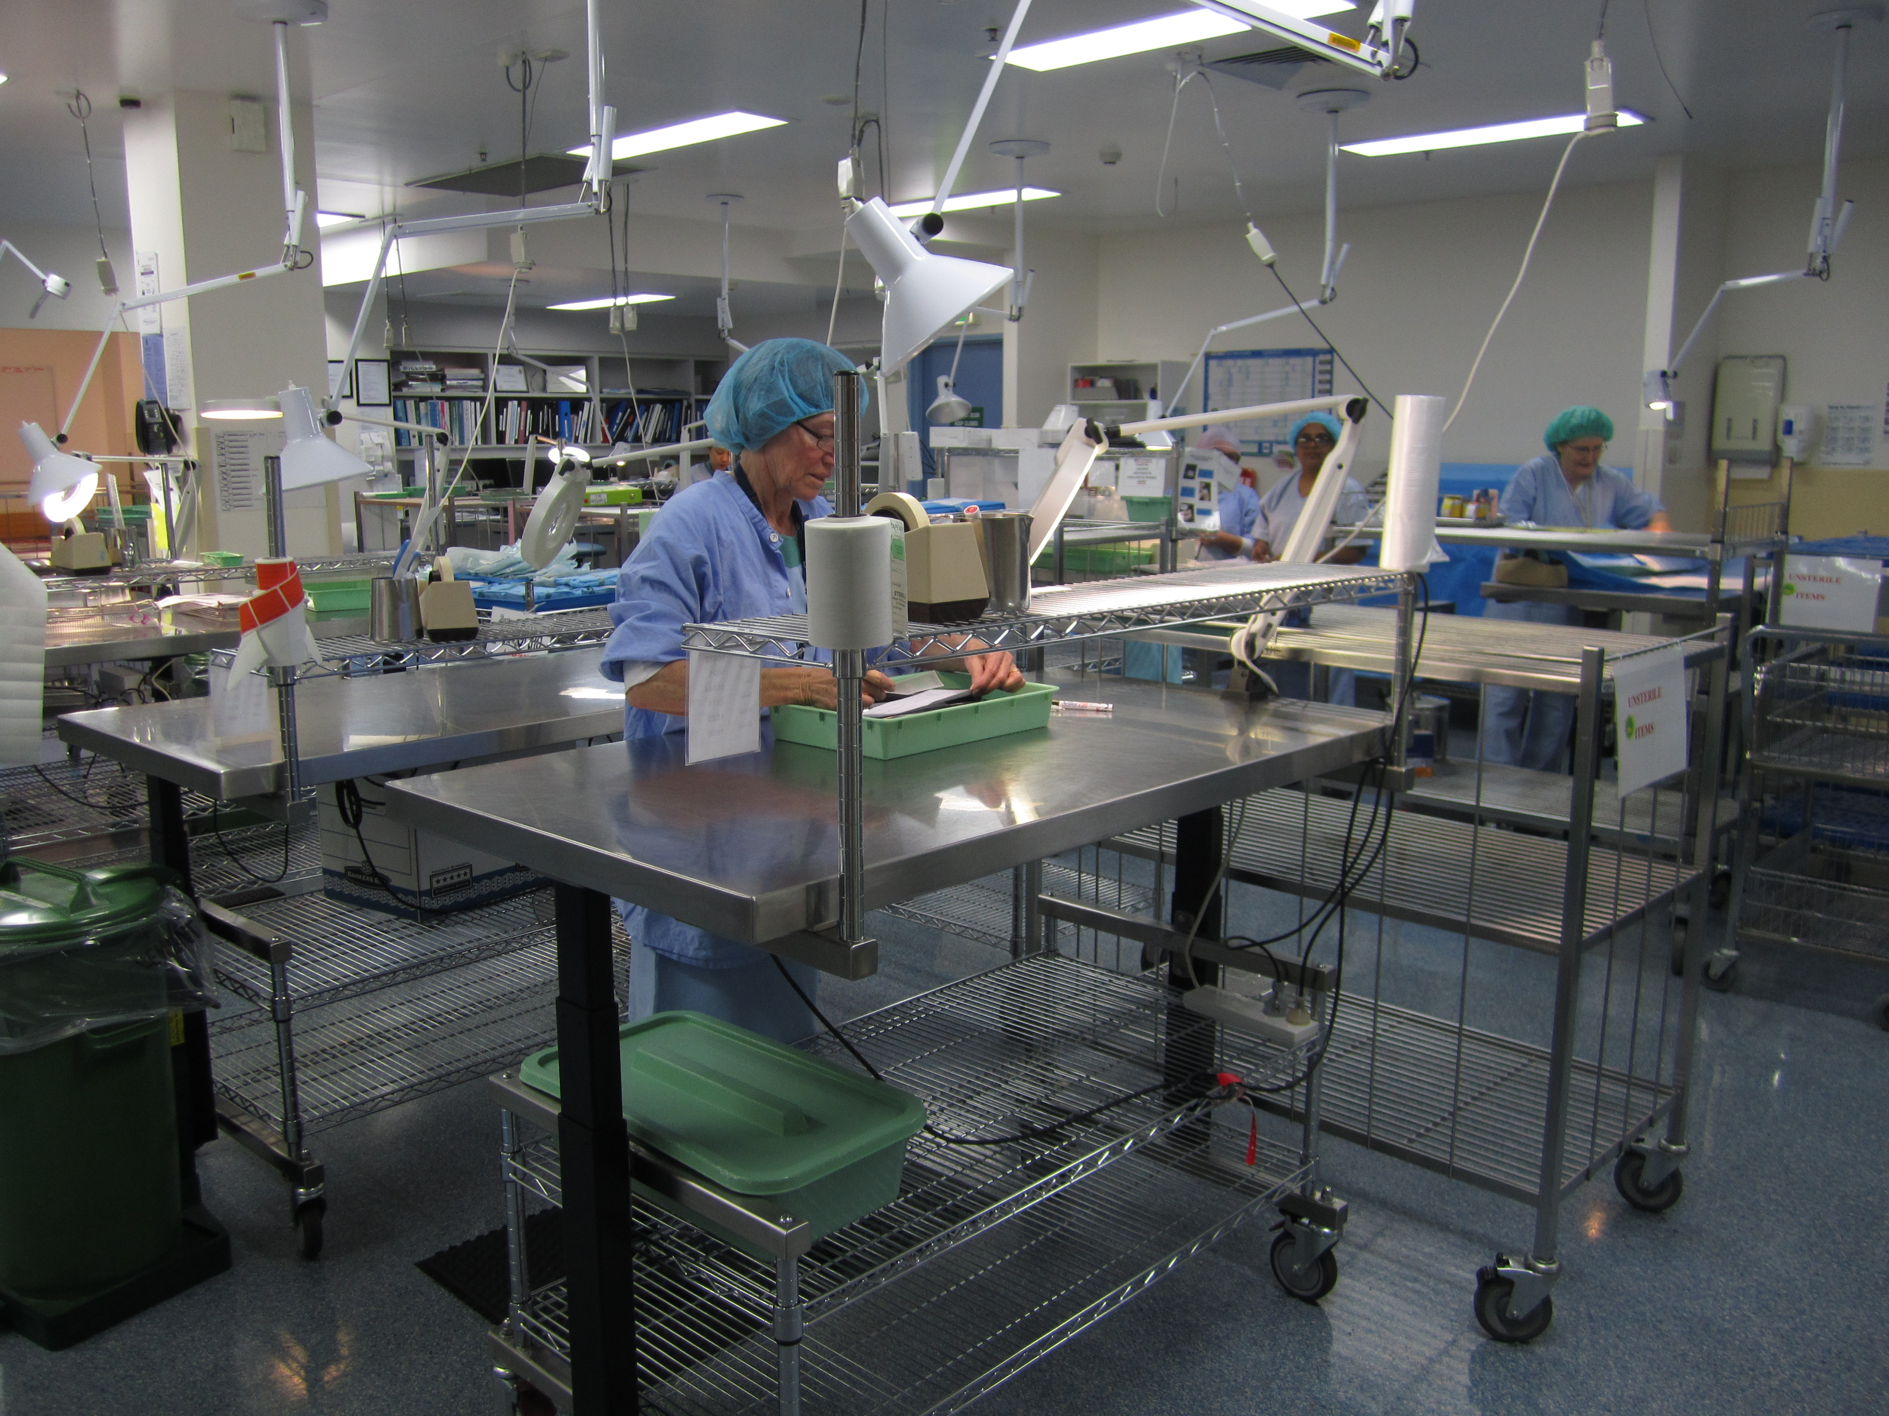
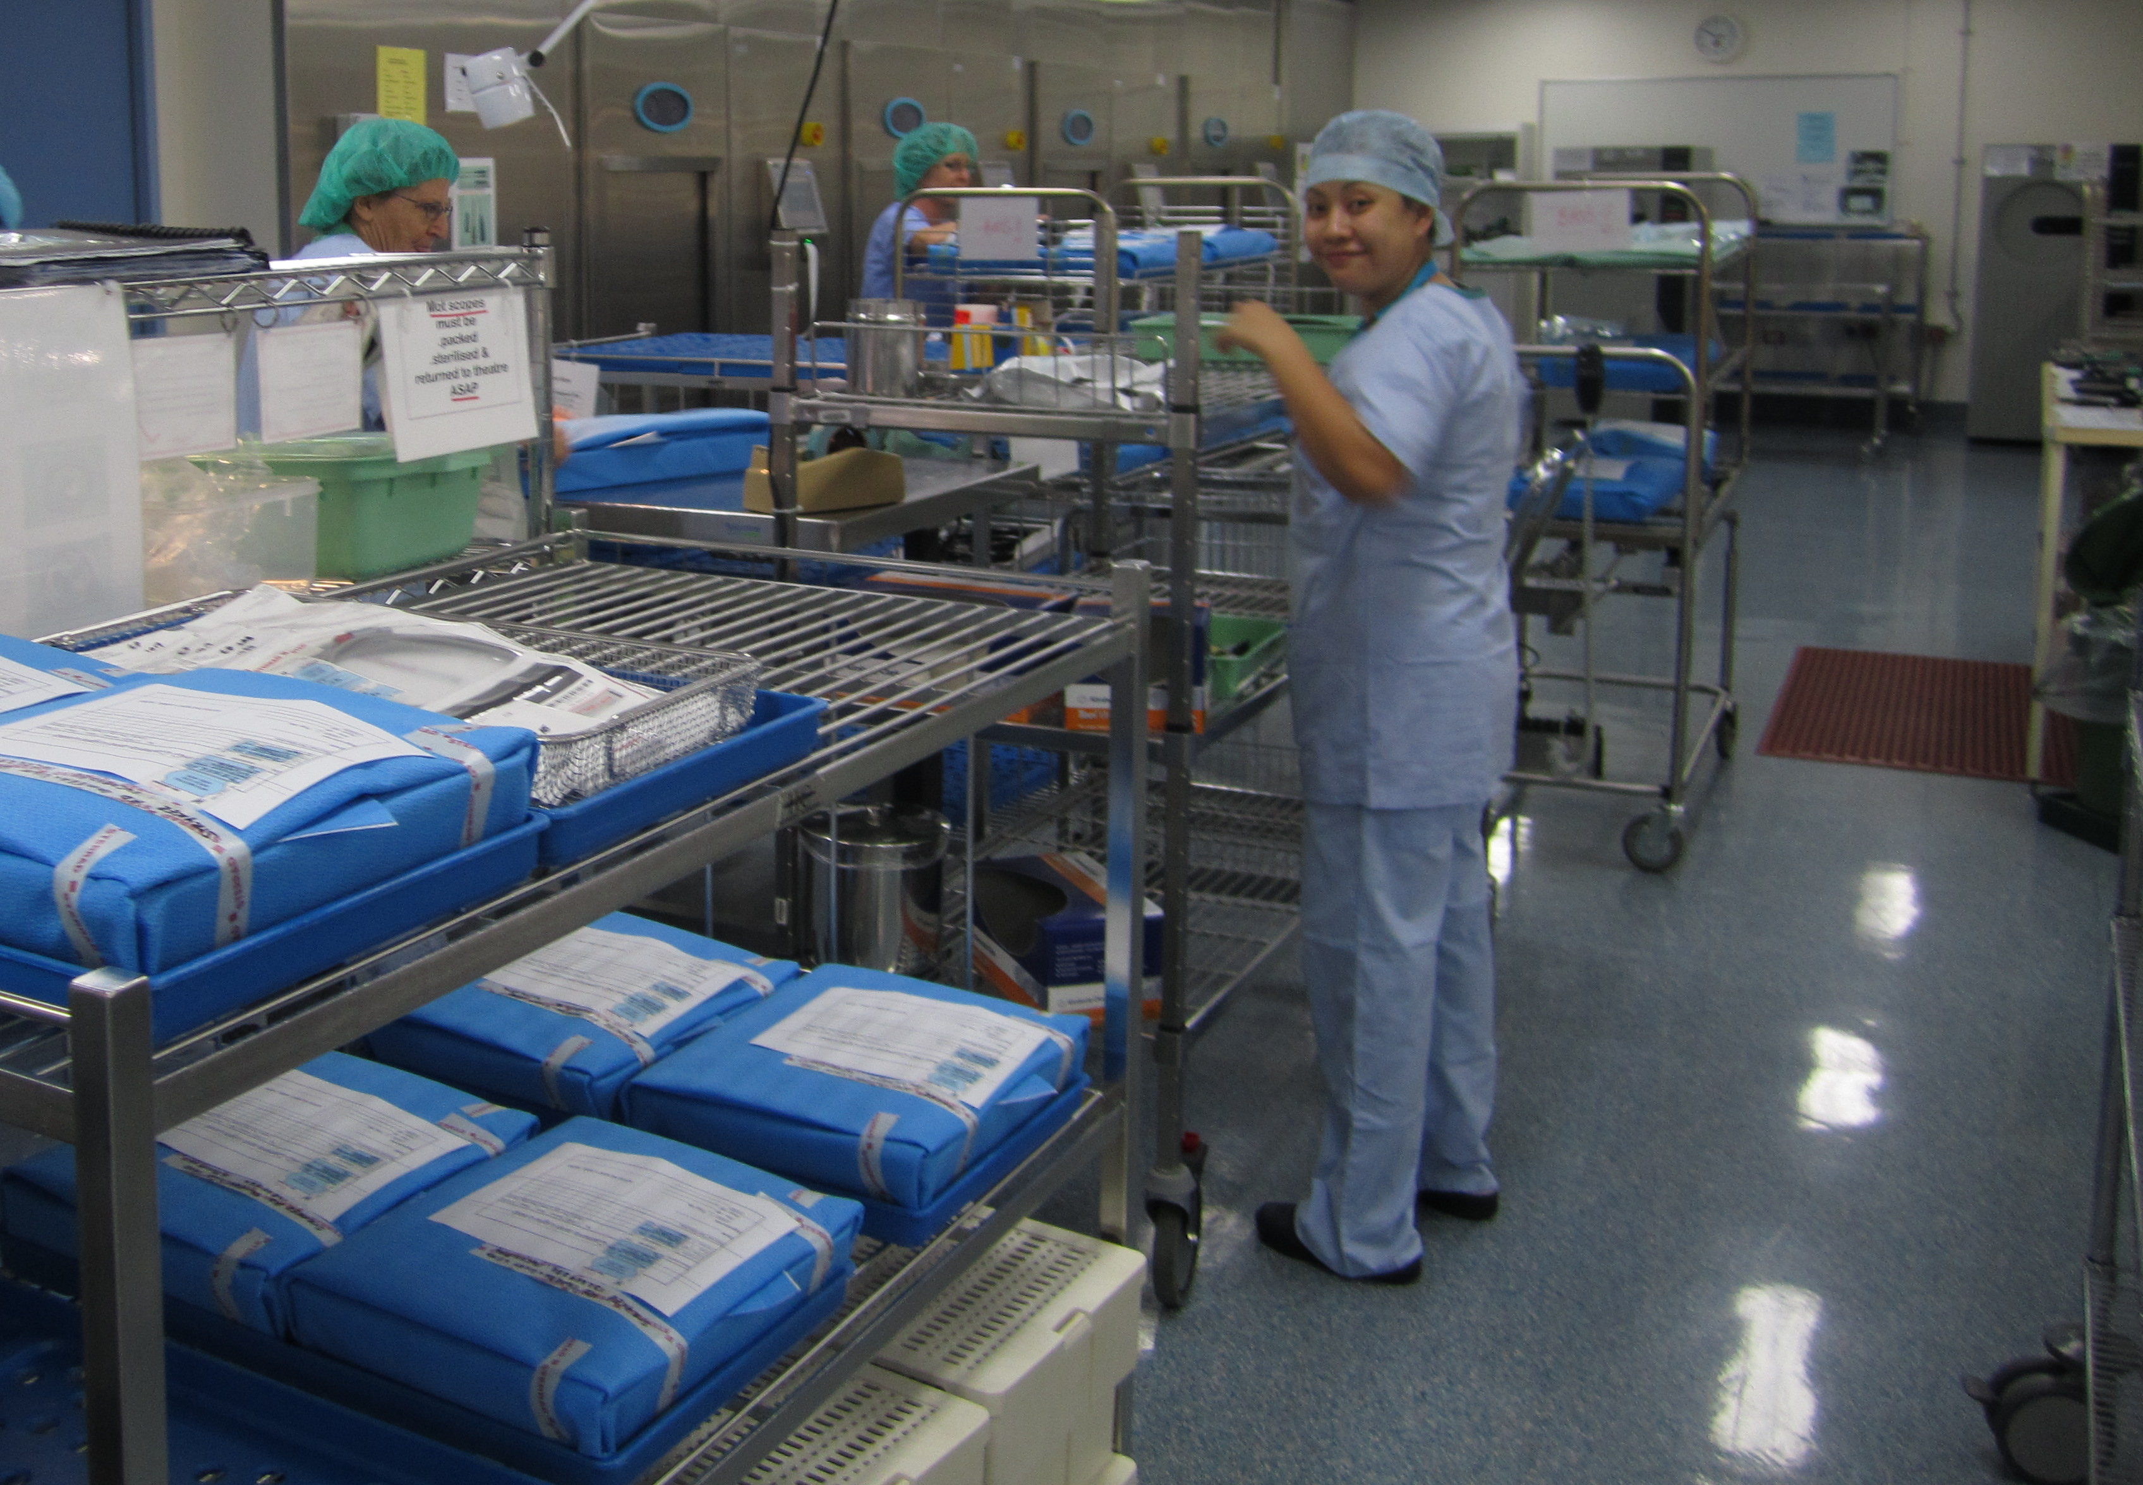
Summary

Slide 37
Reference
Queensland Health Guideline – Management of Instrument Loan Sets Version 2 – July 2013
Medical devices — Quality management systems ISO 13485:2003(E
ASNZ 4187: 2014
ISO 17664 2004
ISO/TS 17665-3 2013-04-15
2015 PQ Report 2015 Andrew Gay

Slide 38
Acknowledgement
The CSD staff of TPCH
Andy Gay
Cathy Saxton
Ronald Vergara
Michelle Love
Elaine Foster

