Slide 1



An e-learning platform to reassess the expertise of our sterilization staff members
Presenting author : Julie Lefebvre
Julie LEFEBVRE⁽¹⁾, Julie SCHOLLER ⁽¹⁾, Romain DESCHAMPS⁽¹⁾, Bernard MATHERN⁽¹⁾, Marie-Pierre KEMPF⁽¹⁾, Bénédicte GOURIEUX⁽¹⁾
Establishment : Strasbourg University Hospital, FRANCE
Department : Pharmacy-Sterilization
Notes:
Ladies et gentleman good afternoon,
First I would like to thank the organizing committe for giving me the opportunity to present this work. I’m a junior pharmacist at the University Hospital of Strasbourg, and I work in the sterilization department during one of my resident semesters.
The work that I am going present to you today has focused on the development of the sterilization staff member’s reassessment tool

Slide 2
Context
The « Good Practices in a Hospital Pharmacy » BPPH (2001) : «The quality of sterile medical device preparation greatly depends on the expertise, the training and the behavior of the staff involved in these operations»
Normes ISO 9001/13485 (6.2.2) «Expertise, awareness and training»
Initial training plan :
  Theoretical training
  Practical training + tutor
  Supervisor assessment
2013 : Audit report of the ISO 9001/ 13485 certification process :
  « Lines of thought about reassess the expertises »
  Revision of the skills management process : « reassessment for an activity systematic three years after the first empowerment »
  Currently reassessment isn’t formalized
Notes:
The Guideline Number 1 specifies in Good Practices in a Hospital Pharmacy that "The quality of sterile medical device preparation greatly depends on the expertise, the training and the behavior of the staff involved in these operations." ISO 9001/13485 standards also mention the concept of evaluation of staff skills.
Currently in our sterilization department the initial training plan includes: a theoretical phase, a field practice with a tutor and a personal interview with supervisor
In 2013, upon renewal of certification, has been proposed a thought about reassess the expertises as track progress.
The skills management process has been modified to include the reassessment conditions. The sterilization staff member’s must be reassessed every three years.
Currently the reassessment is not formalized in sterilization
9001 : nine thousand and one
13485 : thirteen thousand and four hundred and eighty-five
2013 : two thousand and thirteen

Slide 3
Objectives / Methodology
  Aims : make the reassessment for an activity systematic three years after the first empowerment
  Development of a tool to reassess the expertise
  Assessment and validation the tool
  Involvement of agents in the reassess process
  Methodology :
Platform procurement
Theme
Issues formulation
Mapping sterilization : sterilization process
Validation
Tests formulation
Configuration
Validation
Configuration
Internal procedures, BPS
Questionnaire : staff members feelings
Steam sterilization
Supervisor validation
Tests phases
Ergonomic and autonomy
ECAMPUS OnlineformaproTM
Notes:
The main objective of this work is the development of a tool to reassess the expertise three years after the first empowerment.
The aims is to develop a tool, then assess and validate this tool.
The secondary goal is to involved the sterilization staff member’s in the reassess process.
For that, the acquisition of a platform for e-learning enabled to use new technologies in this framework.
Reassessment themes were defined using the mapping of the sterilization process.
Questions were formulated from the internal procedures, quality documents of the sector and the good practices for sterilization.
Several testing phases were necessary to confirm the settings and evaluate the tool.
In parallel, a questionnaire was given to learners to collect their feeling about the tool.

Slide 4
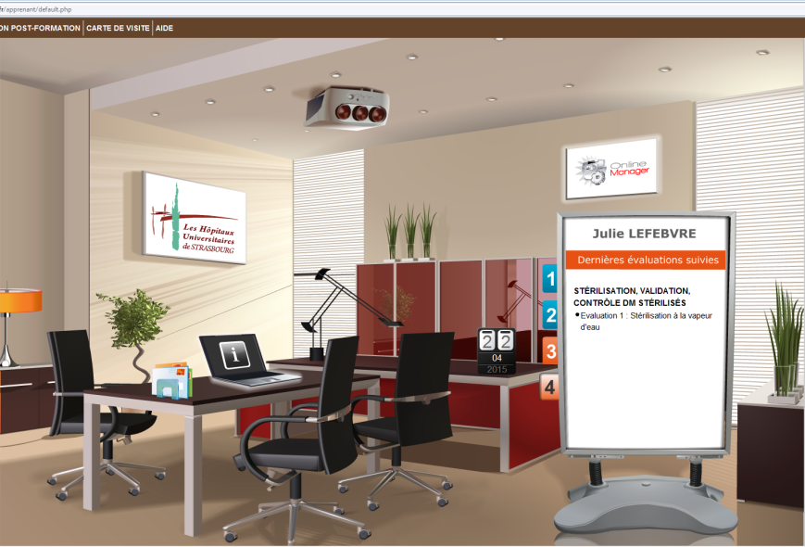
Platform ECAMPUS : development and configuration
Theme :
STERILIZATION
Item 4 :
Sterilization, validation, control, sterilised medical device
Questions formulation
Item 3 :
pretreatment
Questions formulation
Assessment 1 : Steam sterilisation
Assessment 2 : Vaporized hydrogen peroxide sterilization
Assessment 2 : Medical devices cleaning process
Learner system
Manager system
  onlineManager mode
  onlineAuteur mode
Configuration : coefficient, duration, percentage rate,…
Notes:
The platform is called ECAMPUS® and is accessible via a secure address. There are two levels of access to the platform: a learner account and a manager account.
The account manager is composed of two modules:
-The onlinemanager module allows the administrator to manage the feedback and created training, learning accounts. There are a reporting function that allows you to perform statistical queries regarding to monitoring and training results and evaluations.
-The onlineauteur module is a set tools for creating evaluations and training modules.
As administrator, i mainly use these modes to create all the questions and evaluations
This diagram explain the organization of the platform. It is available in theme, item, evaluation and questions.
Initially for the theme STERILIZATION, 6 items for scanning all the skills necessary for a staff member’s have been defined. Each item includes one or more assessments.
Secondly, a set of questions drafted. The structure of the questionnaire was carried out on two points: a theoretical approach with basic concepts necessary in sterilization and a practical approach of the critical points encountered in the field.
Finally, several parameters should be configured, for example : coefficient of each questions, duration of the evaluation , display configuration, percentage of success

Slide 5
Platform ECAMPUS : validation and assessment
3 tests phases :
  Supervisory staff → validation assessments item 4
    Content and configuration
    Questions titles and answers proposals rephrasing
    → Learner best understanding
  2 staff members → item 4 fictitious assessment
    ergonomic and use assessment
    → Familiarisation with the tool : creating a pre-training assessment to the platform
Notes:
Three testing phases have followed
Initially supervisory staff validated the content, the relevance of the questions and the configuration of the item 4 “Sterilization, validation and control of sterilised medical device ». At the end of this phase some questions and proposed answers have been amended to improve the understanding of the learner.
Secondly, Two officers carried out fictitiously items 4 reassessments (steam sterilization and Vaporized hydrogen peroxide sterilization), to check ergonomics and ownership of the platform for learners.
Following this phase, an evaluation including a 3 short questions for learners to become familiar with the tool was created.

Slide 6
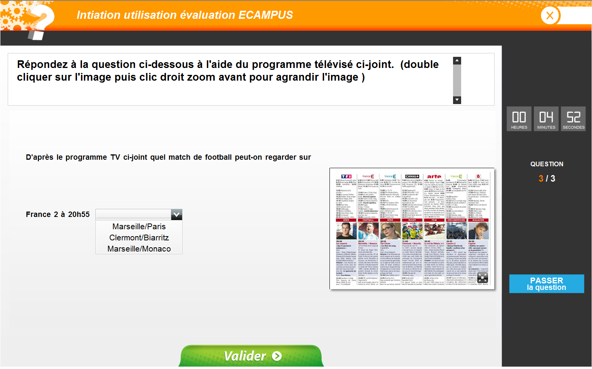
Pre-training question preview :
Notes:
You can see on this slide an overview of this pre-training to the platform. This evaluation named "initiation eCampus" will be proposed to the learner before starting the actual reassessment. The preview shows an example of the question to learn to drop down and zoom in on documents to related questions.
Here the goal is to read the TV program and answer to the question from a drop down menu.

Slide 7
Platform ECAMPUS : validation and assessment
3 tests phases :
  Supervisory staff → validation assessments item 4
    Content and configuration
    Questions titles and answers proposals rephrasing
    → Learner best understanding
  2 staff members → item 4 fictitious assessment
    ergonomic and use assessment
    → Familiarisation with the tool : creating a pre-training assessment to the platform
  Test phase : steam sterilization reassessment
Notes:
Finally, half of the sterilization staff members, participated in a test phase, which focused on "steam sterilization” which I will present to you on the next slide.

Slide 8
Test phase : steam sterilization reassessment
To assess :
  Relevance of the issues
  Number, complexity of the issues
  Quality of the answers
  Coefficient, Dedicated time of the reassessment
  Autonomy staff members
  Feed back form
  Staff members feelings
  Satisfaction and adherence to the tool
Notes:
The aim of this phase is:
to assess the relevance of the issues, the number and complexity from the perspective of the learner
assess the autonomy of agents against the computer tool
To validate the setting coefficients and dedicated time. A coefficient of 1 to 4 is applied depending on the difficulty of the question or by the impact of a wrong answer in daily practice on the quality of sterilization work. More impact for wrong answer is important for the safety of the agent or the quality of the finished product, more the coefficient of the matter is important.
At the end of the evaluation the learner completed a questionnaire of 6 questions to assess his feelings about the reassessment via an e-learning platform

Slide 9
Test phase organisation
  45 learners
  Topic « Steam sterilization »
  Test duration : 20 minutes
  15 questions (QCS, QCM, graphics)
Notes:
Half of the staff , about 45 learners, participated in this phase.
The reassement period was set at 20 minutes for 15 questions
45 : fourty and five

Slide 10
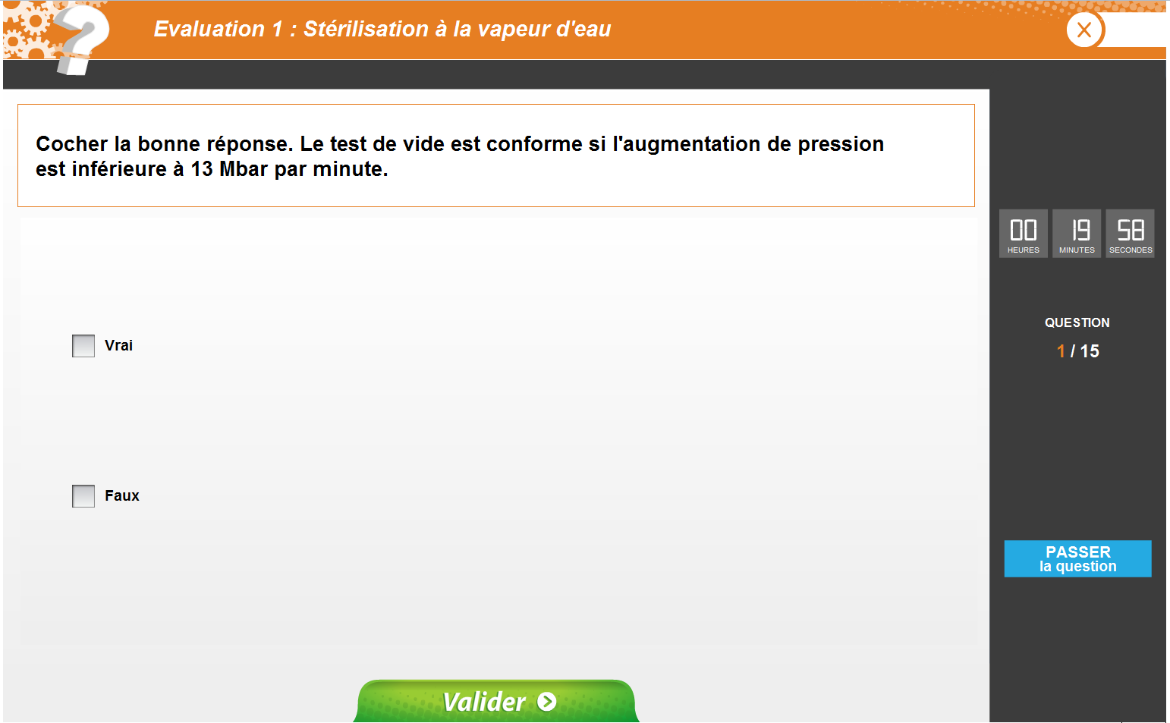
Simple choice question preview
Notes:
Here we can see a question overview : the learner can see the dedicated time and the question number. He can passed the question. It will be proposed again if he still has time.
The types of questions used in the questionnaires are:
Simple choice questions: True / False
For example : every day, before the first sterilization, the agent must be performed a vacuum test.
Here, the learner must know the maximum pressure value in order to define the vacuum test as conform.

Slide 11
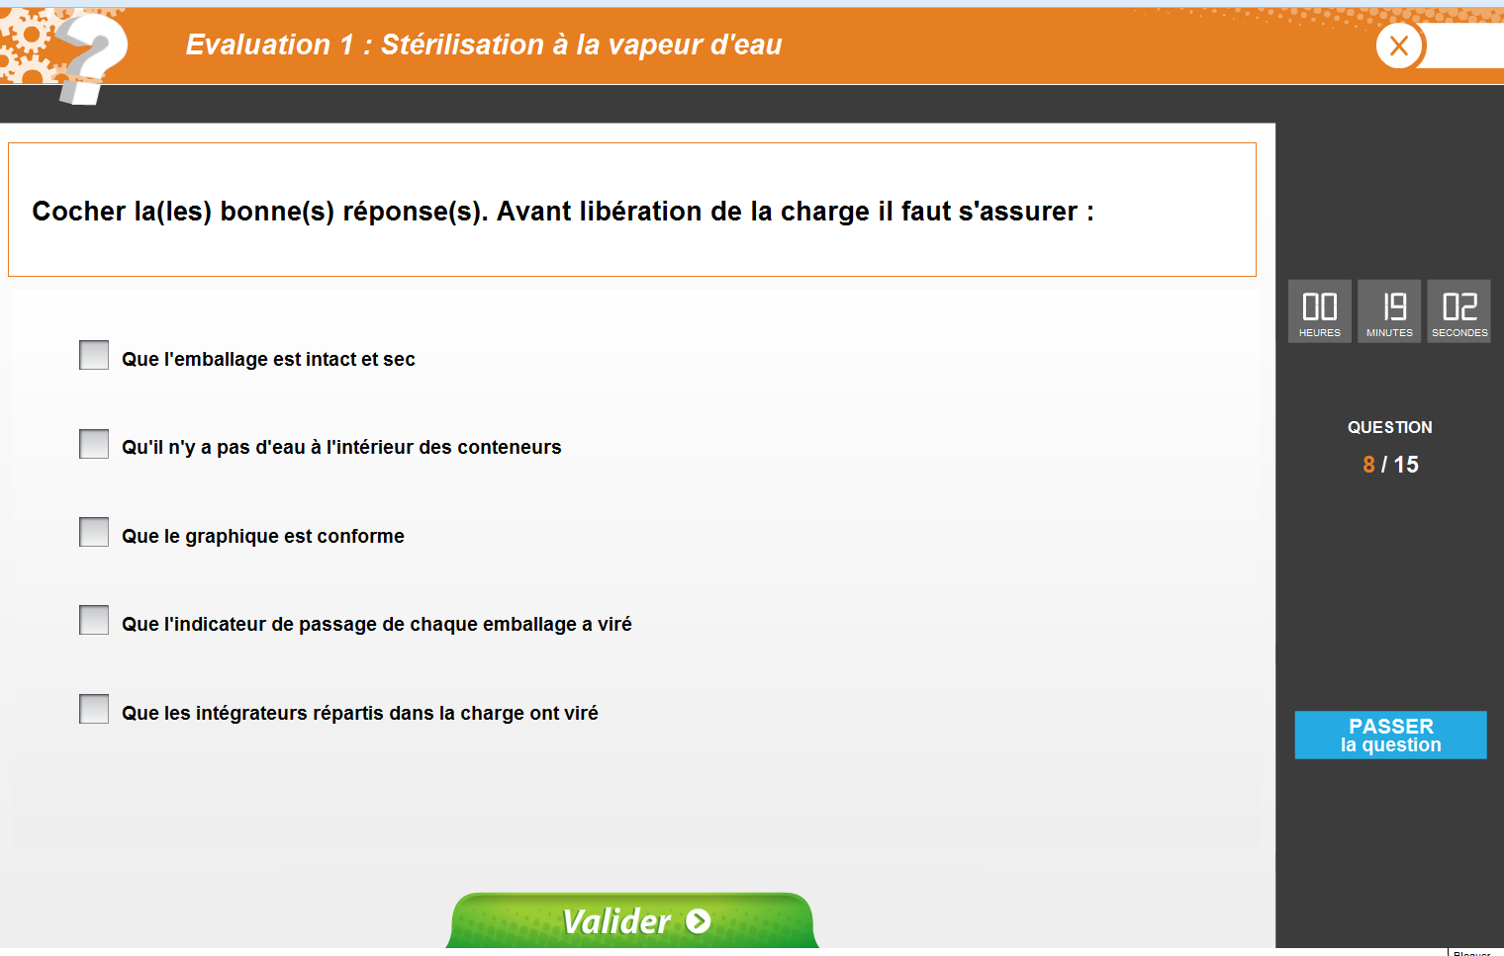
Multiple-choice question preview
Notes:
An other type of question is multiple Choice Questions (MCQ) including a statement along with different options including one or more are correct
Here the learner has to select the correct control to release a sterilization load.

Slide 12
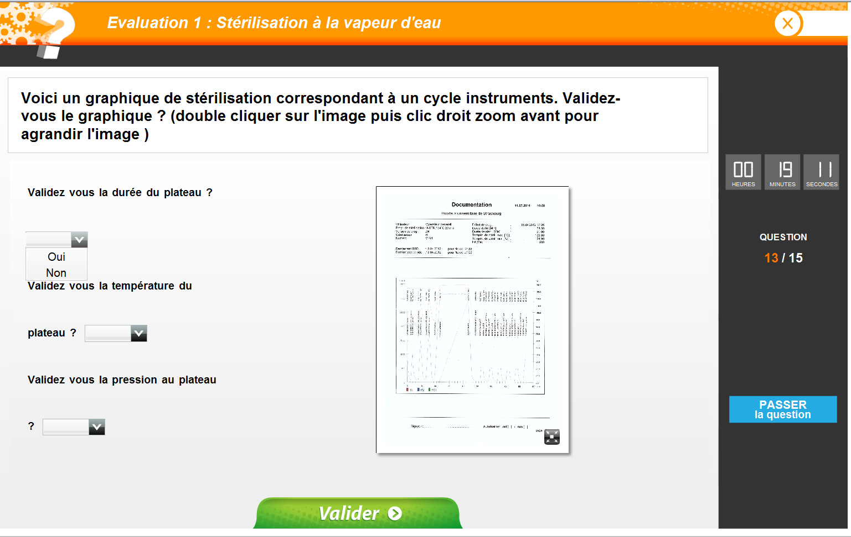
Illustration-question preview
Notes:
Here we have an example of a question with single choice from a drop down menu. It is possible to match pictures within the issues.
In this example the learner has to validate the questions from a steam sterilization graph. The goal is to evaluate the validation of cycles in real working conditions.

Slide 13
Test phase : general characteristics
  45 learners : distribution on seniority and staff categories
Average age (Years) | 37
Minium age (Years) | 21
Maximum age (Years) | 60
Notes:
This slide shows the general characteristics of learners in the third test stage.
The distribution of qualification is represented in this table. The distribution reflects the overall agent distribution of our sterilization service. Learners were divided into two groups for the exploitation of results: PPH / IBO (assistant pharmacists and operating theatre nurses) on one hand and AS / OPQ (help nurses and qualified workers) on the other.
The learner had a mean seniority of 7.9 years in the sterilization service of the Strasbourg University Hospital (HUS) .
The average age of learners is 37 years [21-60] The youngest is 21, the oldest is 60 years old.
The sex ratio was 0.41 (women majority = 71.1% women).

Slide 14
Results : general characteristics
% medium rate | 84.7%
% rate score maximum | 99.0%
% rate score minimum | 63.0%
Medium time | 10 min 50s
Time minimum | 4 min 18s
Time maximum | 20 min 6s
77,8% (35/45) score > 80% = successful reassessment
Use 50% of the allotted time
Notes:
At the end of the evaluation, the results of each question are expressed on 3 levels: successful, partially successful, failed. The final result of the evaluation is expressed as a percentage of consistent responses. The validation threshold has been set at 80% correct answers.
80= eighty
About three quarters (77.8%) of learners had a score of correct answers higher or equal to 80%.
In case of non-validation of the test, the senior will review the agent for an initial assessment. That is to say by a personal interview.
The learners took an average of 10 minutes and 50 seconds to answer the 15 questions. So they used 50% of the allotted time. Only one learner failed to complete the evaluation within the 20 minutes allotted.
50 = fifty

Slide 15

Results : Rate percentage and question coefficient
  Coefficient 1 success [88,9%-97,8%]
  Coefficient 2 success [82,2%-31,1%]
  Coefficient 4 success [95,6%-37,8%]
Coefficient 2 et coefficient 4 : formulation problem or practice deviation, lack of training ?
Notes:
On this slide the graph outlines the distribution by outcomes of the 15 questions (in blue) based on the coefficient (in orange).
The coefficient 1 questions do not seem to be problematic to the learners, the results are homogeneous with more 89% successful. (eighty and nine)
Regarding issues coefficient 2, the success rate is lower with a majority under 80% successful.
The distribution of the good answers for coefficient 4 issues is more heterogenous. More than 95% sucessed the question 3. Tree quarter sucessed the question 8,13 and 14. Whereas only 37% sucessed the question 12.
An extraction to a number of questions has been done to study the distribution of responses and discuss whether the small percentage of correct response is due to a formulation problem of questions / responses or if there is a drift practices or a lack of training.
In most cases this seems to be a formulation problem.

Slide 16
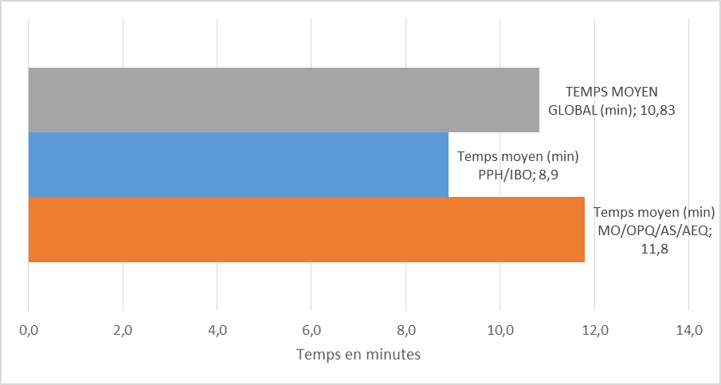
Results according to learner qualification
Learner qualification : Success > 80% score
  Assistant pharmacists/nurses = 93,3%
  help nurses/qualified workers = 70%
  Best rate score assistant pharmacists/nurses
Medium time according to learner qualification :
  1,3 more for help nurses and qualified workers
Notes:
On this slide the graph outlines the results according to learner qualification
As we says before, to exploit the results the learner were separated into two groups. A group including assistants pharmacist and operating theatre nurses (in blue) and a second group comprising help nurses and qualified workers (in orange).
93.3% (ninety and three) of learners assistants pharmacist (PPH) and operating theatre nurses (IBO) have a result greater than or equal to 80% of correct answers against 70.0% (seventy) of help nurses (AS) and qualified workers (OQ). So best rate score for assistant pharmacists and nurses.
Concerning time : learners help nurses and qualified workers group put 1.3 times longer that learners assistant pharmacist and nurses to make the evaluation.

Slide 17
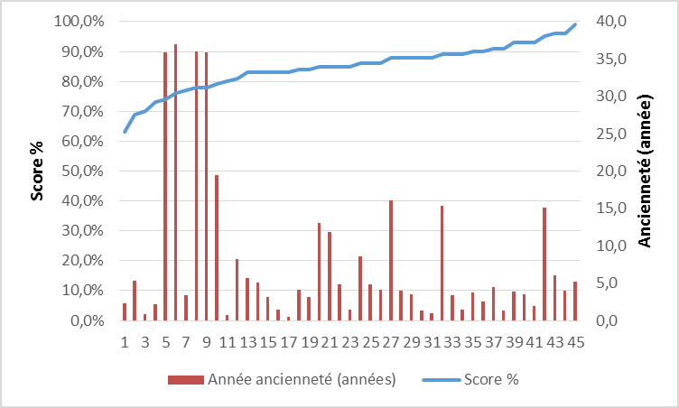
Results according to learner seniority and âge
    Learner seniority
  Seniority > 19 years → success < 80% score
Learner age
  Older = significant seniority
  Best rate score : younger and/or little seniority
Notes:
On this slide the graph to the left outlines the distribution by outcomes (in blue) based to learner seniority. And the graph to the right outlines the distribution by outcomes (in blue) based to learner age.
Age and learner seniority are represented by the read stick.
The breakdown of results according to seniority highlights the fact that after 19 years, results are lower than 80% success rate. The majority of learners are between 2 and 6 years of seniority.
At the right, the distribution according to age do not show a difference of the distribution of results. However all older being the oldest, the distribution of older results is the same as that based on seniority.

Slide 18
Results according to learning qualification and seniority
  All age and qualification approriate tool
  Requirement ressassment with the seniority
Notes:
Finally, we can say that, the tool is suitable for all business skills and ages. However, the results highlight the need for a reassessment with seniority. Its confirms the decision of the management procedure : reassessment every 3 years

Slide 19
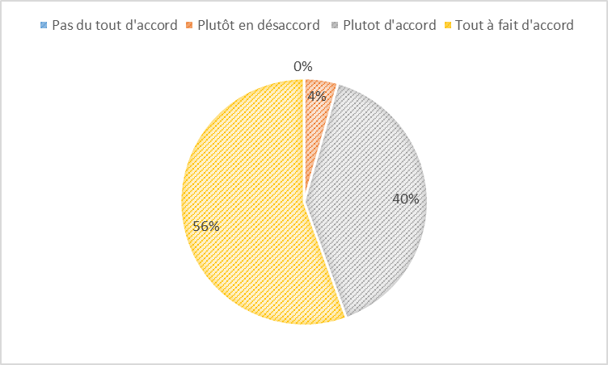
Results : staff member experience ergonomic and content (1)
The platform is easy to use ? 96 % easy
The difficulty level of assessment is appropriate with my professional skills ? 98 % agree
Dedicated time enough ? 95% YES
Notes:
At the end of the reassessment the learner completed a questionnaire with six questions to assess his feelings about the reassessment via the platform.
The general finding indicates that whatever the learner qualification, they have not encountered difficulties when using the platform. For 96% (ninety and six) of the learners it’s easy to use.
For 95% (ninety and five) of learners, the time available to respond to 15 questions (20 minutes) seems sufficient. Indeed, on average learners have less than 11 minutes to complete, and only one learner failed to complete the evaluation within the 20 minutes allotted.
Learners do not encounter difficulties, 98% (ninety and eight) find that the questions are in line with their professional capacities.

Slide 20

Results : staff member experience ergonomic and content (2)
What is your opinion on the skills reassessment via an e-learning platform ?
  98 % global satisfaction with these method
Inconvenients ?
  Agent are not equal with informatic tool
  Timer put a lot of pressure (2)
  Graphic zoom too small (2)
  To Allow time for review
Notes:
Regarding to the use of an e-learning platform; Agents whetever their function seems to have enjoyed the reassessment method with a percentage of overall satisfaction of 98% (ninety and eight).
The learner feedback highlight the usefulness of this method in terms of monitoring levels of individual skills, usability of the platform and playful form of this reassessment method.
Fixing a limited time to answer questions that were reported by two agents as a disadvantage. Using a computer tool among agents with different ages was cited as problematic only once.

Slide 21
Discussion
Development and implementation phase requires time-consuming
  Lake of interaction tool between word/platform
  External service provider : cost +
  But this will lead to customizing the reassessment
Test phase = necessary step
  Validation / adapting configuation
  Fixing bugs
Encouraging results
  Informatic tool : well accepted
  Identify individual and collective level of skill
  Identify gaps and practice deviation
  Limits
  Not adaptable to the overall sterilization process :
    E.g. : recomposing process → requires on-site assessment
Notes:
Currently in our sterilization department, the revaluation of skills is not formalized.
A reassessment with management on the same principle as the initial assessment is not an option , due to the large number of the sterilization staff , the number of workstations, and the time required to achieve it. The use of new technologies in staff reassessment was seen as an advantage to formalize the implementation of this requirement.
The creation of assessment is very time consuming for many reasons. On the one hand the assessment creation phase in the software is long because there is no dialog tools between the interface of the platform and Microsoft® documents requiring manually enter by copy and paste.
This type of evaluation can be performed by an external service, but the cost is high.
The internal creation allows for customization of the reassessment as close as practical service.
The different phases of tests are necessary.
We must find questions that scan the entire sector. Questions should be clear and unambiguous to the learner, which is why it is necessary to read and validate the issues by the entire supervisory staff. Unlike an oral evaluation it is not possible to reformulate the questions in case of misunderstanding of the learner.
You must then perform a number of tests to ensure the settings and lack of bugs.
The results of the test phase encourage us to continue. The computer tool is well accepted. From the point of view of management staff it is possible to identify the individual and collective level and thus helping to highlight training gaps or practices drifts.
Although the use of a computer platform holds many advantages, but the system also has constraints and limitations.
In fact, the e-learning solutions are not adaptable to all situations. For example the reassessment on the subject of the Assembly and Packaging Process is not possible in this format.

Slide 22
Conclusion
Tests phases : validate and strengthen the tool using
2015 : Extended development to all topics
  Pretreatment, hygiene, assembly packaging, low temperature sterilisation, tracking software sterilisation, quality.
  2016 : Empowerement to all staff members with three years working experience
Aim as part of the ISO 9001/13485 certification process : continuous quality improvement of our performance
Notes:
In conclusion we can say that :
This first testing phase allowed to validate and consolidate the tool.
The completion of the validation of assessments and other topics on the platform will be carried out over the year 2015/2016. (two thousand and fifteen/two thousand and sixteen)
The goal is that all agent in office for more than 3 years can be reassessed via the platform from 2016.
This work is performed as part of the ISO 9001/13485 certification process, which aims at a continuous quality improvement of our performance
9001 : nine thousand and one
13485 : thirteen thousand and four hundred and eighty-five

Slide 23
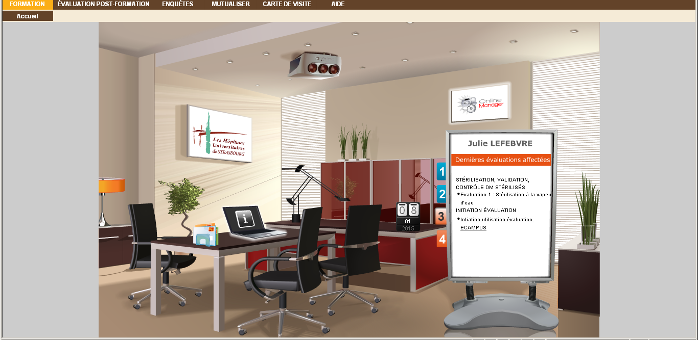
THANKS FOR YOUR ATTENTION
Notes:
Thank you for your attention

